Slide 1
80/20 – THINK! What do you NEED to cover with your set
Grade | Learning Objective | Learning Outcome
1 | Describe the gas exchange system in humans | Recall the structure of the gas exchange system Describe how parts of the gas exchange system are adapted to their function Describe the composition of inhaled and exhaled air
2
3

Slide 2
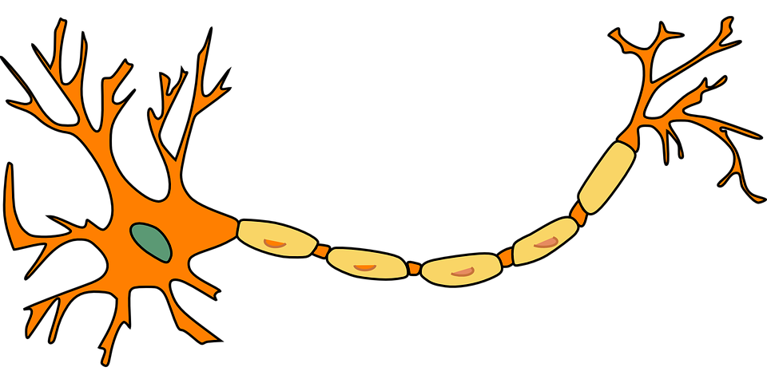
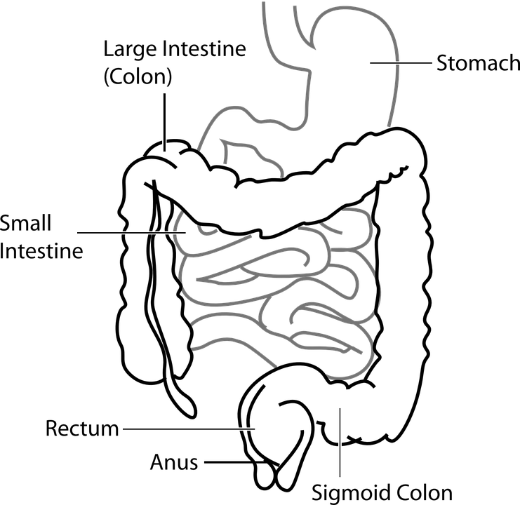
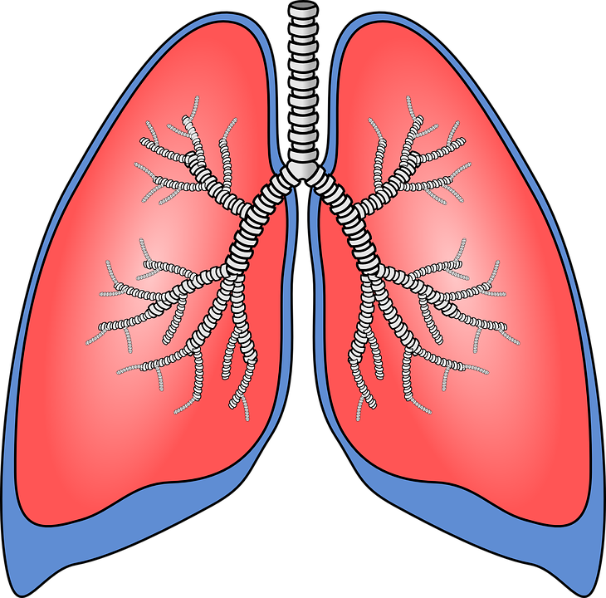
Gas Exchange
Do now activity: Place the following structures in order of size, smallest to largest.
Muscle tissue
Nerve cell
Digestive System
Lungs

Slide 3
Progress indicators
GOOD PROGRESS:
Recall the structure of the gas exchange system
Describe how parts of the gas exchange system are adapted to their function
OUTSTANDING PROGRESS:
Describe the composition of inhaled and exhaled air

Slide 4
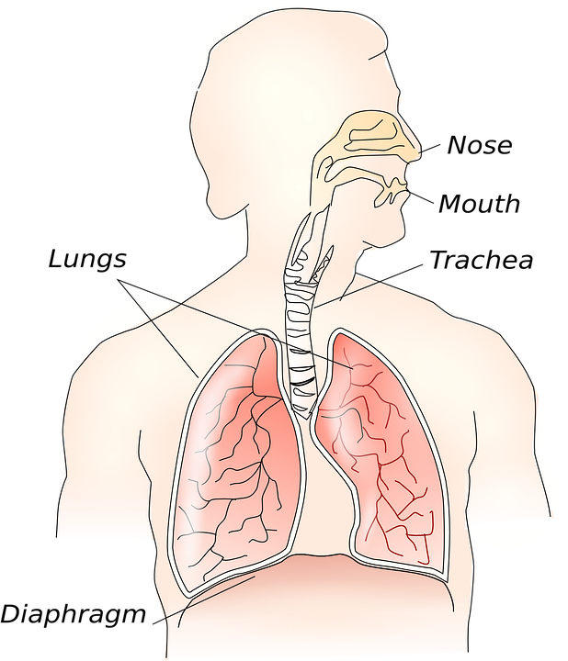
When we breathe in, we take in oxygen from the air and when we breathe out, we release carbon dioxide.
This process is called gas exchange and takes place in the lungs.

Slide 5
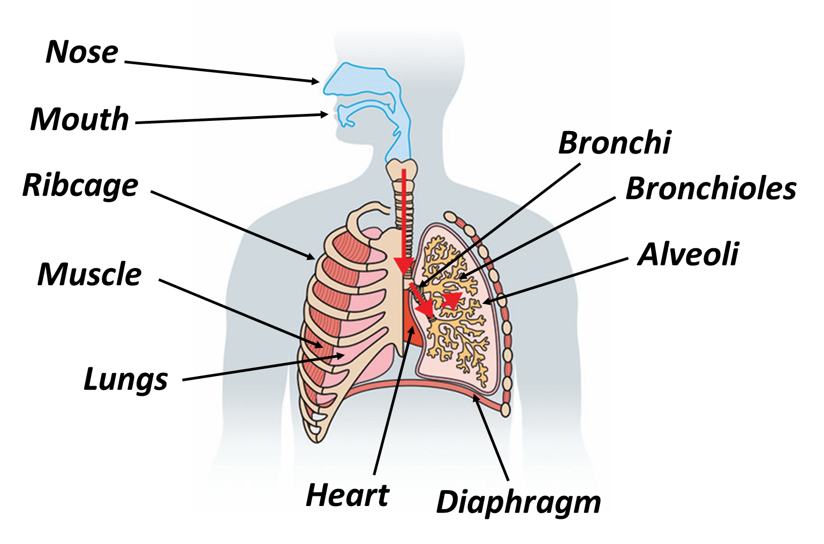
Memory Test: Spend three minutes studying this diagram, try to remember the location of each of the structures!

Slide 6
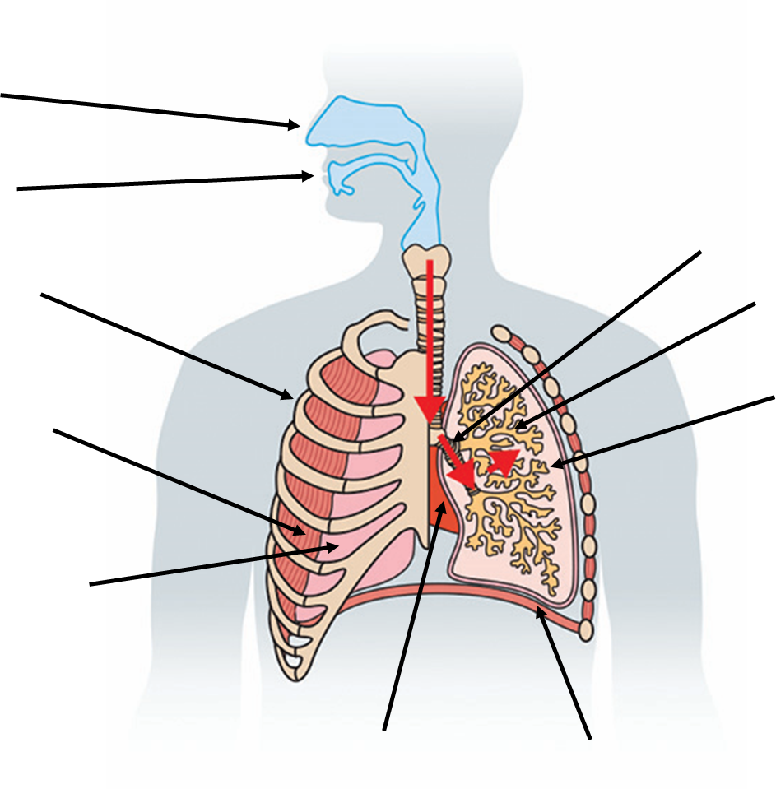
Memory Test: Spend three minutes trying to label the structures of the respiratory system!

Slide 7
How many did you get right?

Slide 8
Task: Watch the video and answer the following questions:
What is contained within the thorax?
What is the role of the trachea?
Describe the route an oxygen molecule travels as it moves through the lungs.
What are some special features of the alveoli?
https://www.youtube.com/watch?v=ylEknRf0jLU

Slide 9
Self-assessment:
The breathing apparatus
The trachea connects the mouth to the lungs, also known as the windpipe.
Oxygen is breathed in through the mouth, it then travels down the trachea, into the bronchi to the bronchioles and finally the alveoli.
Alveoli have a large surface area, moist, thin walls and a good blood supply.

Slide 10
Why do we breathe in and out?
Think > Pair > Share
What is the name of the gas that we breathe in?
What is this gas used for, inside our bodies?
What is the name of the gas that breathe out?

Slide 11
Self-assessment:
We breathe in oxygen from the air.
Oxygen is used in a process called respiration; this releases energy that our bodies can than use.
Carbon dioxide is a waste gas that we breathe out.

Slide 12
Task: Complete the worksheet on the composition of inhaled and exhaled air.
Self-assessment:
The percentage composition of nitrogen gas remains unchanged between inhaled and exhaled air.
The percentage composition of carbon dioxide gas is greater in exhaled air than it is in inhaled air.
The percentage composition of oxygen decreases from 21% to 15%, so a total of 6% from inhaled to exhaled air.
Oxygen passes through the alveoli wall and into the bloodstream, here is travels to cells where it is used in respiration to release energy.

Slide 13
Plenary: Exit Card
Task: On a piece of paper write down:
3 things you have learnt today
5 key words
1 question to test your peers
Notes:
Endocrine gland image by US Government [Public domain], via Wikimedia Commons
Nervous system image by OpenStax [CC BY 4.0 (http://creativecommons.org/licenses/by/4.0)], via Wikimedia Commons

Slide 14
Resources

Slide 16
Composition of Inhaled & Exhaled Air
Composition of Inhaled & Exhaled Air
Gas | Inhaled Air (%) | Exhaled Air (%)
Nitrogen | 78 | 78
Oxygen | 21 | 16
Carbon Dioxide | 0.04 | 5.04
Other gases | 0.96 | 0.96
Gas | Inhaled Air (%) | Exhaled Air (%)
Nitrogen | 78 | 78
Oxygen | 21 | 16
Carbon Dioxide | 0.04 | 5.04
Other gases | 0.96 | 0.96
Name a gas whose composition in the air remains unchanged between inhaled and exhaled air.
Name a gas whose composition increases in exhaled air.
Calculate by how much the composition of oxygen decreases between inhaled and exhaled air.
Explain what happens to the oxygen that has been removed from inhaled air.
Name a gas whose composition in the air remains unchanged between inhaled and exhaled air.
Name a gas whose composition increases in exhaled air.
Calculate by how much the composition of oxygen decreases between inhaled and exhaled air.
Explain what happens to the oxygen that has been removed from inhaled air.

Slide 17
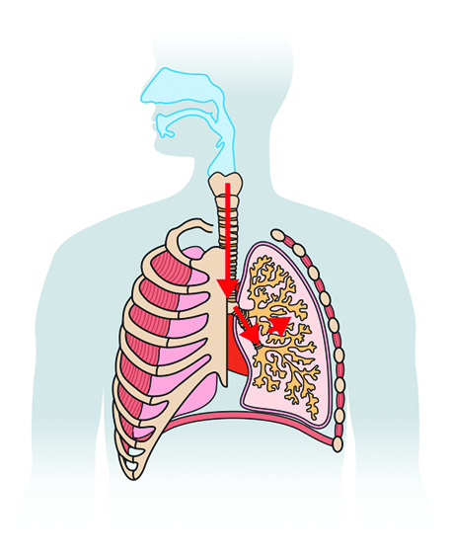
Nose
Mouth
Bronchi
Ribcage
Bronchioles
Alveoli
Muscle
Lungs
Heart
Diaphragm

