Slide 1
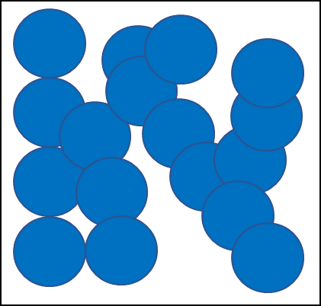
Internal Energy
Do now activity:
Draw a particle diagram for a solid, a liquid and a gas
Compare the arrangement of particles in a liquid to that of a gas
Explain what is meant by ‘latent heat’

Slide 2
Progress indicators
GOOD PROGRESS:
- Define the internal energy of a system and identify changes in state
- Describe the effect heating can have on the energy of the particles in a system
OUTSTANDING PROGRESS:
- Explain how the strength of the bonds between the particles will affect how much energy is needed to change the state of the substance.

Slide 3
Solid
Liquid
Gas
Think > Pair > Share: How would you describe the properties of each state of matter?

Slide 4
Task: Copy and complete the table to identify the properties and arrangement of particles in a solid, liquid and a gas.
State of matter | Properties | Arrangement of particles
Solid | > > Fixed volume | > Vibrating around fixed positions >
Liquid | > Takes the shape of the container > | > > Very close to one another
Gas | > > Fills the space available | > Moving rapidly >
Spreads out
Moving around
Fixed shape
Spreads out
Moving chaotically
Almost touching
Extra Challenge: In which state of matter do particles have the greatest energy?

Slide 5
Self-assessment:
State of matter | Properties | Arrangement of particles
Solid | > Fixed shape > Fixed volume | > Vibrating around fixed positions > Almost touching
Liquid | > Takes the shape of the container > Spreads out | > Moving around > Very close to one another
Gas | > Spreads out > Fills the space available | > Moving rapidly > Moving chaotically

Slide 6
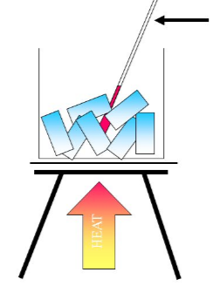
The energy stored by the particles of a substance is called the substance’s internal energy. The internal energy of a substance is the sum of:
The kinetic energy the particles have relative to their individual motions
The potential energy the particles have relative to their individual positions
The temperature of a substance increases
Heating a substance changes the internal energy of a substance by increasing the energy of it’s particles
The substance changes state

Slide 7
Task: Watch the video and answer the following questions:
What is the name of the forces between particles?
Define ‘internal energy’
Describe what happens to the internal energy of a solid, and its physical state, when it is heated.
What is the name of the process which turns a solid directly into a gas?
What is the difference between a ‘physical’ change and a ‘chemical’ change?
https://www.youtube.com/watch?v=5WVT5NR0iLA

Slide 8
Self-assessment:
Intermolecular forces or chemical bonds
Internal energy is the energy stored within a system by the particles. It is the sum of the total kinetic energy and potential energy of all the particles (atoms and molecules) which make up a system.
The internal energy of the solid will increase and at some point, the solid will melt into a liquid. If it carries on being heated the internal energy will increase further and the liquid will turn to a gas.
When a solid turns directly to a gas, this is called sublimation.
A physical change is one where if the change is reversed the substance recovers its original properties.

Slide 9
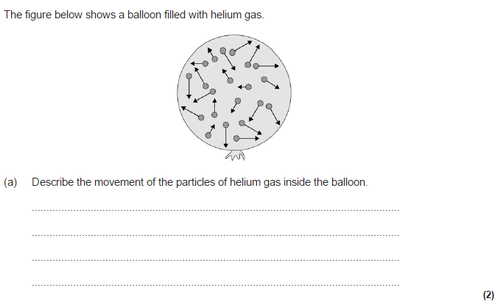
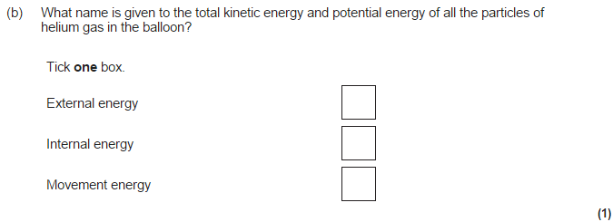
Mini-plenary
Answer in your books

Slide 10
Mark Scheme:
Range of speeds, some faster and some slower 1
Particles are moving in different directions (random motion) 1
b) Internal energy 1

Slide 11
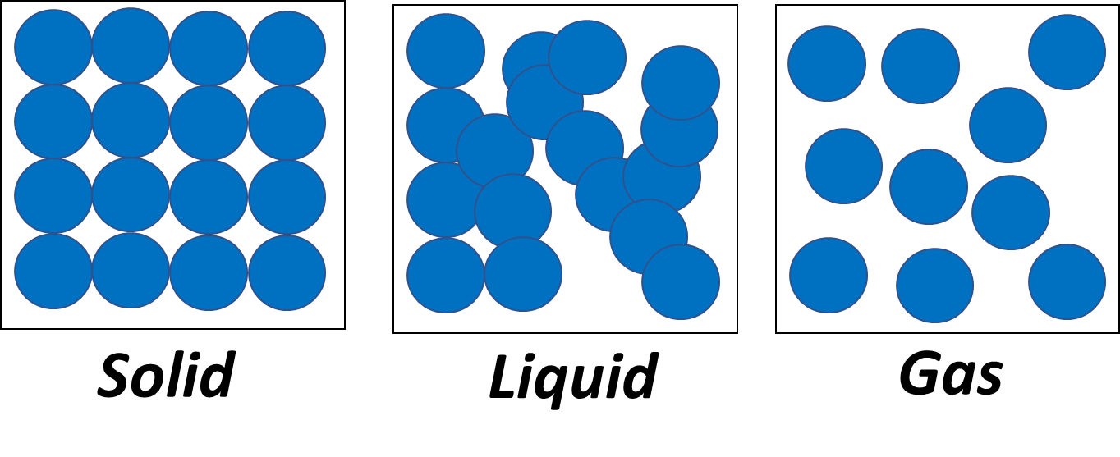
Forces of Attraction
There are strong forces of attraction between particles found in a solid, these forces bond the particles in fixed positions.
There are weaker forces of attraction between the particles than in a solid. These weaker forces are not strong enough to hold the particles in a rigid structure.
There are very weak forces of attraction between gas particles. The gas particles can move about at high speeds in random directions.

Slide 12
Task: Complete the worksheet
Key Words
Vibration
Speed (or energy)
Size
Liquid
Boiling

Slide 13
Self-assessment:
Stuck in place –solid; can move past each other – liquid; can break the bonds – gas
Vibration; size; shape; liquid; shape; size; speed (or energy); boiling; shape; size.
Boiling – liquid to gas; heating – increasing temperature; melting – solid to liquid; cooling – decreasing temperature; solidifying – liquid to solid; condensing – gas to liquid
Third and fifth statements are both correct.

Slide 14
True or False?
The internal energy of a substance is the sum of the kinetic energy and potential energy of the particles within the substance
If you apply heat energy to a substance, the energy of the particles decreases
Gases have weaker forces of attraction between particles as the particles are close to one another
Liquids are able to flow to fill a container
Solids have a fixed shape and fixed position, the particles vibrate about a fixed position.
True
False
False
True
True

Slide 15
Plenary – What did you learn this lesson?
3 facts
3 key words
1 question to test your peers

Slide 16
Resources

Slide 17
What is the name of the forces between particles?
Define ‘internal energy’
Describe what happens to the internal energy of a solid, and its physical state, when it is heated.
What is the name of the process which turns a solid directly into a gas?
What is the difference between a ‘physical’ change and a ‘chemical’ change?
What is the name of the forces between particles?
Define ‘internal energy’
Describe what happens to the internal energy of a solid, and its physical state, when it is heated.
What is the name of the process which turns a solid directly into a gas?
What is the difference between a ‘physical’ change and a ‘chemical’ change?

Slide 18
