Slide 1
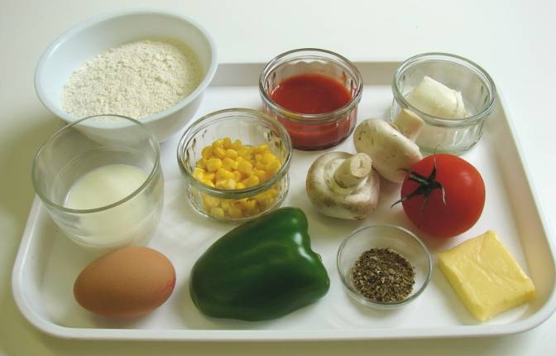
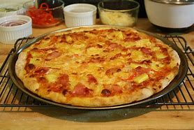
Step by Step – Pizza
Equipment
Mixing bowl
Sieve
Weighing scales
Wooden spoon
Chopping board
Sharp knife
Baking tray
Ingredients
250g Strong White Bread Flour
1/2 tsp salt
1/2 tsp sugar
1 tsp yeast
150ml warm water
Tomato puree
Grated cheese
Favourite toppings
(all meat must be pre cooked)

Slide 2
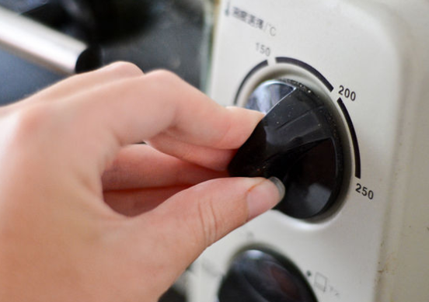
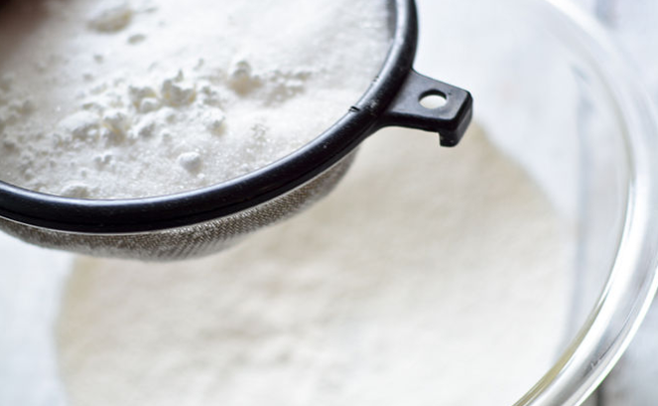
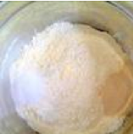
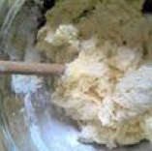
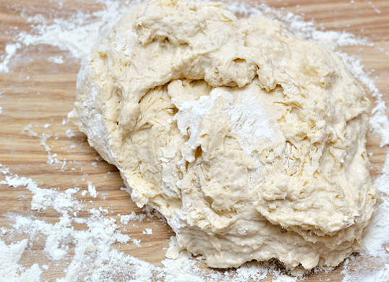
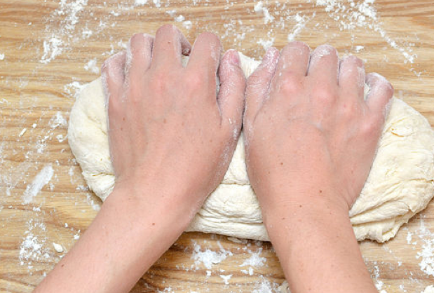
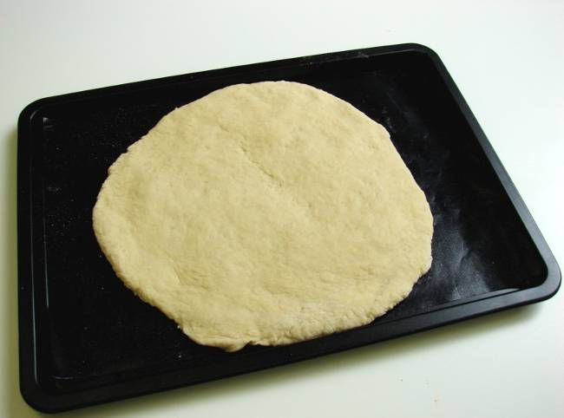
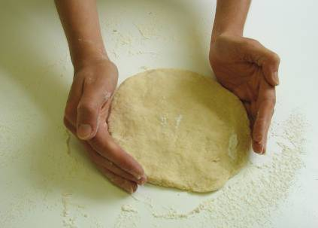
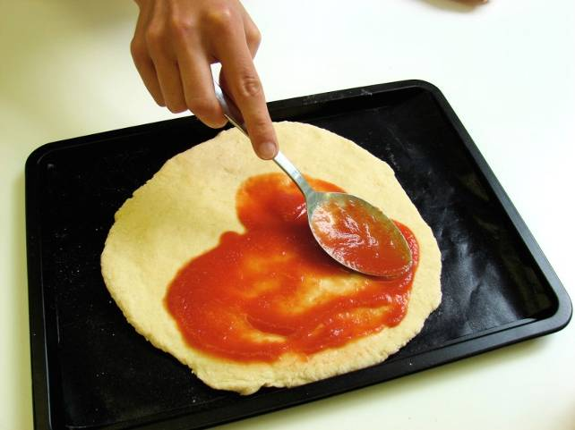
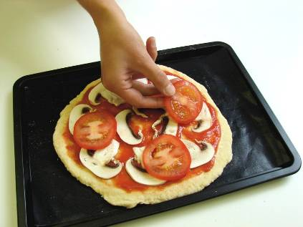
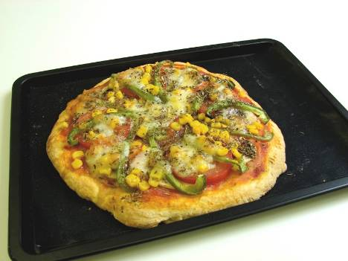
step BY STEP: pizza
Step 1-Preheat your oven to 220c or gas mark 7.
Step 2-Sieve flour into a mixing bowl.
Step 3-Add the yeast, sugar and salt to the flour, at opposite sides of the bowl.
Step 4-Add the warm water, a
tablespoon at a time and mix .
Step 5- Turn the mixture out onto a floured surface.
Step 6- Knead the dough for five minutes.
Step 8 – place the dough onto a baking tray.
Step 7- shape the dough into a flat circle using a rolling pin.
Step 9 – spoon on the base sauce.
Step 10 – add cheese and chosen toppings.
Step 11 – cook for 10-15 minutes.
Notes:
Step by step guide

