Slide 1
CwK
Wednesday, 23 September 2020
Acceleration required Practical
Do Now Activity
What is the unit for acceleration?

Slide 2
Self Assess
m/s²

Slide 3
Progress Indicators
Good Progress
State independent, dependent and control variables
Describe the relationship between force and acceleration
Describe the relationship between mass and acceleration
Outstanding Progress
Describe a method to investigate how force affects acceleration.
Last Lesson: Acceleration
This Lesson: Acceleration
Next Lesson: Terminal Velocity

Slide 4
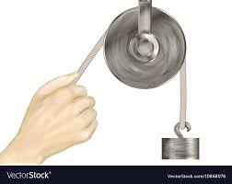
Word Consciousness
Pulley-wheel that carries a rope

Slide 5
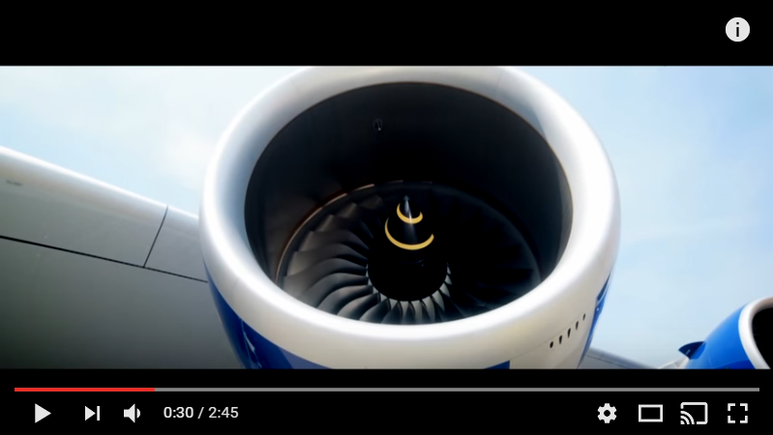
Man vs Plane-who will win and why?
https://www.youtube.com/watch?v=P66ISniQCqY

Slide 6
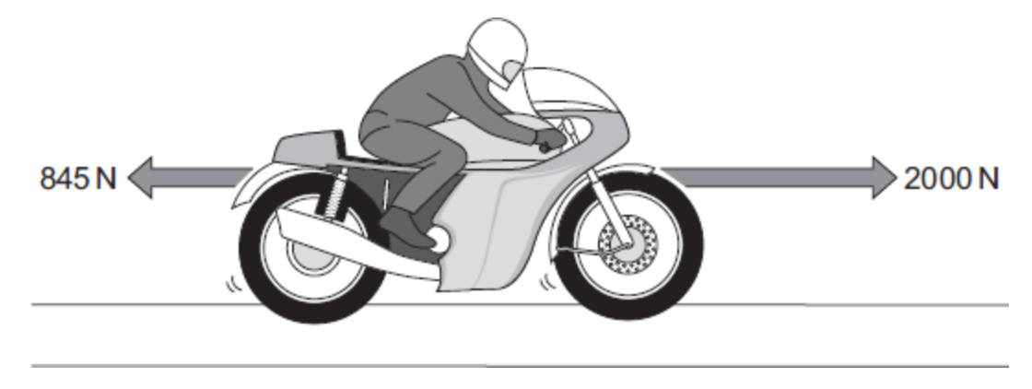
F=ma
F= force N
m= mass Kg
a= acceleration m/s²
A motor bike has a mass of 275Kg, calculate its acceleration
Force= 2000-845
Force= 1155
1155= 275 x a
a=1155/275
a= 4.2m/s²

Slide 7
Questions
Calculate the resultant force on a sprinter of mass 80kg who accelerates at 8m/s²
A car and a trailer have a total mass of 1500kg, calculate the force needed to accelerate the car and the trailer at 20m/s2
Complete the table
 | Force (N) | Mass (Kg) | Acceleration (m/s2)
A |  | 20 | 0.80
B | 200 |  | 5.0
C | 840 | 70
D |  | 0.40 | 6.0
e | 5000 |  | 0.20

Slide 8
Self Assess
Calculate the resultant force on a sprinter of mass 80kg who accelerates at 8m/s²
^{640N}
A car and a trailer have a total mass of 1500kg, calculate the force needed to accelerate the car and the trailer at 20m/s
30000N
 | Force (N) | Mass (Kg) | Acceleration (m/s2)
A | 16 | 20 | 0.80
B | 200 | 40 | 5.0
C | 840 | 70 | 12
D | 2.4 | 0.40 | 6.0
e | 5000 | 25000 | 0.20

Slide 9
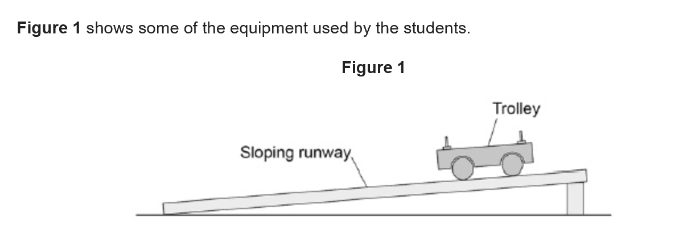
Exam Question
Two students investigated how the acceleration of a trolley depends on the force applied to the trolley. Describe a method used by the students (6)

Slide 10
https://www.youtube.com/watch?v=ugzjeggjznw&list=PLM7lGCvspoEyIf73YJHl5zzFTo0xOus6U&index=14
From the video you need to note down, equipment, basic method and variables (independent, dependent and control), range of force and what equation you need.

Slide 11
Exam Question
Two students investigated how the acceleration of a trolley depends on the force applied to the trolley. Describe a method used by the students (6)

Slide 12
Describe the method used
I would need a trolley, masses, pulley and a ramp. In order to make the trolley accelerate I would attach a string to a mass hanger and put it on a pulley. I would use masses as the force added to the trolley. I would keep the masses the same throughout the practical as changing mass would change acceleration, this ensures there is only one independent variable.
To increase the accelerating force each time I would take one mass off the trolley and add it to the mass hanger (increasing the force). I would add light gates onto the ramp so that when the trolley passes them the time taken (change in velocity over a given distance) between them is measured this will allow me to calculate acceleration using F=ma. I would use a range of forces from 2-10N. I would need to reduce friction as much as possible so that the resultant is as close to 2 N as possible. To do this I will raise the ramp to a point where the trolley rolls all the way down without stopping.

Slide 13
Describe the method used-improved by 11H2
I would need a trolley and a piece of card which will block the light which would measure time and distance , masses, pulley and a ramp. In order to make the trolley accelerate I would attach a string to a mass hanger and put it on a pulley. I would use masses as the force added to the trolley. I would keep the masses the same throughout the practical as changing mass would change acceleration, to do this the mass will be kept in the system, either on the mass hanger or the trolley this ensures there is only one independent variable.
To increase the accelerating force each time I would take one mass off the trolley and add it to the mass hanger (increasing the force). I would add light gates onto the ramp so that when the trolley passes them the time taken (change in velocity over a given distance) between them is measured this will allow me to calculate acceleration using F=ma. I would use a range of forces from 2-10N in intervals of 2N. Repeat the measurement 5 times by changing the force. I would need to reduce friction as much as possible so that the resultant force is as close to 2 N as possible. To do this I will raise the ramp to a point where the trolley rolls all the way down without stopping.

Slide 14
Describe the method used- improved by 11T1
I would need a trolley, masses, pulley and a ramp. In order to make the trolley accelerate I would attach a string to a mass hanger and put it on a pulley. I would use masses as the force added to the trolley. I would keep the masses the same throughout the practical as changing mass would change acceleration, this ensures there is only one independent variable.
To increase the accelerating force each time I would take one mass off the trolley and add it to the mass hanger (increasing the force). I would add light gates onto the ramp so that when the trolley passes them the time taken (change in velocity over a given distance) between them is measured this will allow me to calculate acceleration using F=ma. I would use a range of forces from 2-10N. I would need to reduce friction as much as possible so that the resultant is as close to 2 N as possible. To do this I will raise the ramp to a point where the trolley rolls all the way down without stopping.

Slide 15
Results
Mass (Kg) | Force (N) | Speed at A (m/s) | Speed at B (m/s) | Increase in speed (m/s) | Time from A to B (s) | Acceleration (m/s²) | Theoretical Acceleration (m/s²)
2 | 2 | 0.61 | 1.20 | 0.59 | 0.64 | 0.92 | 1
2 | 4 | 0.92 | 1.70 | 0.78 | 0.44 | 1.77 | 2
2 | 6 | 1.08 | 2.05 | 0.97 | 0.37 | 2.62 | 3
2 | 8 | 1.34 | 2.44 | 1.10 | 0.32 | 3.44 | 4
2 | 10 | 1.50 | 2.71 | 1.21 | 0.27 | 4.48 | 5
Calculation
Acceleration = increase in speed/time
Theoretical calculation
Acceleration= force/ mass
Notes:
10

Slide 16
Plot a graph of Force against Acceleration
Describe the relationship between force and acceleration
Acceleration (m/s²)
Force (N)
Notes:
10

Slide 17
Plenary

