Slide 1
Contemporary Issues in Sport
Pupils at home!
Work through the PowerPoint and complete any task that is in a yellow box using the PowerPoint
GOOD | OUTSTANDING
Identify a range of user groups and barriers they may face to be involved in sport | Link 3 use groups, barriers and offer a possible solution that’s means they could participate in sport

Slide 2
The different user groups who may participate in sport
Ethnic minorities,
Retired people/over 50’s,
Teenagers,
Children (0-13),
Unemployed/economically disadvantaged,
Working single’s & couples
Disabled

Slide 3
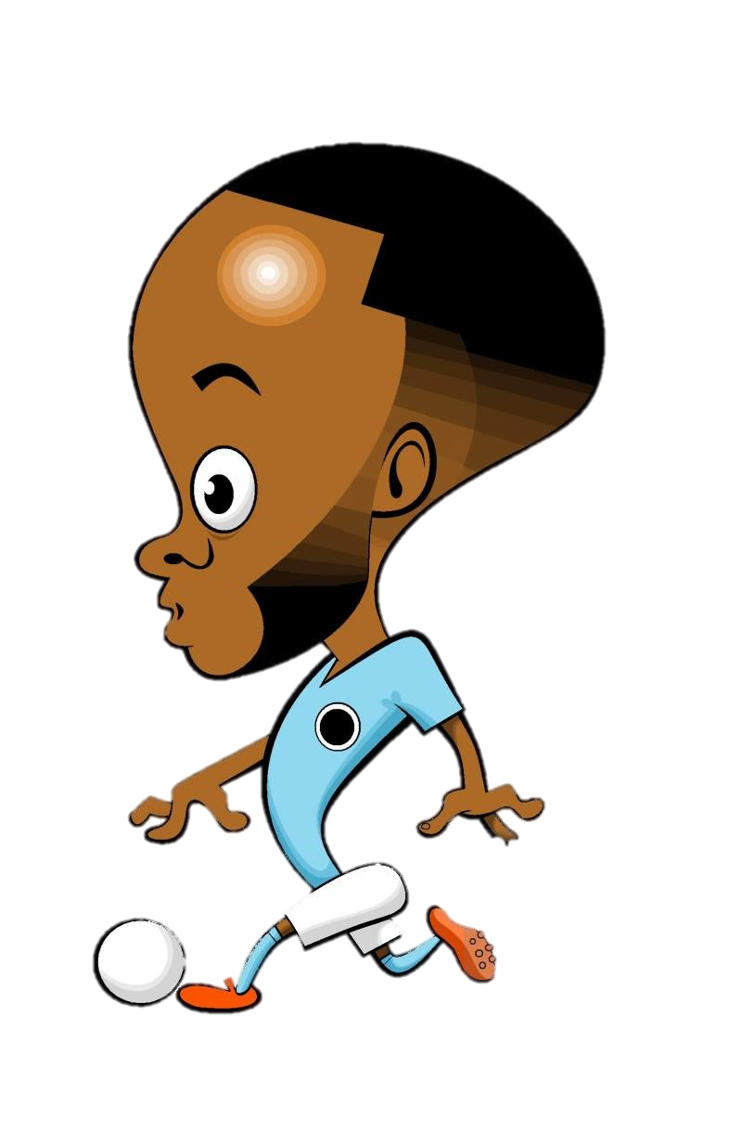
Employment/time
Work restrictions and family commitments
Disposable income
Accessibility of facilities/equipment
Lack of role models
Provision of activities
Awareness of activity provision

Slide 4
Pupils at home!
Link two user groups to barriers they may face from the last two slides
User group 1:
Barrier they may face:
User group 2:
Barrier they may face:

Slide 5
Unemployment & economically disadvantaged/time
Not have that much free time available
Lack of income
Lack awareness of suitable sessions
May not be motivated to play sport.

Slide 6
Lack of role models
Lack of role models means some areas do not have an inspiration to take part/look up to
There may not have many female role models in a sport which discourages females athletes to participate
Some sports do not have many ethnic role models, an example would be a lack of Premier League Asian male footballers

Slide 7
Lack of disposable Income
Cannot afford cost of participation
Cannot afford equipment/clothing for activity
Cannot afford membership/facilities fees

Slide 8
Work restrictions
May not have time (shift work)
Shift work can get in the way
May have family commitments outside of work for example some women still seen as bringuing up the gamily and not being involved in sport

Slide 9
Accessibility to facilities
May not have available transport
Lack of suitable equipment
Lack of disabled equipment/access

Slide 10
Awareness of activity Provision
People not aware of what is on offer
Caused by poor advertising/communication
Not enough different sports on offer

Slide 11
Barrier to Sport | Examples of this barrier
Unemployed/economically disadvantaged
Lack of role models
Lack of disposable income
Work restrictions
Accessibility to facilitates
Awareness of provision

Slide 12
Solutions

Slide 13
Promotion
Targeted promotion
Using role models
Initiatives
Provision
Programming sessions for use by different user groups
Planning of times to suit different user groups
Providing appropriate activity
Access
Access to facilities
Access to equipment
Sensible pricing/concessions

Slide 14
Complete the exam questions and then use the mark scheme to mark them
Answer in this box
Answer in this box

Slide 15
Answer in this box
Jan
2018
Answer in this box

Slide 16
Answer in this box
Jan
2018

Slide 17
Jan
2019
Answer in this box
Answer in this box

Slide 18
May
2017 – Mark Scheme

Slide 19
Jan 2018
Mark Scheme

Slide 20
Jan 2018
Mark Scheme

Slide 21
Jan 2019
Mark Scheme

