Slide 1
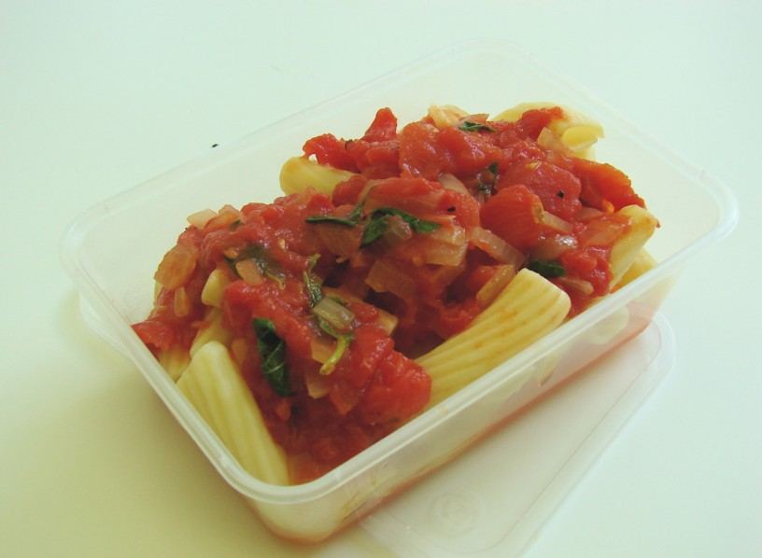
Step by Step Ragu
Stretch & Challenge
1 celery
1 carrot
1 courgette
Equipment-
Knife
Chopping board
Garlic press
Spoons
X 2 Saucepan
Wooden spoon
Ingredients-
1 onion
1 clove garlic
1 x 15ml spoon oil
1X 400g canned chopped tomatoes
Pasta

Slide 2
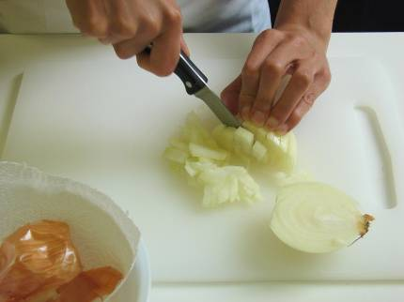
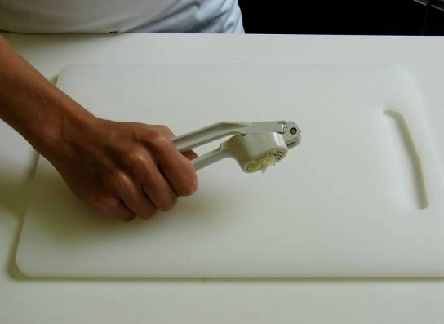
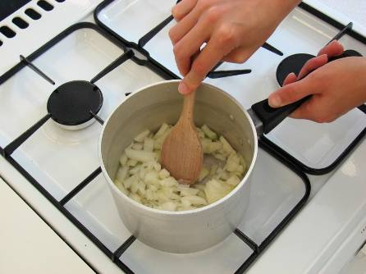
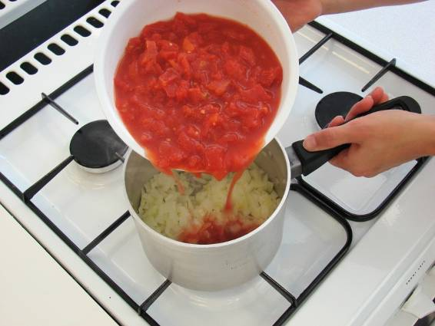
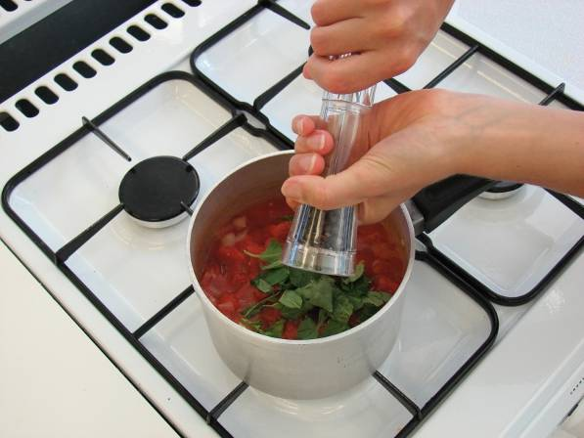
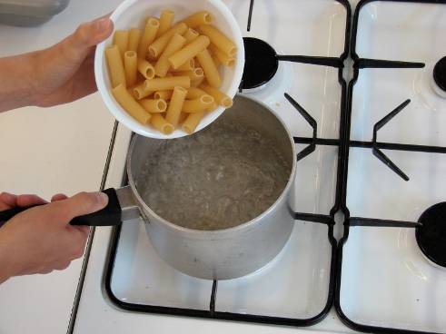
Step by Step Ragu
Peel and chop onion
Crush garlic
Fry the onion and garlic
In oil for 5 minutes
Add the tomato's and add
chosen herbs
Mix the cooked pasta and
Tomato sauce together
Simmer gently for 20 minutes
Boil water in sauce pan.
Add pasta and simmer
for 10 minutes
Until Al Dente.
Then drain water.

