Slide 1
Lesson Three
C/W Date
Lesson Title: Inference and Deduction
Lesson Focus: - Extract main points and information by using a range of strategies

Slide 2
DNA – Making deductions. What do you think has happened here?
Write down your ideas/

Slide 3
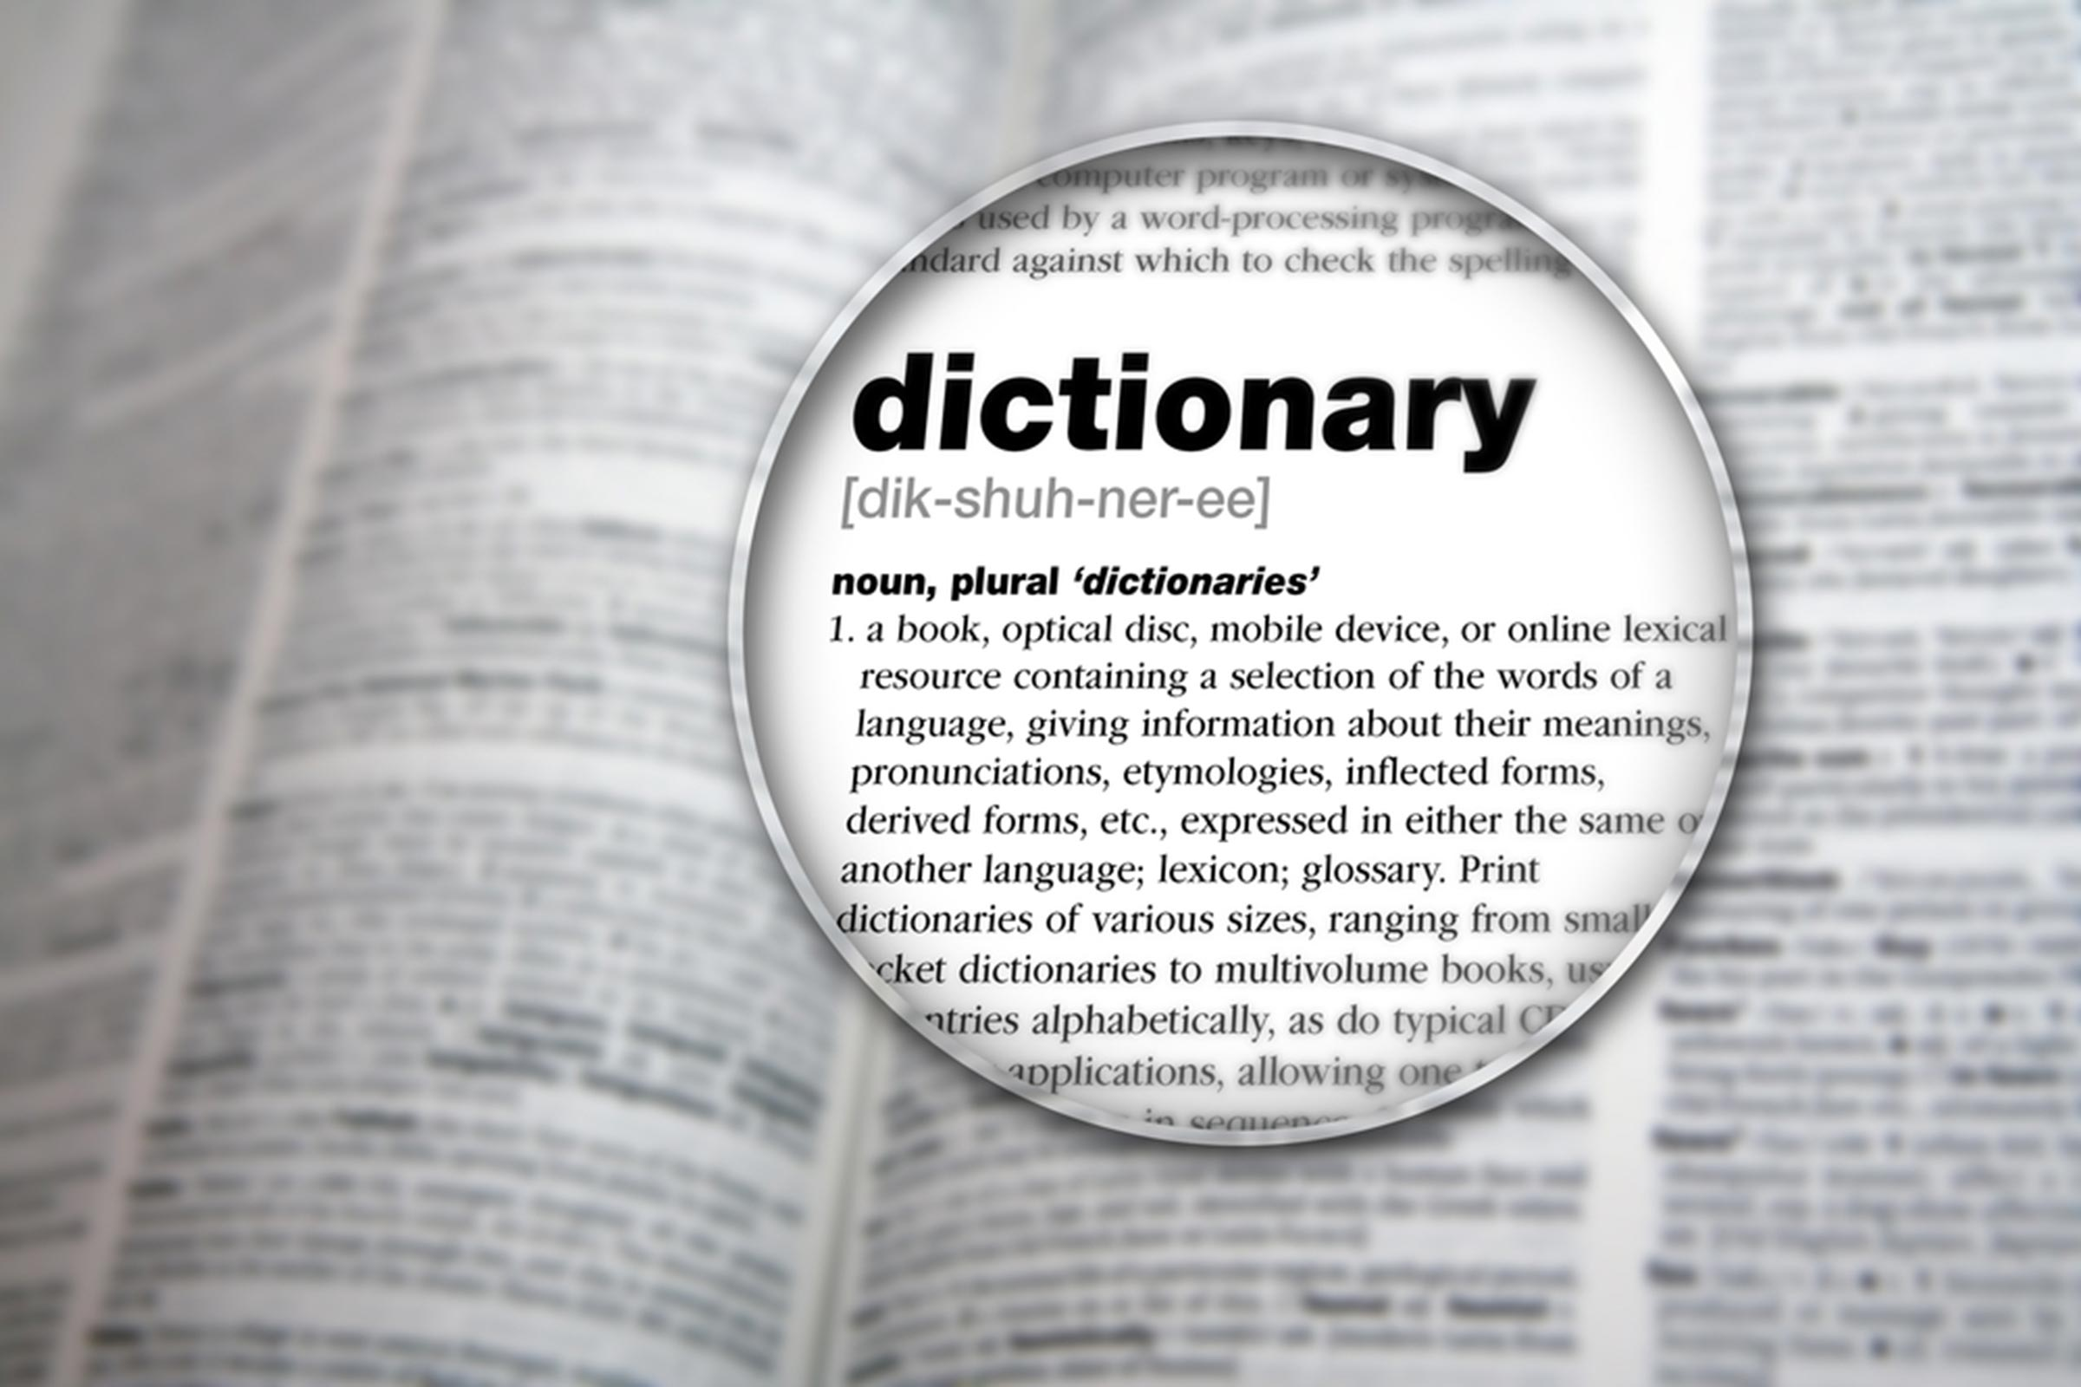
Task - Word Consciousness
1) Please copy this out. If you are using your exercise book, this should be in the back.
2) Please complete this column by putting the definitions into your own words AND coming up with synonyms*. You saw and copied an example of how to do this in lesson 1.
*synonym means alternative words
Word and definition | Your definition or synonyms
Deduce (Verb) - arrive at (a fact or a conclusion) by reasoning; draw as a logical conclusion.
Infer (Verb) - to conclude (something) from evidence and reasoning rather than from obvious statements.
Recumbent (adjective) – lying down.

Slide 4
Learning Journey
Last lesson we looked at who Arthur Conan Doyle was and the time he was writing in.
Today we are going to look at the opening of his novel The Hound of the Baskervilles and begin our detective journey by making inferences about a key prop in this chapter.
This will help us to understand the main ideas and themes in the novel and why they were relevant at the time.

Slide 5
Read pg 11-14 stop at “very well” I answered, accepting the challenge.
You are now going to become detectives and see what you can deduce from a little bit of information – a bit like Sherlock Holmes will do!
Detective hats at the ready.
Spy glasses in hand.

Slide 6
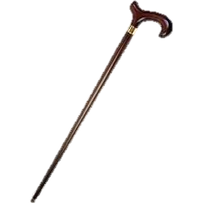
Task:
Somebody has left their walking stick lying around. Can you identify the owner of the walking stick?
What type of person might need a walking stick? What could have happened to them?
What can you tell about their wealth and status from looking at the picture?
What job do you think they would have?
Bullet point your ideas under the heading Walking Stick and be ready to feed back.
Notes:
Encourage students to answer – ‘elderly’ ‘professional’ ‘well-esteemed’

Slide 7
TASK – Think about how these new facts affect our inference about the cane and its owner?
The cane is inscribed with ‘To James Mortimer, M.R.C.S from his friends of the C.C.H.’
Bite marks on the bottom of the cane
The stick has been ‘well-worn’
Does this change your initial ideas? Add to your notes.

Slide 8
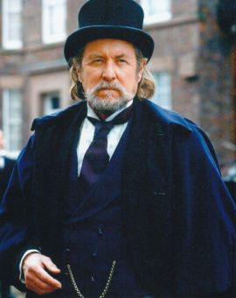
How did your inferences compare? How close were you?
Use a red pen to:
- Tick off anything you wrote down yourself
Use a green pen to:
Add anything extra you learn
The cane belongs to Dr James Mortimer.
He used to work at
Charing Cross Hospital
but moved to be a country practitioner.
Despite his initial appearance, he is not retired and is around the age of 50.
He has a small spaniel.

Slide 9
Task: Read to the end of Chapter 1
This Photo by Unknown Author is licensed under CC BY

Slide 10
Read this to check your understanding of the chapter… Chapter One Plot Summary
We are introduced to Sherlock Holmes’ most amazing adventure ‘The Hound of the Baskervilles’ through Watson who wakes from a nightmare about this and decides to write the whole story down. He is established as our narrator.
We are introduced to the character of Watson and Holmes and how Holmes is a character who is often called in to help with mysteries when the police are baffled.
Holmes is bored and in need of a case and is able to show off his deductive powers by analysing a walking stick that was left at his home by a potential client the day before.
As Holmes concludes the owner of the walking stick is a doctor a doctor just happens to appear at his door. He is the owner of the walking stick and our story has begun.

Slide 11
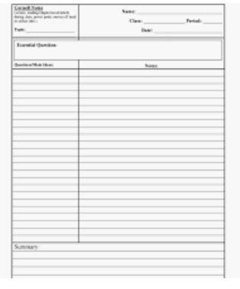
Cornell Notes
Use your notes template to make some notes about chapters 1 or use your book/paper.
If you aren’t sure how to do this then watch the video to help you.

Slide 12
A call has been made to the police station – the body of an important man has been found. He appears to have died a "sudden and tragic death” following a heart attack.
Task
You are the lead detective on the case. Write down:
1) What are the first questions you will ask?
2) Who might you question with regards to the case?

