Slide 1
Reaction Time Required Practical
Plan and carry out an investigation into the effect of a factor on human reaction time.
Investigating whether practice reduces human reaction times
Messages travel very quickly around your body through the nervous system. This is so that you are able to respond to changes in the environment. The time it takes for you to respond to such a change is called your reaction time.
Athletes spend hours practising to try to reduce their reaction time. This is to help them improve their performance in their particular sport. Responding quicker to the starter’s pistol in a race can gain you the advantage over other runners.
You will conduct a simple, measurable experiment called the ruler drop test. From this you can determine whether your reaction time can be reduced with practice.

Slide 2
Reaction Time Required Practical
Messages travel very quickly around your body through the nervous system. This is so that you are able to respond to changes in the environment. The time it takes for you to respond to such a change is called your reaction time.
You will conduct a simple, measurable experiment called the ruler drop test. From this you can determine whether your reaction time can be reduced with practice.
Your hypothesis needs to explain what you think is going to happen in your practical and why.
In this practical you will conduct a simple, measurable experiment called the ruler drop test. From this you can determine whether your reaction time can be reduced with practice.
What do you think is going to happen?
What variables are you going to look at?
Why do you think it is going to happen?

Slide 3
Reaction Time Required Practical
Plan and carry out an investigation into the effect of a factor on human reaction time.
METHOD
Use your weaker hand for this experiment. If you are right handed then your left hand is your weaker hand.
Sit down on the chair with good upright posture and eyes looking across the room.
Place the forearm of your weaker arm across the table with your hand overhanging the edge of the table.
Your partner will hold a ruler vertically with the bottom end (the end with the 0 cm) in between your thumb and first finger. Practice holding the ruler with those two fingers.
Your partner will take hold of the ruler and ask you to remove your fingers.
Your partner will hold the ruler so the zero mark is level with the top of your thumb. They will tell you to prepare to catch the ruler.
Your partner will then drop the ruler without telling you.
You must catch the ruler as quickly as you can when you sense that the ruler is dropping.
After catching the ruler, look at the number level with the top of your thumb.
Continue to repeat the test several times.
Swap places with your partner. Repeat the experiment to get their results.

Slide 4
Reaction Time Required Practical
Plan and carry out an investigation into the effect of a factor on human reaction time.
Drop test attempts | Ruler measurements in cm |  | Reaction times in seconds
 | Person 1 | Person 2 | Person 1 | Person 2
1
2
3
4
5
6
7
8
9
10

Slide 5
Plan and carry out an investigation into the effect of a factor on human reaction time.
Reliability & Reproducibility
Reliability: the degree to which the result of a measurement, calculation, or specification can be depended on to be accurate.
Task
How do we know if results are reliable?
How do we know if results are reproducible?
How could we improve our method to make it more reliable & reproducible?
Reproducibility : The ability of an entire experiment or study to be duplicated, either by the same researcher or by someone else working independently. Reproducing an experiment is called replicating it.

Slide 6
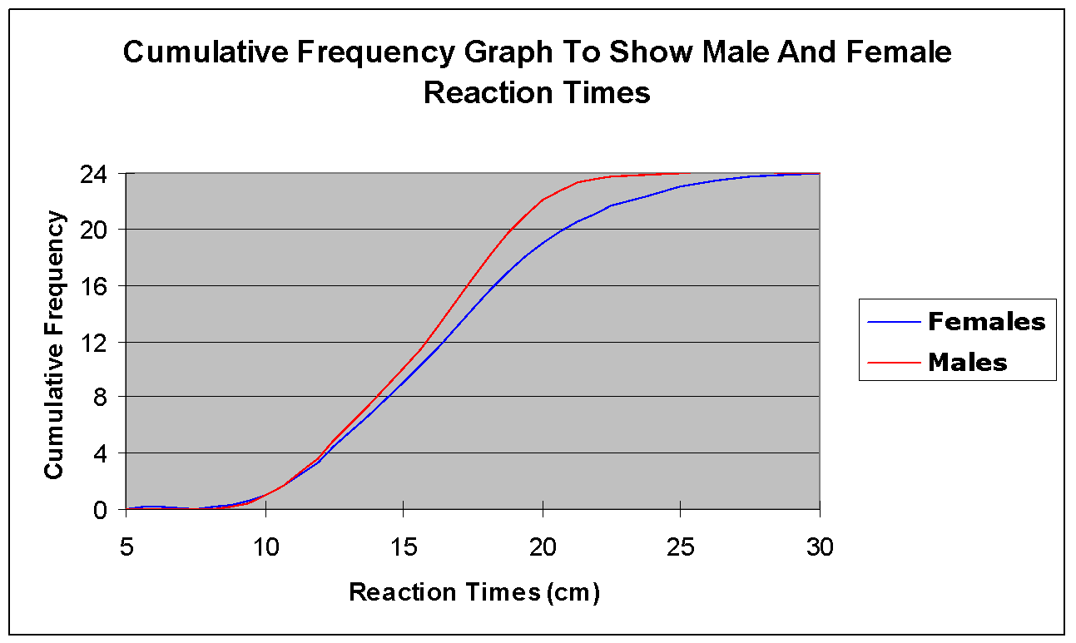
Plan and carry out an investigation into the effect of a factor on human reaction time.
Required Practical
Aim
Control Variables
Accuracy
Hight the rulers dropped from
Hand used
Accuracy tells you how close your measurements of the variable are to the true value of the variable.
Repeat tests
Take an average
Discount anomalies
The time it takes for you to respond to such a change is called your reaction time. You will conduct a simple, measurable experiment called the ruler drop test. From this you can determine whether your reaction time can be reduced with practice.
Dependant Variables
Reaction time
Example Results
Independent Variables
Number of tries
Reliability
How to look at the results
This graph shows that the fastest females are just as fast as the fastest males, however, as the reaction times get slower, the slowest female has a slower reaction time than the slowest male. Females have a bigger range.
If measurements are slightly different from the others the results are repeatable, meaning that each time a measurement is taken it has approximately the same value.

Slide 7
Plan and carry out an investigation into the effect of a factor on human reaction time...
.
Reaction Time Required Practical
Things to remember when answering 6 mark exam questions:
Try and remember everything you can about what the question is asking before you start answering it
Make at least 6 points
Write in full sentences starting with capital letters and ending with full stops
Try and answer the question in around five minutes
Check your answer to make sure you have not left anything out
Remember to use key words when appropriate

