Slide 1
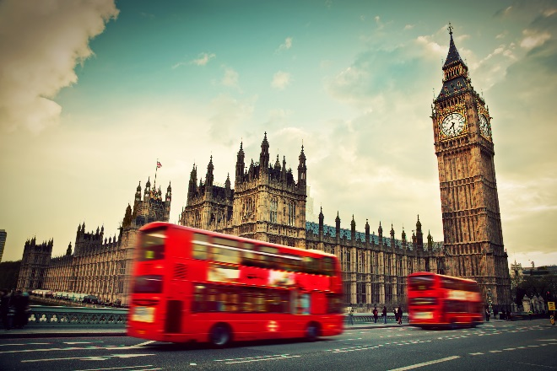
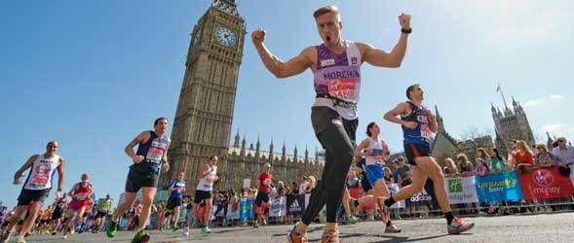
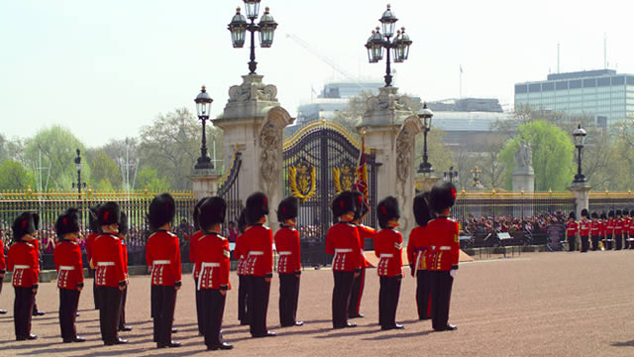
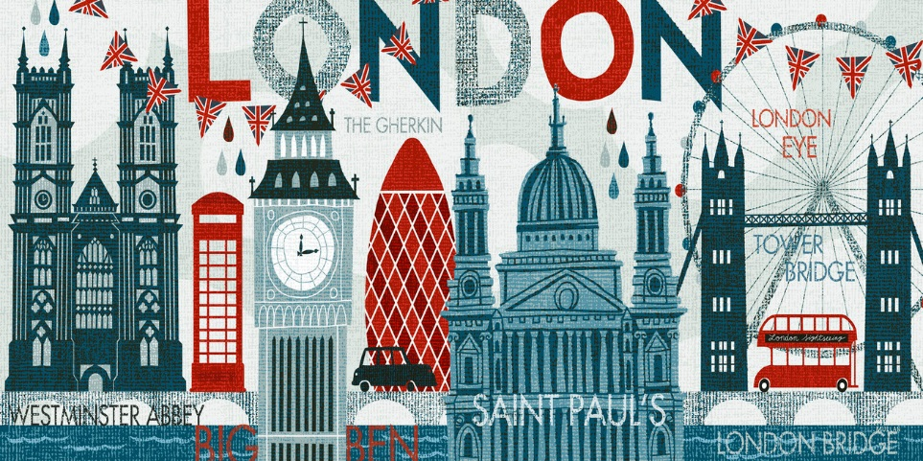
Week Two focus: Understanding Pathos and the Key Themes
6
What adjectives would you
use to describe London and
London life?

Slide 2
Year 9: Transactional Writing
Lesson Title: Absorption Text One: ‘London’
Lesson Focus: develop interpretation of texts with detailed textual evidence
Progress indicators:
 | Good | Outstanding
Assessment reminder: The paparazzi have a damaging impact on society. Write an article in which you explain your
point of view on this statement.

Slide 3
Word Consciousness – Please record on the back page of your exercise books
Word and definition | Your definition
Narrator (n) the person/character telling a story/poem
Revolution (n) when a large part of society challenges those in power to change to a new system.
Chartered (a) belonging to a company to make profit (money)

Slide 4
Learning Journey
Explored the role of the monarchy in modern society.
Explore the key themes of monarchy and government.
Analysis of the poem ‘London’ by William Blake.

Slide 5
Self-assessment:
Use the features of an autobiography video from last lesson (the link in the lesson resources column) to decide on:
Two WWW and
1 EBI for your autobiography.

Slide 6
What’s the difference?
Task: Create a double-bubble map which demonstrates the differences between the two images?
How is the first image presenting London? Is there a different perspective in the second image?

Slide 7
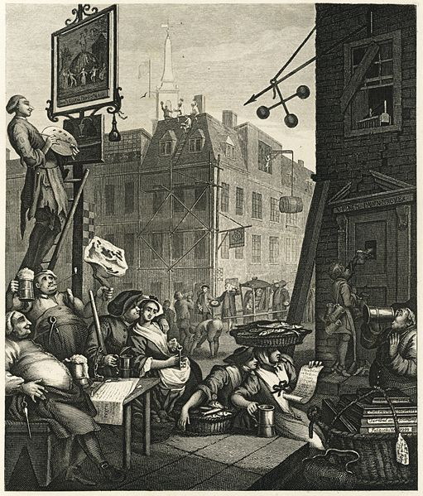
HOPELESSNESS?
What does this
picture say
about London in
18th century?
Poverty
Lawlessness
Immoral behaviour
Drunkenness
?

Slide 8
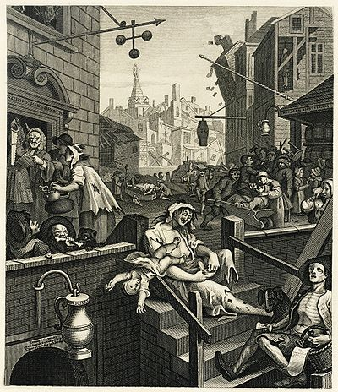
What does this
picture say
about London in
18th century?
Hogarth’s ‘Gin Alley’

Slide 9
The poem ‘London’ is about the difference between the lives of the working class people and those who are rich/in positions of power in the country.
Blake wants to challenge the structure of society by showing the reader how terrible it is that, while those in power have freedom and choices, those lower down the social ladder are treated poorly.
Class discussion.
Pupils to make notes about key information

Slide 10
Viva la revolution!
Click on the link to watch the video about the French Revolution
Task: Make notes about the events of the French Revolution to help you understand what the poem ‘London’ is about.

Slide 11
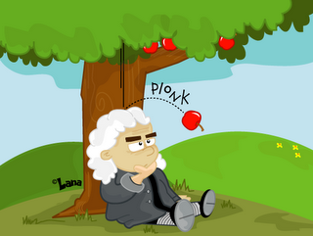
The Enlightenment
Sir Isaac Newton
Task: Match up the key terms with the definition
Teacher note: Handout in resources folder – lesson 6
Philosophy
Reason – Everything that is natural is considered to be good and reasonable.
Nature – With a scientific approach, society can be perfected. (Science vs religion debate)
Happiness – Individuals involved in the Enlightenment era believed that truth could be discovered through reason and logical thinking. (No room for God or religion)
Progress – If you live by natures laws you will find happiness (So not happiness in worshipping God)
Liberty – Through reason and logical thinking society can be set free. (Religion shackles you – trapped)

Slide 12
The Enlightenment
Sir Isaac Newton
Answers to previous task.
Philosophy
Reason – Individuals involved in the Enlightenment era believed that truth could be discovered through reason and logical thinking. (No room for God or religion)
Nature – Everything that is natural is considered to be good and reasonable.
Happiness – If you live by natures laws you will find happiness (So not happiness in worshipping God)
Progress – With a scientific approach, society can be perfected. (Science vs religion debate)
Liberty – Through reason and logical thinking society can be set free. (Religion shackles you – trapped)

Slide 13
Contiguous read of the poem and then class discussion focusing on the presentation of everyday life in London for the average working class individual.
Teacher note: Copy of poem in resources folder – lesson 6

Slide 14
5 Ws
Teacher note: Handout in resources folder – lesson 6

Slide 15
Review Quiz: True or False?
Blake considers that the lives of the working class are easy.
Blake thinks that those in power need to change their behaviour.
The poem’s narrator is describing his journey through the streets of London.
London is presented in a positive light to encourage people to visit the city.
Blake was influenced by the events of the French revolution.

Slide 16
Review Quiz: True or False?
Blake considers that the lives of the working class are easy. (F)
Blake thinks that those in power need to change their behaviour. (T)
The poem’s narrator is describing his journey through the streets of London. (T)
London is presented in a positive light to encourage people to visit the city. (F)
Blake was influenced by the events of the French revolution. (T)

