Slide 1
TASK – use an example of a creative piece and mark it yourself.

Slide 2
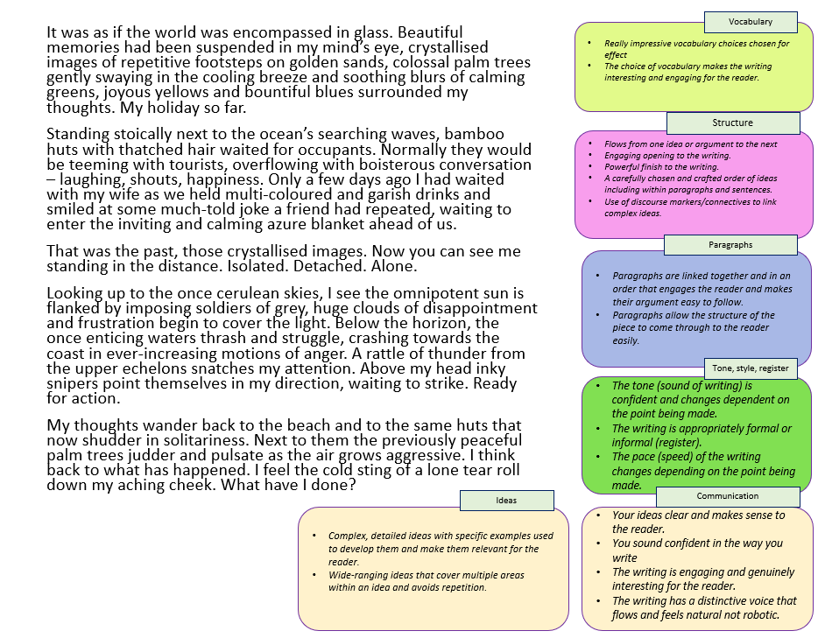
Look at the example answer to the question provided to you
Using the mark scheme boxes and ideas given to you, think about what really works well in this answer in terms of:
Vocabulary
Structure
Paragraphs
Tone, style, register
Communication
Ideas
Go through the answer and highlight sections that work well in your opinion.
Make notes on how this answer works well and meets the requirements of the mark scheme.
Having reflected on this example, what might you add or change to your own version and why?

Slide 3
It was as if the world was encompassed in glass. Beautiful memories had been suspended in my mind’s eye, crystallised images of repetitive footsteps on golden sands, colossal palm trees gently swaying in the cooling breeze and soothing blurs of calming greens, joyous yellows and bountiful blues surrounded my thoughts. My holiday so far.
Standing stoically next to the ocean’s searching waves, bamboo huts with thatched hair waited for occupants. Normally they would be teeming with tourists, overflowing with boisterous conversation – laughing, shouts, happiness. Only a few days ago I had waited with my wife as we held multi-coloured and garish drinks and smiled at some much-told joke a friend had repeated, waiting to enter the inviting and calming azure blanket ahead of us.
That was the past, those crystallised images. Now you can see me standing in the distance. Isolated. Detached. Alone.
Looking up to the once cerulean skies, I see the omnipotent sun is flanked by imposing soldiers of grey, huge clouds of disappointment and frustration begin to cover the light. Below the horizon, the once enticing waters thrash and struggle, crashing towards the coast in ever-increasing motions of anger. A rattle of thunder from the upper echelons snatches my attention. Above my head inky snipers point themselves in my direction, waiting to strike. Ready for action.
My thoughts wander back to the beach and to the same huts that now shudder in solitariness. Next to them the previously peaceful palm trees judder and pulsate as the air grows aggressive. I think back to what has happened. I feel the cold sting of a lone tear roll down my aching cheek. What have I done?
Vocabulary
Really impressive vocabulary choices chosen for effect
The choice of vocabulary makes the writing interesting and engaging for the reader.
Structure
Flows from one idea or argument to the next
Engaging opening to the writing.
Powerful finish to the writing.
A carefully chosen and crafted order of ideas including within paragraphs and sentences.
Use of discourse markers/connectives to link complex ideas.
Paragraphs
Paragraphs are linked together and in an order that engages the reader and makes their argument easy to follow.
Paragraphs allow the structure of the piece to come through to the reader easily.
Tone, style, register
The tone (sound of writing) is confident and changes dependent on the point being made.
The writing is appropriately formal or informal (register).
The pace (speed) of the writing changes depending on the point being made.
Ideas
Communication
Complex, detailed ideas with specific examples used to develop them and make them relevant for the reader.
Wide-ranging ideas that cover multiple areas within an idea and avoids repetition.
Your ideas clear and makes sense to the reader.
You sound confident in the way you write
The writing is engaging and genuinely interesting for the reader.
The writing has a distinctive voice that flows and feels natural not robotic.
Notes:
Can be printed off. Word document version also included.

Slide 4
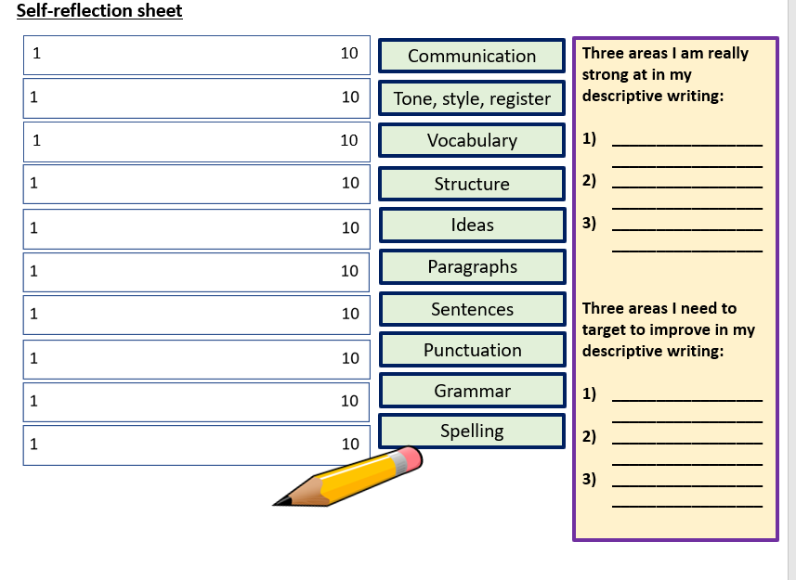
Complete a self-reflection sheet and make changes or additions to your own answer in red pen.
Communication
Tone, style, register
Vocabulary
Structure
Ideas
Paragraphs
Sentences
Punctuation
Grammar
Spelling

Slide 5


Self-reflection sheet
1 10
Communication
Three areas I am really strong at in my descriptive writing:
__________________________________
__________________________________
__________________________________
Three areas I need to target to improve in my descriptive writing:
__________________________________
__________________________________
__________________________________
Tone, style, register
1 10
Vocabulary
Structure
Ideas
Paragraphs
Sentences
Punctuation
Grammar
Spelling
Notes:
To print off

Slide 6
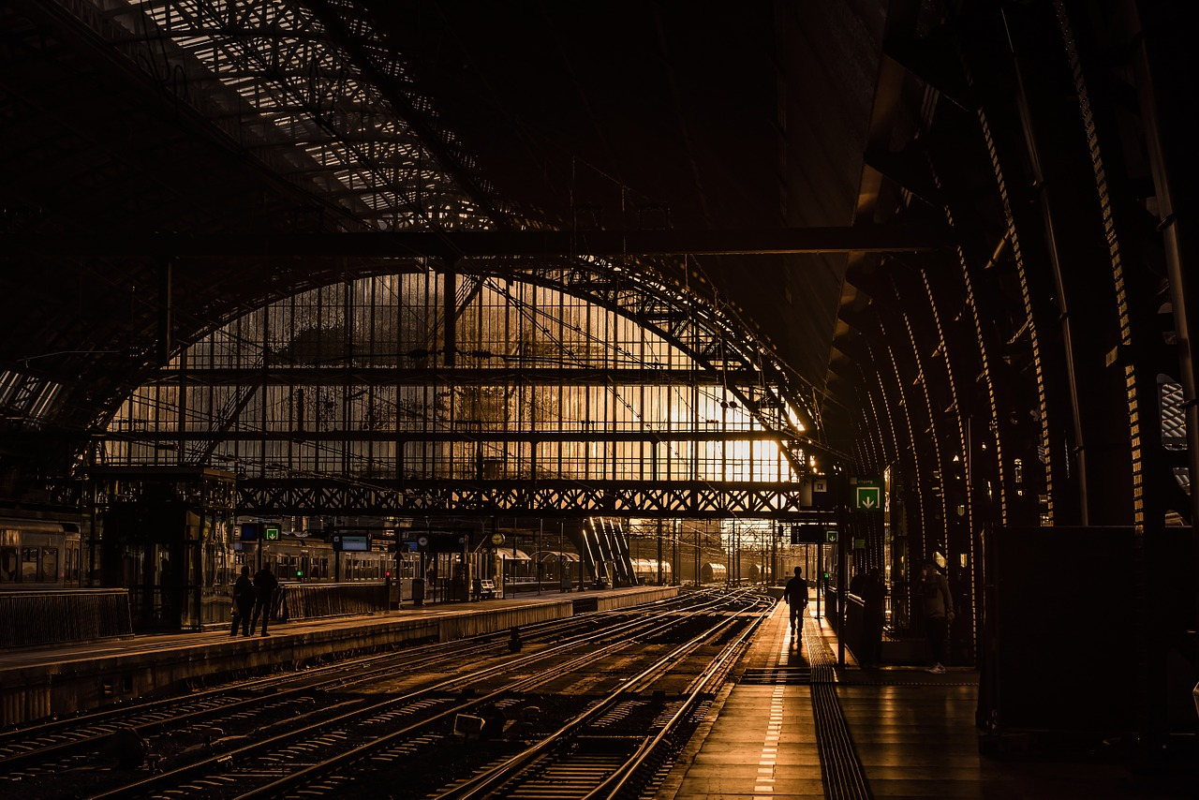
An online competition for creative writing is under way, and you have decided to enter.
Either
Write a story about a journey, as suggested by this picture:
or Write a story with the title ‘New Beginning’.
(24 marks for content and organisation 16 marks for technical accuracy) [40 marks]
Notes:
Complete task and send to your teacher

