Slide 1
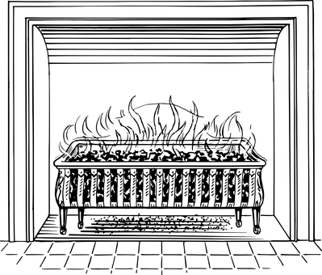
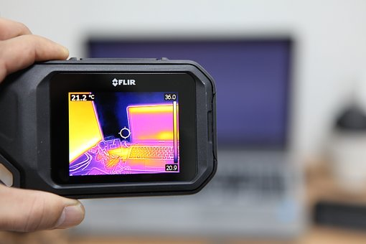
Energy Transfer: Infrared Radiation
Do now activity: Describe the difference between the processes of conduction and convection.

Slide 2
Progress indicators
GOOD PROGRESS:
Describe some sources of infrared radiation
Explain how energy is transferred by radiation
OUTSTANDING PROGRESS:
Compare thermal energy lost through different surfaces

Slide 3
Word Consciousness
Emit – To give out

Slide 4
What is infrared radiation?
Task: Watch the video and try to come up with a definition for ‘infrared radiation’
https://www.youtube.com/watch?v=JcWOyaqNo8I
Infrared radiation is the transfer of heat energy by means of infrared electromagnetic waves. All objects take up energy by infrared radiation and also gives out energy by infrared radiation. Different objects give out different amounts of radiation depending on their temperature.

Slide 5
Infrared radiation
4 surfaces:
Shiny white
Shiny black
Dull black
Dull white
Different surfaces emit different levels of infrared radiation
Leslie’s cube
What’s the difference? Which emits more and which emits less infrared radiation?
Task: Write a prediction in your books

Slide 6
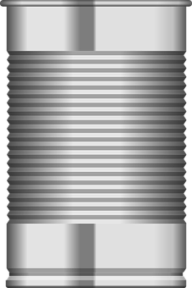
Watch the video to see the practical
https://www.youtube.com/watch?v=LFwio38EK9s
Equipment:
400ml beaker
Black tin
Silver tin
Cork mat
Hardboard lid
Thermometers
Method:
Pour 400ml of boiling water into the plastic beaker.
Pour 200ml of the 400ml into the black tin and the remaining 200ml into the silver tin.
Place the tins onto a cork mat and place a thermometer into each tin.
Take the starting temperature of the water in each tin and record in the table at time = 0 minutes.
Start the stopwatch and take the temperature of the water in each tine every minute for 15 minutes. Record your results in the table below:
Black tin
100
97
96
95
94
93
92
91
90
89
88
87
87
86
86
Silver tin
100
96
95
92
90
88
85
81
78
74
70
68
66
64
62

Slide 7
Analyse your Results
y
Complete the following the tasks:
Draw a graph to show your results
Which tin showed the greatest change in temperature in the 15 minutes?
Explain your results
How could you improve your experiment?
What else could you study?
Temperature in ºC
x
Time in minutes

Slide 8
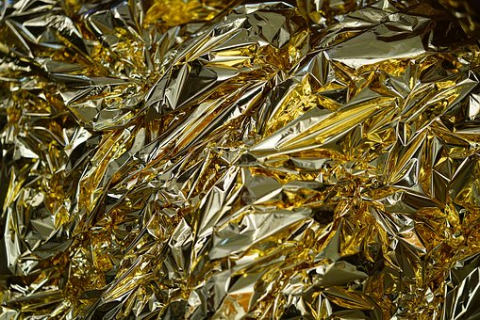
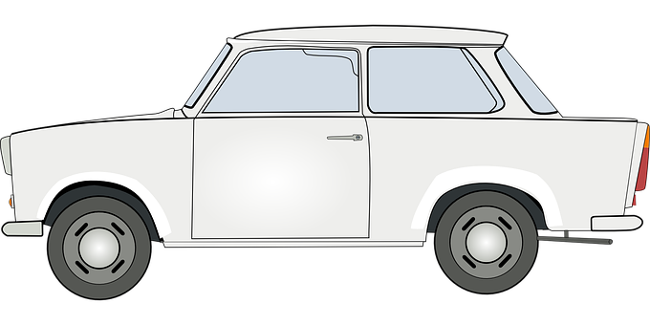
Absorbing & reflecting infrared
You can feel that you have absorbed infrared radiation from the Sun, as you skin warms up and you get hotter.
Objects that are made from darker materials absorb more infrared radiation than objects made from lighter coloured materials.
Foil is has shiny surface, this material can be used to reflect infrared radiation.
When you wrap hot food in foil, you are reflecting the heat of the food back towards the food in order for it stay warm.

Slide 9
Infrared Radiation
Task: Copy and complete the following sentences using the key words below:
Dark Waves Reflect Hot Shiny Vacuum
_____ objects transfer heat by radiation in the form of infra-red _____. Radiation is the only way heat can be transferred through a ______. _____ surfaces absorb radiation quickly, but ______ surfaces ________ radiation.

Slide 10
Self-assessment:
Hot objects transfer heat by radiation in the form of infra-red waves Radiation is the only way heat can be transferred through a vacuum. Dark surfaces absorb radiation quickly, but shiny surfaces reflect radiation.

Slide 11
Plenary ~ Pick a task:
Summarise what you have learnt today in 3 sentences
Write a definition for the following key words:
a) radiation
b) conduction
c) convection
d) reflection
e) vacuum

