Slide 1
80/20 – THINK! What do you NEED to cover with your set
Grade | Learning Objective | Learning Outcome
1 | Explain how joints allow movement in our bodies | Recall the types of joints Describe the role of joints in movement Explain how to measure the force exerted by different muscles
2
3

Slide 2
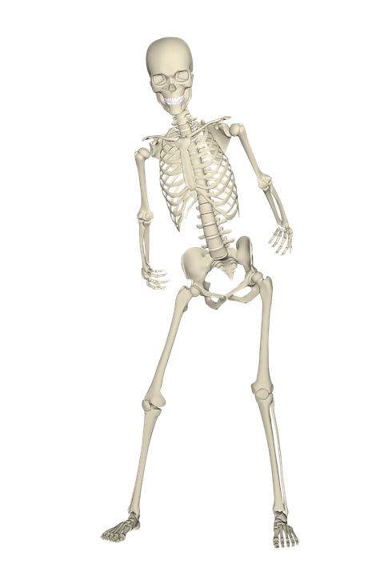
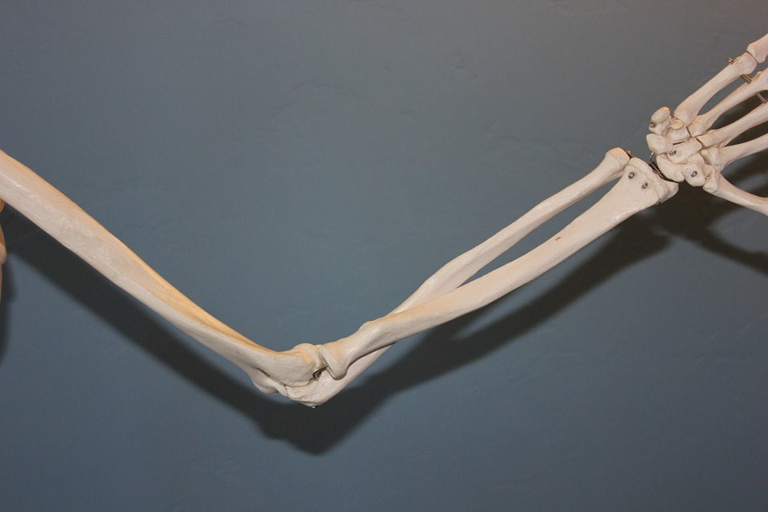
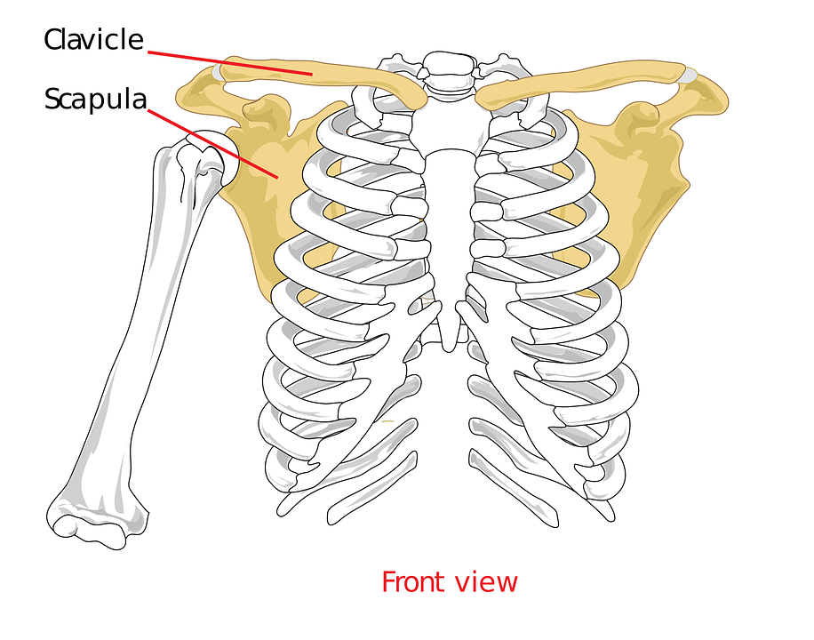
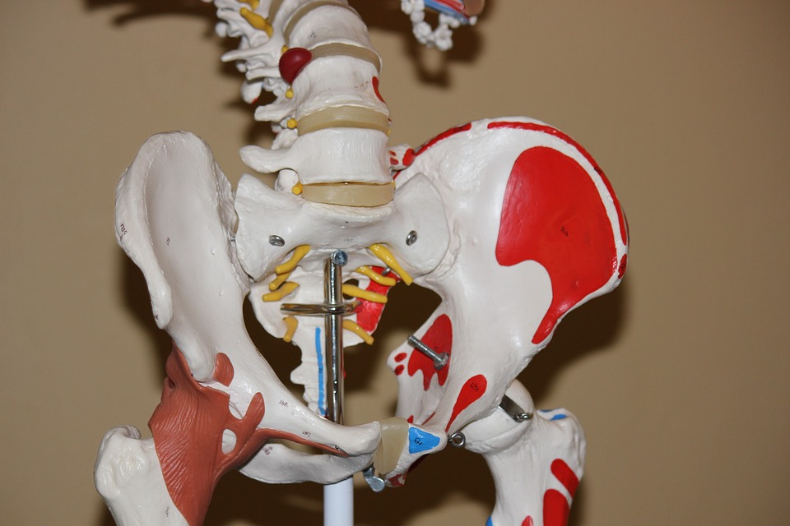
Movement: Joints
Do now activity: What are the four main roles of the skeleton?

Slide 3
Progress indicators
GOOD PROGRESS:
Recall the types of joints
Describe the role of joints in movement
OUTSTANDING PROGRESS:
Explain how to measure the force exerted by different muscles

Slide 4
Joints
A joint is where two or more bones join together.
Move your body about a bit and think about your joints.
Think > Pair > Share: What do you notice about your joints as you move around? Is every joint in your body the same? If not, how are they different?

Slide 5
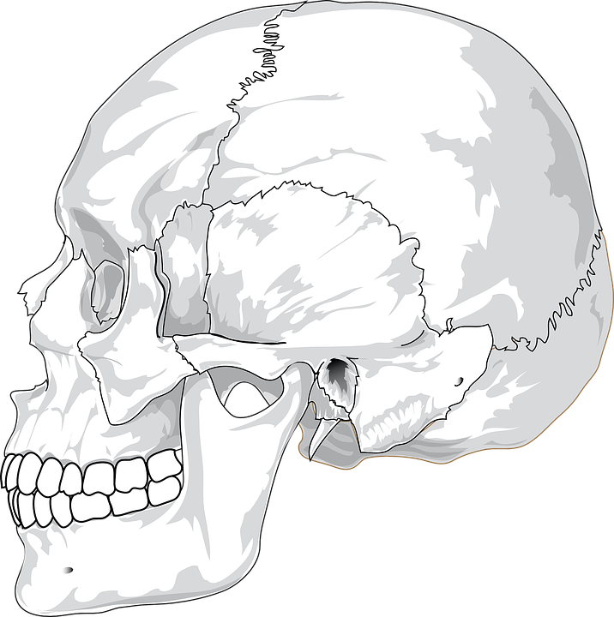
Different types of joints allow movement in different directions.
Hinge joints ~ Movement backwards and forwards, for example the knee and elbow.
Ball & socket joints ~ Movement in all directions, for example the hip and shoulder
Fixed joints ~ Do not allow any movement, for example the skull

Slide 6
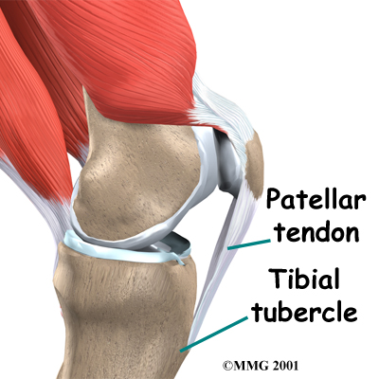
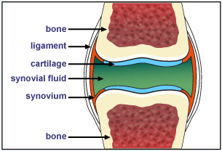
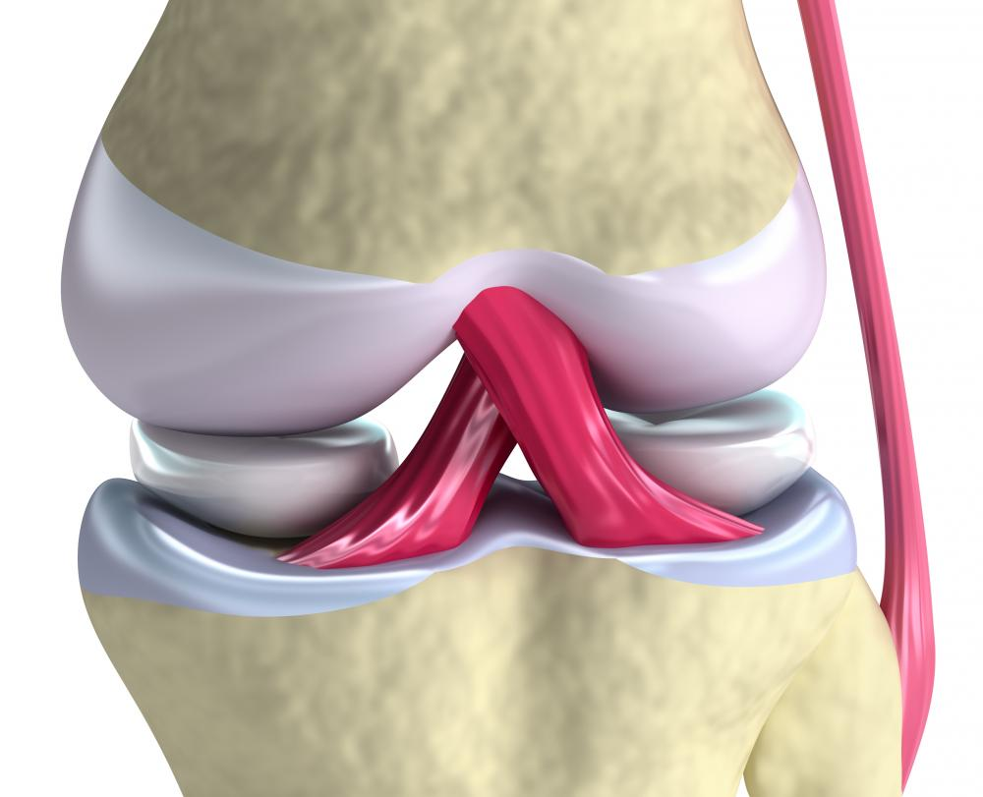
Skeletal Tissues
Task: You will be given an information sheet about the tissues found within a joint, you will need to complete the summary table using the information.
Extra Challenge:
1. Describe the three connective tissues related to joints?
2. Which of the tissues is an athlete most likely to injure?
3. Predict what would happen if the cartilage was removed from a joint.

Slide 7
Joint Tissues - Ligaments
Ligaments are a type of connective tissue
They connect Bone to Bone.
Ligaments are elastic and stretchy. This allows the joint to move where it needs to, but keeps the bones aligned
When we tear a ligament, the connective tissue is damaged and causes pain when we move the joint.
If ligaments were not stretchy, they would snap every time we bent a joint!
Ligaments of the Knee in Pink

Slide 8
Joint Tissues - Tendon
Tendons are a type of connective tissue
They connect Muscle to Bone.
Tendons are not elastic and not stretchy. This allows the muscles to pull up on a bone.
If tendons were stretchy, when a muscle contracted to move a joint, it would stretch the tendon and the joint would not move
Tendons have to be very tough and strong to hold powerful muscles to strong bones.
Tendons of the Knee in White

Slide 9
Joint Tissues - Cartilage
Cartilage is a strong and spongy tissue
It forms around the end of ball and socket, hinge and pivot joints to protect the end of the bone
When we move, cartilage in our joints acts to reduce friction to protect our bones.
Arthritis is when cartilage wears down and the ends of bones in a joint grind together when it is moved.
Cartilage in a joint, here in blue

Slide 10
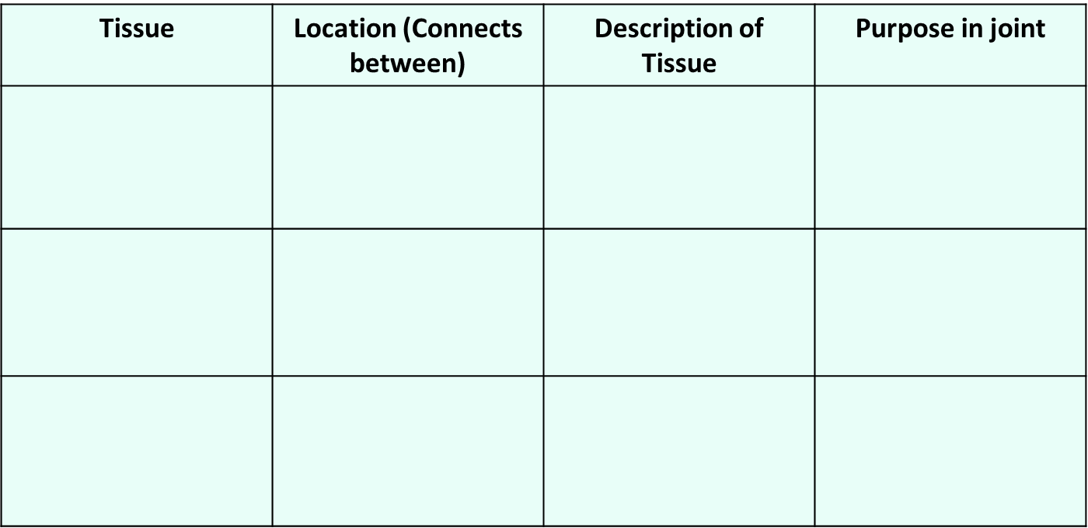

Slide 11
Self-assessment:
Tissue | Location (Connects between) | Description of Tissue | Purpose in joint
Ligament | Bone to bone | Ligaments are made of connective tissue and are elastic and stretchy. | This allows the joint to move where it needs to, but keeps the bones aligned
Tendon | Muscle to bone | Tendons are made of connective tissue that is not stretchy/elastic but very tough. | Tendons attach powerful muscles to bones, when muscle contract the tough tendons allow the muscle to pull up on a bone.
Cartilage | Between ball & socket, hinge and pivot joints. | Strong, spongy tissue. | When we move, cartilage in our joints acts to reduce friction to protect our bones.

Slide 12
Measuring muscle strength
Different muscles have different strengths. We can measure the strength of a muscle by how much force it exerts, this can be achieved by pushing as hard as you can onto a Newton scale.
Task: In pairs, follow the method below to measure the strength of your forearm, biceps and triceps. Record your results in a suitable table
Firstly, place the Newton scale on top of the table and push down as hard as you can – this will measure your triceps strength.
Next, place the scales under the table and push upwards as hard as you can – this will measure your bicep strength
Lastly, to measure your forearm strength, hold the Newton scale in the air and squeeze as hard as you can, without using thumbs.

Slide 13
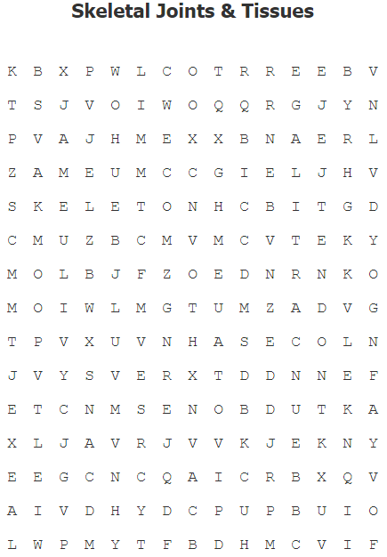
This is a structure made of up of lots of different types of bones which provides support to our bodies: _____________.
A _________ connects bone to bone.
This is a spongy tissue needed to protect our bones
A _________ connects muscle to bone.
An example of a __________ joint is the elbow.
A __________ joint forms between parts of the bone that do not move.
A tendon connects _________ to the bone and is enables our skeleton to move.
A _______ joint allows our bones to rotate 360⁰.
Our muscles and our bones work together to allow our skeleton to bring about ____________.
A ligament is a connective tissues which joins together a bone with other _______.

Slide 14
Task: Answer the questions to find a list of words you need to then find in the word search!
Skeleton
Ligament
Cartilage
Tendon
Hinge
Fixed
Muscle
Pivot
Movement
Bones

Slide 15
Plenary ~ Pick a plenary:
Unscramble these anagrams to reveal 5 key words from the today’s lesson:
a) emanlgti
b) ntoedn
c) gacealrit
d) injto
e) lemcsu
Use the following key words to summarise what you have learnt in today’s lesson: tendons, cartilage, muscle, bones, hinge, fixed, ball-and-socket.
Notes:
Anagram: 1. selective 2. modified 3.medicine 4. agriculture 5. disadvantages

Slide 16
Resources

