Slide 1
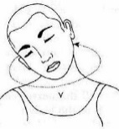
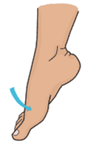
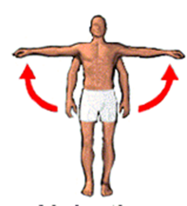
1. | Tendons connect__________ to______________ ligaments connect__________ to_______________ The difference between both is:
Where in the body are the following synovial joints located? Hinge joint: Ball and socket: Pivot: Condyloid: | Give examples of the following classifications of bones. Flat Short Long Irregular
Challenge 1 – one function of the skeletal system is production of red and white blood cells, can you recall others?
Challenge 2 – There are 20 bones of the human body you need to know, how many can you recall?

Slide 2
1. Rotation Plantar Flexion | Tendons connect__muscle________ to___bone___________ ligaments connect__bone________ to___bone____________ The difference between both is: Tendons aid movement, bones are pulled by contracting muscles. Ligaments keep joints stable.
Where in the body are the following synovial joints located? Hinge joint: elbow/knee Ball and socket: shoulder/hip Pivot: elbow joint ulna/radius or between atlas and axis Condyloid: wrist between radius and carpals or joint between base of the skull atlas. | Give examples of the following classifications of bones. Flat- cranium, scapula, ribs, pelvis, clavicle, sternum Short- carpals and tarsals Long- humerus, femur, metatarsals, phalanges, radius, ulna, metacarpals, fibula, tibia. Irregular- patella, vertebrae
adduction
Abduction
Dorsi-flexion
Challenge 1 – one function of the skeletal system is production of red and white blood cells, can you recall others? Platelets, movement, protection, storage of calcium, muscle attachment.
Challenge 2 – There are 20 bones of the human body you need to know, how many can you recall?

Slide 3
1. Rotation Plantar Flexion | Tendons connect__muscle________ to___bone___________ ligaments connect__bone________ to___bone____________ The difference between both is: Tendons aid movement, bones are pulled by contracting muscles. Ligaments keep joints stable.
Where in the body are the following synovial joints located? Hinge joint: elbow/knee Ball and socket: shoulder/hip Pivot: elbow joint ulna/radius or between atlas and axis Condyloid: wrist between radius and carpals or joint between base of the skull atlas. | Give examples of the following classifications of bones. Flat- cranium, scapula, ribs, pelvis, clavicle, sternum Short- carpals and tarsals Long- humerus, femur, metatarsals, phalanges, radius, ulna, metacarpals, fibula, tibia. Irregular- patella, vertebrae
adduction
Abduction
Dorsi-flexion
Challenge 1 – one function of the skeletal system is production of red and white blood cells, can you recall others? Platelets, movement, protection, storage of calcium, muscle attachment.
Challenge 2 – There are 20 bones of the human body you need to know, how many can you recall?

Slide 4
1. Rotation Plantar Flexion | Tendons connect__muscle________ to___bone___________ ligaments connect__bone________ to___bone____________ The difference between both is: Tendons aid movement, bones are pulled by contracting muscles. Ligaments keep joints stable.
Where in the body are the following synovial joints located? Hinge joint: elbow/knee Ball and socket: shoulder/hip Pivot: elbow joint ulna/radius or between atlas and axis Condyloid: wrist between radius and carpals or joint between base of the skull atlas. | Give examples of the following classifications of bones. Flat- cranium, scapula, ribs, pelvis, clavicle, sternum Short- carpals and tarsals Long- humerus, femur, metatarsals, phalanges, radius, ulna, metacarpals, fibula, tibia. Irregular- patella, vertebrae
adduction
Abduction
Dorsi-flexion
Challenge 1 – one function of the skeletal system is production of red and white blood cells, can you recall others? Platelets, movement, protection, storage of calcium, muscle attachment.
Challenge 2 – There are 20 bones of the human body you need to know, how many can you recall?

Slide 5
1. Rotation Plantar Flexion | Tendons connect__muscle________ to___bone___________ ligaments connect__bone________ to___bone____________ The difference between both is: Tendons aid movement, bones are pulled by contracting muscles. Ligaments keep joints stable.
Where in the body are the following synovial joints located? Hinge joint: elbow/knee Ball and socket: shoulder/hip Pivot: elbow joint ulna/radius or between atlas and axis Condyloid: wrist between radius and carpals or joint between base of the skull atlas. | Give examples of the following classifications of bones. Flat- cranium, scapula, ribs, pelvis, clavicle, sternum Short- carpals and tarsals Long- humerus, femur, metatarsals, phalanges, radius, ulna, metacarpals, fibula, tibia. Irregular- patella, vertebrae
adduction
Abduction
Dorsi-flexion
Challenge 1 – one function of the skeletal system is production of red and white blood cells, can you recall others? Platelets, movement, protection, storage of calcium, muscle attachment.
Challenge 2 – There are 20 bones of the human body you need to know, how many can you recall?

Slide 6
1. Rotation Plantar Flexion | Tendons connect__muscle________ to___bone___________ ligaments connect__bone________ to___bone____________ The difference between both is: Tendons aid movement, bones are pulled by contracting muscles. Ligaments keep joints stable.
Where in the body are the following synovial joints located? Hinge joint: elbow/knee Ball and socket: shoulder/hip Pivot: elbow joint ulna/radius or between atlas and axis Condyloid: wrist between radius and carpals or joint between base of the skull atlas. | Give examples of the following classifications of bones. Flat- cranium, scapula, ribs, pelvis, clavicle, sternum Short- carpals and tarsals Long- humerus, femur, metatarsals, phalanges, radius, ulna, metacarpals, fibula, tibia. Irregular- patella, vertebrae
adduction
Abduction
Dorsi-flexion
Challenge 1 – one function of the skeletal system is production of red and white blood cells, can you recall others? Platelets, movement, protection, storage of calcium, muscle attachment.
Challenge 2 – There are 20 bones of the human body you need to know, how many can you recall?

Slide 7
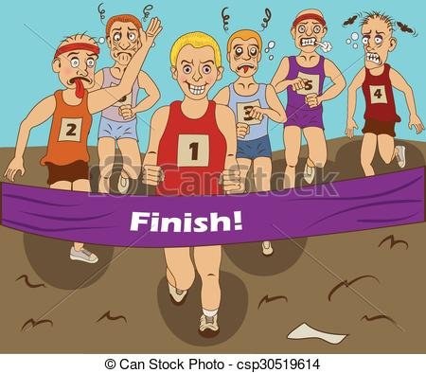
Team Sweet’s Exam league table:
Position | Learner
1st | Tahir Zada (36)
2nd | Jasmin Celaj (33) Mohammad Annas (33)
3rd | Dally Samra (31) FYI Lornie got 34 ;-)
4th | Izzy Pearson (29)
5th | Ruben Wilkinson (28)
Miss Curlett’s group…
Position | Learner
1st | Clarke (34)
2nd | Abi (31)
3rd | Lewis (24)

Slide 8
Monday 4th November 2019
Green for Growth
Good Progress | Outstanding Progress
Will be able to identify areas of development and with some support work towards recapping the learning | Will be able to identify areas of development and independently work towards recapping the learning
Task: complete your individual feedback in your books in GREEN pen.

Slide 9
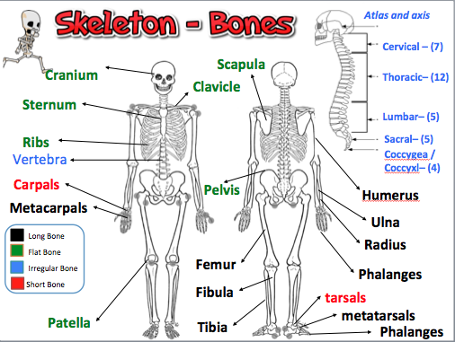
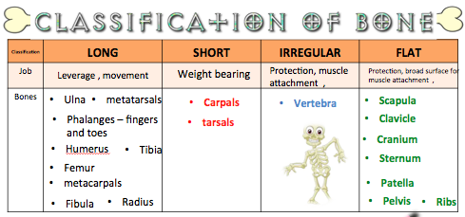
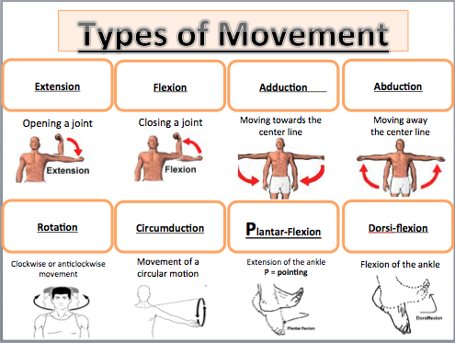

Slide 10
GREEN FOR GROWTH
Functions of the skeletal system | Example of use during a basketball game
Protection
Movement
Blood production
Challenge: can you give an example how platelets, muscle attachment and storage of calcium are used during a game of basketball.

Slide 11
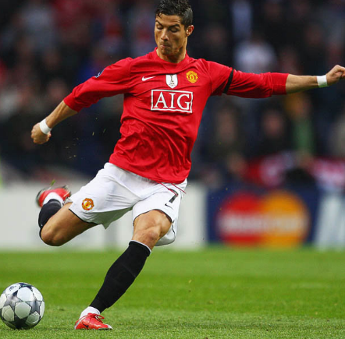
GREEN FOR GROWTH
What bones and joints are involved in these sporting actions? Annotate each picture.
Challenge: can you annotate the movement involved?

Slide 12
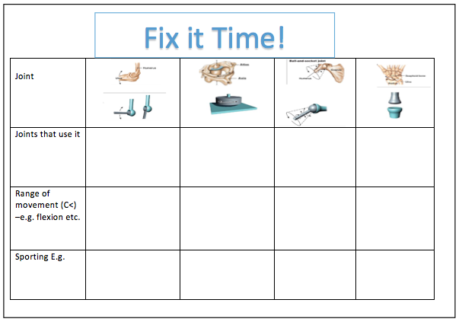
GREEN FOR GROWTH

Slide 13
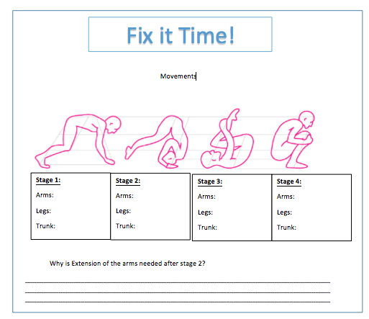
GREEN FOR GROWTH

Slide 14
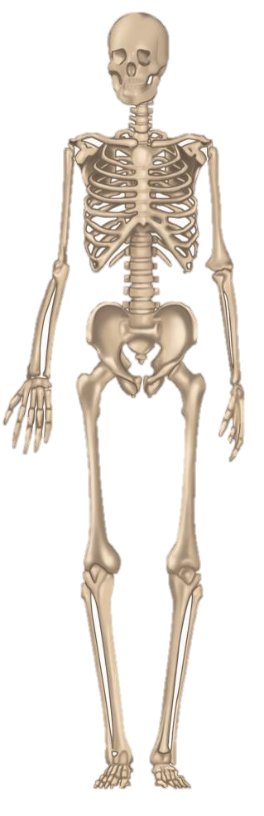
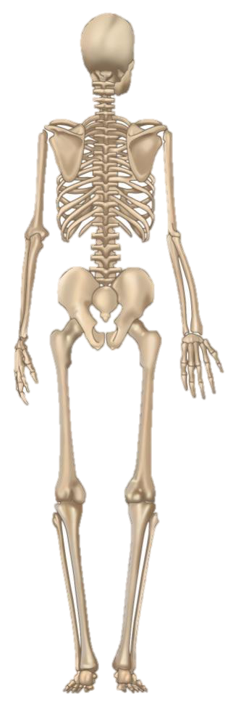
GREEN FOR GROWTH
Label 20 bones.
Challenge: can you label the synovial joints on there too?

Slide 15
Draw a line and match the correct classification of bone to their description.
GREEN FOR GROWTH
These protect the internal organs. Attachment of muscles to help movement
Irregular bones
Long bones
Short bones
Flat bones
Provide shape and protection
Movement - to generate strength and speed.
Shock absorption – spreading the load.
Challenge: list the bones in each classification. Example Clavicle is a flat bone.

Slide 16
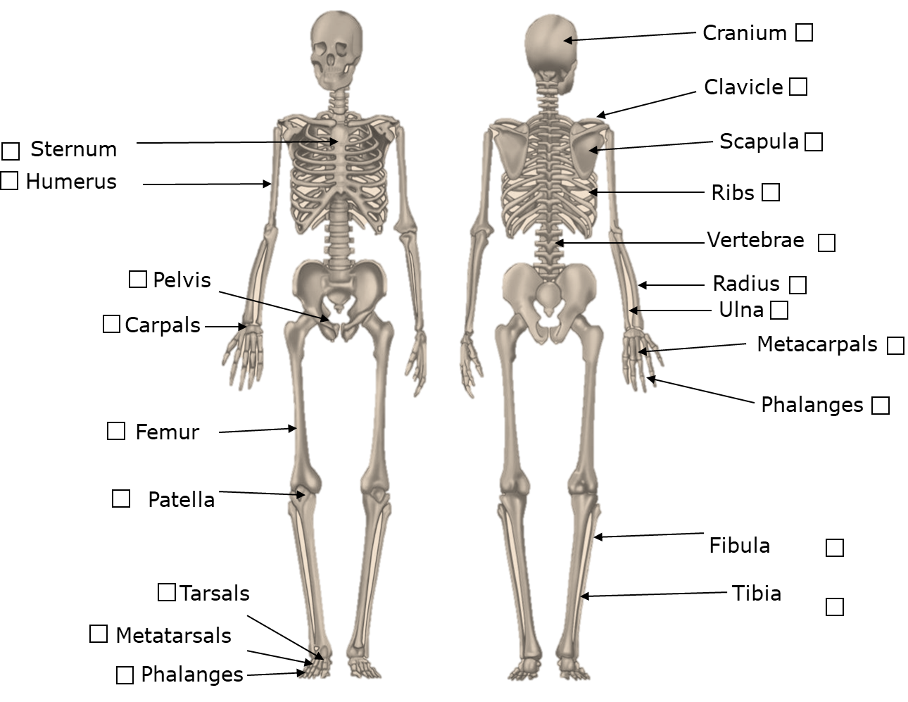
Help sheet

Slide 17
Fact Sheet! Pivot Joint
One bone has a bit that juts out, like a peg or a ridge.
This fits into a ring or notch on the other bone.
The joint allows only rotation.
Examples
• the joint between the atlas and axis (the top two vertebrae)
• the joint between the radius and ulna, below the elbow

Slide 18
Fact Sheet! Hinge Joint
This works like a hinge on a door.
The bone can swing back and forward. The end of one bone is shaped like a spool of thread.
It fits into a hollow in the other. The joint will open until it’s straight, but no further.
Examples
• the elbow joint (between the humerus and ulna)
• the knee joint (between the tibia and femur)

Slide 19
Fact Sheet! The Condyloid Joint
A rounded bump on one bone sits in a hollow formed by another bone or bones.
The joint allows movement back and forward and from side to side.
Ligaments prevent the bones from rotating.
Examples
• the joint at the wrist between the radius and carpals
• the joint between the base of the skull and the top vertebra (atlas)

Slide 20
Fact Sheet! Ball and Socket
This is the most moveable joint in the body.
One bone has a bulge like a ball at the end.
This fits into a socket in the other bone.
It can turn in many directions.
Examples
• the hip joint
• the shoulder joint

Slide 21
Classification and characteristics of muscle types:
Forming the heart
Of the skeletal system
In blood vessels
this is involuntary
striated muscles due to their appearance
we can't make them contract when we think about it.
this is voluntary
It is under the control of the autonomic nervous system
highly resistant to fatigue due to the presence of a large number of mitochondria
not under our conscious control
found in the internal organs
are under our conscious control
found in the walls of hollow organs such as the Stomach
we can move these muscles when we want to
Sometimes known as smooth muscle

Slide 22
Classification and characteristics of muscle types:
Problem:
There are 3 types of muscles make a list of the characteristics of each type using the
1) Voluntary muscles
2) Cardiac muscle
3) Involuntary muscles

Slide 23
Classification and characteristics of muscle types:
Problem: There are 3 types of muscles make a list of the characteristics of each type using the
1) Voluntary muscles
2) Cardiac muscle
3) Involuntary muscles
In blood vessels
Of the skeletal system
Forming the heart
found in the internal organs
this is voluntary
This is involuntary
It is under the control of the autonomic nervous system
not under our conscious control
are under our conscious control
we can't make them contract when we think about it.
we can move these muscles when we want to
highly resistant to fatigue due to the presence of a large number of mitochondria
Sometimes known as smooth muscle
striated muscles due to their appearance
found in the walls of hollow organs such as the Stomach
FIX IT WITH GREEN PEN!!!

