Slide 1
CwK
Wednesday, 01 July 2020
Momentum
Do Now Activity
Define momentum

Slide 2
Self Assess
Momentum is the property of a moving object, it is defined as mass x velocity.

Slide 3
Progress Indicators
Good Progress
Apply the rate of change of momentum equation
Outstanding Progress
Explain the effect of factors on momentum

Slide 4
Word Consciousness
Momentum-has both size and direction it is a vector quantity

Slide 5
Change in Momentum
When a force acts on an object that is moving, or able to move, a change in momentum occurs.
The equations F = m × a and a = v − u
t
combine to give the equation F = m Δ v
Δt
where mΔv = change in momentum
ie force equals the rate of change of momentum.
Force- N
Change in momentum kgm/s
Time s
U- initial velocity
V- final velocity

Slide 6
Practice
What is the force needed to change a cyclist’s momentum by 24kgm/s in 4 seconds
F = m Δ v
Δt
F= 24 ÷ 4
F= 6N
What is the force needed to change a cars momentum by 3000kgm/s in 5 seconds
F = m Δ v
Δt
F= 3000÷5
F= 600N

Slide 7
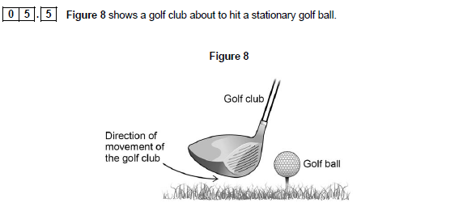
The golf club is in contact with the golf ball for 1.8ms and exerts a force of 1500N on the golf ball
The mass of the golf ball is 0.045Kg
Calculate the velocity of the ball as it leaves the golf club

Slide 8
1.8ms = 0.0018s
F = m Δ v
Δ t
1500=0.045 x v (0.045 x 0)
0.0018
V=1500 x 0.0018
0.045
V=60m/s

Slide 9
longer the time of contact the greater the change of momentum
since the mass of the golf ball is constant
the velocity of the golf ball must increase
increasing the distance the golf ball travels

Slide 10
Plenary

