Slide 1
DNA:
It is still important to have a royal family in modern society.
How far do you agree with the statement above and why?
1.
2.
3.

Slide 2
Year 9: Transactional Writing
Lesson Title: The Royal Family in the Modern Era
Lesson Focus: Select from a range of strategies to locate, retrieve and compare information
Progress indicators:
 | Good | Outstanding
Assessment reminder: The paparazzi have a damaging impact on society. Write an article in which you explain your
point of view on this statement.

Slide 3
Word Consciousness – Please record on the back page of your exercise books
Word and definition | Your definition
Constitution (noun) a decree, ordinance, or law.
Tourism (noun) the commercial organization and operation of holidays and visits to places of interest.
Perpetuates (verb) make (something) continue indefinitely.

Slide 4
Learning Journey
Explain how the media can have a detrimental effect on individuals
Explore the relevance of a royal family in modern society
Consider the benefits and drawbacks of the British royal family.

Slide 5
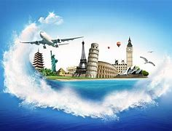
‘The royal family are great for the tourist industry in the United Kingdom’
What does this statement mean?
Discuss with your partner and then write in your own words.

Slide 6
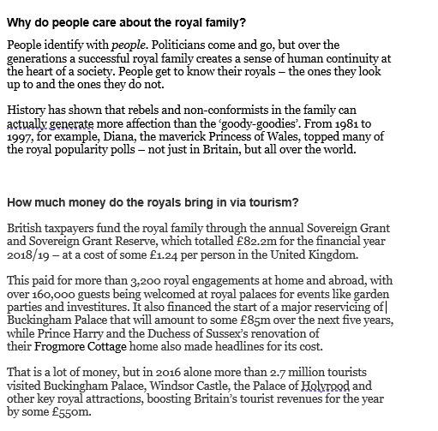
Teacher note – copy in resources folder – lesson 21
We are going to read an article about the benefits and drawbacks of the United Kingdom’s Royal Family.
If there are any words you can’t define or understand, they highlight them and we’ll discuss them afterwards.

Slide 7
Comprehension Questions:
What does a successful royal family create over the generations?
Which type of royals generate more interest in the general public?
How is a royal family funded?
How much was the Sovereign Grant Reserve in the year 2018/2019?
Which things were funded by the Sovereign Grant in 2018/2019?
How many tourists visited the royal family’s tourist attractions in 2016?
How much money was made as a result of these tourists in 2016?

Slide 8
Watch the video clips below to explore peoples’ views on the royal family’s impact on the tourism industry.
For
Against
https://www.youtube.com/watch?v=bhyYgnhhKFw
https://www.youtube.com/watch?v=Kav846OCBQ8
Both videos are obviously at least slightly biased – can you spot any features which show you that they are biased pieces?

Slide 9
Use the article and video clips to create a comparison table of the benefits and drawbacks of a royal family:
Benefits
Potential Problems

Slide 10
Your opinions…….
The royal family is still necessary in modern society – how far do you agree with this statement now and why?
Reason three and explanation
Reason two and explanation
Reason one and explanation

Slide 11
Review Question:
Which reasons do people have for questioning the importance of having a royal family in modern society?

