Slide 1
Principles of training
&
Normative data
DNA – On whiteboard - List and discuss what you can remember about principles of training
Progress Indicators
Good | Outstanding
Be able to explain the purpose of normative data and state 4 principles of training | Link a principle of training to a sporting example (of it being used effectively)

Slide 2
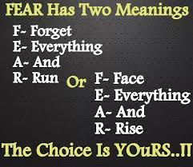
Make an acronym …….
Cardiovascular fitness (aerobic endurance)
Strength
Muscular endurance
Flexibility
Body composition
Agility
Balance
Coordination
Power
Reaction time
Speed

Slide 3

What is
‘Normative data’…?
Discuss, 2 minutes

Slide 4
Normative Data
Normative data is data from a population that gives a range of measurements in an area that can be used for a comparison. This data is taken from a randomly selected general population.
In normal speak…. It can gives a set of fitness test results you can compare your own with to see what level you are at!

Slide 5
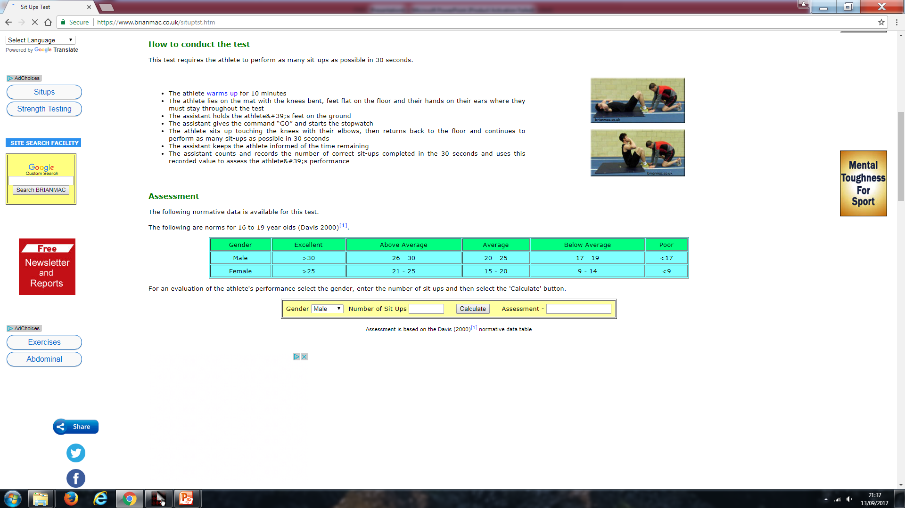
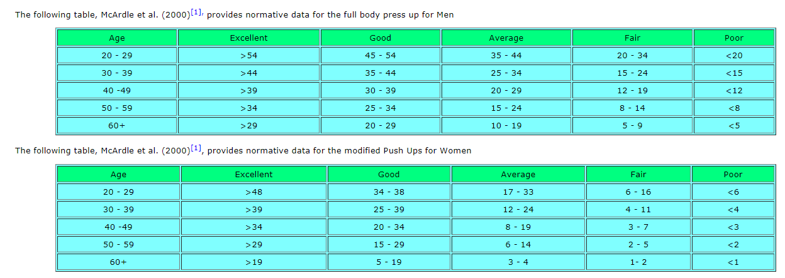
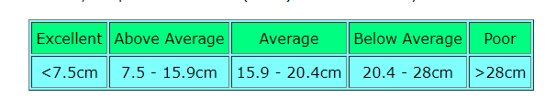
Press Up Test
Sit Up Test
Ruler drop test

Slide 6
Your turn!
Chose two of the available fitness tests
Do them both
Write your result in your book
Use ‘www.brianmac.co.uk’ to make a normative data comparison of your results
Write down what normative data category for your age group you were in for each test

Slide 7
How can we improve these fitness components?
Will improving these fitness components improve performance?

Slide 8
Answer each question for each result
What test have you completed
What component of fitness is it testing
What was your score
What normative data category are you in
What does this mean in terms of this fitness component
How far away (in measurement) are you from the next category up on this test
What method of training would improve this component of fitness (last year!)

Slide 9
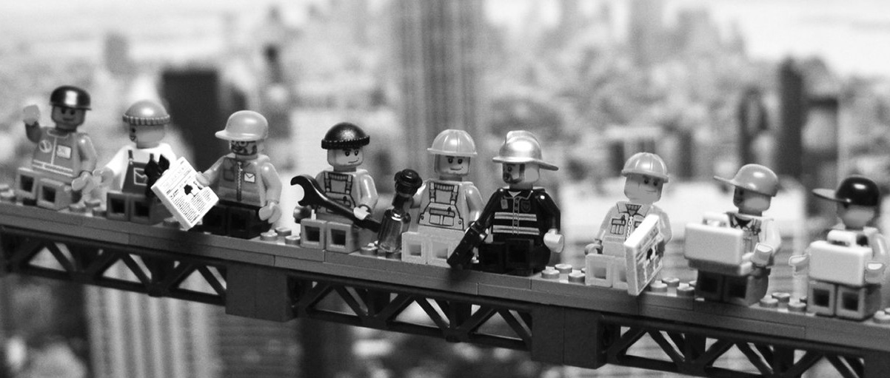

Slide 10
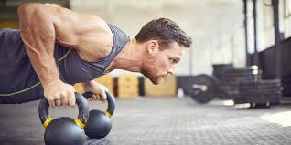

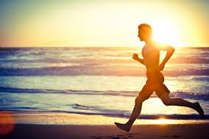
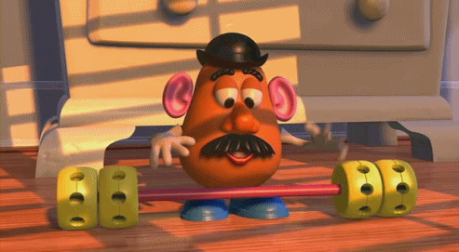
Principles of Training

Slide 11
S
P O
O
R
T
I
F
I
T
T
Principles of Training
SPORTI

Slide 12
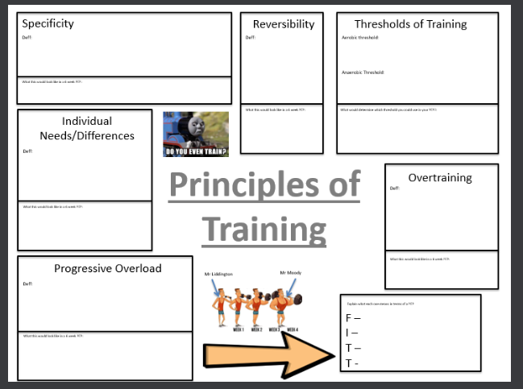
The most valuable part is the ‘how can it be used’ section
Using the text books or PC’s research the principles of training and explain how they can be applied in training

Slide 13
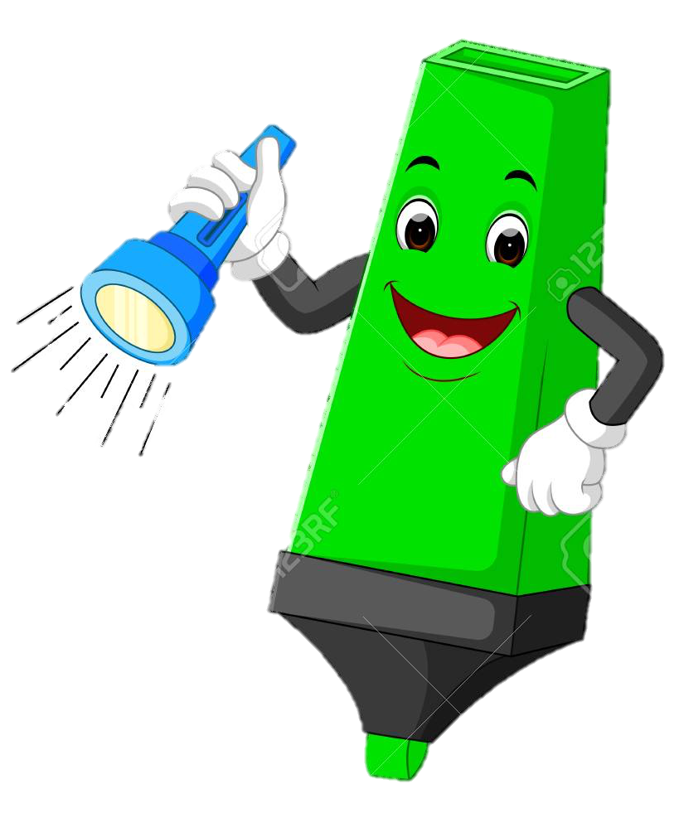



Demonstrate
Question: Discuss, using examples, how the principles of training can improve the fitness of a group of GCSE PE students. (6)
Add to your Demonstrate
___/ 6

Slide 14
1-2
3-4
5-6

Slide 15
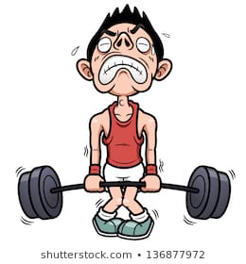
Specificity
Progressive Overload
Overtraining
Reversibility
Threshold Training
Individual needs
Frequency
Intensity
Time
Type
Anaerobic = 80-90%
Aerobic = 60-80%
This will become clearer later – but so you get used to remembering this
So what are the
principles of training
THINK
SPORTI

Slide 16
Help
Cardiovascular Endurance:
Spinning
Muscular endurance:
Body Pump
Aerobics
Weight/resistance training
Circuit training
Interval training
Body Pump
Fartlek training
Continuous training
Spinning
Circuit training
Flexibility:
Speed
Interval training
Flexibility training
Weight/resistance training
Yoga / pilates
Muscular strength:
Power:
Interval training
Weight/resistance training
Weight/resistance training
Body Pump
Plyometric training

Slide 17
Connect
Identify all the Principles of training
Give a definition of each
Give simple examples of how most the PoT will help improve fitness
Detail of how each PoT will be applied in a PEP to improve Muscular Strength
Challenge
Describe how this would be different for a 21 year old male athlete trying to improve his strength and a 40 year old female who wants to improve her cardiovascular fitness

