Slide 1
Do Now Activity
Page 7 of your book
What are the main causes of the “Digital Divide”?
Think about
Social
Cultural
Attitude
Geographical
Economic

Slide 2
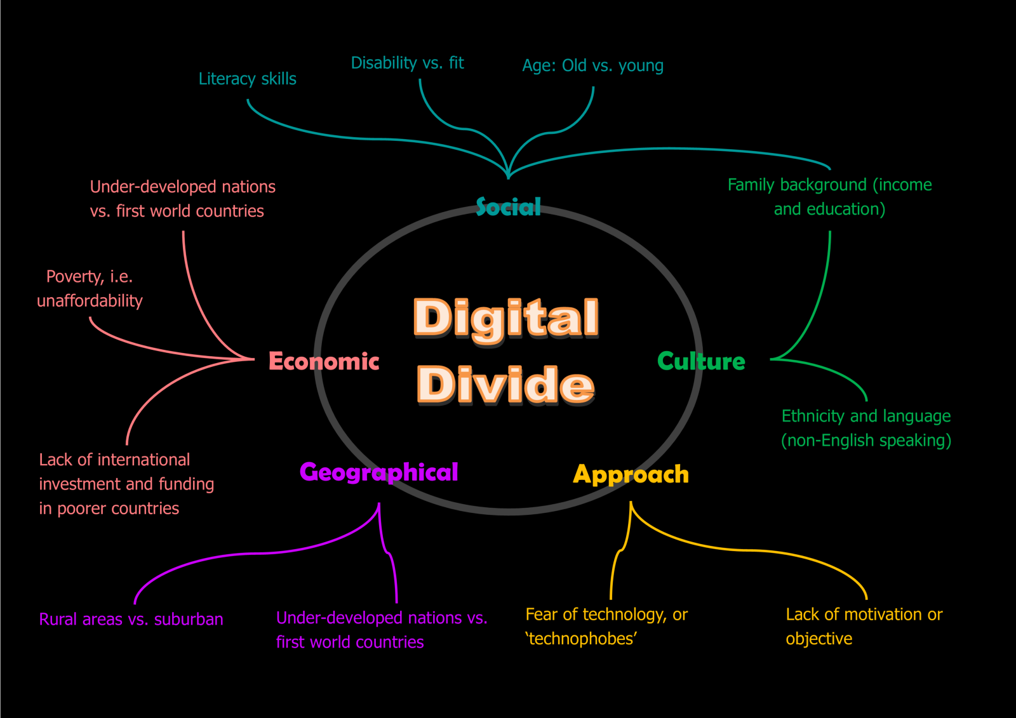
Do Now Activity - Answers

Slide 3
Unit 7 Ethical, Legal, Cultural and Environmental Concerns
Progress Indicators
Good – Identify causes of the Digital Divide
Outstanding – Explain the impact of Computing on the Environment
Digital Divide = moral principles / right and wrong

Slide 4
Energy Consumption and Climate Change
Notes:
https://www.youtube.com/watch?v=iuZDylVFbhs

Slide 5
E-Waste
Notes:
https://www.youtube.com/watch?v=JXDrIvShZKU

Slide 6
Recycling
Notes:
https://www.youtube.com/watch?v=Iw4g6H7alvo

Slide 7
Positive Impact
Technology used to monitor Climate Change
Digital Tracking devices used to monitor animals and their behaviours (Conservation)
Energy Production – Wind Turbines and tidal energy technologies are designed and tested using Computer Science

Slide 8
Task 1
Energy Consumption + E-waste
Explain what the term means
What causes it
Methods we can use to cut down
Individuals
Global
Positive impact of technology

