Slide 1
Do Now Activity
What kind of work can be Copyrighted?
Software / Games
Movies / Images / Graphics
Literary and Dramatic works
Music and Lyrics
Architecture
Choreography
Art (Paintings and Sculptures)

Slide 2
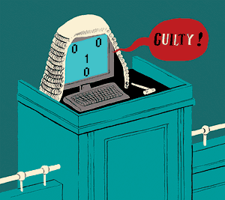
Unit 7 Ethical, Legal, Cultural and Environmental Concerns
Progress Indicators
Good – Describe how Copyright and Creative Commons works
Outstanding – Compare Copyright and CC to software licencing
Legislation= the process of making or enacting laws

Slide 3
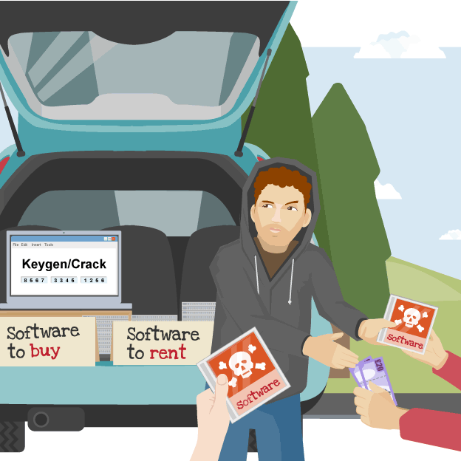
Copyright Designs and Patents Act 1988
Copyright gives the creators of some types of media rights to control how they're used and distributed. Music, books, videos and software can all be covered by copyright law. It also makes it an offence to copy or distribute other people’s intellectual property without permission
What effects would software piracy have on companies?
Loss of income, Loss of jobs
What steps can software companies take to stop piracy?
Licence agreements between users and developers
Unique Key to activate software
Some applications only run if verified through the internet

Slide 4
Copyright Designs and Patents Act 1988
The legal penalties for breaking the copyright law include unlimited fines and up to two years in prison.
All the software that you use should be fully licensed. When you purchase software you usually are licensed to use it on just one computer. It is illegal to make copies of the software to use on other computers, even if they are your own.
Software licences can be:
Single user - licensed for installation on one computer
Multi-user - the license allows you to install the software on a named number of computers
Site-licence - the licence lets you install the software onto an unlimited number of computers, as long as they are on one distinct site such as a school

Slide 5
Copyright Designs and Patents Act 1988

Slide 6
Copyright and Fair use
There are still instances where you can use copyrighted materials as long as you:
Check who owns the copyright
Get permission to use it
Give credit to the creator
Buy it (if necessary)
Use it responsibly
There are some exceptions to the Copyright Law where people can use small sections of the Copyrighted work. This is called Fair Use. Examples of this include:
Use for Education / School work
News Reporting
Criticising or Commenting
Comedy or Parody
Find an example of copyright infringement on the internet use the search term
“copyright case study”

Slide 7
Do Now Activity - Whiteboards
What is open source software?
Give 2 examples of proprietary software?
Name the 4 creative commons licences?
Describe one advantage of open source software?

Slide 8
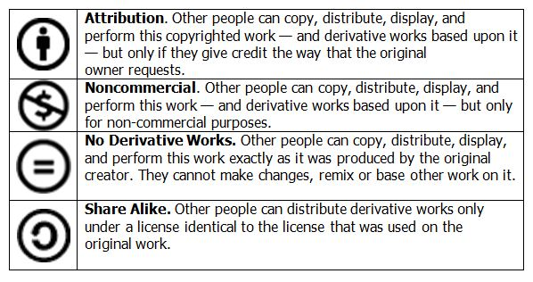
Creative Commons Licensing
Creative Commons is an organisation that provides licences that allow creators to give public permission to share and use their work under certain conditions. For example, a CC licence might say that other people can copy and distribute the copyright owner's work as long as they give them credit.
The four main licences are..

Slide 9
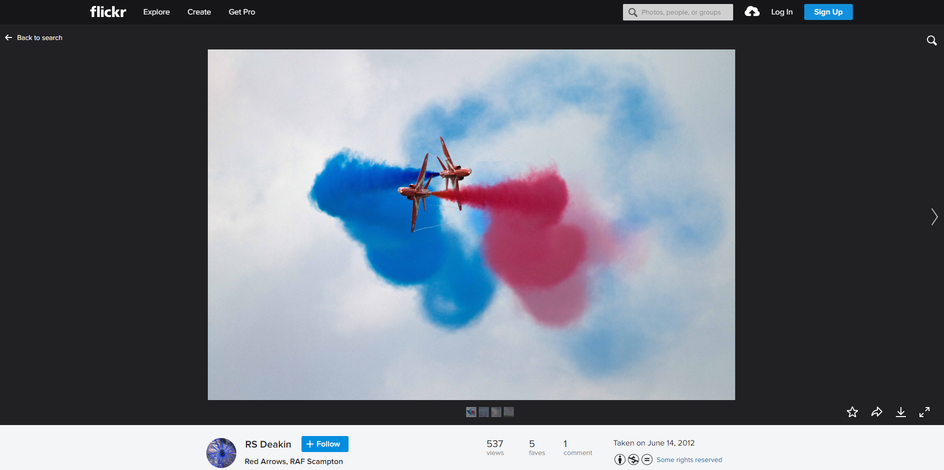
Creative Commons Example

Slide 10
Open Source vs Proprietary Software
All software development takes time and expertise, but there are many models for funding software development, and different models of ownership.
Proprietary Software | Open Source
Software that legally remains the property of the organisation, group, or individual who created it. The organisation that owns the rights to the product usually does not release the source code, and may insist that only those who have purchased a special licence key can use it. Free software Free software (also called freeware) is licensed at no cost, or for an optional fee. It is usually closed source. | Open source software is free and openly available to everyone. People who create open source products publish the code and allow others to use and modify it. Communities of programmers often work together to develop the software and to support users. Open source products are usually tested in public by online contributors.

Slide 11
Open Source vs Proprietary Software
Proprietary Software | Open Source
Advantages Developed carefully and tested thoroughly as people are paying for it Support provided by company Regular Updates Disadvantages Can be expensive Software developed for majority of users, may not meet the needs of individuals who aren’t able to modify it Support and Updates maybe expensive | Advantages Free to use Users can modify source code to adapt to their needs Constant upgrades available Community of enthusiasts who can provide support Disadvantages May need specialist knowledge to develop May not appear as professional May not have been tested as thoroughly

