Slide 1
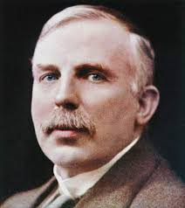
More about Alpha, Beta and Gamma
Last Lesson:
More about Alpha, Beta and Gamma
This Lesson:
Half Life
Next Lesson: Nuclear radiation in medicine.
Do now activity:
What is an Isotope
What do we use to measure radioactivity?
What is this measured in?
Which type of particle is unaffected by a magnetic/electric field?

Slide 2
Progress indicators
GOOD PROGRESS:
- State the 3 definitions of half-life
- Find the half-life of a substance from a graph / Plot a graph showing the decay of a sample and use it to determine half life.
OUTSTANDING PROGRESS:
- Calculate the changes in count rate or nuclei remaining.

Slide 3
Isotopes
A
Atoms of the same element but a different number of neutrons than protons
The number of protons and neutrons is indicated by A which is also the mass number
X
Z

Slide 4
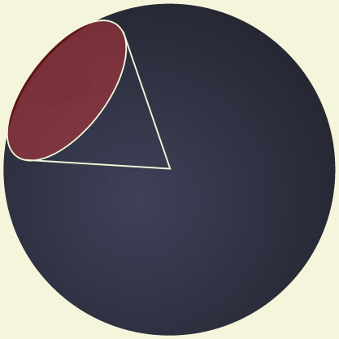
Activity vs Count Rate
3D
Activity
Count Rate is the number of counts per second from a Geiger Counter at the imaginary surface of the cone of the sphere projected out from the centre of the radioactive source.
Radioactive
Source
Count Rate
2D

Slide 5
Calculating Activity and Count Rate of an Un-Stable Radioactive Isotope.
Activity:
Number of atoms that decay per second from the nucleus
Activity = Number of Atoms that Decayed
Time (s)
Count Rate:
Number of counts per second from a Geiger Counter
Count Rate = Number of counts from Geiger Counter
Time (s)

Slide 6
Count Rate over Time
200
180
160
140
120
Count Rate
100
80
Example radioisotope
60
40
20
0
0
15
30
45
60
75
90
105
120
135
150
Time (mins)

Slide 7
Half Life – Count Rate
Count Rate Measurements over time
Count Rate
Count Rate |  | Time (mins)
200 |  | 0
100 |  | 30
50 |  | 60
25 |  | 90
12.5 |  | 120
6.25 |  | 150
3.125 |  | 180
Time (mins)

Slide 8
Half Life – Count Rate
Count Rate
Count Rate Measurements over time
Count Rate | Count Rate Diff. | Time (mins) | Time Interval (mins)
200 |  | 0
100 | =200÷2 | 30 | 30
50 | =100÷2 | 60 | 30
25 | =50÷2 | 90 | 30
12.5 | =25÷2 | 120 | 30
6.25 | =12.5÷2 | 150 | 30
3.125 | =6.25÷2 | 180 | 30
Time (mins)

Slide 9
Half life - Definition
Pattern:
Every 30mins the count rate reduces by half of the previous count rate
Half Life – Definition 1:
The average time taken for the count rate to reduce to half of its initial (previous) value

Slide 10
Half life from a graph
Count Rate
7
T2 - T1 = Half Life
Should be
roughly
the same
To Check:
T3 – T2 = Half Life
1
C1
8
3
Complete the Worksheet on calculating Graphical Half Life
C1 ÷ 2 = C2
C2 ÷ 2 = C3
5
T1
T2
T3
Time (mins)
2
4
6

Slide 11
Half life - Definition
Reminder Half Life – Definition 2:
The average time taken for the number of un-stable radioactive isotope nuclei to half in number.
Half Life – Definition 3:
The average time taken for the mass of un-stable radioactive isotope atoms to half in mass.

Slide 12
Task
What’s the difference between Activity and Count Rate?
Activity is the total number of all atoms that decay per second.
Count Rate is the number of counts per second from a Geiger Counter at a particular point from the source of the radioactivity
What are the three definitions of Half Life?
The average time taken for the count rate to reduce to half of its initial (previous) value
The average time taken for the number of un-stable radioactive isotope nuclei to half in number
The average time taken for the mass of un-stable radioactive isotope atoms to half in mass

Slide 13
Calculating Half Life
The half-life of a material is 3 hours. If the initial count rate is 544 Bq, what will the count rate be after 15 hours?
We are told that the half-life of the material is 3 hours.
In 15 hours there are 5 iterations of the half life (15 ÷ 3 = 5).
After each half-life the count rate is halved.

Slide 14
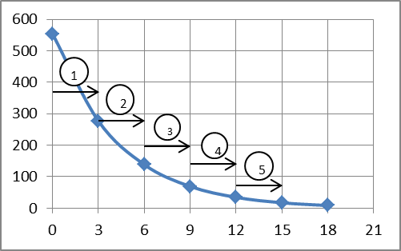
Calculating Half Life
Notes | Count Rate (Bq) | Number of Half Lives
Starting Count Rate = 554 | 554
554 ÷ 2 = 272 | 272 | 1
272 ÷ 2 = 136 | 136 | 2
136 ÷ 2 = 68 | 68 | 3
68 ÷ 2 = 34 | 34 | 4
34 ÷2 =17 | 17 | 5
5 steps of 3 hours each
Answer: That after five half-lives the count rate is 17 Bq.

