Slide 1
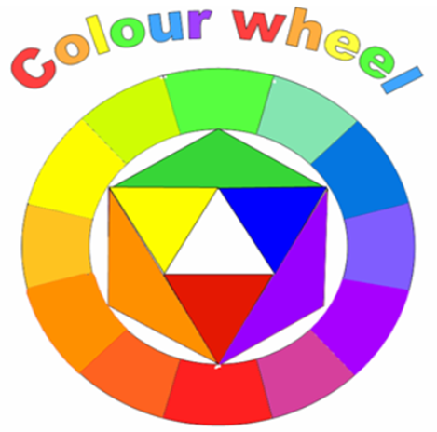
Task 1
Research colour theory
Write the definitions and give examples of :
Primary -
Secondary -
Tertiary -
Complimentary -
Monochromatic -

Slide 2
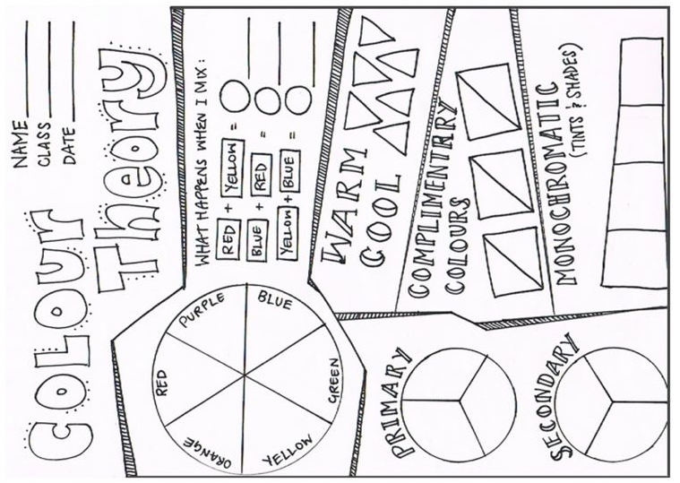
Task 2
COMPLETE THIS SHEET
1) If you are able to print, print out this sheet and complete it using coloured crayons.
2) If you are unable to print then please design your own copy that looks similar including all the elements on here

Slide 3
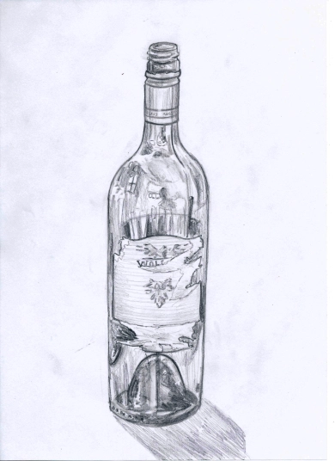
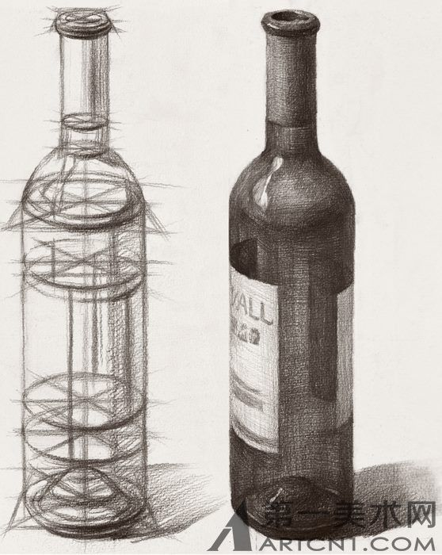
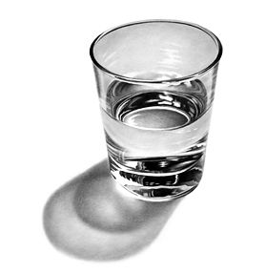
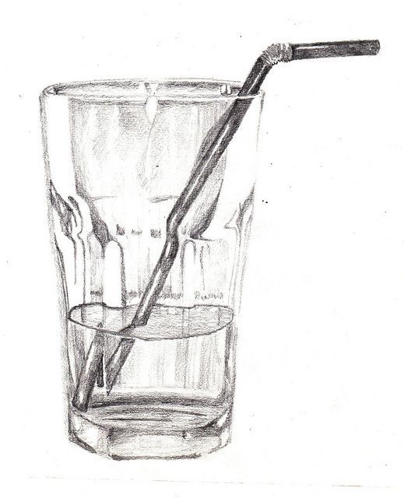
Task 3 – Observational Drawing
Place a bottle or a cup in front of you on the table.
Observe the shape, form, sizes of the objects, draw what you see. ONLY DRAW WHAT YOU CAN SEE.
Add shading to make your drawing look 3D
Look at the examples on this page

Slide 4
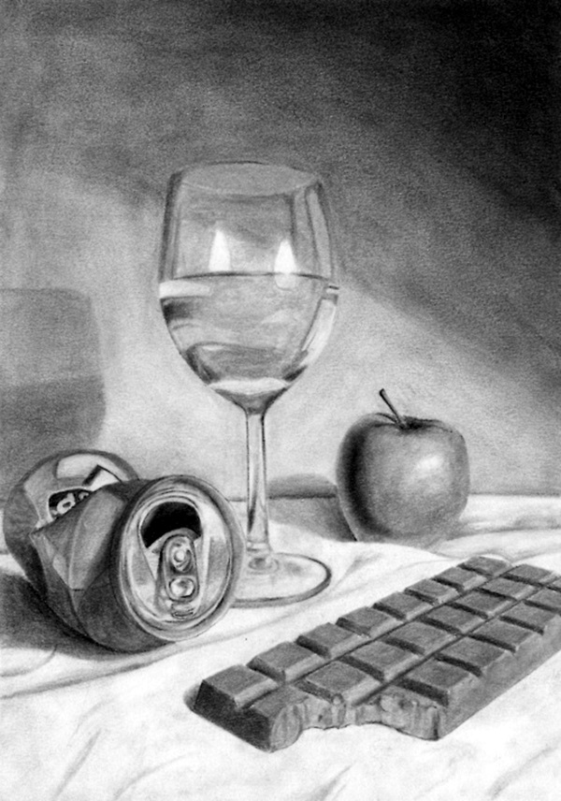
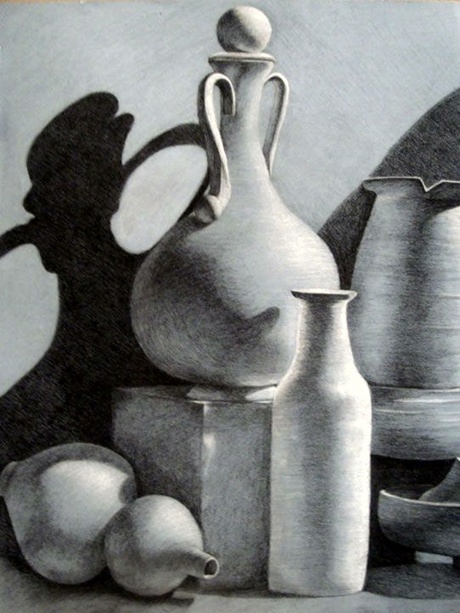
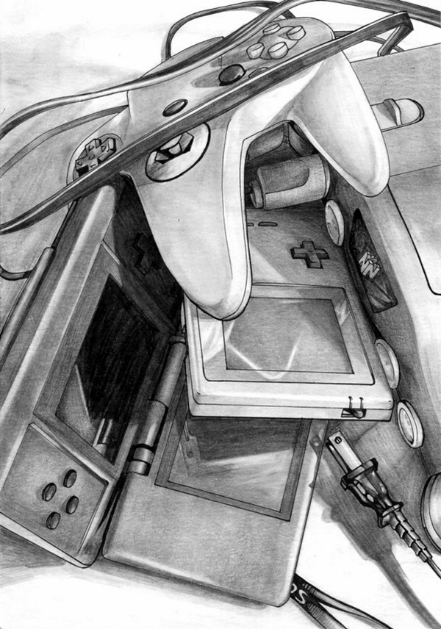
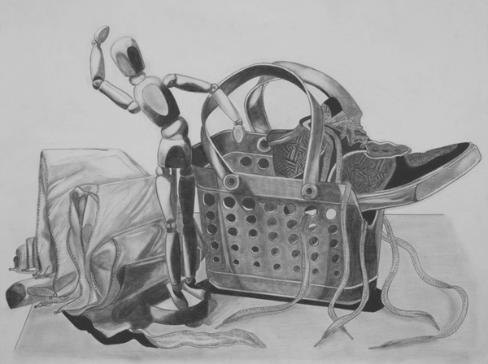
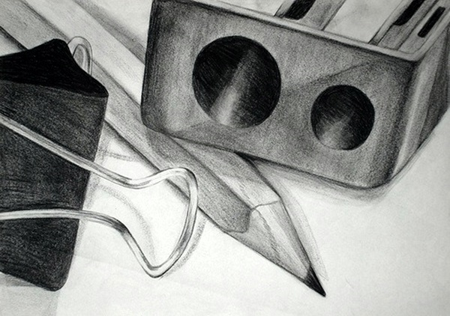
Task 4 – Observational Drawing
Place 3 objects in front of you on the table.
Observe the shape, form, sizes of the objects next to each other, draw what you see. ONLY DRAW WHAT YOU CAN SEE.
Add shading to make your drawing look 3D
Look at the examples on this below to give you ideas and
inspiration

