Slide 1
LO4
Diet Plan
DNA
Write 3 points, what a good diet should look like
Good Progress | Outstanding Progress
Be able to explain the importance of gathering information about a client before creating a diet plan | Outline and explain 2 targets that are clear for your client

Slide 2

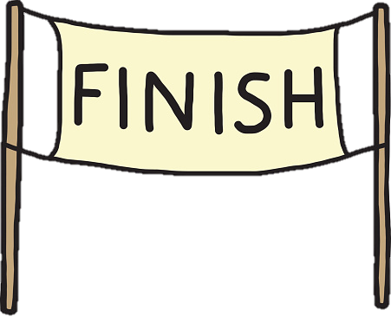


Where we are……..
Year 11
Fitness Unit
Exam
Unit
Nutrition Unit
Body Unit
LO1
LO2
LO3
LO4

Slide 3
LO4 CAU
Details of client
Aims
Goals
Time of year plan
Duration
Needs of the diet (variations of nutrients)
Organisation of diet plan (2 week plan)
Where we
need to get to

Slide 4
Details of client
Why it is important to know you client
Its important to gather information about the client so you know their:
Age
Gender
Religious beliefs
Food budget
Cooking skill
Allergies
This is important so that I know their needs for the diet plan and then I can make sure that this plan is the most effective than it can be and meets their sporting needs.

Slide 5
Examples why for each category
Age
My client is age 16 and is currently preparing for his GCSE exams, this diet plan should help boost his energy levels in school as we can give him more carbohydrates that are slow releasing on heavy days at school to focus.
Cooking Skill
Medium, he has some cooking experience, I will try and keep all preparation of meals to a minimum as much as possible as anything complicated could be too difficult for him and then he might not stick to the plan.
Gender
Male, this means his calories intake needs to be higher than a female (1700 with exercise per day).
Allergies
NUTS: He can eat anything except any type of nuts
Religious beliefs
My client is Muslim and must have halal foods and no pork within his diet.
Sport he does
He does occasional football and likes to play dodgeball also lifts weights in his spare time.

Slide 6
Aim of Diet Plan
An overall aim of a program is a ‘why am I doing it?’
Examples:
Loose weight
Increase muscle
Increase fitness component (aerobic endurance)
Goals of Diet Plan
A Specific goal of the programme that can be measured
Examples:
Increase my energy throughout the days throughout the 2 weeks (feedback from interview)
Increase fitness level on cooper run after 2 weeks (pre test result: 2156m)
Lose 4 kg to increase muscle tone up in 2 weeks

Slide 7
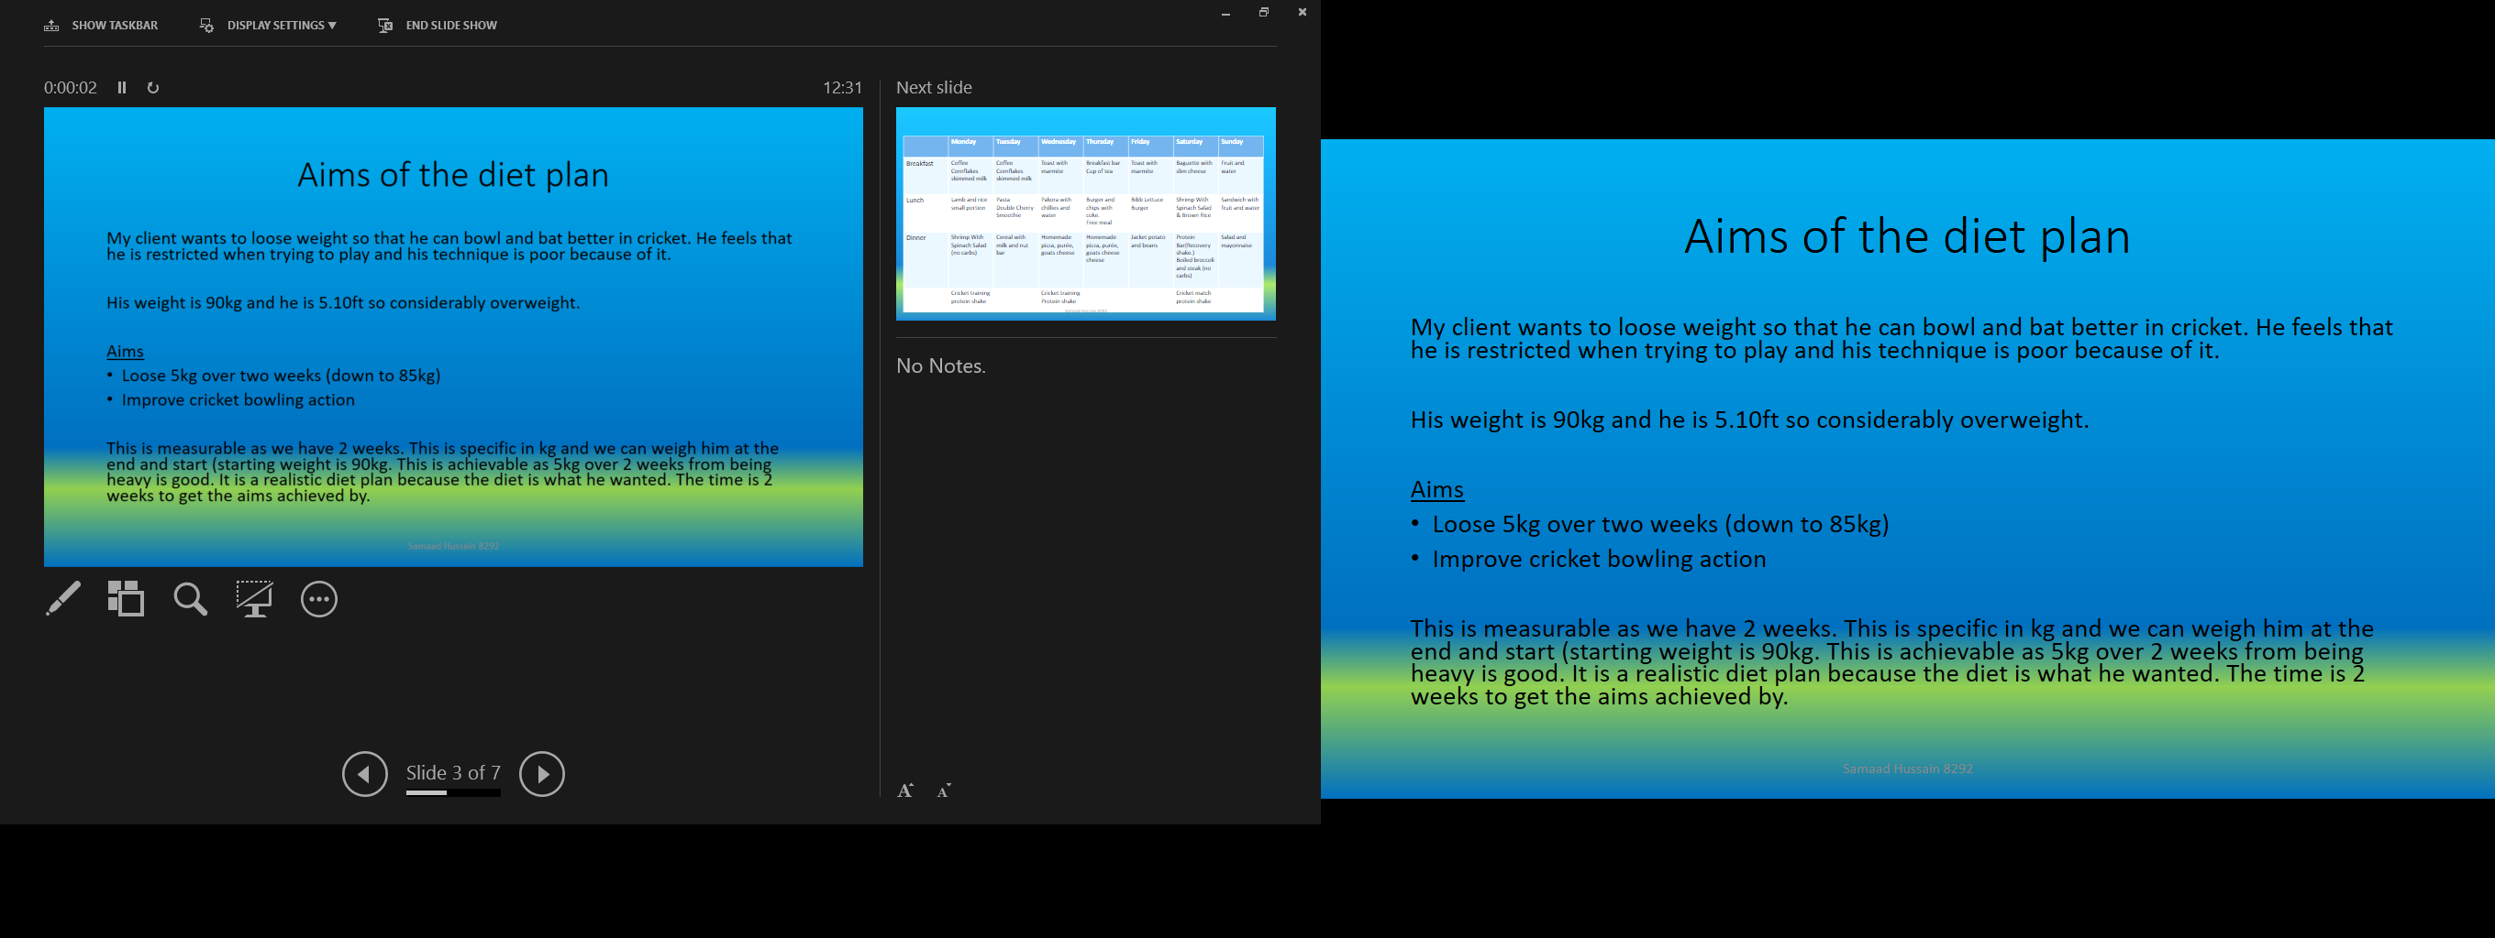
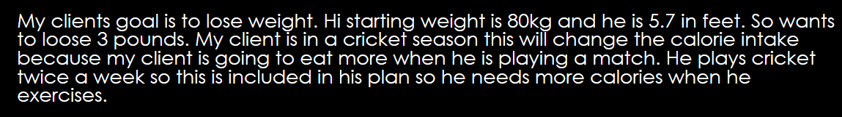

Slide 8
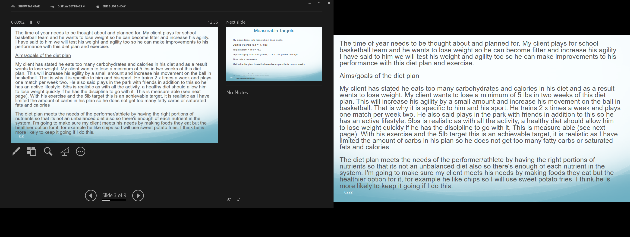

Slide 9
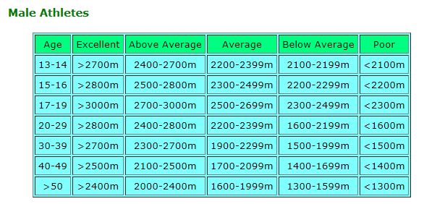
smart TARGETS
Specific
Make sure your goals are precise and stated in performance terms. For instance, if you want to lose weight, your goal might be "to lose 15 pounds in the next 10 weeks.“
Measurable
A goal is measurable when it is easy to determine if it has been accomplished. The weight loss goal listed above is easily measured.
Achievable
One of the biggest mistakes people make while setting goals is that they set unattainable goals. Goals should be set high, but they must also be realistic. A goal to lose 20 pounds in four weeks is both unrealistic and unhealthy.
Relevant
Your goals should be important to you. Don't set a goal just because your friends, family members or exercise partners have set that goal.
Time-Bound
Make sure each goal has a specific time frame for completion. This allows you to easily determine if it has been achieved.
Targets
Increase my energy throughout the days throughout the 2 weeks (feedback from interview)
Increase fitness level on cooper run after 2 weeks (pre test result: 2156m)
Lose 4 kg to increase muscle tone up in 2 weeks
https://www.brianmac.co.uk/gentest.htm

Slide 10
Time of year plan
Is this for pre-season training
During season
Off season
If so this should link to your goals or your calorie limit you may set
Duration
You are creating a 2 week diet plan to improve your performance. Your goals have a 2 week limit. Keep this in mind when setting targets!

Slide 11
Needs of the diet
Your clients lifestyle & goals will determine how many calories they should eat & what nutrients they should have more of.
Consider the following variants
Calories – (lose weight = less, bulk up = more)
Carbohydrates – (more for energy)
Protein – (more for any kind of recovery)
Water – After exercise and 3L per day for all

Slide 12
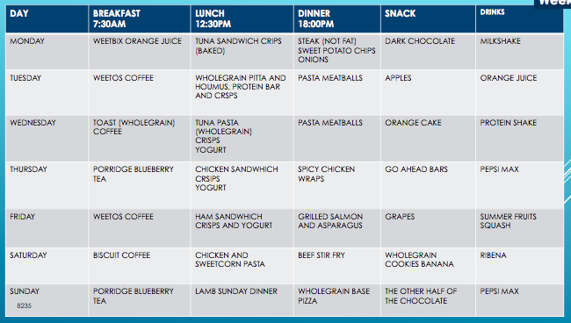
Organisation of the diet plan (2 week plan)
2 week programme
Plan for
  Breakfast
  Lunch
  Dinner
  Snacks
Everyday for
2 weeks!

Slide 14
LO4 CAU
Details of client
Aims
Goals
Time of year plan
Duration
Needs of the diet (variations of nutrients)
Organisation of diet plan (2 week plan)
Evaluation of plan
Slide for each section,
all focussed on your client!

Slide 15
Evaluation of Clients Diet Plan
DNA: List some ideas in how you could find out if a diet programme that you had devised was effective. Eg, measure their body fat before/after programme.
Good Progress | Outstanding Progress
Be able to explain different ways that can help evaluate the effectiveness of the diet plan | Will be able to reference recommendations to the client to help improve the diet plan.

Slide 16
Where we are……..
Year 11
Fitness Unit
Exam
Unit
Nutrition Unit
Body Unit
LO1
LO2
LO3
LO4

Slide 17
Details of client
Why it is important to know you client
Its important to gather information about the client so you know their:
Age
Gender
Religious beliefs
Food budget
Cooking skill
Allergies
This is important so that I know their needs for the diet plan and then I can make sure that this plan is the most effective than it can be and meets their sporting needs.

Slide 18
Aim of Diet Plan
An overall aim of a program is a ‘why am I doing it?’
Examples:
Loose weight
Increase muscle
Increase fitness component (aerobic endurance)
Goals of Diet Plan
A Specific goal of the programme that can be measured
Examples:
Increase my energy throughout the days throughout the 2 weeks (feedback from interview)
Increase fitness level on cooper run after 2 weeks (pre test result: 2156m)
Lose 4 kg to increase muscle tone up in 2 weeks

Slide 19
Time of year plan
Is this for pre-season training
During season
Off season
If so this should link to your goals or your calorie limit you may set
Duration
You are creating a 2 week diet plan to improve your performance. Your goals have a 2 week limit. Keep this in mind when setting targets!

Slide 20
Needs of the diet
Your clients lifestyle & goals will determine how many calories they should eat & what nutrients they should have more of.
Consider the following variants
Calories – (lose weight = less, bulk up = more)
Carbohydrates – (more for energy)
Protein – (more for any kind of recovery)
Water – After exercise and 3L per day for all

Slide 21
Organisation of the diet plan (2 week plan)
2 week programme
Plan for
  Breakfast
  Lunch
  Dinner
  Snacks
Everyday for
2 weeks!

Slide 22
Evaluation of diet plan
Recording outcomes
Comments from performer
Improvements suggestions

Slide 23
Evaluating the effectiveness of your diet plan
Interview your client
(devise around 10-12 questions on how effective your diet plan was)
Weight (compare weight before to weight after, what are losses/gains?)
Measure (using tape measure, to measure size of muscle gain)

Slide 24
Answer these questions when completing your evaluation
Evaluation
Has he noticed any physical changes since starting the diet plan?
Has your client noticed any psychological changes since starting the diet plan?
Does he feel like he has got more energy?
How does he feel after his training sessions?
Does your client feel a difference in his energy levels now, compared to before the diet started?
Does he feel there were a right amount of variation in the diet?
Does your client feel the portion sizes satisfied his energy needs?
How did he monitor his fluid intake?
What was his favourite meal? Why?
Did your client achieve his targets? If so explain by how much
Did your client feel he ate a variety of different meals?
Was there enough food choices to keep him motivated to stay on track?
Did your client feel he could assess the recipes or methods to make each meal?
Do he think he’s improved his cooking skills?
How much weight did he lose or muscle gained?
What were the measurements before and after?
Would he recommend this diet plan? If no please explain
What was his favourite part of the diet plan?
Would he continue eating the foods in the plan?
Can he recommend any changes if a new diet plan was organised/planned?

Slide 25
Answer these questions when completing your evaluation
Evaluation
Has he noticed any physical changes since starting the diet plan?
Has your client noticed any psychological changes since starting the diet plan?
Does he feel like he has got more energy?
How does he feel after his training sessions?
Does your client feel a difference in his energy levels now, compared to before the diet started?
Does he feel there were a right amount of variation in the diet?
Does your client feel the portion sizes satisfied his energy needs?
How did he monitor his fluid intake?
What was his favourite meal? Why?
Did your client achieve his targets? If so explain by how much
Did your client feel he ate a variety of different meals?
Was there enough food choices to keep him motivated to stay on track?
Did your client feel he could assess the recipes or methods to make each meal?
Do he think he’s improved his cooking skills?
How much weight did he lose or muscle gained?
What were the measurements before and after?
Would he recommend this diet plan? If no please explain
What was his favourite part of the diet plan?
Would he continue eating the foods in the plan?
Can he recommend any changes if a new diet plan was organised/planned?

Slide 26
Evaluation
Overall I stuck to the plan well. I achieved my target of increasing energy and toning up with muscle tone. For example I changed the dark chocolate bar in week one to a more impact on weight than their would be fruit. Even though dark chocolate has a lot of benefits there is still more impact on weight than their would be in fruit. Also I changed the snack of sweets In week one which were a treat to a go ahead bar in order to maximise the potential weight loss.
Feedback:
I feel I made a positive start and results were good from my 2 week programme. Family said they could visually see a difference in body tone and more muscle definition. I really enjoyed the plan and said afterwards that I had more energy. Furthermore I think that eating more little and often worked well as they didn’t then binge eat fatty foods in the evenings.
Improvements and adjustments that I would want next time was more variety of meals. For example a lot of the foods were kept the same for breakfast. Also to be more specific on portion sizes and to give a guide the client could use as hopefully this would keep him losing more weight.
Targets evaluation
1. Increase my energy throughout the days throughout the 2 weeks (feedback from interview)
I felt after 3 days of the diet plan that I had more energy which had a positive impact on my performance in cricket and in every day school life.
2. Increase fitness level on cooper run after 2 weeks (pre test result: 2156m)
I increased my cooper run score to 2297 which is great showing fitness progress with this diet plan and my exercise I have been doing. I moved up a normative data category to below average also.
3. Lose 4 kg to increase muscle tone up in 2 weeks
I lost 3kg which means I didn’t improve this target which was a same. Might have been because I ate a lot of carbohydrates each day perhaps I would reduce the portion sizes.

Slide 27
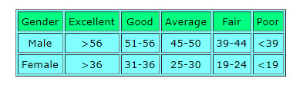
Timing of dietary intake
I have made sure that my client has a higher calories intake on days that he does resistance training. This will make sure that he can maintain muscle and hopefully insure that he does not lose muscle size and make reversibility happen. With more calories on a gym day this means his muscles will get the nutrients they need to adapt and grow.
Testing results after nutrition diet plan
I have made sure that my client has a higher calories intake on days that he does resistance training. This will make sure that he can maintain muscle and hopefully insure that he does not lose muscle size and make reversibility happen. With more calories on a gym day this means his muscles will get the nutrients they need to adapt and grow.
Hand grip dynamiter score pre diet plan : 42
Normative data: average
Hand grip dynamiter score after diet plan : 52
This shows there was an increase of 10kg on this fitness test showing an increase in strength. The training combined with my diet plan has given him enough nutritional clue to get stronger and make progress in the areas he wants to develop. This is great as I know I have used the right amount of foods.
https://www.brianmac.co.uk/grip.htm

Slide 28
How to evaluate the effectiveness of the diet plan
My client gave me feedback that the portion sizes were good, however he felt hungry a lot so I maybe could have made the portion sizes even bigger on gym days. This means that he could lose weight in the areas of his body that he wanted to but he might not add enough muscle on in the other areas. Next time I did this I could find out before hand what an average plate or dinner looks like and then base my nutrition plan off of that. My client felt at the 2 week halfway stage that they were making good progress in terms of strength gained. He also said that he was having a little bit of trouble sleeping but anything apart from that the energy what I gave them was good. The sleep could have been because sometimes the dinner portions were quite high. He also said that his energy levels were good but he ate late in the evening. If I were to plan this programme again I would make sure that maybe I could add the times he should eat each meal so that his metabolism would work really well and maximize his results.
He said he wasn’t getting enough food on Tuesdays, maybe this is because of his training on a Tuesday so I could uptake his calories. My client said it was a bit hard to get used to but after it got a lot easier and he said he then found it useful as he started to put on muscle slowly. I would put more food on the diet plan for Tuesday and show how much protein to drink on the night to make the most of his training.

Slide 29
What my client gave as feedback
My client felt that he could work harder and had more energy in the days, he said he struggled in the evenings but liked the freedom to choose whatever snack he could have from his snack list each day. He said if we did this plan again I should add more snacks to this list so that he could change what he more as I had 7 snacks in there. This is fair and I agree with it.
My client said that since being on the diet his training is feeling easier because of the amount of nutrients he’s getting making his body feel better. My client said after training he feels better about himself because he has pushed himself to the limits but he feels tired after training. My client said no he was not tired or bored of eating the same foods because he enjoys these foods and will continuing with some of the meals after this diet plan has finished which shows I have made a positive impact on his lifestyle which is good.
My client did say that he felt the he had enough variety of dishes but it was good I limited his portion size as he felt someone with less control could have made the portions too big and then gained weight which is not what we would have wanted to do.

Slide 30
Targets reflection
Target: loose 5lbs in two weeks.
Starting wight: 173lbs, Final weight: 169lbbs, bs lost: 4lbs, Agility score: 17.1, Difference:1.4 seconds
This shows that my client lost 4lbs and decreased his Illinois agility score which his good. Unfortunately he did not achieve his target weight but was only 1lbs off it. This shows that he was going in the right direction and would achieve it with another couple of days on this diet plan. He did reduce his Illinois agility test score which will help increase his performance dribbling in basketball which is good.
Where did it go wrong?
After speaking to my client after the plan I think the problem was that I planned 3 large meals per day in terms of content and he often ate the largest meal in the evening. I think I would need to spread his foods out so he does’t eat too much at one time an then his body can digest it all throughout the day and not get too much food. I would also be more specific in the plan and make sure portion sizes and volume of foods was clear so they cannot eat too much. It is not a complete failure this plan as he is so close but I think with these bits to change he would definitely meet his diet plan goals.
Gender Excellent Above Average Average Below Average Poor
Male <15.2 secs 15.2 - 16.1 secs 16.2 - 18.1 secs 18.2 - 19.3 secs >19.3 secs
Female <17.0 secs 17.0 - 17.9 secs 18.0 - 21.7 secs 21.8 - 23.0 secs >23.0 secs
https://www.brianmac.co.uk/illinois.htm

Slide 31
My client found out his weight did reduce and he met his aims within the diet plan. He found his training easier because he had enough energy from his plan which means my diet plan was planned out well. I put a good variety of foods but he wanted more days where he could eat some more fatty foods s a reward. My client said that sometimes he would feel like he has overeat which means this might have stopped him from losing more weight. My client met all of aims because my diet plan was well planned.
If I were to run another diet plan I would add in some type of cheat days. Cheat days are good to have because they allow you to keep your diet plan and give you freedom to change it on your free days sand then get back to eating well.
High protein foods- I tried to make him have high protein foods on my days that he would training days because it helps my muscles grow an examples of high protein foods are chicken breast, eggs and milk .
The diet plan was suitable for sporting performances because it gave him more energy in cricket so he can bowl faster and run faster between the wickets and hit more boundaries.

Slide 32
Evaluation of clients training programme
In the diet plan I included a lot of salad meals and some meals without carbohydrates in them. This was a to make sure he would loose weight. My client said before this that he used to make his portions large on all meals. The reason I removed some carbs from only some meals is that if he loaded his plate with other nutrients instead of carbohydrates he could lose weight and get full. He said he was happy with this in our after plan interview.
Reflection on results
My client lost 7kg over two weeks. This means he achieved his first aim. This was good as he must have stuck to my diet plan and it was a realistic target which was also good. I am sure he could have lost more but I am happy with how much weight he lost now. He also said that he was happy with the variety of foods as he found it interesting but some of the meals did not change. Week 2 had the same lunches all week.
His second aim was to improve his bowling action. This was because his stomach was large and then he felt he could not rotate on the bowling as much as he should. This I could not measure and he felt it had not change much. I think I set this target with not enough time to get there so if I did this I could set a bigger time to make sure I got it for him.

Slide 33
A perfect cheat day would be having burger and chips as having not healthy for one day out of 7 would not effect you that much. They are good to have as they allow you to keep to your diet plan and freedom to change it on cheat days. My client said he was pleased that I put these in his plan as he did not think he could have stuck to it without something like this to look forward to in his diet.
My client also said that he got tired quicker (fatigue) when he was bowling in cricket. This is because I made some of his meals without carbohydrates. I think this sometimes (not all the time) without enough energy stores to perform. If I were to do this plan again I would go and add strong carbohydrate related meals on all exercise days as I did not notice I had let these days be the same.

Slide 34
LO4 CAU
Details of client
Aims
Goals
Time of year plan
Duration
Needs of the diet (variations of nutrients)
Organisation of diet plan (2 week plan)
Evaluation of plan
Slide for each section,
all focussed on your client!

