Slide 1
80/20 – THINK! What do you NEED to cover with your set
Grade | Objective | Outcomes
1-3 | Describe and explain the role and interactions of the hormones oestrogen, progesterone, FSH & LH during the menstrual cycle. | Identify the names of hormones needed in the menstrual cycle
4-6 |  | Describe the menstrual cycle, including the role of hormones
7-9 |  | Explain the interactions between hormones involved in the menstrual cycle

Slide 2
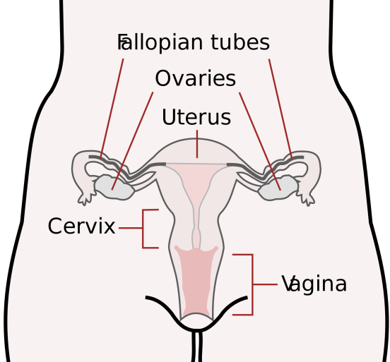
The menstrual cycle
Do now activity:
Name the four hormones involved in the menstrual cycle and identify where they are released from
Describe the role of each of these hormones
Explain how the levels of each of these hormones change throughout the menstrual cycle
Notes:
Image by CDC, Mysid [Public domain], via Wikimedia Commons

Slide 3
Progress indicators
GOOD PROGRESS:
Identify the names of hormones needed in the menstrual cycle
Describe the menstrual cycle, including the role of hormones
OUTSTANDING PROGRESS:
Explain the interactions between hormones involved in the menstrual cycle

Slide 4
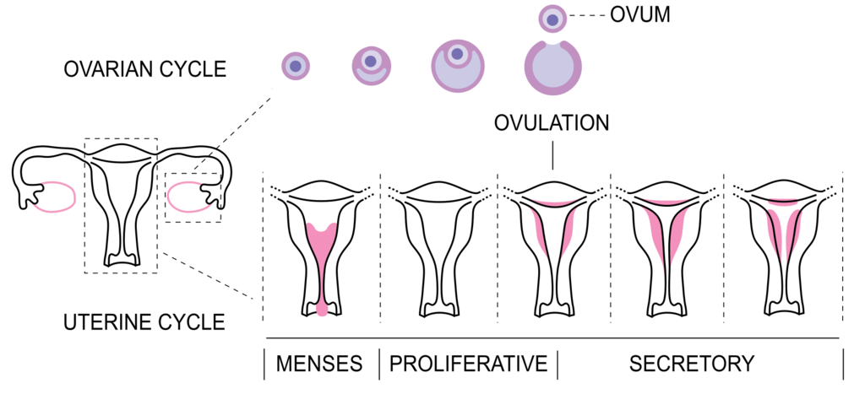
A woman’s menstrual cycle is a good example of control by hormones, the level of hormones rise and fall in a pattern which affects the way her body works.

Slide 5
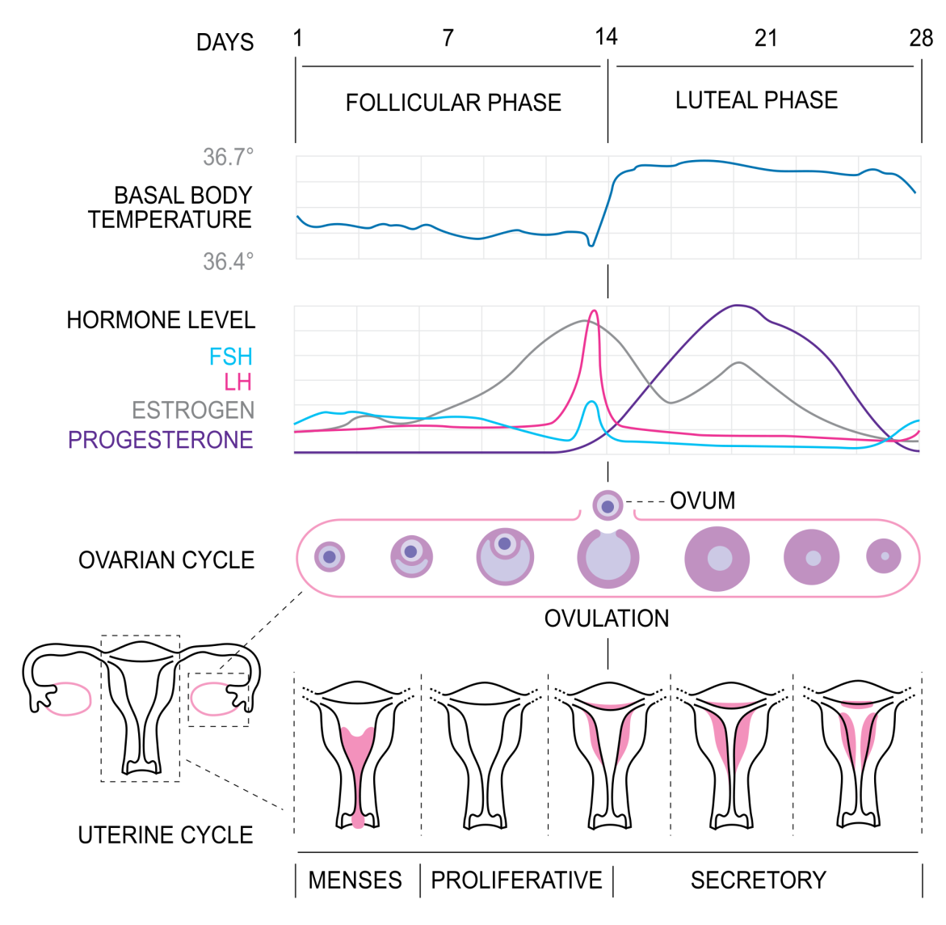
Task: Complete the questions on your worksheet by watching the video.
http://www.nhs.uk/Video/Pages/Menstrualcycleanimation.aspx
Notes:
Image by Isometrik (Own work) [CC BY-SA 3.0 (https://creativecommons.org/licenses/by-sa/3.0) or GFDL (http://www.gnu.org/copyleft/fdl.html)], via Wikimedia Commons

Slide 6
Self-assessment:
Every 28 days

Slide 7
uterus
pituitary gland
Ovulation is the release of eggs from the ovaries
Oestrogen
It breaks down and is released through the vagina, this is a period

Slide 8
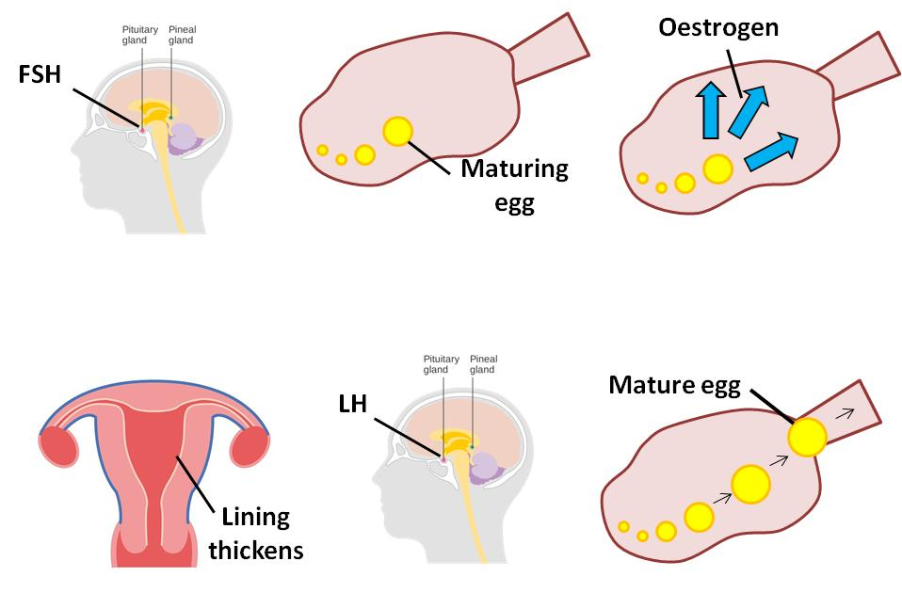
This diagrams below show the sequence by which hormones are released in a woman to control her menstrual cycle. Think > Pair > Share: Can you describe what is happening?
2.
3.
1.
4.
6.
5.

Slide 9
Task: Complete the boxes underneath the diagrams to show the stages of the menstrual cycle:
Oestrogen is released from the ovaries
The lining of the uterus starts to thicken
A mature egg is released from the ovary – this is ovulation
FSH causes the egg to mature in the ovaries
LH – released from the pituitary gland
FSH is released from the pituitary gland in the brain

Slide 10
Self-assessment:
FSH is released from the pituitary gland in the brain
FSH causes the egg to mature in the ovaries
Oestrogen is released from the ovaries
The lining of the uterus starts to thicken
LH – released from the pituitary gland
A mature egg is released from the ovary – this is ovulation

Slide 11
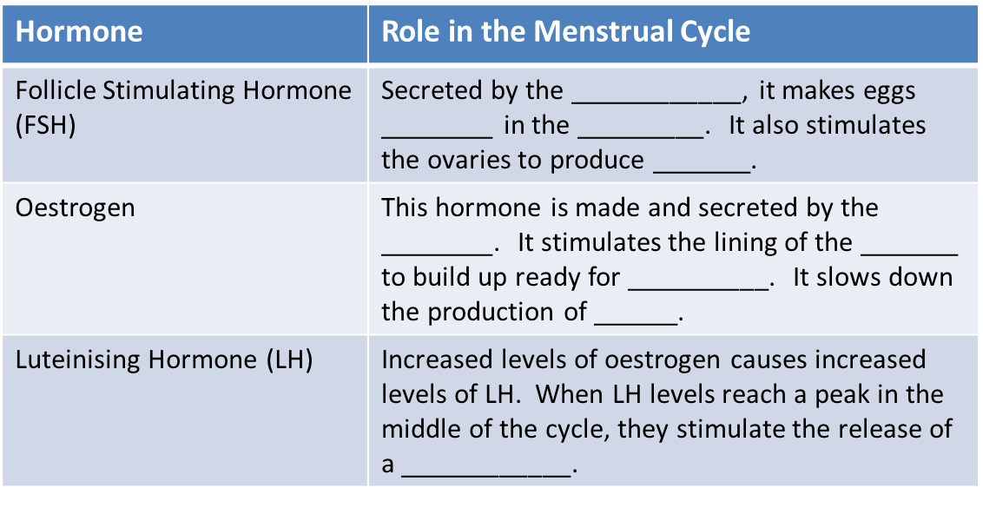
Task: Complete the table to describe the role of each of the following hormones:

Slide 12
Self-assessment:
pituitary gland
mature
ovaries
oestrogen
ovaries
uterus
pregnancy
FSH
mature egg

Slide 13
True or False?
FSH stands for Follicle Stimulating Hormone
Ovaries are a type of nerve
FSH is released from the Pituitary Gland
Oestrogen is released from the ovaries
The menstrual cycle is about 32 days
True
False
True
True
False

Slide 14
Plenary: Exam-style Question
Progesterone
Oestrogen
Hormone level
0 4 8 12 16 20 24 28 32 36 40
Weeks of pregnancy
1. Describe the patter of progesterone and oestrogen levels from week 4 to week 36 of pregnancy.
(4 marks)

Slide 15
Any four (must include at least one statement about progesterone and oestrogen):
Progesterone starts being produced at 4 weeks
From four weeks the level of progesterone begin to increase
Oestrogen is at a constant level from 0 – 20 weeks
From 20 weeks oestrogen begins to increase
From 20 – 36 weeks the level of oestrogen rises more steeply than progesterone
Self-assess your work

Slide 16
Resources

Slide 18
Notes:
Pituitary gland by Cancer Research UK uploader (Own work) [CC BY-SA 4.0 (https://creativecommons.org/licenses/by-sa/4.0)], via Wikimedia Commons

Slide 19
