Slide 1
DO NOW ACTIVITY
Buzz and Go
Grade 3+4 = state
Grade 5 = describe
Grade 6 + = explain why it is happening/ needed

Slide 2
DO NOW ACTIVITY
Buzz and Go
Grade 3+4 = state
Grade 5 = describe
Grade 6 + = explain why it is happening/ needed

Slide 3
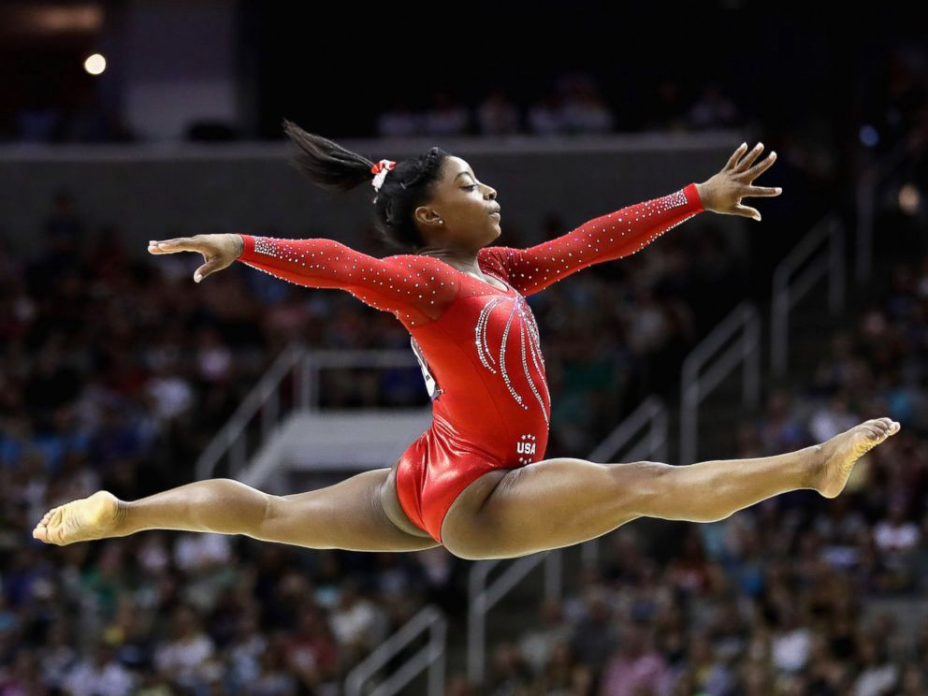
DO NOW ACTIVITY
Buzz and Go
Grade 3+4 = state
Grade 5 = describe
Grade 6 + = explain why it is happening/ needed

Slide 4
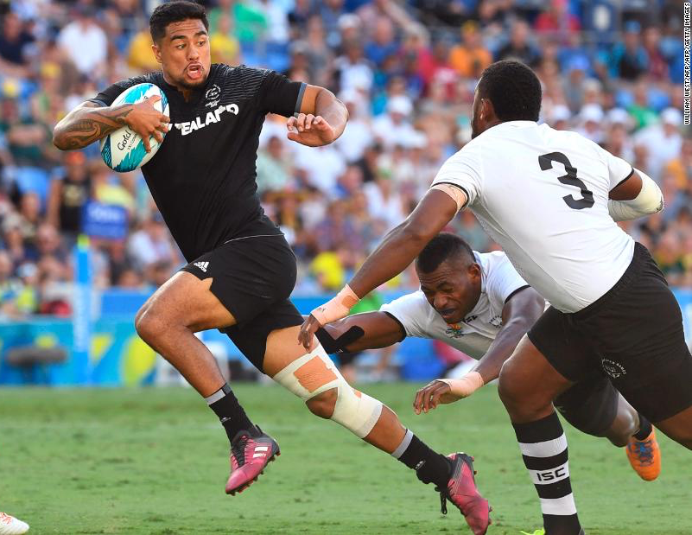
DO NOW ACTIVITY
Buzz and Go
Grade 3+4 = state
Grade 5 = describe
Grade 6 + = explain why it is happening/ needed

Slide 5
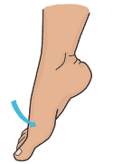
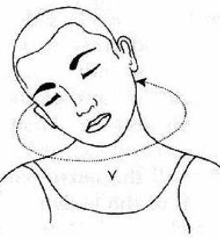
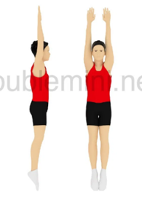
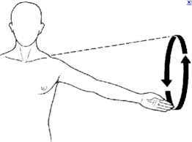
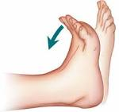
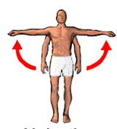
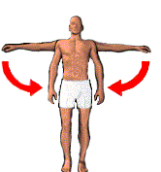

Slide 6
Rotation
Plantar Flexion
Flexion
Plantar Flexion
Adduction
Circumduction
Abduction
Dorsi-flexion
Adduction
Extension
Abduction

Slide 7
Tendons, Ligaments and Cartilage
Monday 7th October 2019
Progress indicators
 | Good progress | Outstanding progress
3+4 | Be able to state the functions of the tissues named. | Be able to explain the functions of the tissues
5+ | Be able to explain and then describe the importance of the tissues. | Link the functions of the tissues to sporting actions using key words from previous lessons (bones, joints, movements)

Slide 8
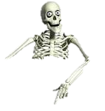
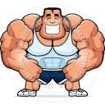
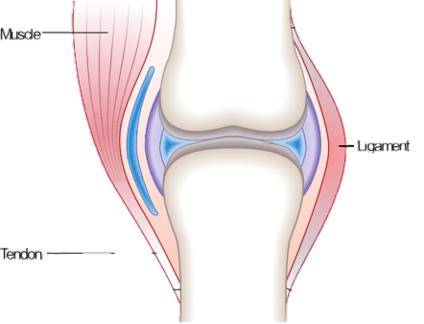
Tendons
Use a whole page and copy this into your book making the key works STAND OUT
Ligaments
Cartilage
Ligaments
Cartilage

Slide 9
Tendons
Use a whole page and copy this into your book making the key works STAND OUT
Ligaments
Cartilage
Muscle – Bone
Bone - Bone
Care
Cartilage (which is smooth) prevents bones from rubbing together and reduces friction
Ligaments
Like to Like
Same to Same
A tendon is a fibrous tissue which connects the muscle to bone.
Tendons are strong and flexible.
A tendon aides movement.
A Ligament is a fibrous tissue which connects bone to bone in a joint.
A Ligament is strong and flexible.
A Ligament keeps a joint stable and holds structures together.
Cartilage

Slide 10
TASK
Complete the table
Tendon | Ligament
Connective Tissue | Connective Tissue
Connects __________ to bone | Connects ____________ to bone
Strong | __________
__________ | Flexible
Aides ___________ | Keeps Joint__________
Movement
Muscle
Bones
Flexible
Stable
Strong

Slide 11
Check your table
Tendon | Ligament
Connective tissue | Connective tissue
Connects MUSCLE to bone | Connects BONE to bone
Strong | STRONG
FLEXIBLE | Flexible
Aides MOVEMENT | Keeps joint STABLE
Green pen = corrections

Slide 12
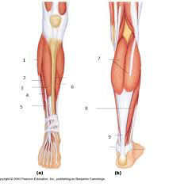
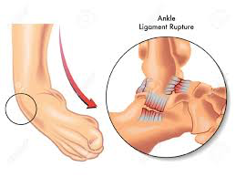
Tendon or Ligament?

Slide 13
Tendon or Ligament?
Tendon
Tendon
Ligament
Ligament
Ligament
Tendon
TIP = IF YOU CAN SEE SOME MUSCLE ATTATCHED TO IT = TENDON

Slide 14
TASK
Using the diagrams describe a bicep curl. Use the ALL the keywords below (underline them in your sentence when you have used them), think about the role of the muscle, tendons, cartilage and ligaments.
Keywords (*these are not in the order you need to write them in)
Tendon, contracts, relaxed, flexion, extension, pulls, stable, bicep, Tricep, forearm (radius and ulna) ligament, cartilage

Slide 15
Question: How are the ligaments and tendons helping us kick this ball?

Slide 16
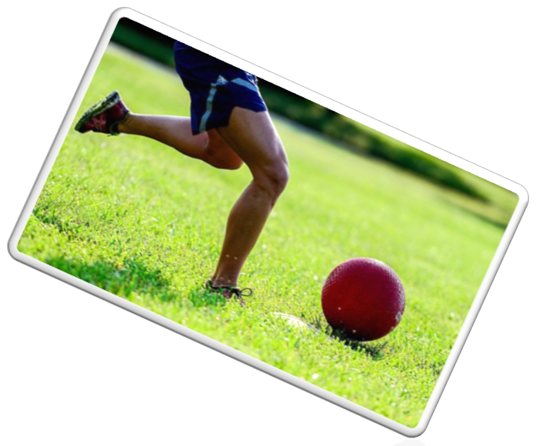
How are the ligaments and tendons helping us kick this ball?
Name:
Name:
Name:
Name:

Slide 17
Tendons, Ligaments and Cartilage
Progress indicator review …
Progress indicators
 | Good progress | Outstanding progress
3+4 | Be able to state the functions of the tissues | Be able to explain the functions of the tissues
5+ | Be able to explain and then describe the importance of the tissues | Link the functions of the tissues to sporting actions using key words from previous lessons (bones, joints, movements)
4
6
In your books write:
I THINK I HAVE MADE ________ PROGRESS (grade ____) BECAUSE__________

Slide 18
Homework:
Complete the tendons and ligament worksheet

Slide 19
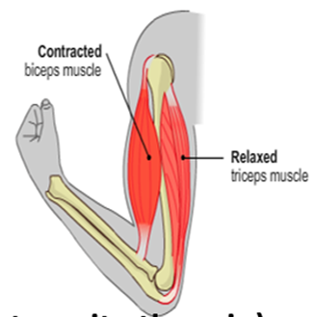
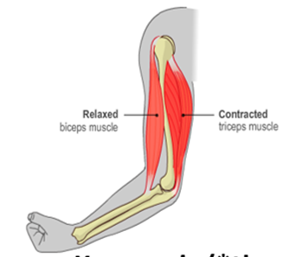

Slide 20
Tendon | Ligament
Connective Tissue | Connective Tissue
Connects __________ to bone | Connects ____________ to bone
Strong | __________
__________ | Flexible
Aides ___________ | Keeps Joint__________
Tendon | Ligament
Connective Tissue | Connective Tissue
Connects __________ to bone | Connects ____________ to bone
Strong | __________
__________ | Flexible
Aides ___________ | Keeps Joint__________
Stable
Movement
Stable
Muscle
Strong
Movement
Strong
Bones
Flexible
Muscle
Bones
Flexible
Tendon | Ligament
Connective Tissue | Connective Tissue
Connects __________ to bone | Connects ____________ to bone
Strong | __________
__________ | Flexible
Aides ___________ | Keeps Joint__________
Tendon | Ligament
Connective Tissue | Connective Tissue
Connects __________ to bone | Connects ____________ to bone
Strong | __________
__________ | Flexible
Aides ___________ | Keeps Joint__________
Stable
Movement
Strong
Movement
Strong
Muscle
Bones
Flexible
Stable
Muscle
Bones
Flexible

