Slide 1
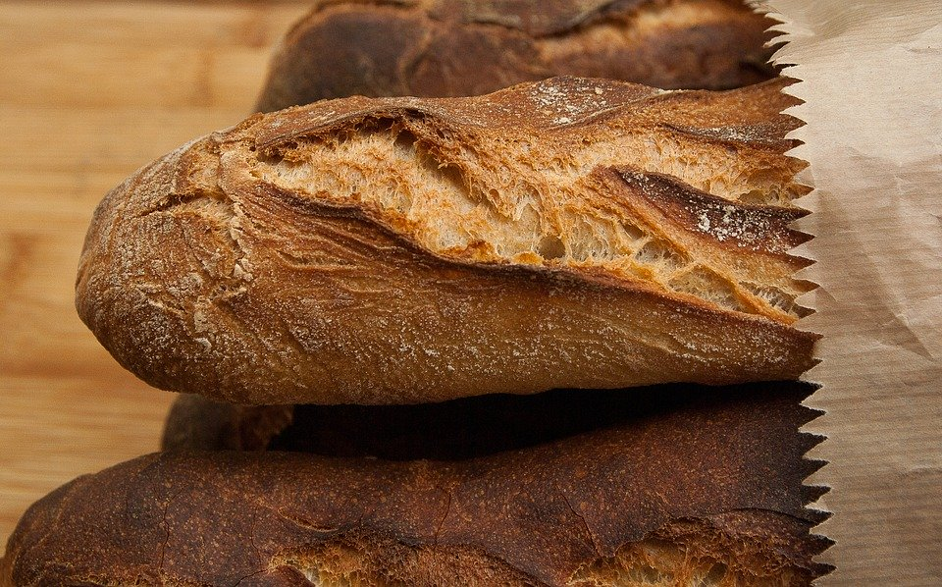
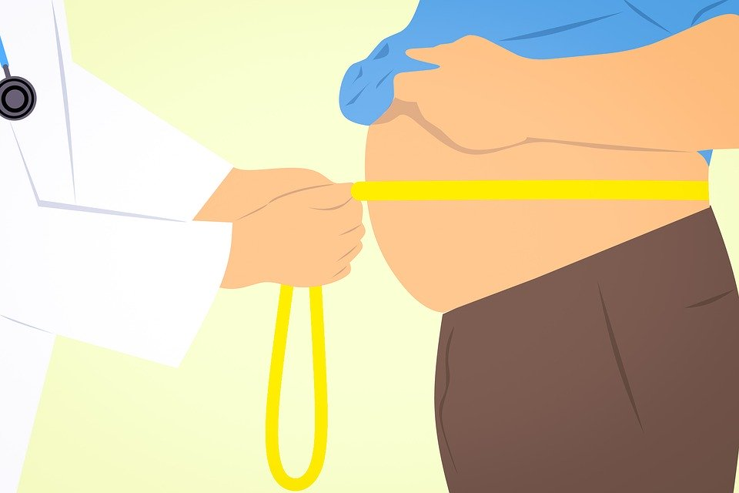
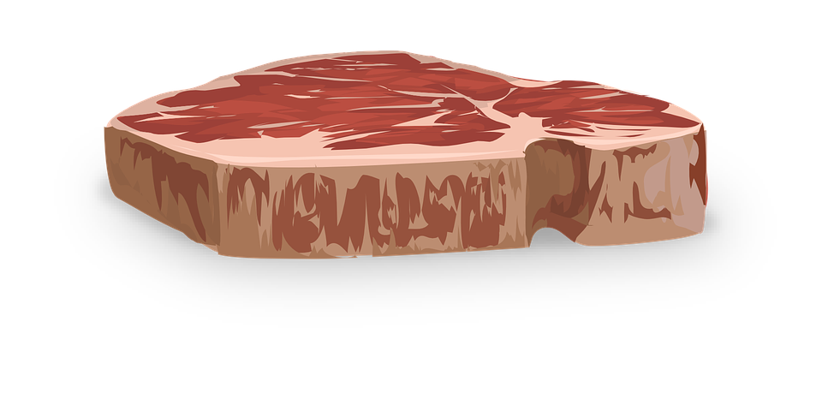
Unhealthy Diet
Do now activity: Which type of nutrients do we need more of? And why?

Slide 2
Progress indicators
GOOD PROGRESS:
Recall some health issues caused by an unhealthy diet
Describe the effects of some health issues caused by an unhealthy diet
Calculate the energy requirements of different people
OUTSTANDING PROGRESS:
Discuss the effectiveness of various diet plans

Slide 3
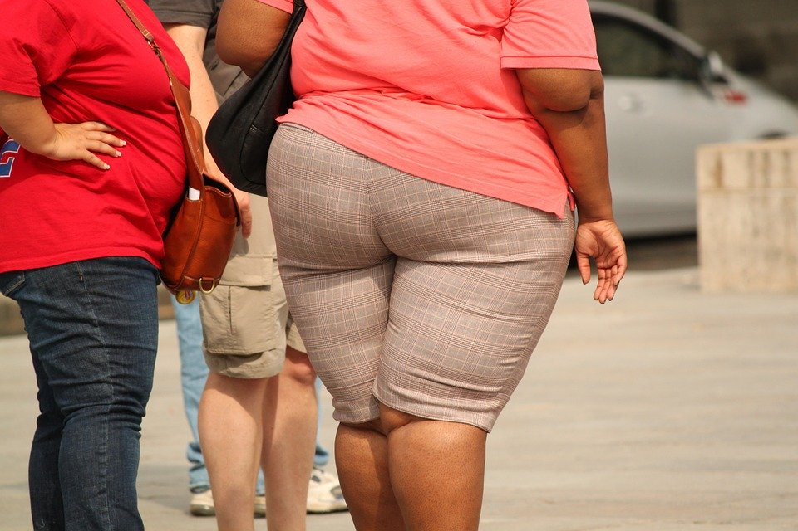
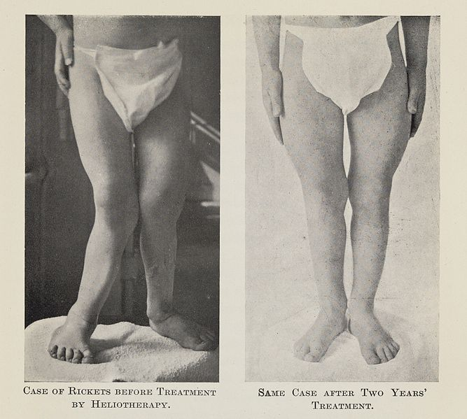
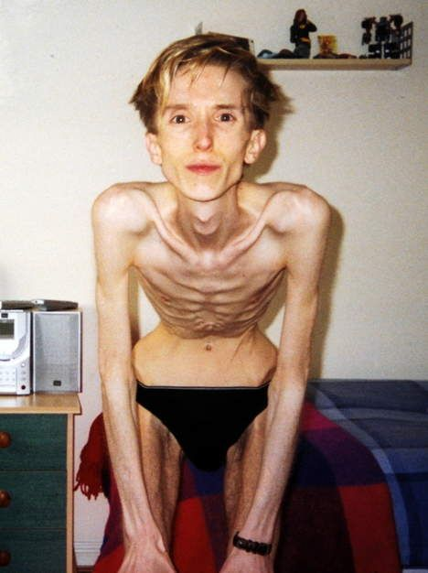
Think > Pair > Share: Why do these people look so different?
Are they all malnourished?
Notes:
Rickets Image: See page for author [CC BY 4.0 (https://creativecommons.org/licenses/by/4.0)]

Slide 4
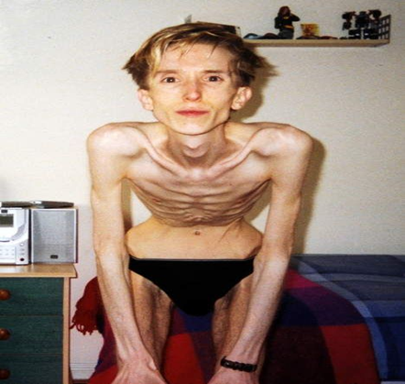
If you take in more energy than you use, the excess is stored as fat.
Overtime you can become overweight or even obese.
This can lead to serious health problems.
Arthritis
Type 2 diabetes
Heart disease
Combination of not eating enough so not getting enough energy and possibly too much exercise.
This girl has rickets – a disease you can get if you don’t receive enough vitamin D in your diet.
Notes:
Rickets Image: See page for author [CC BY 4.0 (https://creativecommons.org/licenses/by/4.0)]

Slide 5
Task: Write as many points as possible for how people might lose weight.
How do people lose weight?

Slide 6
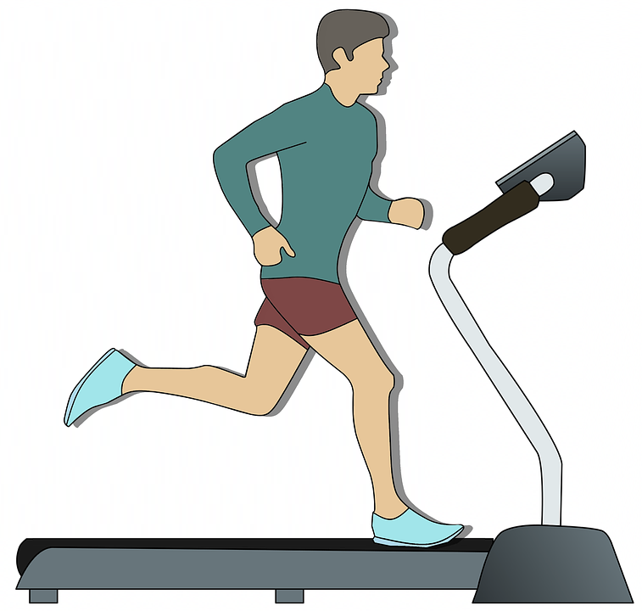
Self-assessment:
Cut out fatty/sugar foods
Control portion sizes
How do people lose weight?
Exercise more regularly
Regulate food intake and exercise so no excess energy is taken on as stored as fat.

Slide 7
Task: Copy and complete the following sentences:
If you take in more ________ than you
use, the excess is stored as ______. If you eat too much over a long period of time, you will eventually become _______. To lose weight you need to eat _______ and exercise _______.
more
obese
energy
fat
less
If finished: One slimming programme controls your food intake, another controls your food intake and has an exercise programme. Which one would be the most effective and why?

Slide 8
Self-assessment:
If you take in more energy than you
use, the excess is stored as fat. If you eat too much over a long period of time, you will eventually become obese. To lose weight you need to eat less and exercise more.
Answer: A slimming programme which controls your food intake and has an exercise programme is the better option. As the person will be burning excess energy by exercising as well as ensuring they do not intake a surplus of food, which would then be stored as fat.

Slide 9
Task: Use your planner cards to identify which ones are true or false:
Carbohydrates, fats & proteins release the energy you need to live
You need large amounts of vitamins and minerals in your diet
A teenager needs less energy than a 70-year old man
Metabolic rate is the rate of chemical reactions in your cells
If someone eats more food than they need this is a form of malnourishment
The best way to lose weight is just by doing more exercise, it doesn’t matter about the amount of food you eat.
TRUE
FALSE
FALSE
TRUE
TRUE
FALSE

Slide 10
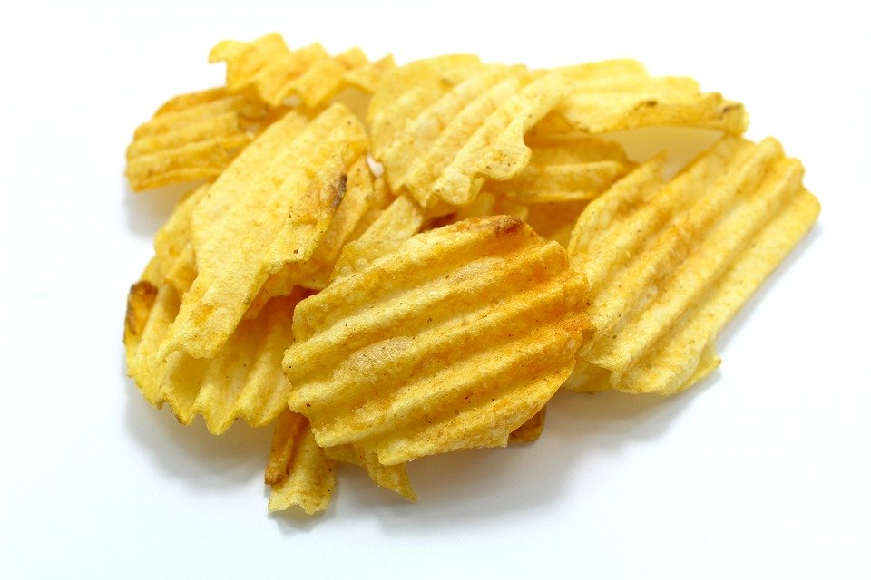
How much fat do you eat?
Score one point for each ‘yes’
Do you:
Eat fried food every day (such as crisps, chips or other food fried in fat)?
Eat fast food like take-away or ready meals twice or more a week?
Use whole milk rather than skimmed or semi-skimmed?
Spread butter or margarine thickly on bread (so the bite marks show)?
Eat the fat on meat?
0–1 very good, your diet is likely to contain a healthy amount of fat
2–3 not bad, but your diet could probably be healthier
4–5 probably not very healthy (depending on quantities)

Slide 11
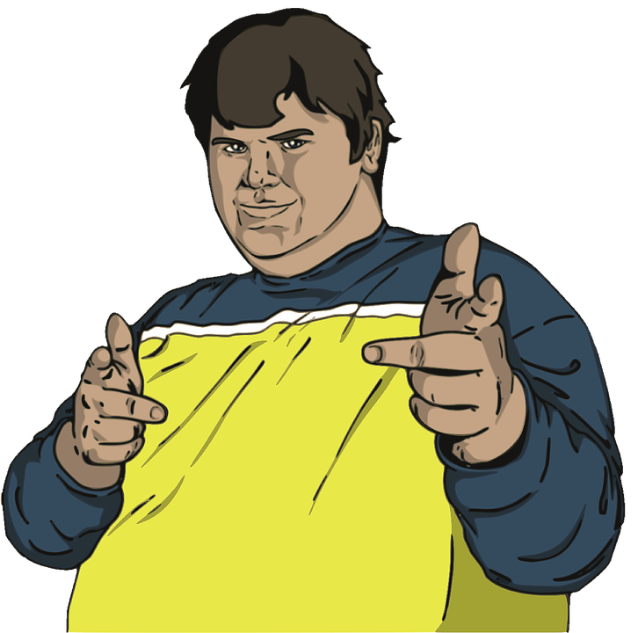
Starting weight: 115kg (18 stone)
Height: 170cm (5 foot 7 inches)
Target weight: ??
Favourite meal: Chinese takeaway
Vices: Drinking alcohol, smoking
Hobbies: Watching football matches, playing darts.
Johnny V
Task: Write a letter to Johnny V to give him some advice on how to lose weight and why it is so important to his health that he does so.
You will need to:
Give some information about the health problems caused by being overweight.
Explain some methods he could employ to lose the weight.

Slide 12
Plenary: Anagram challenge:
Task: Unscramble the following words to reveal 6 key words from the lesson today:
hneomdulsrai
pnierto
eoystbi
bfrie
anmviti
linamer
Malnourished
Protein
Obesity
Fibre
Vitamin
Mineral
Extra Challenge: Come up with a definition for each of the words once you have unscrambled them!
Notes:
Malnourished, protein, obesity, fibre, vitamin, mineral.

