Slide 1
Lesson Four
C/W Date
Lesson Title: The Curse
Lesson Focus: - Extract main points and information by using a range of strategies
Progress indicators:

Slide 2
DNA – using your knowledge, what do you think ‘The Hound of the Baskervilles’ is about. Write down your answer.
Challenge – Make a prediction about the plot. We will come back to this to see if your prediction was right!

Slide 3
Task - Word Consciousness
1) Please copy this out. If you are using your exercise book, this should be in the back.
2) Please complete this column by putting the definitions into your own words AND coming up with synonyms*. You saw and copied an example of how to do this in lesson 1.
*synonym means alternative words
Word and definition | Your definition or synonyms
Resignation (Noun)- an act of resigning from a job or office. 2 - the acceptance of something undesirable but inevitable.
Inevitable (noun) - a situation that is unavoidable (adjective) - certain to happen, unavoidable
Inept (adjective ) - having or showing no skill

Slide 4
Learning Journey
All throughout this week we have been building up our ability to deduce and infer by looking at the small specific clues such as key props, the writer himself and the time the text was written.
Today we are going to develop this further by looking at longer sections of the story and then seeing what we can infer from them.
This will help us to build up our ability to read longer texts and infer from them.

Slide 5
Task: Read – Chapter 2

Slide 6
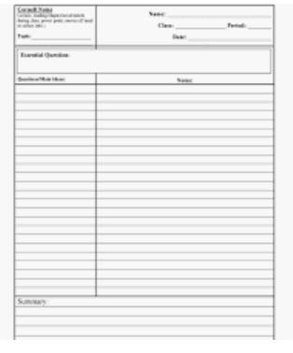
Cornell Notes
Make some notes about chapter 2.
If you aren’t sure how to do this then watch the video to help you.

Slide 7
Read through this to check your understanding of chapter two. Chapter Two Plot Summary – the Curse
We are told that Holmes' help is urgently required and we are introduced to the ‘curse’ of Baskerville Hall.
The curse stems from Hugo Baskerville, a wealthy land-owner from many years back who was a ‘mean, course and violent man’ who had a ‘mad streak in him’.
Hugo is said to have fallen in love with a farmer’s daughter who lived near the farm, but she avoided him. He responded by kidnapping her and locking her in the attic, but she escaped and ran back across the moor towards home. When he found she had escaped he cried out that ‘he would give his soul to hell, if only he could catch ‘the wench’’.
His friends suggested setting the dogs after her and Hugo gave them her handkerchief to catch the scent and then set them lose. Hugo followed on his stallion.
When Hugo’s friends finally went out after him, they passed a shepherd who insisted he had seen the girl being pursued by the dogs but that he has also seen Hugo, on his horse, being pursued by a dark hound of hell.
Eventually the body of the girl was found – she had died of fright and Hugo was dead next to her with a great hound plucking at his throat.
The curse is that the hound has cursed the family and that all the subsequent owners of the hall have died sudden and horrible deaths.

Slide 8
Chapter Two Plot Summary – the Curse
Once Holmes knows of this curse we are introduced to the main problem that the doctor has for Holmes to solve.
We are told that Sir Charles, the most recent owner of Baskerville Hall, has also recently died a sudden and suspicious death and around his body were the footprints of a large hound type animal…

Slide 9
Task: Sum it up … Answer in full sentences:
Who – Who is Hugo Baskerville?
What – What is the Curse? How would the audience react to this?
Where – Where was Sir Charles Baskerville found?
When – When was the manuscript written and what has happened recently that has worried Doctor Mortimer?
Why – Why does Holmes dismiss the curse as “an old fairy tale”?
How – How might Holmes and Watson feel at the end of this chapter? Why?

Slide 10
Investigating the Characters
What kind of person would carry these items in their pocket?

Slide 11
Task: Have a go at playing detective!
Read the quotes from the first two chapters and write down what they show about the character of either Holmes or Watson... or both!
Each quote is numbered so you can just write down the number. You do not need to copy out the quote unless you want to.

Slide 12
1
“I am not usually a nervous man, but last night I woke up screaming”.
Watson pg 11

Slide 13
“I would agree and congratulate you. You have only missed a few little things”.
Sherlock to Watson pg 15
2

Slide 14
3
“Without a challenge, he was like a champion race horse, kept locked in its stable”.
Watson on Holmes pg 13

Slide 15
4
“Early 18th century” stated Holmes, matter-of-factly. “If you call that old”.
Holmes to Dr Mortimer pg20

Slide 16
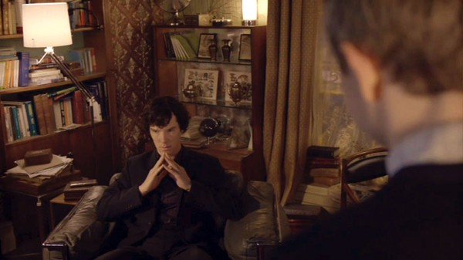
“Holmes nodded and leaned back in his chair. Once again, he placed his fingertips together and closed his eyes, an air of resignation settling across his features”.
Watson on Holmes pg 21
5

Slide 17
Task: Copy and complete this table.
What have you learnt about the characters so far? What can you deduce?
Sherlock Holmes | Doctor Watson

Slide 18
Before next lesson:
Research some information on the background of the Sherlock Holmes stories, especially the period they were set and the way they were printed.

