Slide 1
Density of Materials
Do now activity:
How would you define ‘density’?
What are the names and colours of the three wires which are found within a normal three-pin plug?
Explain the purpose of a fuse and how you would choose the correct fuse for an appliance.

Slide 2
Grade | Objective | Outcomes
1-3 | To be able to recall the density equation and use this to determine the density of a material | To be able to define density
4-6 |  | To be able to measure the density of a solid object or a liquid
7-9 |  | To be able to use the density equation to calculate the mass or the volume of an object or a sample.

Slide 3
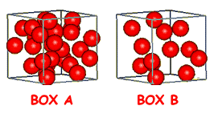
Density is … the mass per unit volume.
Which box is more dense?
The box that has more balls has more mass per unit of volume and would weigh the most. This property of matter is called density.

Slide 4
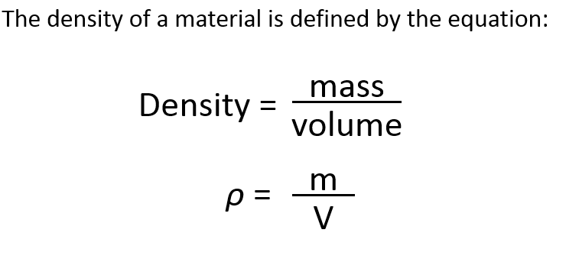
Units
p = kg/m³
m = kg
V = m³
Q: If the mass of a block of aluminium has a mass of 50,000kg and a volume of 18m³ – what is the density of aluminium?

Slide 5
How would you rearrange this formula to work out the:
Mass of the object =
Volume of the object =
density x volume
P x V
Mass x density
m x d

Slide 6
Task: Copy and complete the table to identify the density/volume/mass of a solid material:
Material | Volume (m³) | Mass (kg) | Density (kg/m³)
Gold | 6 | 123,000
Zinc | 2.8 |  | 7135
Silver |  | 330,000 | 10490
Copper | 29 | 26,000
Iron |  | 157,480 | 7,874
Wood | 1000 | 510
Extension: Write a list of materials starting from the most dense to the least dense

Slide 7
Self-assessment:
Material | Volume (m³) | Mass (kg) | Density (kg/m³)
Gold | 6 | 123,000 | 20,500
Zinc | 2.8 | 19,978 | 7135
Silver | 31.5 | 330,000 | 10490
Copper | 29 | 26,000 | 896.6
Iron | 20 | 157,480 | 7,874
Wood | 1000 | 510 | 0.51

Slide 8
Converting units and using standard form:
1kg = 1000g =10³ g
1m = 1,000,000cm3 = 10⁶ cm³
Standard form is written as A x 10^{n}
In standard form n is the number of places you have had to move the decimal point to the left (or right for a negative power of 10) to get the decimal number A.
Maths skills

Slide 9
Converting numbers into standard form:
Example: 150,000cm³ = 1.5 x 10⁵ cm³
2,600cm³
560,000cm³
2000cm³
0.1cm³
600cm³
250,000,000cm³
1. 2.6 x 10³ cm³
2. 5.6 x 10⁵ cm³
3. 2.0 x 10³ cm³
4. 1.0 x 10⁻¹ cm³
5. 6.0 x 10² cm³
6. 2.5 x 10⁸ cm³

Slide 10
Exam-style question
The helium in the balloon has a mass of 0.00245 kg.
The balloon has a volume of 0.0141m³.
Calculate the density of helium. Choose the correct unit from the box.
m³/kg kg/m³ kg m³
(3 marks)
Mark Scheme:
Density = Mass / Volume
Density = 0.00254 kg / 0.0141 m³
Density = 0.18
Units: kg/m³

Slide 11
Problem-solving:
Matt had a block of copper of mass 5000kg, the
dimensions of the block were as follows: Width – 1m, Height – 2m, Length – 3m. What is the density of the block?
Syra knew the density of an iron block, it was
7900kg/m³. The mass of the bar was 7900kg, what were the dimensions of the iron block?
Make sure you show all your working!!

Slide 12
Self-assessment:
Volume = Width x Length x Height
Volume = 1m x 2m x 3m, Volume = 6m³
Density = Mass / Volume
Density = 5000kg / 6m³ , Density = 833.3 kg/m³
Volume = Mass / Density
Volume = 7900 kg / 7900 kg/m³
Volume = 1 m³
So, the dimensions must be =
Width = 1m, Length = 1m, Height = 1m

Slide 13
Measuring the density of a liquid
Firstly, pour the liquid into a measuring cylinder to work out the volume.
Next, find the mass of an empty beaker by placing it on a top-pan balance.
Remove the beaker from the balance, pour the liquid from the measuring cylinder into the beaker.
Use the balance to find out the mass of the beaker and the liquid.
Find the mass of the liquid by subtracting the mass of the empty beaker from the mass of the beaker + the liquid.
Density = Mass / Volume

Slide 14
Quick Check
A measuring cylinder contained a volume of 150cm³ of a liquid. The liquid was then poured into an empty beaker of mass 65g. The total mass of the beaker and the liquid was the found to be 235g.
a) Calculate the mass of the liquid in grams
b) Calculate the density if the liquid in kg / m³
(2 marks)
(2 marks)
Self-assessment:
a) Calculate the mass of the liquid in grams: 235g – 65g = 170g
b) Calculate the density if the liquid in kg / m³ :
Density = Mass / Volume
Density = 170g / 150cm³ = 1.13 g/cm³

Slide 15
True or False?
To calculate density you divide the volume by the mass
To calculate the volume of an object you can divide the mass by the density
Density is measured in kg/m³
160,000cm³ in standard form is 1.6 x 107 cm³
0.0005m³ in standard form is 5 x 10⁻⁵ m³
The volume of an object which has a height of 2cm³, a width of 6cm³ and a length of 3cm³ has a volume of 36cm³
FALSE
TRUE
TRUE
FALSE
FALSE
TRUE

Slide 16
Plenary ~ Write three sentences to summarise what you have learnt this lesson!

