Slide 1
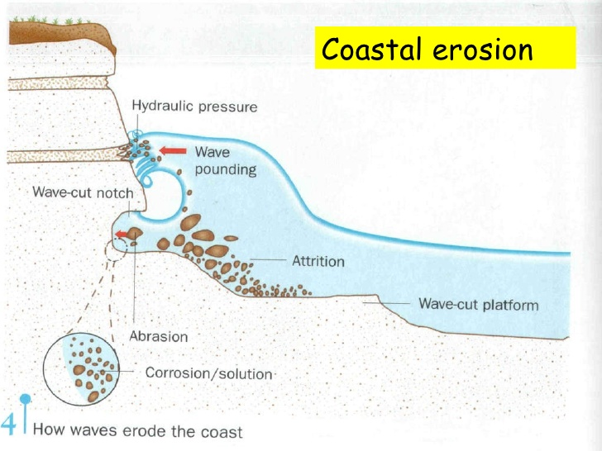
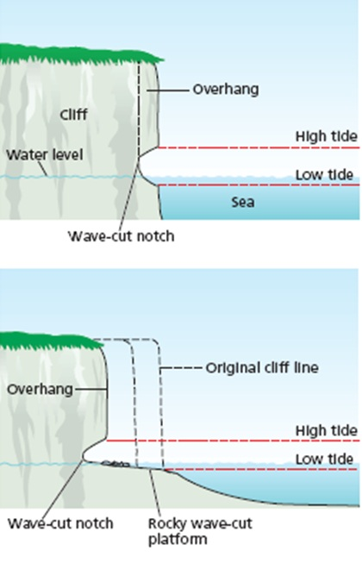
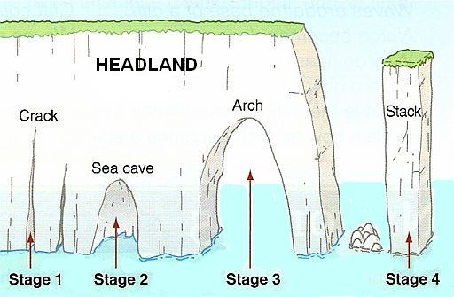
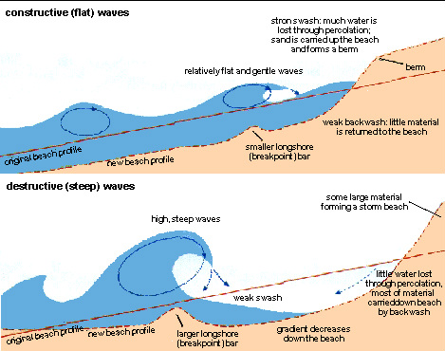
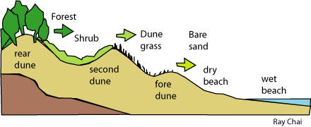
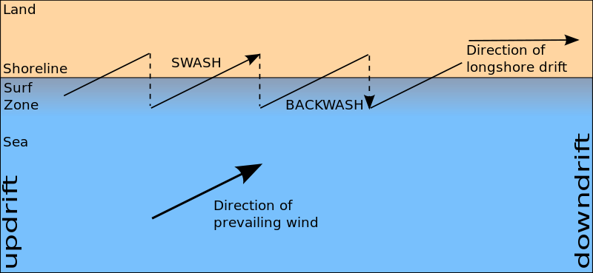
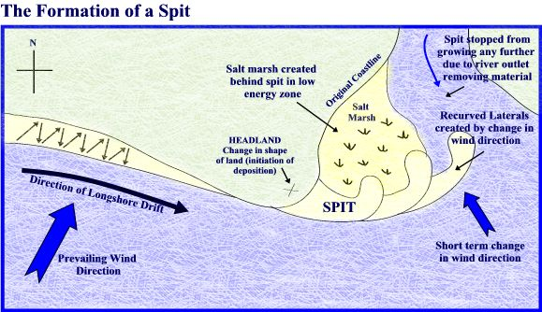
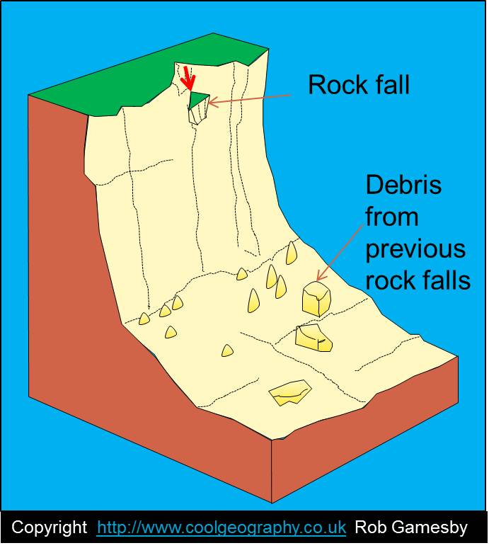
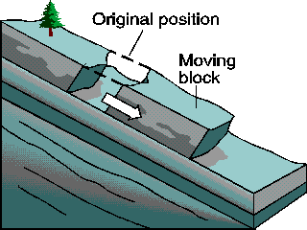
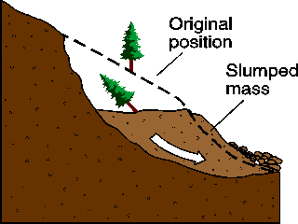
Coastal Processes
Waves are formed by wind blowing over the sea. The size of wave is determined by the strength of the wind, the duration of the wind and the distance the wind blows over (fetch).
Constructive waves are low with long wavelengths. The swash is stronger than the backwash. They build beaches Destructive waves are higher with shorter wavelengths. The backwash is stronger than the swash eroding the coast.
Coastal Erosion
Erosion is the removal of material and sculpting of landforms
Landforms of erosion
Wave cut platforms | Caves, arches and stacks
Weathering
Weathering is the decomposition or disintegration of rock in its original place (erosion involves moving rock)
Chemical | Mechanical
Carbonation. Carbon dioxide dissolved in rainwater forms a weak acid. Reacts with limestone and chalk to form a solution Hydrolysis – acidic rainwater reacts with minerals in granite Oxidation – oxygen in rain reacts with iron | Freeze thaw. Salt weathering – salt in sea water expands to form cracks.
Deposition: Sediment dropped by the waves. Creates beach. The beach is made of material transported by longshore drift.
Landforms of deposition
Sand dunes
Spits
Unit 1
UK Physical Landscapes - Coasts
Mass Movement
Mass movement is the movement of material downslope under the influence of gravity. It is the falling, sliding or flowing of rock, sediment or soil most often along a slip plane (line of weakness). Different types of mass movement can include rockfall, landslides and rotational slumping.
Rockfall | Landslide | Slumping (rotational slip)
Individual fragments of rock fall off cliff usually due to freeze thaw | Rocks fall in a linear fashion along fault lines | Occurs on a curved surface lubricated by water
Coastal Transportation
The shape of the coast is determined by geology. Hard rocks (chalk, granite) erode slowly. Clay and sandstone are softer and erode faster
Hard rocks will form headlands and erode slowly.
Soft rocks will form bays and erode quickly

