Slide 1
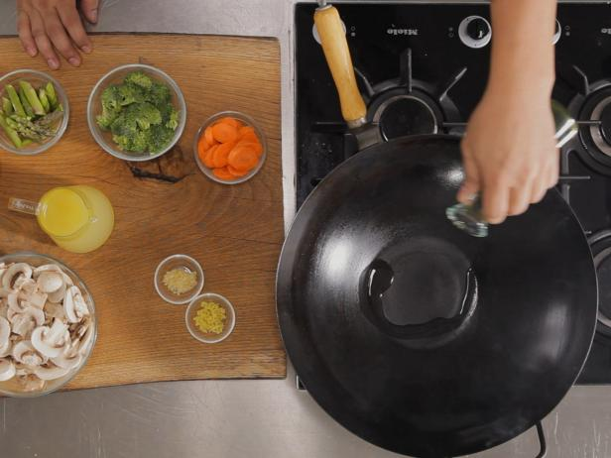
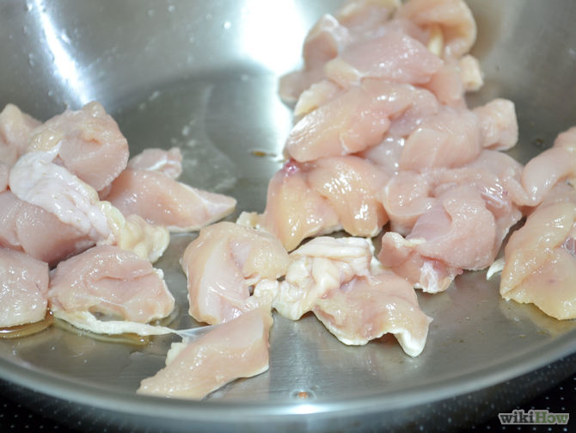
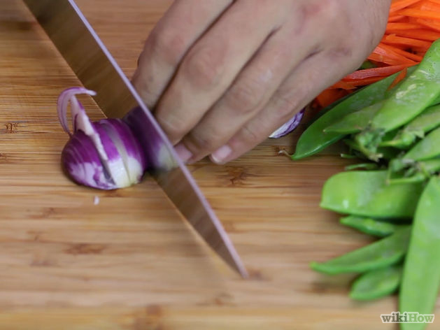
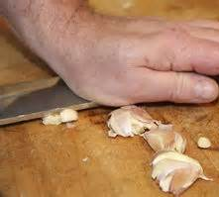
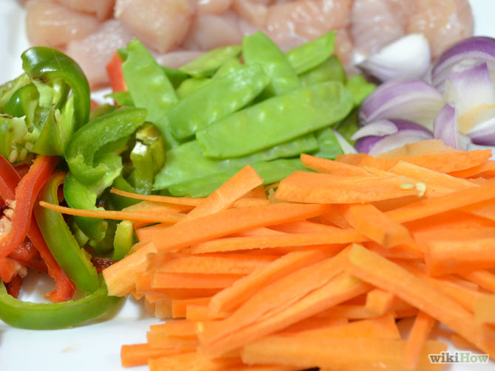
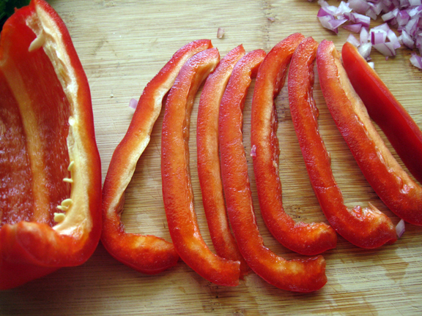
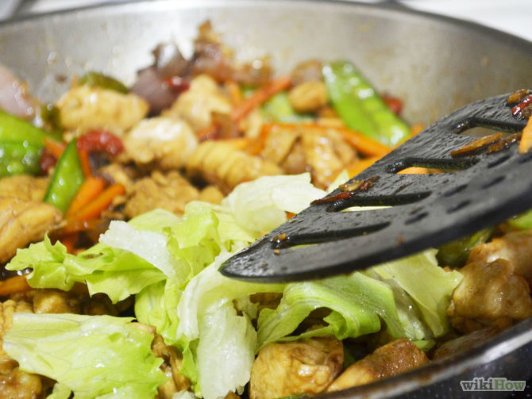
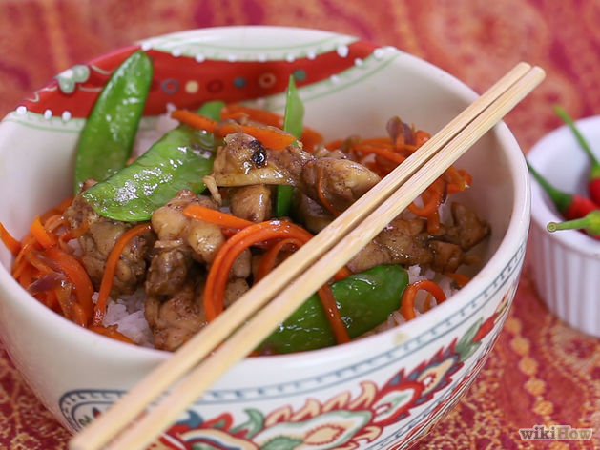
Step by step Stir Fry
Pour a table spoon of vegetable oil into the frying pan.
2. Dice the chicken and add this to the frying pan first.
3. Peel the skin off the onion and begin to use the bridge and the claw technique to dice the onion.
4. Peel the skin off to reveal the cloves inside. Chop the clove finely. Add garlic and onion to frying pan.
5. Peel the carrots and slice into long thin strips.
6. Slice the peppers into thin strips and add to the pan.
7. Mix all of the ingredients together using a wooden spoon. Add your seasoning here. Soy Sauce, Sweet chilli sauce or any other herbs and spices.

Slide 2
Step by step Stir Fry
Equipment-
Chopping board
Bowl
Grater
peeler
spoon
Sharp knife
Wooden spoon
Frying pan
Ingredients-
1 onion
1 pepper
1 carrot
1 Chicken breast
1 garlic clove
Serve with noodles at home.
Provided by school
1 x 15ml sweet chilli
2 x 15ml soy sauce
1 x 15ml dried chilli flakes
Stretch and Challenge Ingredients
2 button mushrooms
4 snap peas
Few leaves of cabbage

