Slide 1
Do Now Activity
Question 1: What is meant by system software?
Question 2: What is an operating system?
*Use your whiteboards

Slide 2
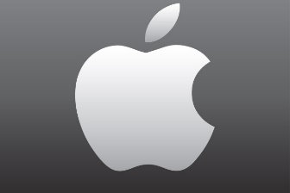
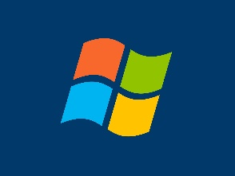
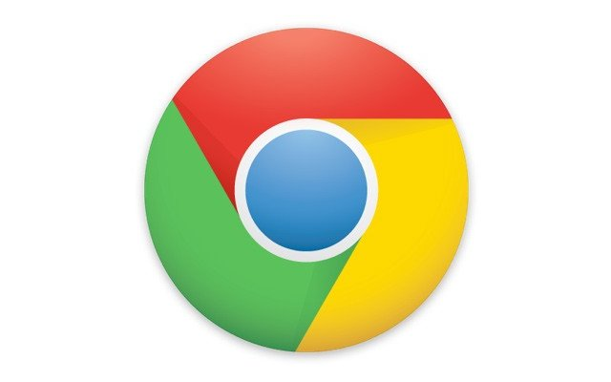
Do Now Activity
Task: Name as many Operating Systems as you can (Page 4)
Challenge: Can you give the types of computer systems they run on?
Operating Systems

Slide 3
Unit 6 – Software Lesson Objective Explain the use of an operating system
Progress Indicators
Good – Describe some functions of an OS
Outstanding - Describe a range of functions of an OS in detail
OS = Software that controls the general operation of a computer

Slide 4
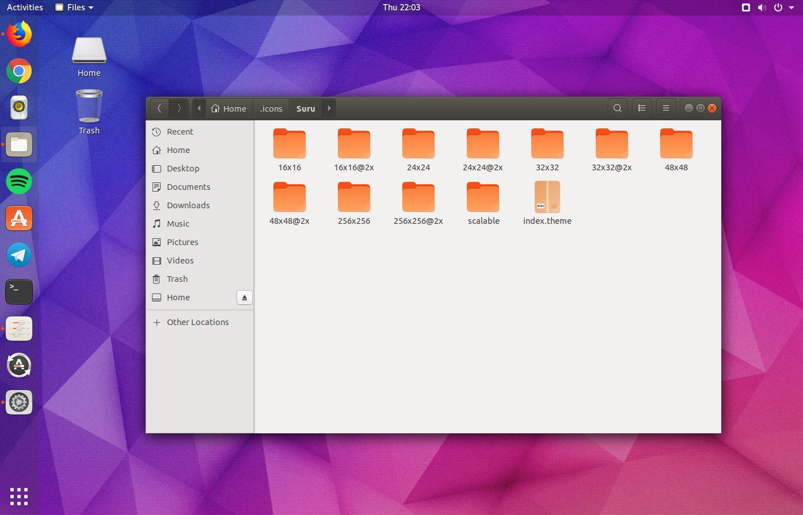
Ubuntu – Open source OS for personal computers

Slide 5
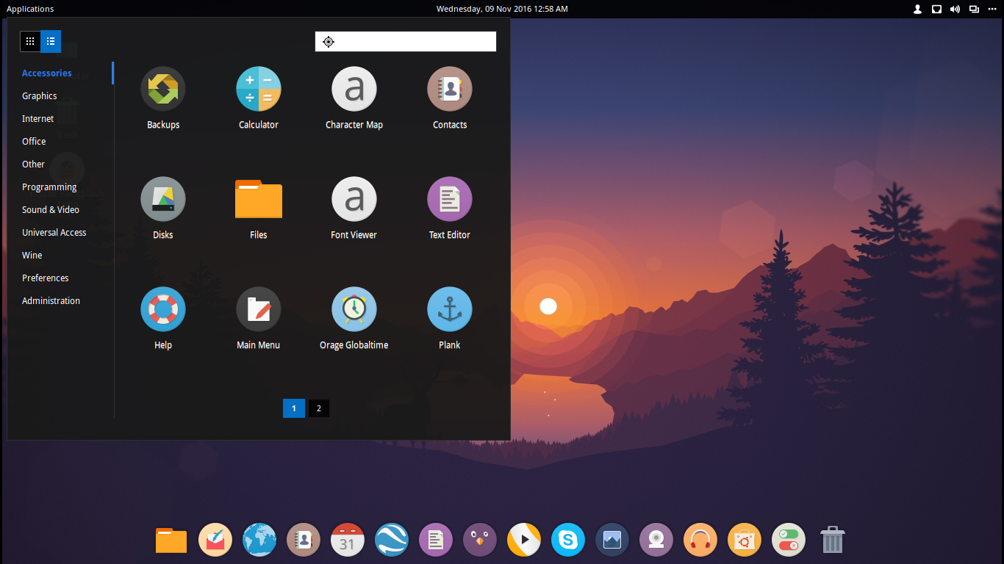
Linux – Another open source OS

Slide 6
Operating Systems

Slide 7
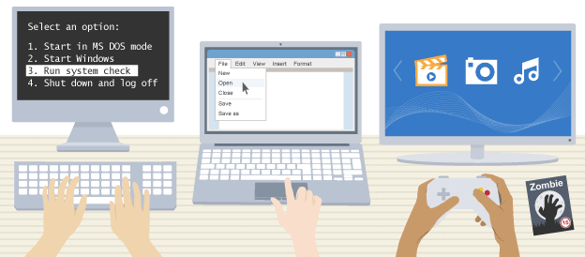
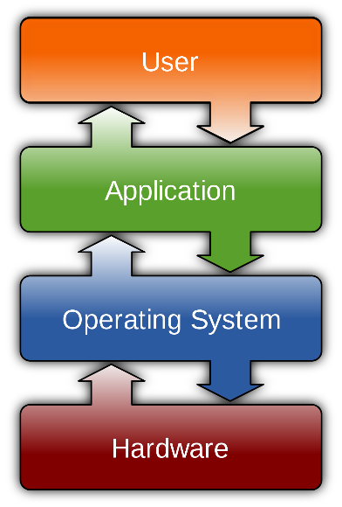
The purpose of an OS
An operating system (or 'OS') controls the general operation of a computer, and provides an easy way for us to interact with computers and run applications.
On some computers it is possible to run a choice of operating systems. Games consoles have their own unique operating systems.

Slide 8
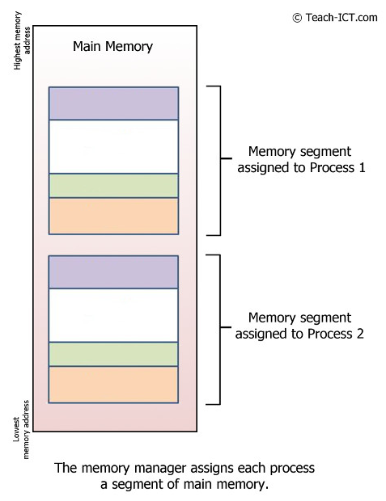
Memory Management
The OS manages how main memory is used. It decides:
How memory is shared between processes
What happens when there is not enough main memory
Different processes running at the same time must not interfere with one another. This means they have to use separate parts of the computer’s memory.
The OS handles the transfer of data between processes. This is done by setting aside areas in memory where data values can be shared.
The OS uses buffering to set aside memory for the temporary storage of data. A process may output data and leave it in the buffer. This means that processes can each get on with their jobs at their own rate. It is only when the buffer is full that processes will need to wait.

Slide 9
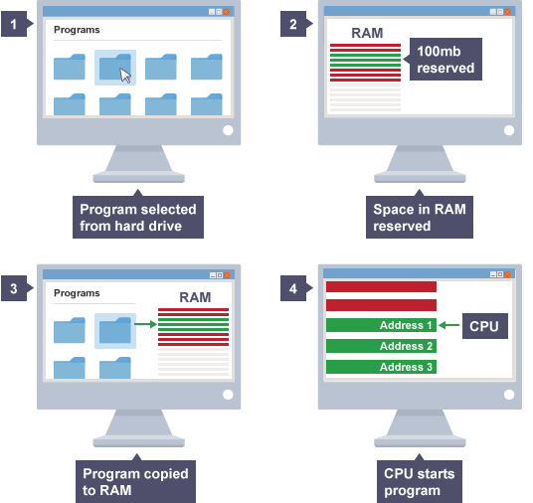
Processor Management
The OS is used to run programs by clicking on an icon, selecting the program from a menu, or typing in an instruction at the command line.
When the OS runs a piece of software it has to find the program files on the storage drive, load them into main memory, and instruct the CPU to start executing the program from the beginning.
In each case, the OS performs the same sequence of steps:

Slide 10
Multitasking
The OS makes it possible to run several programs at once. Several programs can be stored in RAM at the same time, however only one program at a time is processed by the CPU. Programs can be in one of three states:
Running
Waiting
Runnable
CPUs are extremely fast, so if a program is processed for even a short time it can do quite a lot. The OS decides the best way to swap between running, runnable and waiting processes. It controls which process is being executed by the CPU at any point in time, and shares access to the CPU between processes. The job of working out when to swap processes is known as scheduling.
This happens so fast that it appears that all processes are running at the same time.

Slide 11
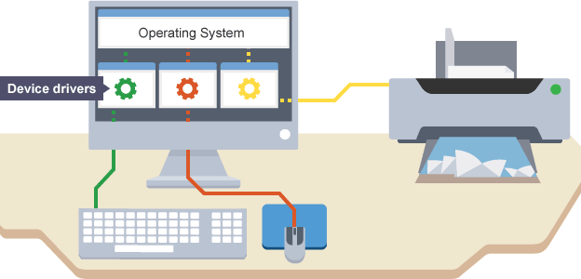
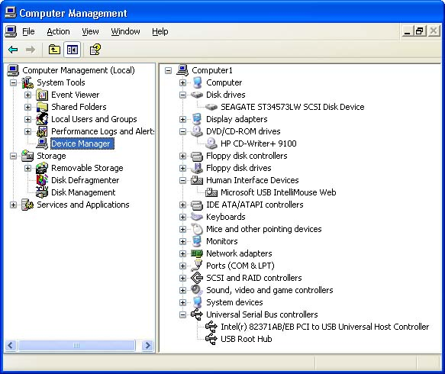
Peripheral Management
Each peripheral is programmed with its own machine code. Each has its own rules that dictate how it transmits data between the computer and the device.
The OS uses programs called device drivers to manage connections with peripherals.
An OS will have generic device drivers to enable it to connect to most common peripherals. Some peripherals, however, will have their own drivers that need to be installed before use.

Slide 12
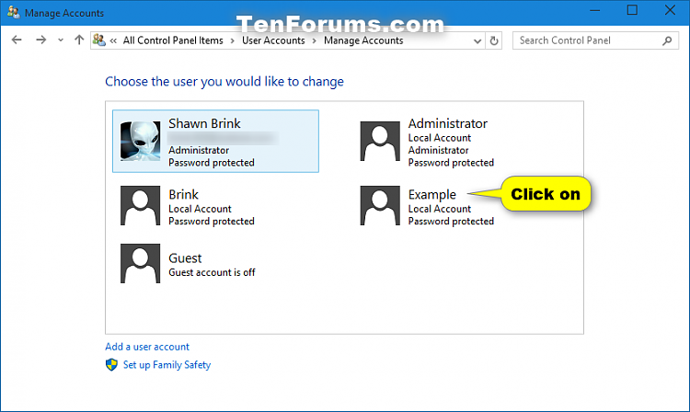
User Management
Modern personal computers can allow multi-user access. A multi-access (or multi-user) system is one where several users can use the same system.
The CPU (central processing unit) deals with users in turn; clearly the more users, the slower the response time. The processor is so fast that the response time is a fraction of a second and the user feels they are being dealt with immediately.
The OS provides different levels of user access and password protection to keep unauthorised users out of the computer system.

Slide 13
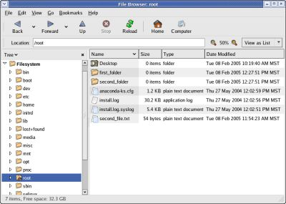
File Management
The OS manages how data is organised into files. This makes it easier for the user to see files using programs like the Windows File Explorer or Mac OS X Finder. The OS organises where and how files are stored, deleted, read, found and repaired. It detects errors such as missing disks or incorrect file names, and informs the user that errors have occurred.
Each file has a unique name and the OS maintains a set of look-up tables that relate file names to locations on storage drives.

