Slide 1
2.4 - Profit
Notes:
Please note that the symbols and buttons behave as follows:
HYPERLINKS – where there is a hyperlink this symbol will be shown in the margin. More information about the hyperlink is given in the notes for each slide
BACK BUTTON – used where hyperlinks have been used to move to a given slide. This button will take you back to the slide the link was from
FORWARD BUTTON – this allows you to move forward to the next section (if there is one) of the presentation. This may skip a number of slides that are linked to from the slide the button appears on.

Slide 2

Profit and Loss
Many businesses set out to make a profit, and avoid making losses!
  But what is “profit”?
Profit can be defined as:
This means that profit is not the same as cash!
“The financial gain obtained from producing/providing a good/service. It is the difference between the amount earned from selling a product/service and the cost of producing/providing it”

Slide 3
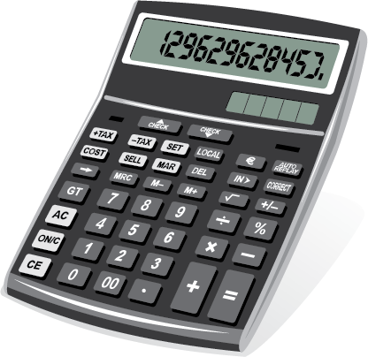


Calculating Profit
Businesses…
  Receive revenue from selling goods/services
  Incur costs making/providing goods/services
Profit is the difference between the two
  It can be calculated using the formula:
=
-
PROFIT
TOTAL REVENUE
TOTAL COSTS
* Note that “Sales Revenue” can be used as an alternative term to “Total Revenue” in this formula

Slide 4

Profit or Loss?
The profit calculation will give either a positive or negative answer
  A POSITIVE answer – means a profit has been made
  A NEGATIVE answer – means a loss has been made
If a profit is being made…
If a loss is being made…
…then a business is selling products for less than it costs to make them.
Whilst a business may allow this to happen for a short time, it won’t want this to continue for long
…then a business is selling products for more than it is costing to make them.
This is exactly what most businesses will aim to do
Notes:
Click to reveal each “note”

Slide 5

Sir Ramics: An Example of Calculating Profit
Sir Ramics is a small pottery business that produces coffee mugs
Last month it sold all of the 30,000
mugs it made for 50p each
It also incurred the following costs:
  Fixed Costs of £10,000
  Variable costs of 10p per mug
The owner, Ken Coe, would like to
know what his profit was last month:
Profit
Profit = Total Revenue - Total Costs
Profit = (30,000 x £0.50) – (£10,000 + £3,000)
Profit = £15,000 - £13,000
Profit = £2,000
Sir Ramics made a profit last month of £2,000
Notes:
Click to reveal each stage of the calculation

Slide 6
Calculating Profit
Total Revenue: £200,000
Total Cost: £250,000
Total Revenue: £40,000
Total Cost: 10,000
Total Revenue: £550
Total Cost: £125
250,000 - 200,000
£40,000 - £10,000
= -£50,000
= £30,000
£550 - £125
= £425

Slide 7
Finance Mini Test
K:
Business Studies
CNAT Enterprise & Marketing
R064 – Exam
LO2 - Financially Viable
  Mini Test

