Slide 1
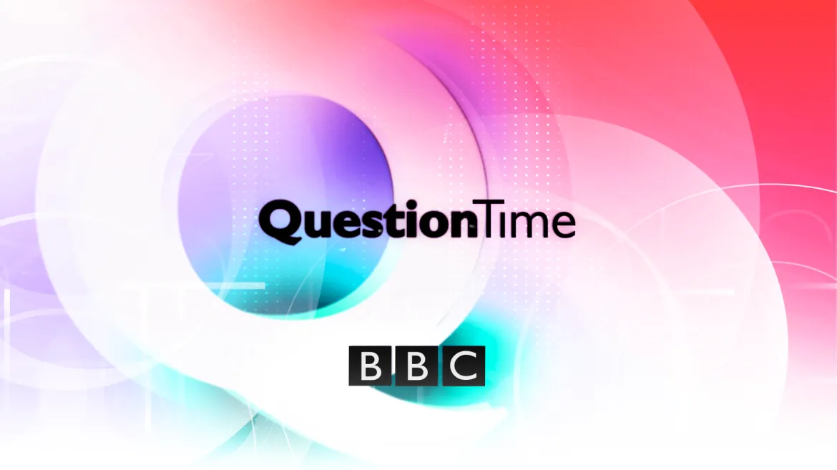
Do Now Activity
What are the 3 benefits exercise has on your well being?
What are the 4 different lifestyle choices that will effect performance?
What are Macronutrients?
What are Micronutrients?
What are the other aspects of a balanced diet?
What are the different types of energy balances
What is a sedentary lifestyle?
What are the 4 factors that affect optimum weight?

Slide 2
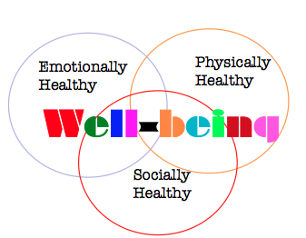
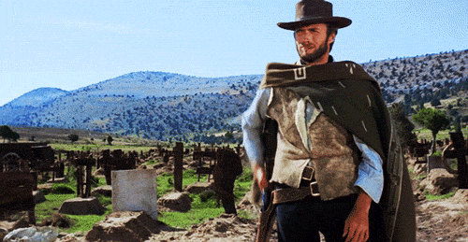
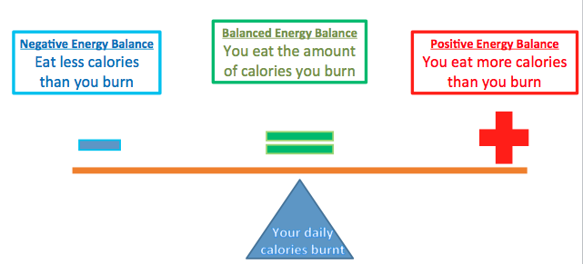
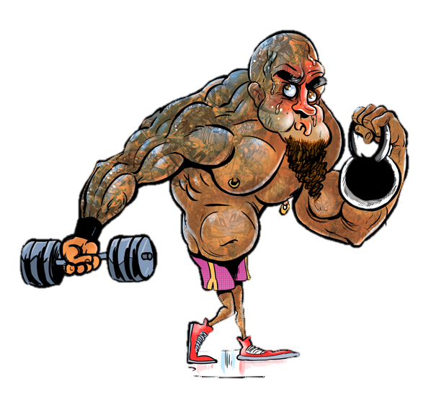
Do Now Activity
What are the 3 benefits exercise has on your well being?
What are the 4 different lifestyle choices that will effect performance?
DRAW!
What are Macronutrients?
Carbohydrates, Fats and Proteins
What are Micronutrients?
Vitamins and Minerals
What are the other aspects of a balanced diet?
Fibre and Water
What are the different types of energy balances
What is a sedentary lifestyle?
Bone structure – people with heavier bone structure would normally be heavier in weight.
Gender - men have a higher optimum weight because of the heavier bone structure and bigger muscle girth.
Height –its most likely a taller person is likely to be heavier then a shorter person (although other factors may affect this)
Muscle girth – people with bigger muscles will weight more
A lifestyle with NO EXERCISE & A POOR DIET
What are the 4 factors that affect optimum weight?
Big, Guys, Have, Muscle

Slide 3
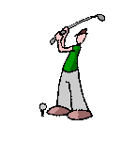
Classification of sporting skills
Progress Indicators
Good progress: 3-5 | Outstanding progress: 6-9
To be able to give an example of each type of skill correctly along the continuum | To be able to explain and describe a few skills and place them along the continuum

Slide 4
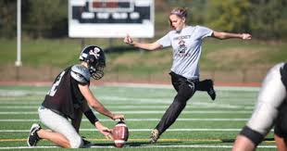
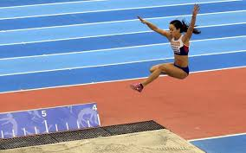
What is a skill
A skill is a specific and defined task that be learned and practised

Slide 5
What is a continuum

Slide 6
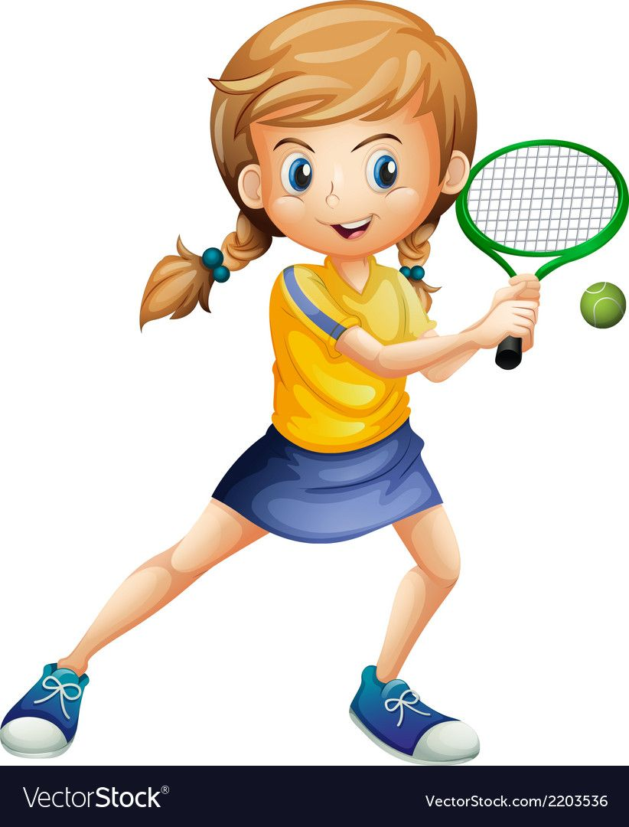
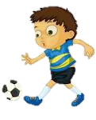
What is a continuum
Miss Sweet
Mr Liddington
Mr Robbs
Mr Moody
Not
Good
looking
Good
looking!

Slide 7
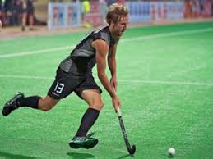
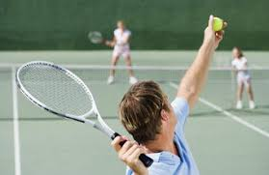
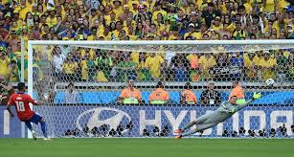
Task
Write an example of an open and closed skill in your books
(1 for each open/closed)

Slide 9
Good progress: 3-5 | Outstanding progress: 6-9
To be able to give an example of each type of skill correctly along the continuum | To be able to explain and describe a few skills and place them along the continuum
Free throw
Shot put
50m swim
Drop kick
Shooting
Catching
Archery
Softball batting

Slide 10
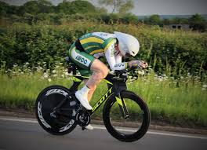
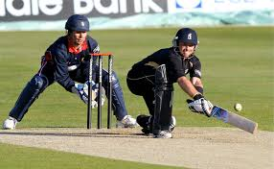

Slide 11
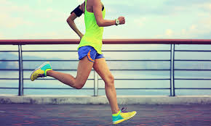
Basic Skills
Basic skills are
Simple
Need little thought
Require little decision making

Slide 12
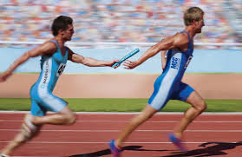
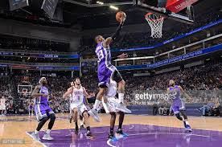
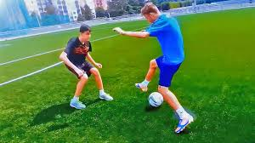
Complex Skills
Complex skills are
Difficult
Need a high level of decision making

Slide 14
?
Open
&
Closed
Basic
&
Complex

Slide 15
Task
Pick a skill, work with a partner to explain where it would be on a open/closed continuum and the on the basic/complex skill continuum as well.
Open / Close skill continuum
Complex / Basic skill continuum

Slide 18
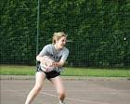
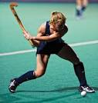
Using the picture examples below place the sporting movements across all 3 continuums.
Once complete you need to annotate off each continuum (draw a line and explain) why you have placed it in that position
6+ must explain other sports too
Target grade 4-5 = 2 sports
Target grade 6-7 = 3 sports
Target grade 8 + = 4 sports

Slide 19
REFLECTION: Classification of sporting skills
Swap books with your shoulder partner
Mark their books (red pen)
WWW / EBI
Write what progress you think they have made
Progress Indicators
Good progress: 3-5 | Outstanding progress: 6-9
To be able to give an example of each type of skill correctly along the continuum | To be able to explain and describe a few skills and place them along the continuum

