Slide 1
CwK
Wednesday, 01 July 2020
Momentum
Do Now Activity
Define stopping distance

Slide 2
Self Assess
Stopping distance=thinking distance + braking distance
Thinking distance is the distance the car travels in the time it takes the driver to react
Braking distance is the distance the car travels during the the time the braking force acts

Slide 3
Progress Indicators
Good Progress
Recall and apply the momentum equation
Define Momentum
Outstanding Progress
Apply the conservation of momentum

Slide 4
Word Consciousness
Momentum-has both size and direction it is a vector quantity

Slide 5
Equation
Momentum= mass x velocity
Kgm/s

Slide 6
Practice
A 1800 kg rhino is running north at 9.50 m/s.
How much momentum does it have?
A 40.0 kg rock that is falling off a cliff has 484 kg m/s momentum. What is the rock’s velocity?

Slide 7
A 1800 kg rhino is running north at 9.50 m/s.
How much momentum does it have?
p=mv = 1800 x 9.50 = 17, 1000 kg m/s to the north.
A 40.0 kg rock that is falling off a cliff has 484 kg m/s momentum. What is the rock’s velocity?
p=mv, v= p/m = 484 / 40 = 12.1 m/s downwards

Slide 8
An Olympic sprinter of mass 86 kg running at 10. 2 m/s.
A bullet of mass 8.5 Kg fired from a gun with a velocity of 300 m/s.
A super tanker of mass 200 000 tonnes (1 tonne = 1000 kg) cruising with a velocity of 12 m/s.
A fully-laden, Boeing-747 jumbo jet is cruising at 275 m/s during a transatlantic flight. If its momentum at this velocity is 121 000 000 kg m/s, calculate its mass.
A male cheetah has an average mass of 64 kg and its momentum when it is moving at top speed is 1920 kg m/s. Use this information to calculate its top speed.

Slide 9
P= 86 x 10.2
P= 877Kgm/s
P= 8.5 x 30
P= 255Kgm/s
P= 200000 x 12
P= 200 x 12
P= 2400Kgm/s
M= 121000000 / 275
M= 44000Kg
V= 1920 / 64
V= 30m/s

Slide 10
Conservation of Momentum
In a closed system the total momentum before an event is equal to the total momentum after the event
This is called conservation of momentum
When a moving object collides with another object, the total momentum of both objects is the same before the collision as it is after the collision.

Slide 11
Examples
Collisions (This could be anything from sub-atomic particles to planets crashing into each other).
Explosions (This could be a bullet fired from a gun, the ejection of an alpha particle from a nucleus or simply a person stepping out of a boat).
A closed system is one in which no external forces act on the objects involved in the event.
Remember momentum is a property of moving objects

Slide 12
Practice
A railway truck of mass 800Kg moving with a constant velocity of 5m/s, collides and couples with another railway truck of mass 650kg which is stationary.
Calculate the velocity with which both trucks move after the collision
Total momentum before= total momentum after

Slide 13
Momentum before = Momentum after
(800 x 5) = (800 + 650) x V
4000 = 1450V
V= 4000/1450
V= 2.76m/s

Slide 14
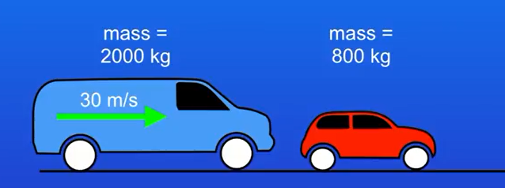
The van collides with a stationary car, both the van and the car move after the collision, calculate the velocity of the van and the car after the collision.
Notes:
Momentum of van= 2000 x 30 = 60000Kgm/s
Car momentum is 0
Total momentum of van and car after the collision Is 60000Kgm/s
60000= 2800 x velocity of van
V=60000/2800
V=21.4 m/s

Slide 15
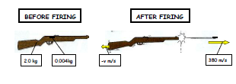
A bullet of mass 4.0g is fired from a rifle of mass 2.0kg with a velocity of 380m/s. What is the initial recoil velocity of the rifle?

Slide 16
Momentum before = momentum after
0 = (0.004 x 380) + (2.0 x v)
0= 1.52 – 2v
V= 1.52/2.0
V= 0.76m/s

Slide 17
Plenary

