Slide 1
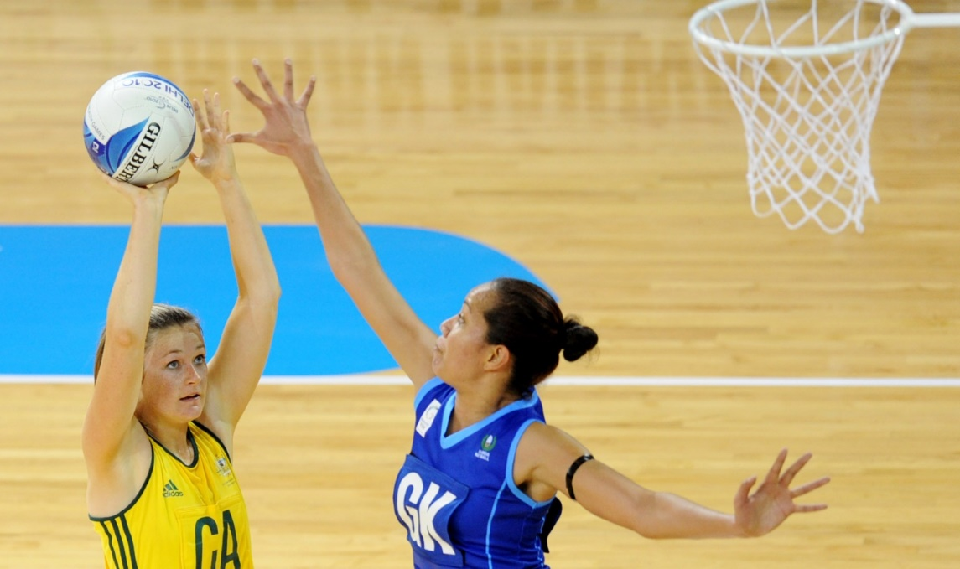
Questioning, fitness, methods and more!
DNA
Good progress
Be able to explain and demonstrate how to access AO2/AO3 marks in a 9 mark question | Successfully demonstrate an answer gaining more than 6 marks

Slide 2
Age
Younger children/ aged 2-5 generally have lower obesity rates
Obesity rates rise with each age group
All age groups show increased obesity rates in 2014 compared to 1994
Gender
Male children aged 2-5 have a higher obesity rate than girls of the same age
Drop in obesity level aged 6-10 from 2009
Increased obesity levels in girls up to 2004 but then plateauing or decrease

Slide 3
How to approach 9 mark questions

Slide 4
AO1
(Marks 1-3)
AO2
(Marks 4-6)

Slide 5
AO3
(Marks 7-9)

Slide 7
AO1
AO2
AO3

Slide 8
Circuit Training
A series of exercise stations completed one after the other in a circuit. Rest after one circuit and then repeat.
Benefits
Easy to adapt the circuit specific to your sport & needs, little equipment needed

Slide 9
Interval Training
Varying levels of intensity. Often anaerobic exercise. Example – sprint for 30sec, walk for 20 sec.
Benefits
Suitable for games players, simulates a live environment (football, netball match) where you are sprinting/walking.

Slide 10
Continuous Training
Moderate level of exercise, maintaining a consistent heart rate between 60-80% MHR (target zone)
This training is aerobic.
Benefits
Suitiable for long distance endurance athletes. E.g marathon runners, 5,000 metre runners.

Slide 11
Weight Training
Using resistance and weights can develop muscular strength/endurance & power in isolation and large muscle groups.
Develops muscle size and mass.
Low repetitions & heavy weight = increase power
High repetitions & lower weight -= Increase muscular endurance

Slide 12
Fartlek Training
Often involves running, using different terrains.
Examples - Completing a circuit of 400m circuit including up & down a hill/bank causing more resistance. This develops aerobic & anaerobic fitness.
Cross country runners can use this training method. It is similar to interval training.

Slide 13
Plyometric Training
Explosive movements mainly jumping movements. This method increases explosive power: box jumps, squat jumps
(focus on leg movements when giving examples)
Example – A netballer does plyometric to improve her jump to intercept the ball

Slide 20
Circuit Training
Interval Training
Continuous Training
Weight Training
Fartlek Training
Plyometric training
Fitness classes
Create an ACRONYM for the methods of training!

Slide 21
Go onto your school email and click on the link in the email and you will gain access to free online GCSE PE revision!
https://app.senecalearning.com/dashboard/join-class/i9twxh2gjb

