Slide 1
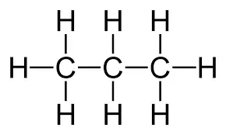
Alkenes
CWK
DO IT NOW:
What is the name of this compound:
What is incomplete combustion?
Give a balanced symbol equation for the complete combustion of ethane
Complete this equation and name the process being carried out:
C₁₀H₂₂ → C₈H₁₈ + ___________
Challenge- Can you draw the structural formula for the compound you gave in question 4?

Slide 2
Alkenes
CWK
DO IT NOW:
What is the name of this compound:
What is incomplete combustion?
Give a balanced symbol equation for the complete combustion of ethane
Complete this equation and name the process being carried out:
C₁₀H₂₂ → C₈H₁₈ + ___________
propane
When there is not enough oxygen so carbon monoxide is produced instead of CO₂
2C₂H₆ + 7O₂ → 4CO₂ + 6H₂O
Process = cracking
C₂H₄

Slide 3
Progress indicators
GOOD PROGRESS:
-Name and draw the structural formula for the first four alkenes
- Describe the reactions of alkenes with oxygen, hydrogen, water and halogens
OUTSTANDING PROGRESS:
-Construct the displayed structural formulae of alkenes reacting with hydrogen, water and halogens

Slide 4
Word consciousness
Functional group – a group of atoms which give organic compounds their characteristic reactions
Alkene – hydrogen carbons with a double carbon-carbon bond
Unsaturated – molecules containing at least one double bond
Displayed formula -2D diagram showing all atoms and covalent bonds

Slide 5
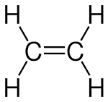
Alkenes
Contain the functional group C=C
General formula: C_{n}H_{2n} (n= no. of C atoms)
End in ‘ene’
The first four alkenes:
Ethene Propene
Butene Pentene
Task: Give the formula and draw the displayed formula for:
Hexene (6 Cs)
Nonene (9 Cs)
Decene (10 Cs)
Notes:
Rules for drawing alkenes – each carbon has four bonds, each hydrogen has one bond, an alkene has one C=C double bond.
In the exam, pupils can draw the double bond anywhere in the carbon chain and gain marks (they do not need knowledge of isomers at GCSE).

Slide 6
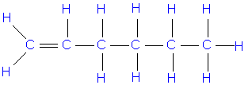
Drawing alkenes
Hexene:
C₆H₁₂
Nonene:
C₉H₁₈
Decene:
C₁₀H₂₀
Notes:
Pupils can draw the double bond anywhere in the chain as long as there are the right number of hydrogens on each carbon but it may be easier to get them in the habit of always starting with the double bond.

Slide 7
Comparing the combustion of alkanes and alkenes
Alkenes react with _________ in combustion reactions in the same way as other _____________, but they tend to burn in air with _________ flames because of _____________ combustion.
Therefore, _________ are used as fuels over alkenes
WORDS: hydrocarbons, alkanes, oxygen, incomplete, smoky
Challenge- Give the word and balanced symbol equation for the complete combustion of ethene

Slide 8
Comparing the combustion of alkanes and alkenes
Alkenes react with oxygen in combustion reactions in the same way as other hydrocarbons, but they tend to burn in air with smoky flames because of incomplete combustion.
Therefore, alkanes are used as fuels over alkenes
WORDS: hydrocarbons, alkanes, oxygen, incomplete, smoky
Challenge:
Ethene + oxygen → carbon dioxide + water
C₂H₄ + 3O₂ → 2CO₂ + 2H₂O

Slide 9
Equations for the combustion of alkenes
Complete the word and balanced symbol equations for the combustion of alkenes:
Ethene + oxygen →
Propene
C₄H₈ + O₂ →
C₅H₁₀
Can you construct a word equation for the incomplete combustion of pentene?
Remember alkenes are hydrocarbons and so react in the same way as alkanes
Notes:
2C₃H₆ + 9O₂ → 6CO₂ + 6H₂O
2C₅H₁₀ + 15O₂ → 10CO₂ + 10H₂O
Pentene + oxygen → carbon + carbon monoxide + water

Slide 10
Equations for the combustion of alkenes
Complete the word and balanced symbol equations for the combustion of alkenes:
Ethene + oxygen → carbon dioxide + water
Propene + oxygen → carbon dioxide + water
C₄H₈ + 6O₂ → 4CO₂ + 4H₂O
2C₅H₁₀ + 15O₂ → 10CO₂ + 10H₂O
Can you construct a word equation for the incomplete combustion of pentene?
Pentene + oxygen → carbon monoxide + carbon + water

Slide 11
Addition reactions of the alkenes
It is the carbon-carbon double bond, C=C, that makes alkenes far more reactive than alkanes.
When a molecule reacts with an alkene, the molecule ‘adds’ to the alkene across their double bond.
General addition reaction:
You need to be able to draw the products formed when the first four alkenes react with Cl₂, Br₂, I₂, H₂ and H₂O for your exams
Notes:
The homework sheet from this lesson gives pupils practise drawing these products.

Slide 12
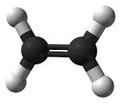
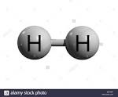
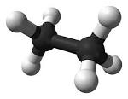
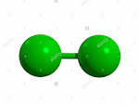
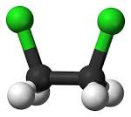
Draw the structural formulas of products from addition reactions
Using the moly mods, construct 2 ethene molecules, hydrogen (H₂) and Bromine (Br₂)
Make the molecule you think is produced if these two compounds are added together (you need to use the same number of bonds)
+
?
Ethane (C₂H₆)
+
?
Dibromoethane (C₂H₄Br₂)
Notes:
Use the green balls in the molymod kit to represent bromine atoms (although these are usually used to represent chlorine). Pupils do not need to know the names of adding halogens to alkenes, only be able to write and draw the formulae.

Slide 13
Mini-plenary
Write the molecular formula and draw the structural (displayed) formula for the products of the following reactions:
Butene and chlorine
Propene and hydrogen
Ethene and water
Cl
Cl
H
H
H
C
C
C
C
H
C₄H₈Cl₂
dichlorobutane
H
H
H
H
H
H
H
H
C
C
C
H
C₃H₈
propane
H
H
H
H
H
H
C₂H₅OH
ethanol
C
C
OH
H
H
For number three, think of water as H-OH
Notes:
Dichlorobutane is highlighted as pupils do not need to be able to name the compound, only draw and give the formula. They will be expected to name the alkanes and alcohols formed (2 and 3).

Slide 14
Bromine water
Bromine water contains bromine molecules (Br₂)
What happens if we add bromine water to an alkene (e.g. ethene)?
How have you met this before?
Bromine water changes from orange to colourless as dibromoethane is produced
Bromine water is used to distinguish between alkenes and alkanes
Alkanes remain orange (no reaction), alkenes go colourless (form dibromoethane)

Slide 15
Conditions
Reaction with hydrogen
Takes place at 60 °C in the presence of a nickel catalyst
Reaction with water (steam)
Takes place under high heat and pressure
Why is a catalyst used?
What type of reaction is this?

Slide 16
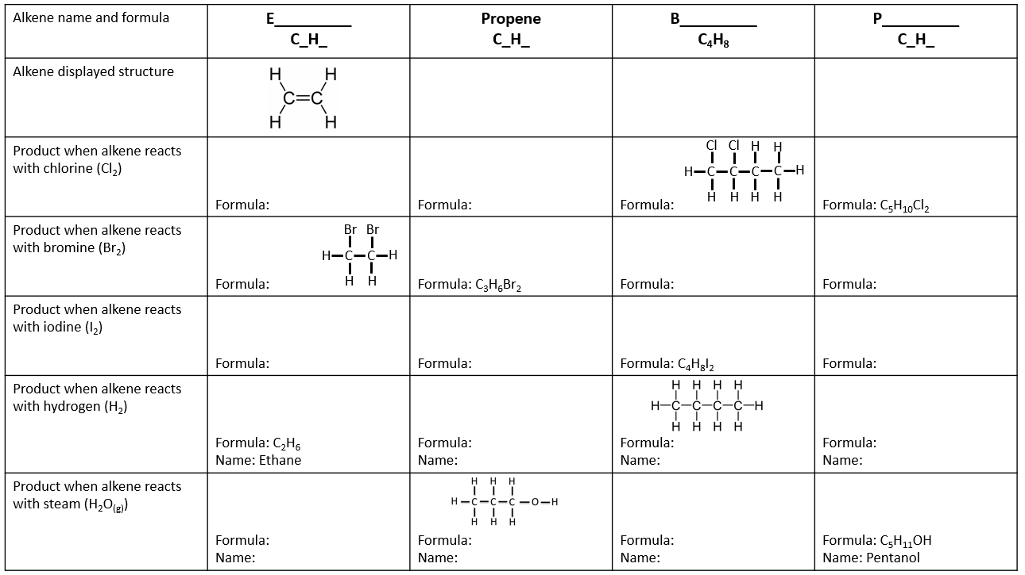
Homework
Based on this lesson, complete the worksheet drawing the first four alkenes and the products when these alkenes react with chlorine, bromine, iodine, hydrogen and water.

Slide 17
Plenary: What is the question?
Colourless
Unsaturated
Carbon monoxide
Nickel catalyst

