Slide 1
Do Now Activity
Principles of training
Components of fitness
Health
Skill
Methods of training
___ / 29

Slide 2
Do Now Activity
Principles of training
Components of fitness
Health
Skill
Methods of training
___ / 29

Slide 3
Do Now Activity
Principles of training
Components of fitness
Specificity
Progressive Overload
Overtraining
Reversibility
Threshold Training
Individual needs
Frequency
Intensity
Time
Type
Health
Skill
Cardiovascular endurance
Muscular Endurance
Muscular Strength
Body Composition
Flexibility
Agility
Balance
Coordination
Power
Reaction Time
Speed
Anaerobic = 80-90%
Aerobic = 60-80%
Methods of training
Circuit
training
Plyometric
Training
Weight
Training
Continuous
Training
Interval
Training
Fartlek
Training
Fitness
Classes
___ / 29

Slide 4
Personal Exercise Plan
Target | GOOD | OUTSTANDING
4-5 | To show understanding of most | To apply knowledge and begin to evaluate ALL
6-9 | To apply knowledge and to evaluate ALL | To anaylse
TASK:
Independently work through your PEP
Explain what that component of fitness is
Explain why it is important for YOUR sport
Explain what fitness test TEST’S that component
Put the normative data table for that test underneath it (with the web address you got it from copied on – see the example in KDRIVE)
Exclude coordination & body composition from this process and just do point 1 & 2 from the above list

Slide 5
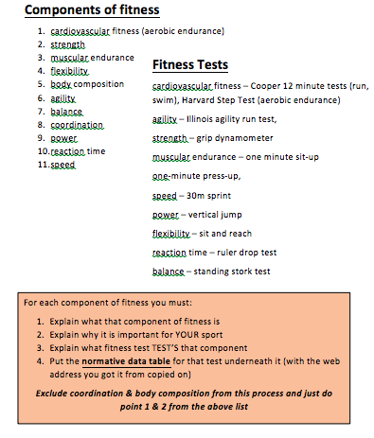
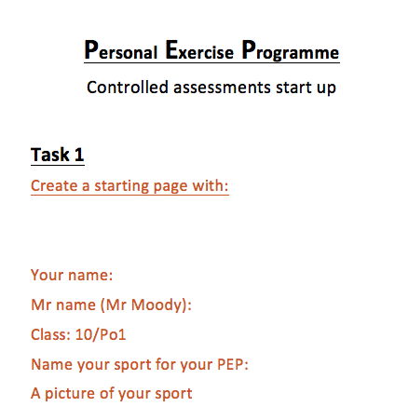
REMINDER

Slide 6
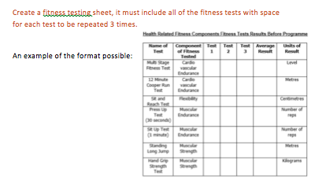
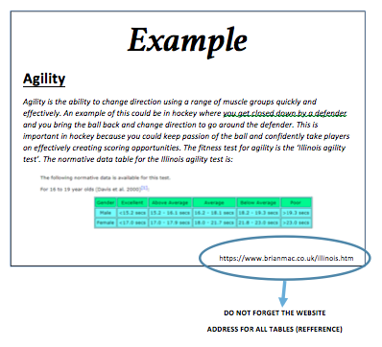
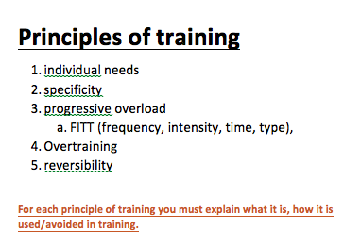

Slide 7
BREAKDOWN TO HALF TERM
W/C 7th Oct | W/C 14th Oct | W/C 21^{sr} Oct | HALF TERM
COMPONENTS / PoTS/ PARQ | AREAS OF STRENGTH / WEAKNESS | AIMS / TYPES OF TRAINING
WED = R Sweet available C009 |  | WED = R Sweet available C009
R Sweet available Wednesday after school to support / catch up on this for the next 3 weeks…C009
AIM to start the planning of the 6 week plan after half term!

Slide 8
Personal Exercise Plan
Target | GOOD | OUTSTANDING
4-5 | To show understanding of most | To apply knowledge and begin to evaluate ALL
6-9 | To apply knowledge and to evaluate ALL | To anaylse
TASK:
Independently work through your PEP
Explain what that component of fitness is
Explain why it is important for YOUR sport
Explain what fitness test TEST’S that component
Put the normative data table for that test underneath it (with the web address you got it from copied on – see the example in KDRIVE)
Exclude coordination & body composition from this process and just do point 1 & 2 from the above list

Slide 9
LESSON TWO

Slide 10
Do Now Activity
Components of fitness:
Explain how to improve your Strength
Good = State
Outstanding = Explain
Progressive overload: Frequency = Increase the time I do weight training every 3 weeks
Weight training = high weights, low reps to increase strength. Bicep curls, deadlifts, chest press
Principles of training
Methods of training
EXAMPLE

Slide 11
Do Now Activity
Components of fitness:
Explain how to improve your Strength
Good = State
Good = State
Outstanding = Explain
Principles of training
Methods of training

Slide 12
Do Now Activity
Components of fitness:
Explain how to improve your Cardiovascular Endurance
Good = State
Outstanding = Explain
Principles of training
Methods of training

Slide 13
Do Now Activity
Components of fitness:
Explain how to improve your Muscular Endurance
Good = State
Outstanding = Explain
Principles of training
Methods of training

Slide 14
Do Now Activity
Components of fitness:
Explain how to improve your Flexibilty
Good = State
Outstanding = Explain
Principles of training
Methods of training

Slide 15
BREAKDOWN TO HALF TERM
W/C 7th Oct | W/C 14th Oct | W/C 21^{sr} Oct | HALF TERM
COMPONENTS / PoTS/ PARQ | AREAS OF STRENGTH / WEAKNESS | AIMS / TYPES OF TRAINING
WED = R Sweet available C009 |  | WED = R Sweet available C009
DONE!
R Sweet available Wednesday after school to support / catch up on this for the next 3 weeks…C009
AIM to start the planning of the 6 week plan after half term!

Slide 16
Personal Exercise Plan
Target | GOOD | OUTSTANDING
4-5 | To show understanding of most | To apply knowledge and begin to evaluate ALL
6-9 | To apply knowledge and to evaluate ALL | To anaylse
Should be done!
AREAS OF STRENGTH / WEAKNESS
TASK:
Independently work through your PEP
Explain what that component of fitness is
Explain why it is important for YOUR sport
Explain what fitness test TEST’S that component
Put the normative data table for that test underneath it (with the web address you got it from copied on – see the example in KDRIVE)
Exclude coordination & body composition from this process and just do point 1 & 2 from the above list
EXTENSION:
CREATE results graphs on your results

Slide 18
LESSON THREE

Slide 19
Chloe wants to increase her fitness for netball. Her teacher suggests circuit training would be an appropriate method to use. Justify why this is an appropriate method of training and describe how you can plan for the principles of training over a 6 week plan
___ /9

Slide 20
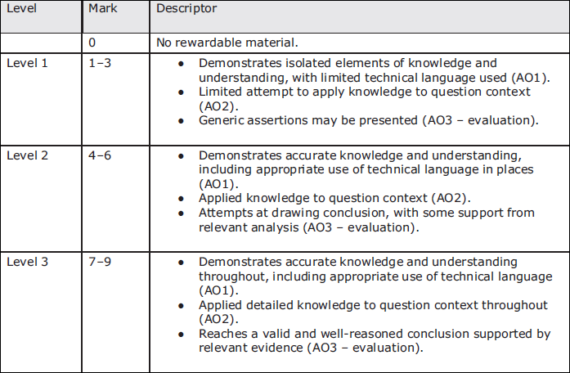
Mark Scheme

Slide 21
Connect
Identify what circuit training is
Identify all the Principles of training
Identify advantages and disadvantages of circuit training and justify other training principles a that would help in netball
Explain 4 stations you would use to improve Netball and how you would increase Progressive overload over the 6 weeks
Challenge
List all the methods of training with a simple definition of each

Slide 22
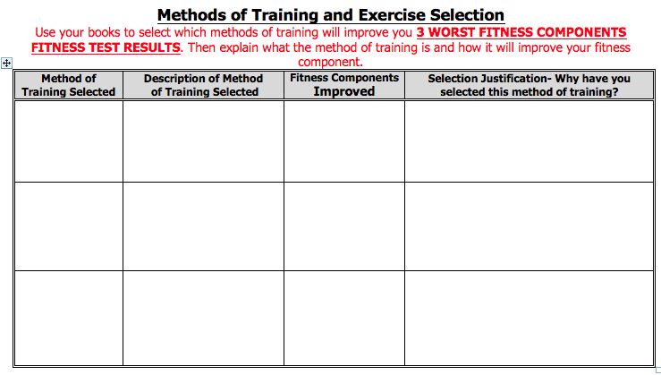
Personal Exercise Plan
Target | GOOD | OUTSTANDING
4-5 | To show understanding of most | To apply knowledge and begin to evaluate ALL
6-9 | To apply knowledge and to evaluate ALL | To anaylse
Should be done!
AREAS OF STRENGTH / WEAKNESS
TASK:
Independently work through your PEP
Explain what that component of fitness is
Explain why it is important for YOUR sport
Explain what fitness test TEST’S that component
Put the normative data table for that test underneath it (with the web address you got it from copied on – see the example in KDRIVE)
Exclude coordination & body composition from this process and just do point 1 & 2 from the above list
EXTENSION:
CREATE results graphs on your results

Slide 23
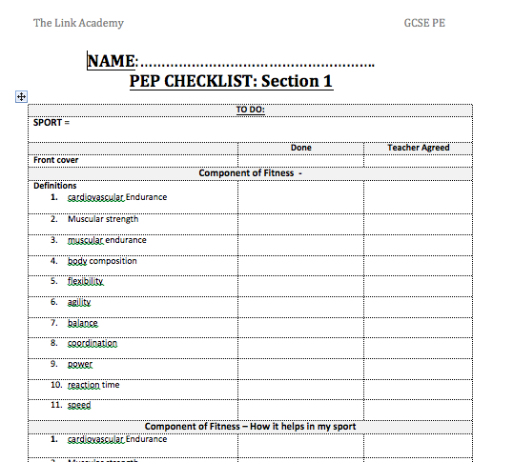
Work through this…

Slide 24
LESSON FOUR

Slide 25
Personal Exercise Plan
Target | GOOD | OUTSTANDING
4-5 | To show understanding of most | To apply knowledge and begin to evaluate ALL
6-9 | To apply knowledge and to evaluate ALL | To anaylse
Should be done!
TASK:
Independently work through your PEP
Explain what that component of fitness is
Explain why it is important for YOUR sport
Explain what fitness test TEST’S that component
Put the normative data table for that test underneath it (with the web address you got it from copied on – see the example in KDRIVE)
Exclude coordination & body composition from this process and just do point 1 & 2 from the above list
EXTENSION:
CREATE results graphs on your results

Slide 27
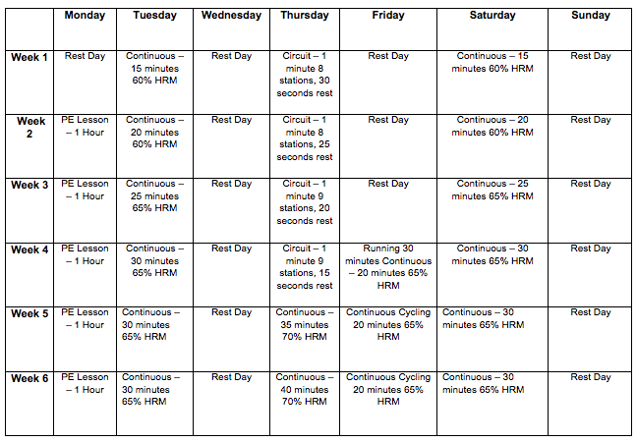
DO NOW ACTIVITY
Using the 6 week training programme answer the following questions
Week 1 -3 what is the frequency of training?
What types of training are they taking part in?
How has he increased his intensity on his continuous run?
How has he increased his intensity on his circuit training?
Has frequency increase? How?
How is the programme varied?
Doe the plan look like he has planned for moderation? (rest days etc…)
What would you suggest the aims of the programme are?

Slide 29
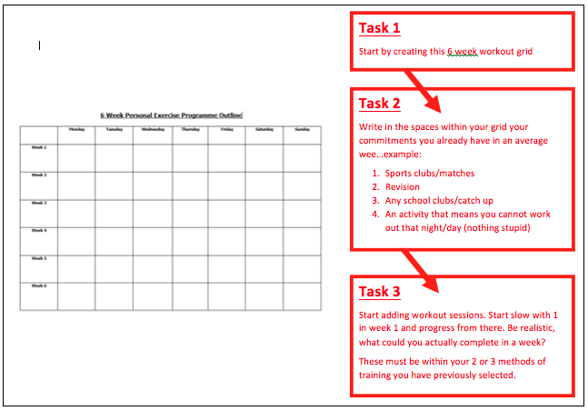

Slide 30
Personal Exercise Plan
Target | GOOD | OUTSTANDING
4-5 | To show understanding of most | To apply knowledge and begin to evaluate ALL
6-9 | To apply knowledge and to evaluate ALL | To anaylse
Should be done!
TASK:
Independently work through your PEP
Explain what that component of fitness is
Explain why it is important for YOUR sport
Explain what fitness test TEST’S that component
Put the normative data table for that test underneath it (with the web address you got it from copied on – see the example in KDRIVE)
Exclude coordination & body composition from this process and just do point 1 & 2 from the above list
EXTENSION:
CREATE results graphs on your results

Slide 31
Fitness Programme –
EXAMPLE
My Aim: To improve my cardiovascular endurance and muscle endurance.
I want to increase my cardiovascular endurance so I can last longer in a football game. Cardiovascular endurance is needed in a football game because you will need to last the full 90 minutes.
I want to improve my muscular endurance so throughout the match I can still be strong on the ball and to win the ball back even towards the end of the game, I need my muscles to still be strong so I can also make strong passes to my team.

Slide 32
Specific Goals
I will be doing continuous training because I need to improve my cardiovascular endurance, stamina and fitness for matches.
I will also be going to the gym and using the weights to do weight training to improve my muscular endurance.
Measurable Goal
Making sure that my target can be measured so that I can track my progress and know when I have achieved my target. I will measure mine and try and get to the next normative data level for both. I will measure this by doing the correct test for each of the components at the start, middle and end.
cardiovascular endurance = Cooper test
muscular endurance = Sit up and press up test
Achievable Goal
To make sure that my target is achievable to succeed in with my individual needs – I only have to increase my results by a little for my tests. I want to increase my
Cooper test = 500 m
Sit up = 5
press up test = 5
Realistic Goals which can be measured:
I will use fitness tests to measure my cardiovascular fitness. To do a better cooper run by at least 500m. For my first test I was put in poor from the norm data-if I improve it by 500m I will get into the next category which is below average. To improve my muscular endurance I will go to the gym and do weight training and try and increase both tests by 5 each which is realistic.
Time bound:
I will be doing a 6 week programme

Slide 33
My individual needs:
I will need to plan this around my school hours and when I play football matches and when I have football training. We do smart targets because we want to measure how we are doing in the training program and what we need to improve.
Variety of training:
For the variety of training I will be doing different exercises such as swimming and running for my cardiovascular fitness and weight training for my muscular endurance making sure I do different exercise. I also will be mixing them up and do running with my friend for my cardiovascular. The reason I will vary my activities is so that I don’t get bored.
Adaptability- how my programme can be adapted:
Most of can be inside and if it does rain for football you can go in the gym.
Moderation:
I have planned for rest days to allow for my body to rest and recover. My methods of training and frequency of training each take into consideration the amount of rest needed. It makes sure that there is enough rest time that allows for recovery to take place but not enough time so that reversibility occurs.

Slide 34
Progression:
Frequency
During the first week, I am going to train for 3 days with 4 days of rest, which in my opinion relates perfect to my current level of fitness. However, the following week I will have 4 days of work followed with 3 days of rest, which allows for progressive overload to occur meaning that my fitness will increase.
Intensity
During the interval training I will increase the percentage of heart rate I will be working at each week so that I am gradually increasing the stress onto my body, but not too much which would result in reversibility.
Time
At the first week I will perform the continuous training for 15 minutes, which I have agreed is a good amount of time which matches my current level of fitness including my current cardiovascular fitness. However, the next week I will increase the time of work to 20 minutes because the progressive overload will help increase my fitness, resulting in an increase on my cardiovascular endurance.
Type
I will be doing continuous training to improve my cardiovascular endurance - Exercises the body at a constant rate, keeping the heartbeat of the person between the aerobic thresholds of 60-80%. Continuous training is effective because if done correctly, it works the aerobic system and only that and therefore significantly increases the individual’s cardiovascular endurance. Also, there is little equipment needed and is fairly cheap to do continuous training which makes it effective for a student like me.
I will also be doing Circuit training which is A series of exercises, completed for a certain amount of time one after each other with periods of rest in between. It will help improve Muscular Endurance and Cardiovascular Endurance. Circuit training is the most important method of training because if planned correctly, it can help increase all 3 of my target components. Also, the short periods of rest after each station allows for my heart to recover this means that my heart will be stronger each week. Furthermore, I can adapt the circuit to help me achieve my aim and make sure it is meeting the aims

Slide 35
Evaluation and reflection:
I was happy with my results because I performed and improved a lot better than I initially thought. I was one of the best in class for cardiovascular fitness. I also improved in all the tests after my programme. I would choose the exact same programme because it worked so well for me this time round, but I would do a more varied continuous training with different activities. My programme aimed at my components I wanted to improve. I think including activities such as passing was good as it was a relevant activity to my sport. Next time I would probably add more muscular endurance activities that links to my sport. Maybe change the stations on week 3 as my body was used to them although I still tried hard I might have been more motivated after a change, but my layout aided my improvements. The way I planned using the principles of training helped as they ensured that I was reaching my targets and that my programme would actually be effective. My progressive overload was increased. My specific training for my aim. FITT was all used effectively with good adaption from my body.
Improvements
There are a few things that I need to improve I think on my programme.
I think it would be easier if I use a HR monitor to help work in zones more effectively. I also think changing the stations in my program on week 3 would help motivate me more. I did get bored of running so adapted my plan so I did more cycling as I enjoyed this more so I would plan for this and also start my continuous training harder as it was a little easy on the bike. I think also Listening to music when training to help more with motivation. The final thing is I would like to improve my circuit and put more muscular endurance stations in the circuit.

Slide 36
LESSON FIVE

Slide 37
Do Now Activity
Principles of training
Components of fitness
Health
Skill
Methods of training
___ / 29

Slide 38
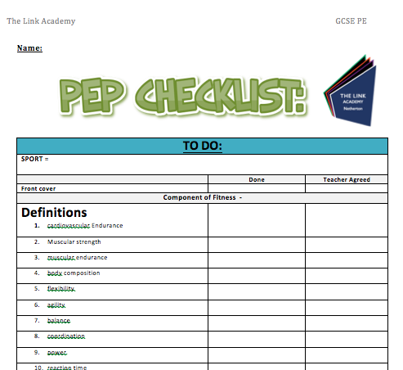
PEP CHECK

Slide 39
Personal Exercise Plan
Target | GOOD | OUTSTANDING
4-5 | To show understanding of most | To apply knowledge and begin to evaluate ALL
6-9 | To apply knowledge and to evaluate ALL | To anaylse
Should be done!
TASK:
Independently work through your PEP
Explain what that component of fitness is
Explain why it is important for YOUR sport
Explain what fitness test TEST’S that component
Put the normative data table for that test underneath it (with the web address you got it from copied on – see the example in KDRIVE)
Exclude coordination & body composition from this process and just do point 1 & 2 from the above list
EXTENSION:
CREATE results graphs on your results

