Slide 1
Task 1:
Example
Create your own title page for ‘Portrait Photography’ by copying some photographs of faces in different compositions from the internet.

Slide 2
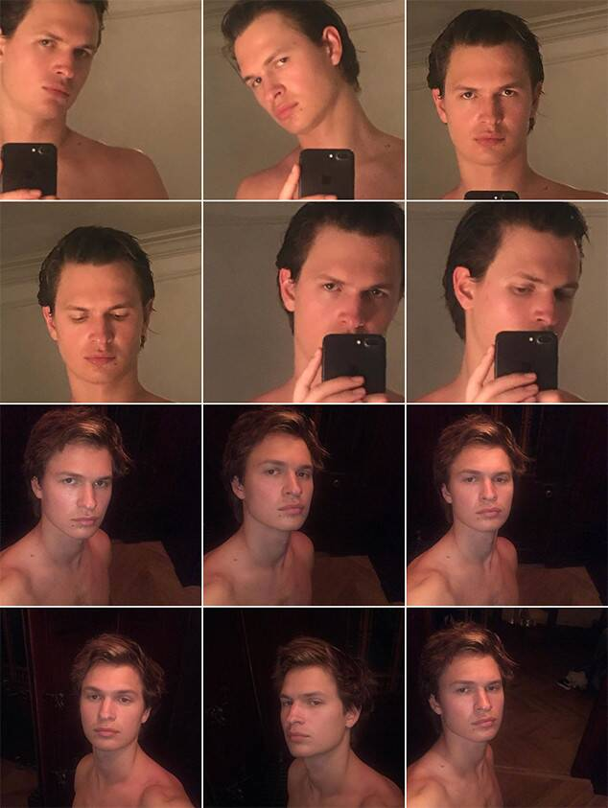
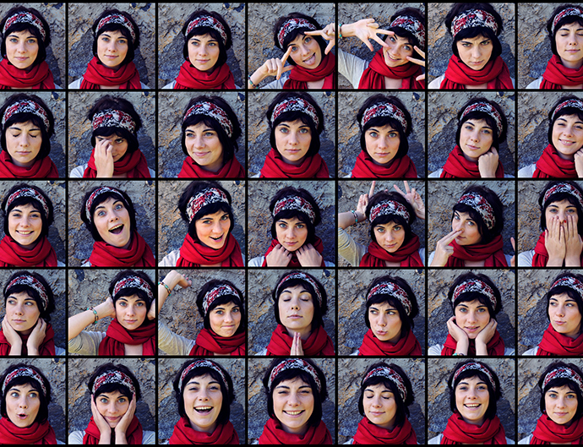
Task 2:
Selfies from different angles and compositions
Using your phone or a camera, take various photos of yourself (or someone else) from
different angles – above, below, move
the camera around. Change your
expressions on your face.
Choose you best photos – (5 minimum) and
Copy them to a powerpoint or use the free
App ‘picollage’ to arrange these photos and
Email it to your Art teacher.

Slide 3
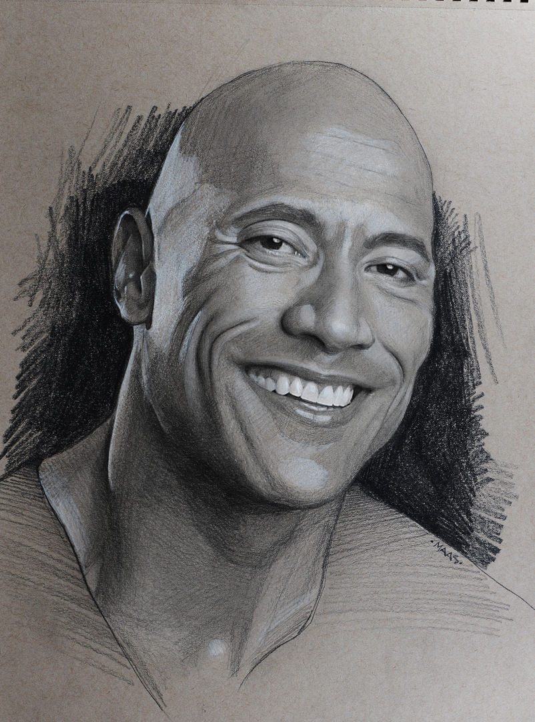
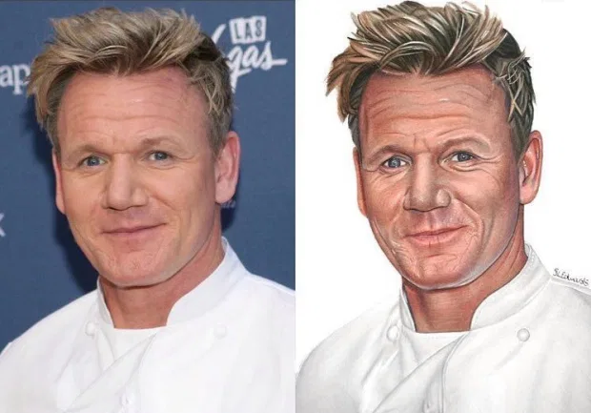
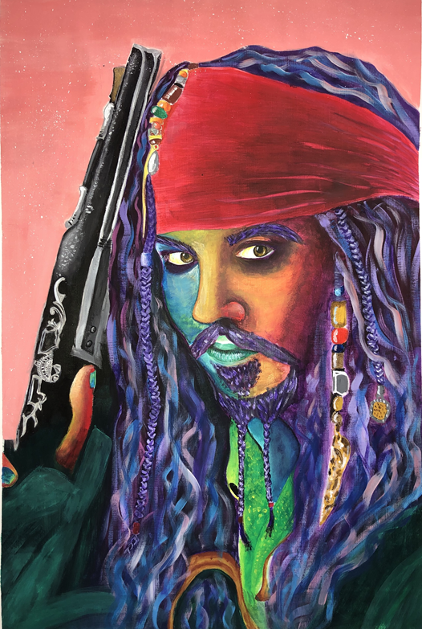
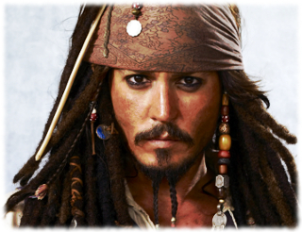
Task 3:
Copy a famous face using pencil or crayon or paint. You could try using a grid to help you get the features in the correct position

Slide 4
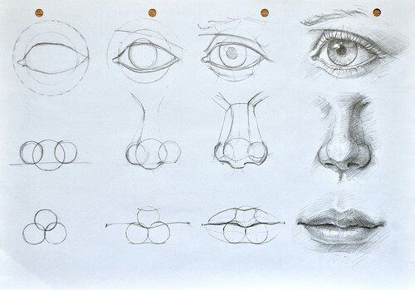
Task 4:
Practise these constructions of the facial features. You could use a mirror to copy the details of your own eye/nose/lips.

Slide 5
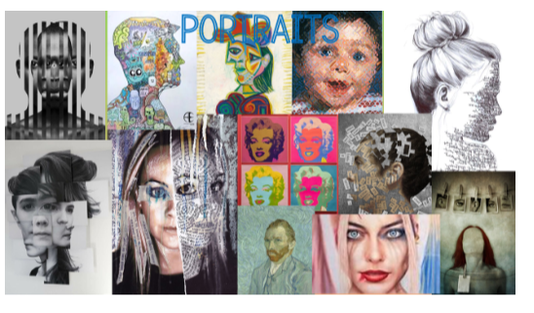
Find several different artistic styles of portraits that you like and collage onto the page. Add title 'Portraits‘ Add artists’ / designers’ name. Hint: Sign into Pintrest to find better quality and variety of art works
Task 5:

