Slide 1
CwK
Thursday, 24 September 2020
Health and Disease
Do Now Activity
List any infectious diseases that you have had since birth.
Infectious means you can catch it.

Slide 2
Progress Indicators
Good Progress
List two communicable and two non-communicable diseases
Describe ways in which pathogens can be spread.
Describe how bacteria and viruses cause disease.
Outstanding Progress
Explain the main differences between bacteria and virus.

Slide 3
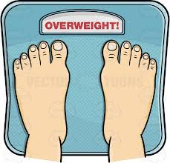
Who is the healthiest and why?
John Jim James
Your health is a state of physical and mental well-being. It is not just an absence of disease. All of these people are not healthy. For example, John does not have a disease, but he was stressed, so he is not healthy. James is unhealthy now as he has the flu, but he may be healthiest soon!

Slide 4
Health
Defined as a state of physical and mental well being.
Ill health can be caused by both communicable and non-communicable disease
It can also be caused by poor diet, stress,

Slide 5
Communicable Disease
Non-Communicable Disease
spread from person to person
Spread by pathogens
Bacteria, virus, protist and fungi
Examples-Flu and measles
Cannot be spread person to person
Examples- heart disease,

Slide 6
Pathogens
Pathogens are microorganisms that spread disease
Pathogens are bacteria, virus, protist and fungi

Slide 7
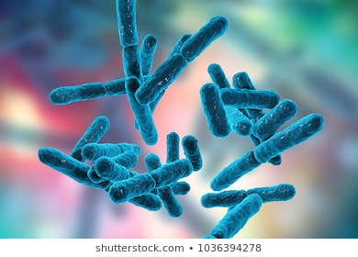
Bacteria
Reproduce rapidly
Release harmful chemicals called toxins
Toxins damage tissues and make us feel ill
Can be killed by antibiotics

Slide 8
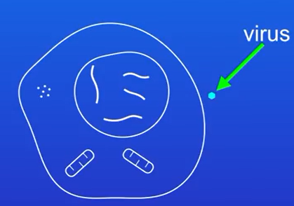
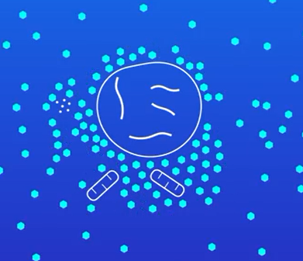
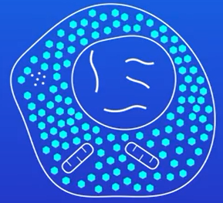
Virus
Cannot reproduce by themselves
Can only reproduce inside a host cell
This damages the cell, causes the cell to burst open and die
Cannot be killed with antibiotics

Slide 9
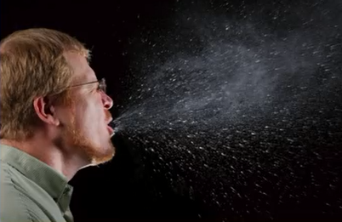
How are pathogens spread?
HIV
Direct Contact
Air-Flu
Water
Cholera

Slide 10
How can we reduce the spread of disease?
Washing hands
Chlorine in drinking water kills microorganisms
Condoms
Isolate patients with highly infectious diseases- Ebola
Vaccination

Slide 11
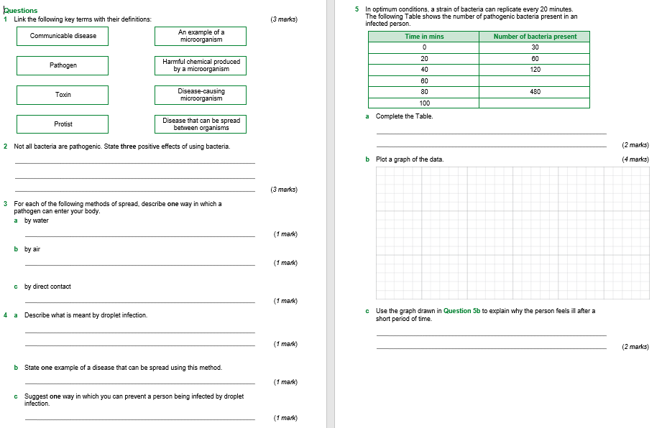

Slide 12
Plenary
Define what is meant by the term health.
List two communicable and two non-communicable diseases
State two other factors that can affect health

