Slide 1
DNA:
5 minutes.
5 questions.
Answer in full sentences.
TRUE OR FALSE. In the 16th Century it was common to get married at a young age. | 2. TRUE OR FALSE. In the 16th Century you had to get permission from your parents if you wanted to marry someone, otherwise it was breaking the law. | 3. Name 3 themes that Shakespeare presents in Romeo and Juliet (think back to lesson 1) | 4. Explain the term ‘patriarchal society’. | 5. Why is it important that Shakespeare structured the play to show Romeo in love with Rosaline at the start, when we know he is fated to marry Juliet?

Slide 2
BIG QUESTION: Explore how Shakespeare presents the characters of Romeo and Juliet throughout the play.
C/W Monday, 28 June 2021
Juliet’s marriage
Lesson Focus: To explore the theme of parental relationships through reading Act 1, scene 3 and the poem Catrin

Slide 3
BIG QUESTION: Explore how Shakespeare presents the characters of Romeo and Juliet throughout the play.
Imagine that one day when you get home from school, your mum comes into your room with some important news while you are doing your homework.
She’s bursting with excitement and can barely contain herself.
‘What is it?’ you ask.
‘I’ve arranged for you to get married!’ she replies.
‘To who?’ you cry.
‘No one you know!’
How would you explain to your mom how you feel about the marriage?

Slide 4
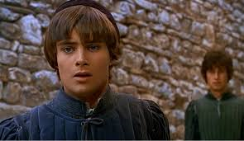
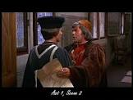
BIG QUESTION: Explore how Shakespeare presents the characters of Romeo and Juliet throughout the play.
At the end of Act 1, scene 1, Romeo is in extreme turmoil because of his love for Rosaline. He says goodbye to Benvolio, telling him that he sees a beautiful woman then he will not forget Rosaline’s beauty.
“Farewell. Thou canst not teach me to forget.”
In Act 1, scene 2 Capulet talks to Paris, a nobel kinsman of The Prince of Verona. The two discuss Paris’ desire to marry Capulet’s daughter, Juliet. Capulet is overjoyed, but also states that Juliet has “not seen the change of fourteen years” (13) and is therefore too young to get married. He politely asks Paris to wait two years unless he can charm her and make her love him, then he will give consent.
“But woo her, gentle Paris, get her heart.”

Slide 5
BIG QUESTION: Explore how Shakespeare presents the characters of Romeo and Juliet throughout the play.
Reading Act 1, Scene 3 - Lines 65 - 100
Things to think about as we read:
What is Juliet’s response to the idea of marriage?
What does her response say about her relationship with her parents?
Was her reaction very different to yours?
What do you think this says about the way children treated their parents then and now?
How much does Juliet speak? Why do you think this is?
Line by line read

Slide 6
LADY CAPULET 65Marry, that “marry” is the very theme I came to talk of. Tell me, daughter Juliet, How stands your disposition to be married? | LADY CAPULET Well, marriage is exactly what we have to discuss. Tell me, my daughter Juliet, what is your attitude about getting married?
JULIET It is an honor that I dream not of. | JULIET It is an honor that I do not dream of.
NURSE An honor! Were not I thine only nurse, 70I would say thou hadst sucked wisdom from thy teat. | NURSE “An honor?” If I weren’t your only nurse, I’d say you had sucked wisdom from the breast that fed you.
LADY CAPULET Well, think of marriage now. Younger than you Here in Verona, ladies of esteem Are made already mothers. By my count, I was your mother much upon these years 75That you are now a maid. Thus then in brief: The valiant Paris seeks you for his love. | LADY CAPULET Well, start thinking about marriage now. Here in Verona there are girls younger than you—girls from noble families—who have already become mothers. By my count, I was already your mother at just about your age, while you remain a virgin. Well then, I’ll say this quickly: the valiant Paris wants you as his bride.
NURSE A man, young lady! Lady, such a man As all the world. Why, he’s a man of wax. | NURSE What a man, young lady. He’s as great a man as any in the whole world. He’s as perfect as if he were sculpted from wax.
LADY CAPULET Verona’s summer hath not such a flower. | LADY CAPULET Summertime in Verona has no flower as fine as him.
Notes:
TDQ:
- What does the word ‘honour’ mean? What are the connotations? Why is it paired with the word ‘dream’? What are the differences between these two words? What is Juliet implying?

Slide 7
NURSE 80Nay, he’s a flower. In faith, a very flower. | NURSE No, he’s a fine flower, truly, a flower.
LADY CAPULET What say you? Can you love the gentleman? This night you shall behold him at our feast. Read o'er the volume of young Paris' face And find delight writ there with beauty’s pen. 85Examine every married lineament And see how one another lends content, And what obscured in this fair volume lies Find written in the margin of his eyes. This precious book of love, this unbound lover, 90To beautify him only lacks a cover. The fish lives in the sea, and ’tis much pride For fair without the fair within to hide. That book in many’s eyes doth share the glory That in gold clasps locks in the golden story. 95So shall you share all that he doth possess By having him, making yourself no less. | LADY CAPULET (to JULIET) What do you say? Can you love this gentleman? Tonight you’ll see him at our feast. Study Paris’s face and find pleasure in his beauty. Examine every line of his features and see how they work together to make him handsome. If you are confused, just look into his eyes. This man is single, and he lacks only a bride to make him perfect and complete. As is right, fish live in the sea, and it’s wrong for a beauty like you to hide from a handsome man like him. Many people think he’s handsome, and whoever becomes his bride will be just as admired. You would share all that he possesses, and by having him, you would lose nothing.
NURSE No less? Nay, bigger. Women grow by men. | NURSE Lose nothing? In fact, you’d get bigger. Men make women bigger by getting them pregnant.
LADY CAPULET Speak briefly. Can you like of Paris, love? | LADY CAPULET (to JULIET) Give us a quick answer. Can you accept Paris’s love?
JULIET I’ll look to like if looking liking move. 100But no more deep will I endart mine eye Than your consent gives strength to make it fly. | JULIET I’ll look at him and try to like him, at least if what I see is likable. But I won’t let myself fall for him any more than your permission allows.
Notes:
Highlighted Juliet’s speech
TDQs – Why does Juliet mention the word ‘consent’? Why is that important that she mentions this as a child in Elizabethan times?

Slide 8
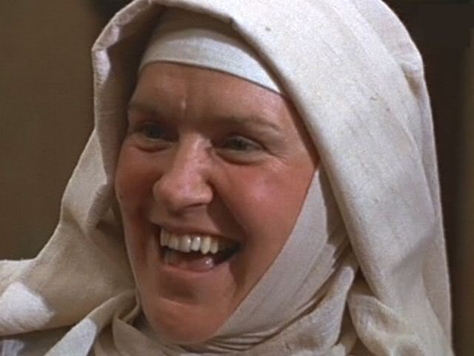
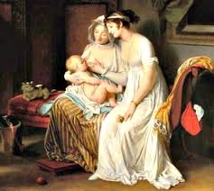
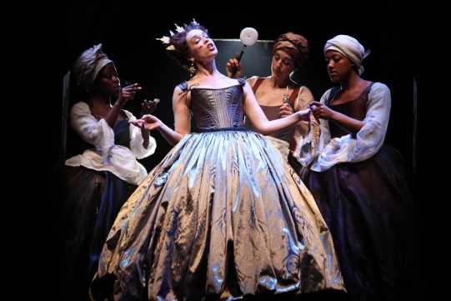
BIG QUESTION: Explore how Shakespeare presents the characters of Romeo and Juliet throughout the play.
Juliet is much closer to the Nurse than she is to her mother. The Nurse has taken care of her since she was born, and was even her “wet nurse” when she was a baby (this means that the Nurse breastfed Juliet, not Lady Capulet).
This was very common in wealthy families in Elizabethan times.
Notes:
TEACHER NOTES:
Explain to students the submissive behaviour of Juliet and lack of speech in the scene. Therefore, we must look at the presentation of other characters and her relationships with them.

Slide 9
BIG QUESTION: Explore how Shakespeare presents the characters of Romeo and Juliet throughout the play.
Let’s read a modern poem called “Catrin” by Gillian Clarke.
I can remember you, child,
As I stood in a hot, white
Room at the window watching
The people and cars taking
Turn at the traffic lights.
Neither won nor lost the struggle
In the glass tank clouded with feelings
Which changed us both. Still I am fighting
You off, as you stand there
With your straight, strong, long
Brown hair and your rosy,
Defiant glare, bringing up
From the heart's pool that old rope,
I can remember you, our first
Fierce confrontation, the tight
Red rope of love which we both
Fought over. It was a square
Environmental blank, disinfected
Of paintings or toys. I wrote
Tightening about my life,
Trailing love and conflict,
As you ask may you skate
In the dark, for one more hour.
All over the walls with my
Words, coloured the clean squares
With the wild, tender circles
Of our struggle to become
Separate. We want, we shouted,
To be two, to be ourselves.
How does this mother feel about her daughter?
Is it similar in any way to the relationship between Juliet and her mother? How do you know?
Notes:
https://www.youtube.com/watch?v=N2V0KQPDBms

Slide 10
BIG QUESTION: Explore how Shakespeare presents the characters of Romeo and Juliet throughout the play.
Close Language Analysis
1.‘Fierce confrontation’: What insight does this give us into their relationship?
2. What connotations does the ‘Red rope of love’ have? What device is being used here?
3. Discuss how the notion of becoming ‘separate’ can be read both literally and metaphorically.

Slide 11
BIG QUESTION: Explore how Shakespeare presents the characters of Romeo and Juliet throughout the play.
Close Language Analysis – Explode a quote
“…tight Red rope of love which we both fought over”
CHALLENGE: How does this quotation link to Juliet’s relationship with her mother?
Notes:
NOTES TO START LINKING TO JULIET:
Two opposing sides locked in a struggle (birth or ongoing) – enjambment
“red rope of love” - Metaphor for the umbilical cord – representing the last time Juliet felt a true connection/bond with her mother?
“rope” – tug of war? Fight? Foreshadowing events to come?
The baby is removed from a position where it is safe, warm and comforted into the unknown – Juliet’s desires to remove herself from the expectations of society/arranged marriage that she “dreams not of”
“Red” – symbolism of passion/blood – we already know from the Prologue that Juliet is going to die

Slide 12
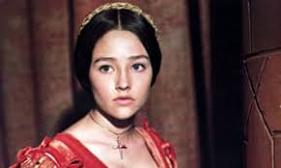
BIG QUESTION: Explore how Shakespeare presents the characters of Romeo and Juliet throughout the play.
This is our first impression of Juliet. Shakespeare has deliberately made the choice to introduce Juliet with her mother and nurse as the action rises.
What does this tell us about Juliet?
Why has Shakespeare has done this now?

Slide 13
BIG QUESTION: Explore how Shakespeare presents the characters of Romeo and Juliet throughout the play.
Plenary:
Complete the exit ticket.
Exit Ticket – Family relationships
Use a maximum of 5 words to describe what Juliet’s relationship is like with her mother.
Why is it important that Juliet uses words such as ‘honour’ and ‘consent’ when speaking to her mother?
What ideas are presented in Act 1, scene 3? (link to the poem)

Slide 14
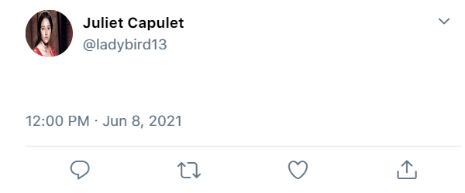
DNA: Create a tweet as Juliet after you have heard the news from Lady Capulet. How does Juliet feel? Aim to use 30 words and at least 1 hashtag.
CHALLENGE: Use the words – honour, dream and consent

Slide 15
BIG QUESTION: Explore how Shakespeare presents the characters of Romeo and Juliet throughout the play.
C/W Monday, 28 June 2021
Romeo and Juliet’s first meeting
Lesson Focus: To explain how language is used in Act 1, scene 5 to portray love and romance between Romeo and Juliet

Slide 16
BIG QUESTION: Explore how Shakespeare presents the characters of Romeo and Juliet throughout the play.
Word Consciousness
Use it
Draw it
Celestial (adj): belonging or relating to heaven or extremely good.
Challenge: What links can you make to words you already know?
Synonyms
Debate it

Slide 17
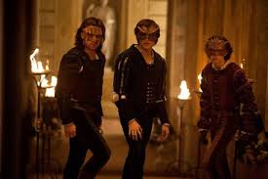
BIG QUESTION: Explore how Shakespeare presents the characters of Romeo and Juliet throughout the play.
In Act 1 scene 4, Romeo, Benvolio, Mercutio and friends are on their way to crash the masquerade party at the Capulet mansion. Romeo doesn’t want to go as he is still depressed over Rosaline and says he will not dance. Romeo fears that something bad is going to come of this night; i.e. he might die.
“Some consequence yet hanging in the stars shall bitterly begin his fearful date.”
Act 1 scene 5 starts by Capulet welcoming everyone to his party. Moving through the crowd, Tybalt hears and recognizes Romeo’s voice. Realising that there is a Montague present, Tybalt sends a servant to fetch his sword. Capulet overhears Tybalt and scolds him, telling him that Romeo is well regarded in Verona, and that he will not have the youth harmed at his feast.
As is common in this play, this violence is then juxtaposed with Romeo falling in love with Juliet, and the first time that Romeo and Juliet meet.

Slide 18
A key term: sonnet
BIG QUESTION: Explore how Shakespeare presents the characters of Romeo and Juliet throughout the play.
Keep this in mind as we explore the scene…
What do you know about the sonnet form?
Hint: it’s a type of poem…
A type of poem that deals with themes of love and/or death
It contains 14 lines
The rhyme scheme is abab cdcd efef gg
It’s written in iambic pentameter (10 syllables per line with 5 stresses – it sounds like a heartbeat)
Shakespeare wrote 154 of them!

Slide 19
ROMEO 40(to a SERVINGMAN) What lady is that which doth enrich the hand Of yonder knight? | ROMEO (to a SERVINGMAN) Who is the girl on the arm of that lucky knight over there?
SERVINGMAN I know not, sir. | SERVINGMAN I don’t know, sir.
ROMEO Oh, she doth teach the torches to burn bright! It seems she hangs upon the cheek of night Like a rich jewel in an Ethiope’s ear, 45Beauty too rich for use, for earth too dear. So shows a snowy dove trooping with crows As yonder lady o'er her fellows shows. The measure done, I’ll watch her place of stand, And, touching hers, make blessèd my rude hand. 50Did my heart love till now? Forswear it, sight! For I ne'er saw true beauty till this night. | ROMEO Oh, she shows the torches how to burn bright! She stands out against the darkness like a jeweled earring hanging against the cheek of an African. Her beauty is too good for this world; she’s too beautiful to die and be buried. She outshines the other women like a white dove in the middle of a flock of crows. When this dance is over, I’ll see where she stands, and then I’ll touch her hand with my rough and ugly one. Did my heart ever love anyone before this moment? My eyes were liars, then, because I never saw true beauty before tonight.

Slide 20
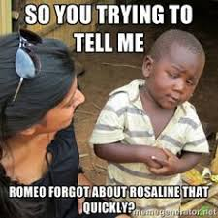
Romeo sees Juliet
BIG QUESTION: Explore how Shakespeare presents the characters of Romeo and Juliet throughout the play.
Read Romeo’s first reaction to seeing Juliet .
(‘What lady’s that…’ to ‘I ne’er saw true beauty til this night’)
How does he react to seeing her?
As we read, highlight quotations that stand out to you the most – get ready to explain why.

Slide 21
Romeo sees Juliet
BIG QUESTION: Explore how Shakespeare presents the characters of Romeo and Juliet throughout the play.
Annotate your text in response to these questions.
CHALLENGE: everyone must do these
EXTRA CHALLENGE: most of you should do these
SUPER CHALLENGE: some of you could attempt these
How do we know that Romeo wants to find out more about Juliet?
How do we know that Romeo thinks Juliet is more beautiful than anyone else in the room?
What do the questions and exclamations reveal about how Romeo is feeling?
What does Romeo mean when he says ‘she doth teach the torches to burn bright’? What is the effect of the language here?
Why does Romeo make a contrast between ‘a snowy dove trooping with crows’? Explore the symbolism here.
Why do you think Shakespeare chose to write this speech in rhyming couplets?
‘I ne’er saw true beauty til this night’ – what does this line suggest about Romeo’s earlier feelings for Rosaline? What do you think of Romeo at this point?
Progress Indicators:
Good –
Outstanding -

Slide 22
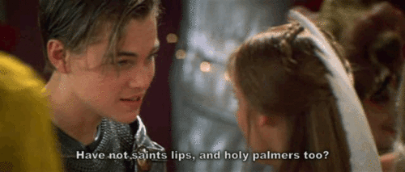
Romeo and Juliet meet
BIG QUESTION: Explore how Shakespeare presents the characters of Romeo and Juliet throughout the play.
In front of you, you have a ‘crunched’ copy of the words that make up Romeo and Juliet’s first conversation, arranged in alphabetical order.
What do you notice?
What do you think is happening?
Notes:
Resource – R+J Lesson 7 – Crunched extract

Slide 23
Act 1.5 Romeo and Juliet’s first meeting – word scramble
a and and ay blushing dear despair devotion do do do do do effect faith for for gentle good grant grant hand hand hands hands hands have have holy holy holy I I if in in is is kiss kiss lest let lips lips lips lips mannerly move move much must my my my not not not O palm palm palmers palmers' pilgrim pilgrim pilgrims pilgrims' pray prayer prayer's prayers' profane ready rough saint saints saints saints sake shows shrine sin smooth stand take tender that that that the then then they they this this this thou though to to to too too touch touch turn two unworthiest use what which while with with wrong you your

Slide 24
Romeo and Juliet meet
BIG QUESTION: Explore how Shakespeare presents the characters of Romeo and Juliet throughout the play.
Annotate the handout to show your ideas
Now share ideas in your tables:
Do any words grab your attention? What? Why?
Are there more nouns, verbs, adjectives, etc? What is the effect of this?
Are there any repeated words that you think might be significant? What is the effect of this?
Are there any groups of words that refer to similar things? What is the effect of this?
What’s the mood and atmosphere? What creates this?
What are they talking about?
What do you think they are doing during the conversation?
What do you think is going to happen at the end of the conversation?
Notes:
TDQs on word level

Slide 25
Romeo and Juliet meet
BIG QUESTION: Explore how Shakespeare presents the characters of Romeo and Juliet throughout the play.
Use as many of the words as you can to create your own version of the conversation they might be having.
Some things to consider…
There is, obviously, an element of romance in this conversation.
However, there is also some lively verbal fencing between the two as they tease and flirt.
Romeo is also bit of a ‘lad’ – and makes some cheeky, ‘typically male’ advances.
Juliet’s ‘typically female’ replies are a little more restrained – but still encouraging.
At the end of the conversation, they kiss.
Challenge: Write it in the style of a sonnet.

Slide 26
BIG QUESTION: Explore how Shakespeare presents the characters of Romeo and Juliet throughout the play.
Plenary:
Complete the exit card.
Exit Ticket – Love at First Sight
Complete the sentence:
Shakespeare shows that Romeo is infatuated by Juliet when he first sees her, as he immediately says “__________________________”.
2. Why is it important that you know what a sonnet is?
3. Linking to context, why is it significant that Romeo and Juliet keep making religious references?

Slide 27
DNA: Recall and Retrieval
Today we are going to continue with Act 1 scene 5. Let’s see how much you remembered from the last few lessons.
What is a sonnet? | What does the word ‘melancholy’ mean? | Give one reason why Romeo does not want to attend the Capulet party.
Where is the play set? | Name 3 words that are repeated at least 3 times when Romeo and Juliet first meet. | Write down one of the opposites that Romeo uses in Act 1 scene 1.
1 horizontal line = 1 merit
Full house = 3 merits

Slide 28
DNA: Recall and Retrieval
Today we are going to continue with Act 1 scene 5. Let’s see how much you remembered from the last few lessons.
A love poem containing 14 lines with alternate rhyme and a rhyming couplet at the end. | A feeling of thoughtful sadness, typically with no obvious cause. | He is still depressed over Rosaline. He fears something bad will happen.
Verona | ‘do’, ‘lips’, ‘prayer’, ‘pilgrim’, ‘palm’, ‘not’, ‘holy’, ‘hands’ | “brawling love” “loving hate” “heavy lightness” “bright smoke” “sick health”
1 horizontal line = 1 merit
Full house = 3 merits

Slide 29
BIG QUESTION: Explore how Shakespeare presents the characters of Romeo and Juliet throughout the play.
C/W Monday, 28 June 2021
Act 1, scene 5 continued
Lesson Focus: To explain how language is used in Act 1, scene 5 to portray love and romance between Romeo and Juliet

Slide 30
Romeo and Juliet’s shared sonnet
BIG QUESTION: Explore how Shakespeare presents the characters of Romeo and Juliet throughout the play.
ROMEO
If I profane with my unworthiest hand This holy shrine, the gentle fine is this: My lips, two blushing pilgrims, ready stand To smooth that rough touch with a tender kiss. JULIET
Good pilgrim, you do wrong your hand too much, Which mannerly devotion shows in this; For saints have hands that pilgrims' hands do touch, And palm to palm is holy palmers' kiss. ROMEO
Have not saints lips, and holy palmers too? JULIET
Ay, pilgrim, lips that they must use in prayer. ROMEO
O, then, dear saint, let lips do what hands do; They pray, grant thou, lest faith turn to despair. JULIET
Saints do not move, though grant for prayers' sake. ROMEO
Then move not, while my prayer's effect I take.
Why is the sonnet form an appropriate way to bring the two lovers together?
Challenge:
Why do you think Shakespeare has Romeo and Juliet share the lines of the sonnet?

Slide 31
BIG QUESTION: Explore how Shakespeare presents the characters of Romeo and Juliet throughout the play.
Notes:
https://www.youtube.com/watch?time_continue=31&v=YY85VwSHFmA&feature=emb_logo

Slide 32
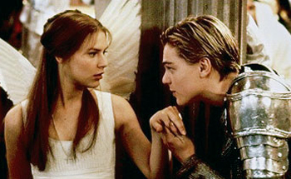
Religious imagery
BIG QUESTION: Explore how Shakespeare presents the characters of Romeo and Juliet throughout the play.
Romeo and Juliet’s sonnet is full of religious imagery.
Look back through the speech and highlight all the examples of religious words and phrases.
Why do you think there are so many?
What is Romeo comparing Juliet to?
Do you think religion would have been important at the time?
Thinking about the importance of religion, why is it significant that Juliet is compared to the ‘holy shrine’?
Key vocab
Shrine – a holy or sacred place dedicated to a saint/god
Pilgrimage – a religious journey (often to a shrine)
Pilgrim – someone who goes on a pilgrimage
SUPPORT: If you are stuck, use the help sheet.
Notes:
Resource – R+J Lesson 8 – Help sheet

Slide 33
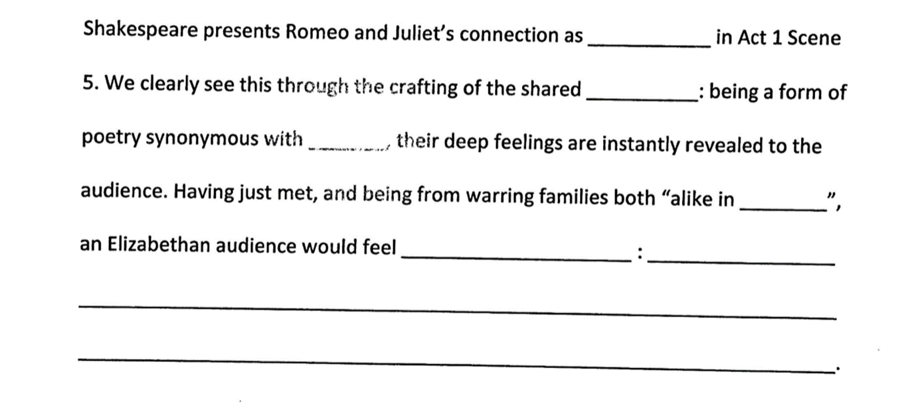
BIG QUESTION: Explore how Shakespeare presents the characters of Romeo and Juliet throughout the play.
DEMONSTRATE: How does Shakespeare present Romeo and Juliet’s connection in their first meeting?
WE DO:

Slide 34
BIG QUESTION: Explore how Shakespeare presents the characters of Romeo and Juliet throughout the play.
DEMONSTRATE: How does Shakespeare present Romeo and Juliet’s connection in their first meeting?
YOU DO:
CHALLENGE: Can you link that to the context of Elizabethan England?

Slide 35
DNA: Re-call challenge 3 MINUTES
What are the names of the two families Romeo & Juliet belong to? | What is the name of the girl Romeo believes he is in love with at the start of the play? | Which other characters, apart from Romeo & Juliet, have we been introduced to so far?
CHALLENGE: What is the purpose of the girl Romeo believes he is in love with? Why did Shakespeare include her as a character we never see?
Notes:
List can be differentiated.

Slide 36
BIG QUESTION: Explore how Shakespeare presents the characters of Romeo and Juliet throughout the play.
C/W Monday, 28 June 2021
Act 2 Scene 2 – ‘The Balcony Scene’
Lesson Focus: To understand the events of Act 2 Sc 2 and explore some of Shakespeare’s methods.

Slide 37
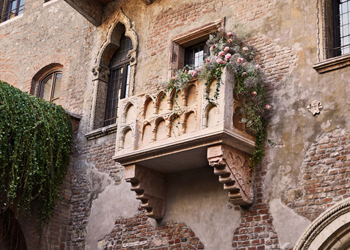
Word Consciousness – Please record on the back page of your exercise books
Word and definition | Your definition Synonyms
Balcony (n) a platform on the outside of a building
Vestal (a) associated with the Roman goddess of virginity, Vesta
Livery (n) uniform worn by a servant

Slide 38
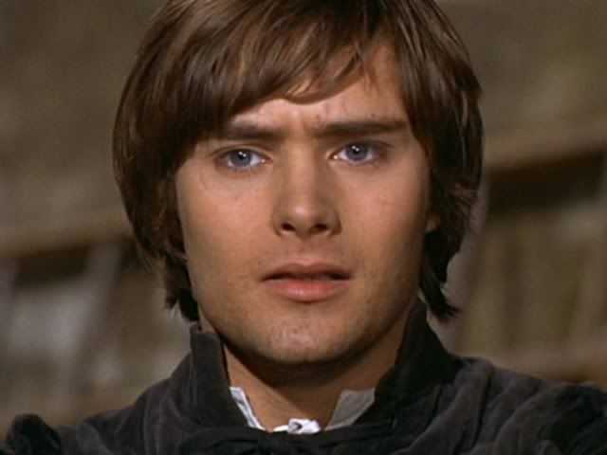
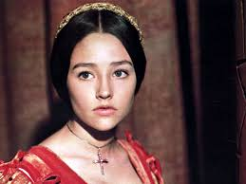
BIG QUESTION: Explore how Shakespeare presents the characters of Romeo and Juliet throughout the play.
At the end of Act 1 Scene 5, Romeo and Juliet are separated by the nurse and find out that they are from rival families.
They are understandably upset by this news:
O dear account! My life is my foe’s debt
My only love sprung from my only hate
Progress Indicators:
Good –
Outstanding -

Slide 39
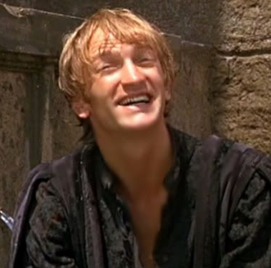
BIG QUESTION: Explore how Shakespeare presents the characters of Romeo and Juliet throughout the play.
Act 2 Scene 1 sees Mercutio and Benvolio looking for Romeo outside the Capulet house and making rude jokes about his love for Rosaline.
They don’t know that Romeo has met Juliet and that he has jumped over the orchard walls and gone back to the Capulet house to seek her out.
I conjure thee by Rosaline’s bright eyes,
By her high forehead and her scarlet lip,
By her fine foot, straight leg, and quivering thigh,
And the demesnes that there adjacent lie,
demesnes (n.) = a piece of land attached to a manor for the Lord’s personal use

Slide 40
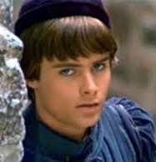
BIG QUESTION: Explore how Shakespeare presents the characters of Romeo and Juliet throughout the play.
Writers’ methods
In the assessment you will be expected to talk about writers’ methods. A writer’s method is, simply, any deliberate choice a writer makes in order to have an effect on their audience.
For example, Shakespeare made a deliberate choice to set Romeo & Juliet in Verona, Italy. For Elizabethans, Italy was particularly associated with romantic passion and they would also have believed that hot climates induced passionate and sometimes irrational behaviour.
This, in turn, would have made Romeo & Juliet’s tragic story seem almost inevitable to the audience, as Romeo & Juliet would have found it difficult to control their feelings due to a mixture of climate and culture.
For now, these hot days, is the mad blood stirring
- Benvolio

Slide 41
Shakespeare presents the characters of Romeo and Juliet
BIG QUESTION: Explore how Shakespeare presents the characters of Romeo and Juliet throughout the play.
Shakespeare has already shown us that Romeo is passionate and impulsive by the speed at which he falls out of love with Rosaline and in love with Juliet.
In Act 2 Sc 2 he continues to present Romeo as impulsive and passionate…and we discover that Juliet can be too!
By setting the play in the warmth and passionate culture of Italy, the speed and strength of the lovers’ passion perhaps feels more believable to the audience.

Slide 42
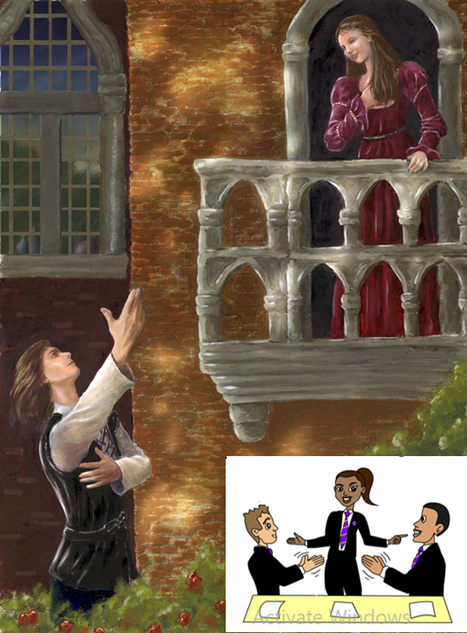
BIG QUESTION: Explore how Shakespeare presents the characters of Romeo and Juliet throughout the play.
Shakespeare deliberately chooses to make the second meeting between Romeo & Juliet private (unlike the first time they meet at the party). Why do you think he might have done that and what effect does it have on their emotions and how they express them?
Why might Shakespeare have deliberately chosen to physically separate the lovers by placing Juliet on a balcony?
Notes:
Hyperlink to video in image

Slide 43
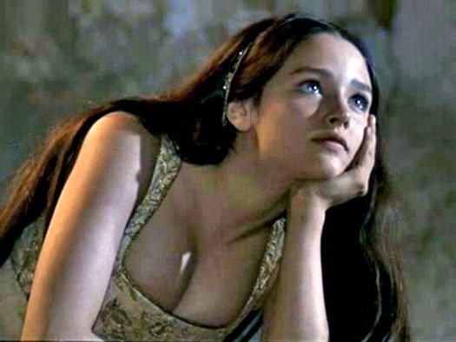
BIG QUESTION: Explore how Shakespeare presents the characters of Romeo and Juliet throughout the play.
O Romeo, Romeo! Wherefore art thou Romeo?
Deny thy father and refuse thy name.
Or, if thou wilt not, be but sworn my love,
And I’ll no longer be a Capulet.
wherefore (adv.)
= for what reason; why
What is Juliet asking in her opening line?
What does she ask Romeo to do? What does she say she will do if he won’t?
How would an Elizabethan audience have reacted to hearing a daughter say these things? Why?
What does it reveal about Juliet and her feelings for Romeo?

Slide 44
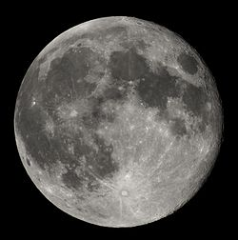
BIG QUESTION: Explore how Shakespeare presents the characters of Romeo and Juliet throughout the play.
Arise, fair sun, and kill the envious moon,
Who is already sick and pale with grief,
That thou, her maid, art far more fair than she.
Be not her maid since she is envious.
Her vestal livery is but sick and green,
And none but fools do wear it. Cast it off!
“fair sun”
“envious moon”
The moon is traditionally associated with virginity.
What is Romeo talking about when he talks about the moon’s ‘vestal livery’?
What is he suggesting to Juliet that she do with her ‘vestal livery’?
What does this reveal about Romeo and his feelings for Juliet?

Slide 45
BIG QUESTION: Explore how Shakespeare presents the characters of Romeo and Juliet throughout the play.
.
By the end of the scene, they have agreed to get married…despite only having just met. As we read, think about who is driving the pace of the relationship? Is it Romeo or Juliet? Make a note of any evidence you find.
Romeo
Juliet
“stony limits cannot hold love out”
“Dost thou love me?”

Slide 46
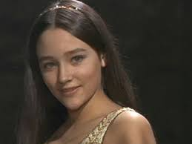
BIG QUESTION: Explore how Shakespeare presents the characters of Romeo and Juliet throughout the play.
If that thy bent of love be honourable,
Thy purpose marriage, send me word tomorrow
By one that I’ll procure to come to thee
Where and what time thou wilt perform the rite,
And all my fortunes at thy foot I’ll lay
And follow thee my lord throughout the world.
Why might they be in such a rush to get married? Think about what you know about the context of Elizabethan society.
“

Slide 47
BIG QUESTION: Explore how Shakespeare presents the characters of Romeo and Juliet throughout the play.
PLENARY
In the play, an awful lot happens in the space of 24 hours!
So why did Shakespeare choose such a tight timescale?
What is he trying to suggest about the characters of Romeo and Juliet?
Sunday morning
Sunday evening
Sunday night
Monday morning
Romeo is sad because Rosaline doesn’t love him.
“Ay me! sad hours seem long.”
Romeo meets Juliet at the Capulet Ball. They fall in love at first sight.
“Did my heart love till now? Forswear it sight! For I ne’er saw true beauty till this night.”
The balcony scene. Romeo & Juliet swear their love and decide to get married.
“Parting is such sweet sorrow, that I shall say good night till it be morrow.”
Romeo and Juliet are married by Friar Lawrence.
“These violent delights have violent ends”

Slide 48
DNA: Recall and Retrieval
Let’s see how much you remembered from the last few lessons.
What is a ‘Petrarchan lover’? CHALLENGE – How does Romeo conform to this? | Explain the term ‘vestal livery’. | Give me 3 adjectives you would use to describe Juliet.
Why was getting married at a young age common in Elizabethan times? | What is a writer’s method? | Give an example of religious imagery used.
1 horizontal line = 1 merit
Full house = 3 merits

Slide 49
BIG QUESTION: Explore how Shakespeare presents the characters of Romeo and Juliet throughout the play.
C/W Monday, 28 June 2021
Light and Darkness
Lesson Focus: to explore the semantic fields in Romeo and Juliet’s characters monologues to analyse the balcony scene.

Slide 50
BIG QUESTION: Explore how Shakespeare presents the characters of Romeo and Juliet throughout the play.
Sort the words below into 4 categories. I am not going to tell you what categories you should put them into. Some words might overlap.
harbor
twinkle
celestial
happiness
fjord
moon
joy
ecstasy
shine
wave
bay
gaiety
cove
stars
sun
brightness
Notes:
Can provide categories for LAP.

Slide 51
BIG QUESTION: Explore how Shakespeare presents the characters of Romeo and Juliet throughout the play.
Light | Astronomy | Sea | Pleasurable emotions
Twinkle brightness Stars sun | Moon Sun Stars Celestial | Harbor Fjord Wave Bay Cove | Joy Happiness Gaiety Ecstasy
Word Consciousness |  | Your definition/synonyms
Semantic field (noun) | a lexical set of semantically related items, for example verbs of perception.

Slide 52
oRIGINAL TEXT | MODERN TEXT
ROMEO returns | ROMEO returns.
ROMEO He jests at scars that never felt a wound. | ROMEO It’s easy for someone to joke about scars if they’ve never been cut.
JULIET appears in a window above | JULIET enters on the balcony.
But soft! What light through yonder window breaks? It is the east, and Juliet is the sun. Arise, fair sun, and kill the envious moon, 5Who is already sick and pale with grief, That thou, her maid, art far more fair than she. Be not her maid since she is envious. Her vestal livery is but sick and green, And none but fools do wear it. Cast it off! 10It is my lady. Oh, it is my love. Oh, that she knew she were! She speaks, yet she says nothing. What of that? Her eye discourses. I will answer it.— I am too bold. 'Tis not to me she speaks. 15Two of the fairest stars in all the heaven, Having some business, do entreat her eyes To twinkle in their spheres till they return. What if her eyes were there, they in her head? The brightness of her cheek would shame those stars 20As daylight doth a lamp. Her eye in heaven Would through the airy region stream so bright That birds would sing and think it were not night. See how she leans her cheek upon her hand. Oh, that I were a glove upon that hand 25That I might touch that cheek! | But wait, what’s that light in the window over there? It is the east, and Juliet is the sun. Rise up, beautiful sun, and kill the jealous moon . The moon is already sick and pale with grief because you, Juliet, her maid, are more beautiful than she. Don’t be her maid, because she is jealous. Virginity makes her look sick and green. Only fools hold on to their virginity. Let it go. Oh, there’s my lady! Oh, it is my love. Oh, I wish she knew how much I love her. She’s talking, but she’s not saying anything. So what? Her eyes are saying something. I will answer them. I am too bold. She’s not talking to me. Two of the brightest stars in the whole sky had to go away on business, and they’re asking her eyes to twinkle in their places until they return. What if her eyes were in the sky and the stars were in her head?—The brightness of her cheeks would outshine the stars the way the sun outshines a lamp. If her eyes were in the night sky, they would shine so brightly through space that birds would start singing, thinking her light was the light of day. Look how she leans her hand on her cheek. Oh, I wish I was the glove on that hand so that I could touch that cheek.
Notes:
Learners to identify the semantic fields in the extract – half the class look at Romeo’s monologue, half the class look at Juliet’s.

Slide 53
JULIET O Romeo, Romeo! Wherefore art thou Romeo? Deny thy father and refuse thy name. 35Or, if thou wilt not, be but sworn my love, And I’ll no longer be a Capulet. | JULIET (not knowing ROMEO hears her) Oh, Romeo, Romeo, why do you have to be Romeo? Forget about your father and change your name. Or else, if you won’t change your name, just swear you love me and I’ll stop being a Capulet.
ROMEO (aside) Shall I hear more, or shall I speak at this? | ROMEO (to himself) Should I listen for more, or should I speak now?
JULIET 'Tis but thy name that is my enemy. Thou art thyself, though not a Montague. 40What’s Montague? It is nor hand, nor foot, Nor arm, nor face, nor any other part Belonging to a man. O, be some other name! What’s in a name? That which we call a rose By any other word would smell as sweet. 45So Romeo would, were he not Romeo called, Retain that dear perfection which he owes Without that title. Romeo, doff thy name, And for that name, which is no part of thee Take all myself. | JULIET (still not knowing ROMEO hears her) It’s only your name that’s my enemy. You’d still be yourself even if you stopped being a Montague. What’s a Montague anyway? It isn’t a hand, a foot, an arm, a face, or any other part of a man. Oh, be some other name! What does a name mean? The thing we call a rose would smell just as sweet if we called it by any other name. Romeo would be just as perfect even if he wasn’t called Romeo. Romeo, lose your name. Trade in your name—which really has nothing to do with you—and take all of me in exchange.
ROMEO I take thee at thy word. 50Call me but love, and I’ll be new baptized. Henceforth I never will be Romeo. | ROMEO (to JULIET) I trust your words. Just call me your love, and I will take a new name. From now on I will never be Romeo again.

Slide 54
BIG QUESTION: Explore how Shakespeare presents the characters of Romeo and Juliet throughout the play.
On your copy of the text, identify the semantic field in either Romeo or Juliet’s monologue. What do they refer to?
oRIGINAL TEXT | MODERN TEXT
ROMEO returns | ROMEO returns.
ROMEO He jests at scars that never felt a wound. | ROMEO It’s easy for someone to joke about scars if they’ve never been cut.
JULIET appears in a window above | JULIET enters on the balcony.
But soft! What light through yonder window breaks? It is the east, and Juliet is the sun. Arise, fair sun, and kill the envious moon, 5Who is already sick and pale with grief, That thou, her maid, art far more fair than she. Be not her maid since she is envious. Her vestal livery is but sick and green, And none but fools do wear it. Cast it off! 10It is my lady. Oh, it is my love. Oh, that she knew she were! She speaks, yet she says nothing. What of that? Her eye discourses. I will answer it.— I am too bold. 'Tis not to me she speaks. 15Two of the fairest stars in all the heaven, Having some business, do entreat her eyes To twinkle in their spheres till they return. What if her eyes were there, they in her head? The brightness of her cheek would shame those stars 20As daylight doth a lamp. Her eye in heaven Would through the airy region stream so bright That birds would sing and think it were not night. See how she leans her cheek upon her hand. Oh, that I were a glove upon that hand 25That I might touch that cheek! | But wait, what’s that light in the window over there? It is the east, and Juliet is the sun. Rise up, beautiful sun, and kill the jealous moon . The moon is already sick and pale with grief because you, Juliet, her maid, are more beautiful than she. Don’t be her maid, because she is jealous. Virginity makes her look sick and green. Only fools hold on to their virginity. Let it go. Oh, there’s my lady! Oh, it is my love. Oh, I wish she knew how much I love her. She’s talking, but she’s not saying anything. So what? Her eyes are saying something. I will answer them. I am too bold. She’s not talking to me. Two of the brightest stars in the whole sky had to go away on business, and they’re asking her eyes to twinkle in their places until they return. What if her eyes were in the sky and the stars were in her head?—The brightness of her cheeks would outshine the stars the way the sun outshines a lamp. If her eyes were in the night sky, they would shine so brightly through space that birds would start singing, thinking her light was the light of day. Look how she leans her hand on her cheek. Oh, I wish I was the glove on that hand so that I could touch that cheek.
Notes:
Learners to identify the semantic fields in the extract.
Romeo – semantic field of astronomy and light/dark
Juliet – semantic field of identity and disobedience

Slide 55
BIG QUESTION: Explore how Shakespeare presents the characters of Romeo and Juliet throughout the play.
Using your Act 2 scene 2 analysis from the last two lessons – focusing on Shakespeare’s methods…
DEMONSTRATE: How does Shakespeare present intense passion between Romeo and Juliet in the first part of Act 2, scene 2?
WHAT? is Shakespeare trying to tell us about their romance? What does the audience think of their passion?
HOW? is Shakespeare doing this? How does he use Romeo and Juliet’s language to convey how he is feeling? How does he show the audience their impressions of passionate love?
WHY? is he doing this? Why does Shakespeare present the intensity in this why? Why is this an integral scene?
Notes:
Resource – Lesson 10

Slide 56
DNA: Honour
What is ‘honour’?
Why was it important in Shakespeare’s time?
Is it still an important concept in the 21st century?
Notes:
List can be differentiated.

Slide 57
BIG QUESTION: Explore how Shakespeare presents the characters of Romeo and Juliet throughout the play.
C/W Monday, 28 June 2021
‘The Lovers’
Lesson Focus: To explore the concept of ‘honour’ in a contemporary non-fiction text.

Slide 58
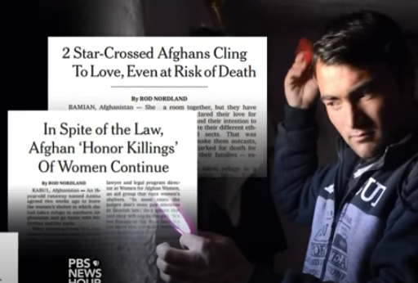
BIG QUESTION: Explore how Shakespeare presents the characters of Romeo and Juliet throughout the play.
Active Listen
You are going to watch a video telling the story of Zakia and Ali, “Afghanistan’s Romeo and Juliet”.
As you watch, answer the following questions.
When we have finished, compare your answers with your table & be ready to feed back to the class.
What paper did Zakia & Ali’s story first appear in?
What were their parents’ jobs?
What was the ‘powerful weapon’ that Zakia’s family had?
According to the reporter, what is an ‘honour killing’?
What does Norland admit that he did?
What are Zakia’s hopes for her daughter?
Notes:
Hyperlink to video in image
A = NY Times
B = Potato farmers
C = The knowledge that no-one had ever been successfully prosecuted in Afghanistan for an honour killing
D = The murder of young women by their own families for causing them shame
E = Stepped over the line between being a participant and a reporter
F = That if she were killed her daughter would know where to go/not to go and would be educated

Slide 59
Word Consciousness – Please record on the back page of your exercise books
Word and definition | Your definition Synonyms
Contemplate (v) think carefully about; look thoughtfully at
Deplorable (a) completely unacceptable
Vow (v) to strongly promise

Slide 60
BIG QUESTION: Explore how Shakespeare presents the characters of Romeo and Juliet throughout the play.
We are going to read an extract from The Lovers, by Rod Norland, which tells Zakia and Ali’s story.
As we read, highlight any similarities or differences you can find between Zakia’s situation and Juliet’s at the end of Act 2 Sc 2….

Slide 61
This extract comes from The Lovers by Rob Nordand and tells the story of Zakia & Ali, two young Afghans who fell in love but whose families opposed their marriage.
Her name was Zakia. Shortly before midnight on the freezing-cold eve of the Persian New Year of 1393 she lay fully clothed on her thin mattress on the concrete floor and considered what she was about to do. She had on all her colorful layers— a long dress with leggings under it, a ragged pink sweater, and a long orange-and-purple scarf— but no coat, because she did not own one. The only thing she did not have on were her four- inch open- toed high heels, since no one would wear shoes indoors in Afghanistan; instead the heels were positioned beside her mattress, neatly left shoe on the left, right on the right, next to the little photograph she had of Ali, the boy she loved. It was not the best escape gear for what she was about to do— climb a wall and run off into the mountains— but it would soon be her wedding day, and she wanted to look good.
That night of March 20, 2014, was not the first time Zakia had contemplated escaping from the Bamiyan Women’s Shelter, which had been her home, her refuge, and her prison for the past six months, since the day she ran away from home in the hope of marrying Ali. Always before, her nerve had failed her. Two of the other girls who shared her room were awake as well, but they would make no move unless she did first. Though Zakia was still terrified and did not know if she had the courage to leave, she felt she was fast running out of both time and opportunity.

Slide 62
This was no small thing, although Zakia was then eighteen and legally an adult, a voluntary shelter resident rather than a prisoner, and in the eyes of Afghan law she was free to go whenever she pleased. But the law is only what men make it, and nowhere is that more true than in Afghanistan. What Zakia was about to do would change not only her life and that of Ali, who waited for her call on the other side of the Bamiyan Valley. She understood that it would change the lives of nearly everyone they knew. Her father, Zaman, and her mother, Sabza; her many brothers; and her male first cousins— they would all give up their farm and devote their lives to hunting down Zakia and Ali, publicly vowing to kill them for the crime of being in love. Ali’s father, Anwar, would be forced into such debt that his eldest son would lose his inheritance, and most of the family’s crops would be forfeited for years to come. Others would be touched in unexpected ways. A woman named Fatima Kazimi, who ran the women’s ministry in Bamiyan and had recently saved Zakia from being killed by her family, would flee to exile in Africa. Shmuley Boteach, a rabbi from New Jersey who that night scarcely knew how to pronounce Zakia’s name, would end up consumed by her case, lobbying at the highest levels of the United States government to intervene on her behalf. In the course of it all, this illiterate and impoverished girl who did not know her numbers up to ten and had never seen a television set would become the most recognizable female face on the Afghan airwaves.

Slide 63
She would become a hero to every young Afghan woman who dreams of marrying the one she loves rather than the one chosen for her by her family, sight unseen. To the conservative elders who preside over their country’s patriarchy, however, Zakia would become the fallen woman whose actions threatened the established social order, actions that were yet more evidence of the deplorable interference of foreigners in Afghanistan’s traditional culture.
That is where I came in, because the articles I wrote about Zakia and Ali in the New York Times in 2014 would bring them that fame and arouse the ire of the conservative Afghan establishment. I didn’t know it at the time, but before long I would become their best hope to survive, entangling myself in their lives in ways that threatened my own values and professional ethics. That night, though, on the eve of the spring equinox and the Persian New Year, I had no idea what they were up to and was three days’ travel away from them elsewhere in Afghanistan. We were the last people on one another’s minds.

Slide 64
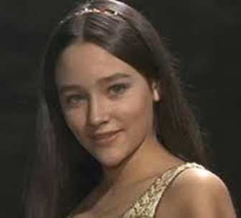
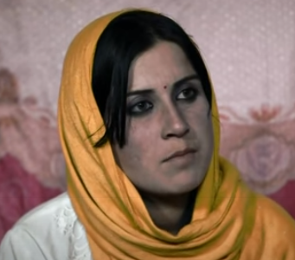
BIG QUESTION: Explore how Shakespeare presents the characters of Romeo and Juliet throughout the play.
Similarities
They both love a man their family will not allow them to marry
They are both due to get married the next morning
They both live in a patriarchal society
They both risk a violent reaction if they disobey their families
They have both had their stories told by a 3rd person
Differences
Zakia is legally an adult, Juliet is 13
Zakia is from a very poor family; Juliet is from an aristocratic family
One is a fictional character, one is real
Juliet ‘lived’ in the 14th century; Zakia lives in the 21st century

Slide 65
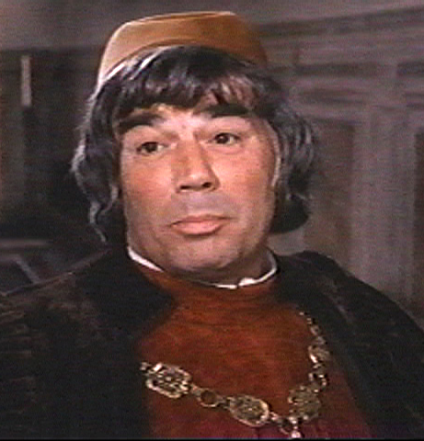
BIG QUESTION: Explore how Shakespeare presents the characters of Romeo and Juliet throughout the play.
This is how Zakia’s family reacted. How do you think Lord Capulet will react if Juliet disobeys him?
“Her father, Zaman, and her mother, Sabza; her many brothers; and her male first cousins— they would all give up their farm and devote their lives to hunting down Zakia and Ali, publicly vowing to kill them for the crime of being in love.“
Lord Capulet

Slide 66
BIG QUESTION: Explore how Shakespeare presents the characters of Romeo and Juliet throughout the play.
“An you be not, hang, beg, starve, die in the streets,
For, by my soul, I’ll ne'er acknowledge thee,
Nor what is mine shall never do thee good.”
Lord Capulet’s reaction – as we shall see later in Act 3 Sc 5 – when Juliet refuses to do as he wishes is as shocking and violent as Zakia’s father.
Both men feel that their honour – and that of their families – has been damaged by their daughters’ disobedience and that they should be punished.

Slide 67
BIG QUESTION: Explore how Shakespeare presents the characters of Romeo and Juliet throughout the play.
DEMONSTRATE: You now need to refer to lines below.
How does the writer use language to describe the impact of Zakia & Ali’s relationship on their families?
This was no small thing, although Zakia was then eighteen and legally an adult, a voluntary shelter resident rather than a prisoner, and in the eyes of Afghan law she was free to go whenever she pleased. But the law is only what men make it, and nowhere is that more true than in Afghanistan. What Zakia was about to do would change not only her life and that of Ali, who waited for her call on the other side of the Bamiyan Valley. She understood that it would change the lives of nearly everyone they knew. Her father, Zaman, and her mother, Sabza; her many brothers; and her male first cousins— they would all give up their farm and devote their lives to hunting down Zakia and Ali, publicly vowing to kill them for the crime of being in love. Ali’s father, Anwar, would be forced into such debt that his eldest son would lose his inheritance, and most of the family’s crops would be forfeited for years to come.
WHAT? Does Norland want to show us about the impact of the lovers’ relationship on their families? What are the consequences?
HOW? Does Norland do this? What kind of language does he use? What language techniques does he use?
WHY? is he doing this? What is he trying to say about patriarchal societies? Does he think that ‘honour’ is a good thing?

Slide 68
BIG QUESTION: Explore how Shakespeare presents the characters of Romeo and Juliet throughout the play.
DEMONSTRATE: You now need to refer to lines 20 to 29.
How does the writer use language to describe the impact of Zakia & Ali’s relationship on their families?
I DO
The writer is trying to show the devastating consequences of Zakia and Ali’s relationship on the lives of their families. He describes how her parents would now “devote” their lives to trying to find and kill her. The connotations of the word ‘devoted’ suggest love and kindness, which is the exact opposite of her parents’ response. Norland is trying to shock the reader in order to expose how horrific and barbaric their concept of honour is and how is it has turned them from parents into potential murders.

Slide 69
BIG QUESTION: Explore how Shakespeare presents the characters of Romeo and Juliet throughout the play.
DEMONSTRATE: You now need to refer to lines 20 to 29.
How does the writer use language to describe the impact of Zakia & Ali’s relationship on their families?
Success criteria:
Make a clear point about the impact on the families?
Provide evidence from the text?
Zoom in further to analyse your evidence further (e.g. exploring connotations)?
Use correct terminology to identify techniques?
Explain the writer’s intentions in their use of language?
Explore the effect on the reader?
YOU DO

Slide 70
DNA: Answer and Question
If this is the answer, what is the question?
Juliet
Lord Capulet refused to let Tybalt fight Romeo.
A shared sonnet
Romeo and Juliet were both thinking about the physical side of love.

Slide 71
BIG QUESTION: Explore how Shakespeare presents the characters of Romeo and Juliet throughout the play.
C/W Monday, 28 June 2021
Making links
Lesson Focus: to use a range of cohesive devices to connect ideas within and between paragraphs

Slide 72
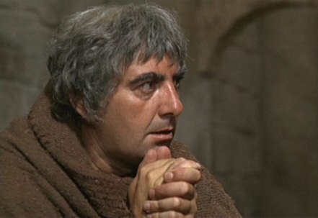
Act 2 Scene 3 Summary
BIG QUESTION: Explore how Shakespeare presents the characters of Romeo and Juliet throughout the play.
Romeo visits Friar Lawrence and tells him that he and Juliet have fallen in love.
The Friar finally agrees to marry the couple, believing that their marriage will bring their two families together.

Slide 73
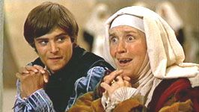
Act 2 Scene 4 Summary
BIG QUESTION: Explore how Shakespeare presents the characters of Romeo and Juliet throughout the play.
Mercutio and Benvolio discuss Tybalt, who has sent Romeo a challenge to a duel.
Romeo appears and enjoys some wordplay with Mercutio
The Nurse arrives, looking for Romeo. He gives her instructions about when and where Juliet is to meet him so that they can be married.

Slide 74
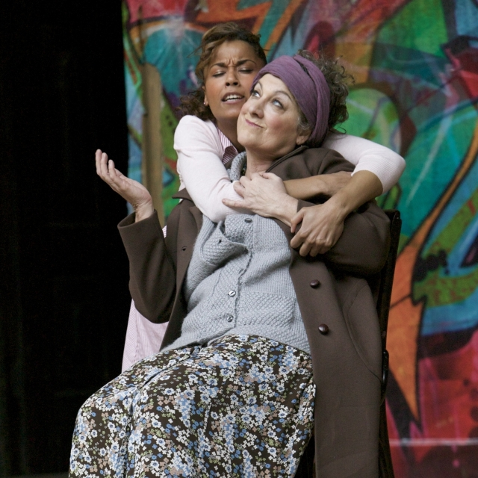
Act 2 Scene 5 Summary
BIG QUESTION: Explore how Shakespeare presents the characters of Romeo and Juliet throughout the play.
When the nurse returns to Juliet, she keeps putting off giving Romeo’s message, complaining of tiredness.
She finally tells Juliet when and where she is to meet Romeo and be married.
‘I am aweary: give me leave a while. Fie, how my bones ache!’

Slide 75
Notes:
This could be printed to glue into students’ books as a summary of the rest of act 2.

Slide 76
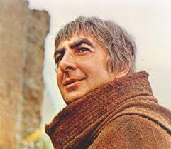
The Marriage of Romeo and Juliet
BIG QUESTION: Explore how Shakespeare presents the characters of Romeo and Juliet throughout the play.
Why does the Friar think that Juliet and Romeo getting married is a good thing?
In Elizabethan times, marriages were arranged by the bride and groom’s fathers.
What does the secrecy show the audience?
To turn your households' rancour to pure love"

Slide 77
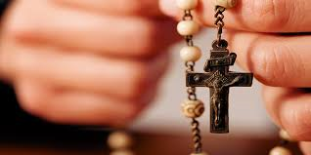
Context
BIG QUESTION: Explore how Shakespeare presents the characters of Romeo and Juliet throughout the play.
Elizabethan England was a Protestant country, but
the characters in Romeo and Juliet are Italian
Catholics.
The fact that the Elizabethan audience see Catholics
making silly choices and being guided by a Catholic
priest into making those decisions would have given
The audience a sense of superiority.

Slide 78
BIG QUESTION: Explore how Shakespeare presents the characters of Romeo and Juliet throughout the play.
TASK: Write a diary as Juliet, describing the events of arranging to get married in secret and her feelings waiting for her wedding day.
Ideas:
Does she feel any remorse towards God/expectations of women?
How does she feel about disobeying her father?
Give bird references – use them as metaphors
Describe her feelings as she waited for the Nurse to arrive with the news.
Success Criteria
Focus on making links about the information we have just gathered about their marriage
At least one word from your word consciousness
Write your diary in the style of Shakespeare
CHALLENGE: Go through your book and find quotes from the play that you can use as part of your diary entry.

Slide 79
Plenary: Friar Lawrence foreshadows
“These violent delights have violent ends,
And in their triumph die like fire and powder,
Which as they kiss consume. The sweetest honey
Is loathsome in his own deliciousness”
The Friar says this to Romeo shortly before he conducts the marriage in act 2 scene 6.
What does he mean? What does he hint will happen?

Slide 80
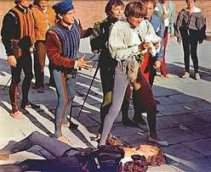
DNA
What do you think happens in the run up to the event pictured (the death of Mercutio)? What do you predict will happen in the immediate aftermath?
10 minutes before |  | 10 minutes after
“They have made worms’ meat of me”

Slide 81
BIG QUESTION: Explore how Shakespeare presents the characters of Romeo and Juliet throughout the play.
C/W Monday, 28 June 2021 Act 3 scene 1
Lesson Focus: To understand the events of Act 3 Scene 1 and identify Tybalt, Romeo and Mercutio’s motivations.

Slide 82
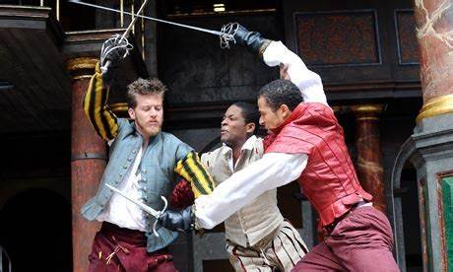
BIG QUESTION: Explore how Shakespeare presents the characters of Romeo and Juliet throughout the play.
New Information
At the beginning of Act 3, Scene 1, Mercutio and Benvolio are again discussing Tybalt’s challenge of a duel with Romeo. Benvolio creates a tense atmosphere when he says “mad blood is stirring”
Tybalt enters the scene. The
aggression from both Montagues
and Capulets here foreshadows
some fatal events.

Slide 83
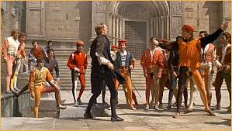
BIG QUESTION: Explore how Shakespeare presents the characters of Romeo and Juliet throughout the play.
Act 3 Scene 1
As we watch, pay attention to the characters of Tybalt, Romeo and Mercutio.
1) Who starts the fight?
2) Who tries to calm things down?
3) Why won’t Romeo fight Tybalt?
4) Why does Mercutio step in?
https://www.youtube.com/watch?v=eF7UwsuQYzg

Slide 84
BIG QUESTION: Explore how Shakespeare presents the characters of Romeo and Juliet throughout the play.
Who does Shakespeare suggest is to blame for Mercutio’s death?
“A plague on both your houses”
“Why the devil came you between us? I was hurt under your arm.”
“Is he gone and hath nothing?”
“A braggart, a rogue, a villain, that fights by the book of arithmetic!”
“They have made worms’ meat of me”
“Zounds, a dog, a rat, a mouse, a car, to scratch a man to death!”

Slide 85
BIG QUESTION: Explore how Shakespeare presents the characters of Romeo and Juliet throughout the play.
The word “plague” is associated with:
The Black Death (1347 onwards) – the bubonic plague killed 1.5 million people in England (out of a population of 4 million). It was highly contagious. It started in Italy.
The Bible – God sent 10 plagues to Egypt to punish the Pharaoh for his treatment of the Israelites.
The plagues included: water turning into blood, locusts, darkness, frogs, boils, and the death of the first-born child.
“A plague on both your houses”
Use the quote above (and others from act 3 scene 1), to answer the question:
DISCUSS: How does Shakespeare present Mercutio’s death in act 3 scene 1?

Slide 86
Romeo, as usual, does not accept any responsibility for the death of Mercutio. Look carefully at his words, who does he blame?
BIG QUESTION: Explore how Shakespeare presents the characters of Romeo and Juliet throughout the play.
ROMEO This gentleman, the prince's near ally, My very friend, hath got his mortal hurt In my behalf; my reputation stain'd With Tybalt's slander,--Tybalt, that an hour Hath been my kinsman! O sweet Juliet, Thy beauty hath made me effeminate And in my temper soften'd valour's steel!
Notes:
In act 3 scene 1, when Romeo hears that Mercutio has died, he immediately seeks revenge on Tybalt.

Slide 87
BIG QUESTION: Explore how Shakespeare presents the characters of Romeo and Juliet throughout the play.
Let’s read how Romeo reacts to the news of Mercutio’s death and see how he responds…
Does his actions surprise you? Why? Why not?
Notes:
Lesson 13 - resource

Slide 88
It’s clear that Romeo is furiously angry with Tybalt. How has Shakespeare used language and structure to show that?
BIG QUESTION: Explore how Shakespeare presents the characters of Romeo and Juliet throughout the play.
“Away to heaven, respective lenity,
And fire-eyed fury be my conduct now!”
“Mercutio’s soul
Is but a little way above our heads,
Staying for thine to keep him company:
Either thou, or I, or both, must go with him”
SUPPORT:
Contrasts
Exclamative sentences
Repetition
Imagery
“O, I am fortune’s fool!”

Slide 89
BIG QUESTION: Explore how Shakespeare presents the characters of Romeo and Juliet throughout the play.
DEMONSTRATE: How does Romeo react to Mercutio’s death in Act 3, scene 1?
YOU DO:
What?
How?
Why?
CHALLENGE: How do the events in Act 1 and 2 foreshadow Tybalt’s death in Act 3?
Progress Indicators:
Good –
Outstanding -

Slide 90
DNA
Write down 3 examples of ‘dramatic irony’ in the play so far.
CHALLENGE: Why might Shakespeare use dramatic irony?

Slide 91
BIG QUESTION: Explore how Shakespeare presents the characters of Romeo and Juliet throughout the play.
C/W Monday, 28 June 2021
Juliet’s wedding song
Lesson Focus: explain how specific choices of form, layout and presentation create effect

Slide 92
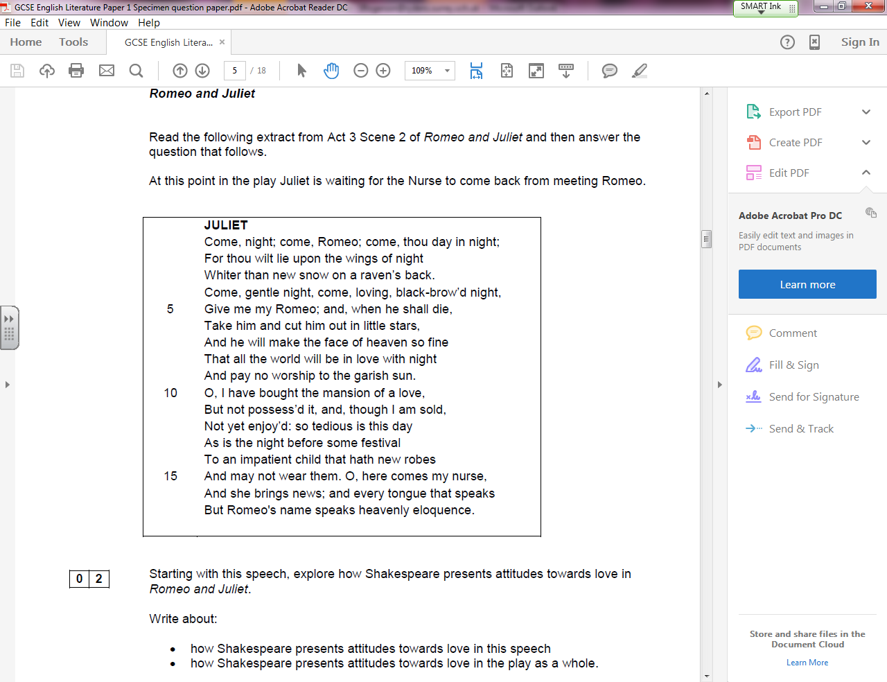
BIG QUESTION: Explore how Shakespeare presents the characters of Romeo and Juliet throughout the play.
This is what your assessment question will look like
An explanation of where the extract is from
An extract – you must refer to this AND the rest of the play
The question and guiding bullet points

Slide 93
BIG QUESTION: Explore how Shakespeare presents the characters of Romeo and Juliet throughout the play.
Within the peaceful confines of her room, Juliet looks forward to the "amorous rites" of her marriage to Romeo.
Juliet's impatience in anticipation of the nurse's arrival echoes her excited anticipation in Act II, Scene 5, when she had to wait for news of the wedding arrangements.
A considerable sense of impending doom hangs in the atmosphere:
Although she is unaware of the tragic news that awaits her (but we as an audience know: dramatic irony), Juliet's soliloquy fantasizing about her wedding night works tragic images (death) into the fabric of her epithalamium, or wedding song.

Slide 94
BIG QUESTION: Explore how Shakespeare presents the characters of Romeo and Juliet throughout the play.
2nd half of Juliet’s 31 line epithalamium (wedding song)
Audiences in Shakespeare’s time would recognise this feature;
Traditionally would be a male role (especially one expressing eagerness for physical relationship).
Most plays use similar female monologues to remind women in the audience of their roles as good wives.
‘Taming of the Shrew’ Kate lectured Bianca at her wedding.
Remember, women had limited rights and seen to belong to men (father → husband)
Shakespeare uses Juliet’s speech to show she is impatiently longing for Romeo’s presence.
A sentiment traditionally expressed by the men.

Slide 95
BIG QUESTION: Explore how Shakespeare presents the characters of Romeo and Juliet throughout the play.
Text-dependent questions
Why is Juliet using the imperative verb “come, night, come”? Why does she want the day to arrive?
How does Juliet see Romeo? Find the metaphors to support this.
What does ‘night’ mean for Juliet? And her relationship with Romeo?
What is the significance of the reference to an “impatient child”?
How does Juliet see herself?
How is Juliet portrayed here?

Slide 96
How does Shakespeare present attitudes towards love in this speech?
BIG QUESTION: Explore how Shakespeare presents the characters of Romeo and Juliet throughout the play.
In his choice of language?
In its structure?
In its form?

Slide 97
BIG QUESTION: Explore how Shakespeare presents the characters of Romeo and Juliet throughout the play.
DEMONSTRATE: How does Shakespeare present attitudes towards love in Act 3, scene 2?
YOU DO:
What?
How?
Why?
CHALLENGE: Focus on the juxtaposition of light and dark imagery.

Slide 98
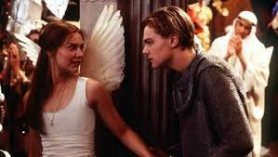
REVIEW:
WHO DO YOU FEEL MORE SYMPATHY FOR?
I feel more sympathy for Juliet because …
or
I feel more sympathy for Romeo because …

Slide 99
DNA: Colour-code the words into two themes
Support
Love
Sadness/death
Challenge: Identify the semantic fields
Notes:
Print out slide for DNA.

Slide 100
BIG QUESTION: Explore how Shakespeare presents the characters of Romeo and Juliet throughout the play.
C/W Monday, 28 June 2021
Juliet hears the news
Lesson Focus: To explore Shakespeare’s use of imagery and oxymoron to convey character’s feelings.

Slide 101
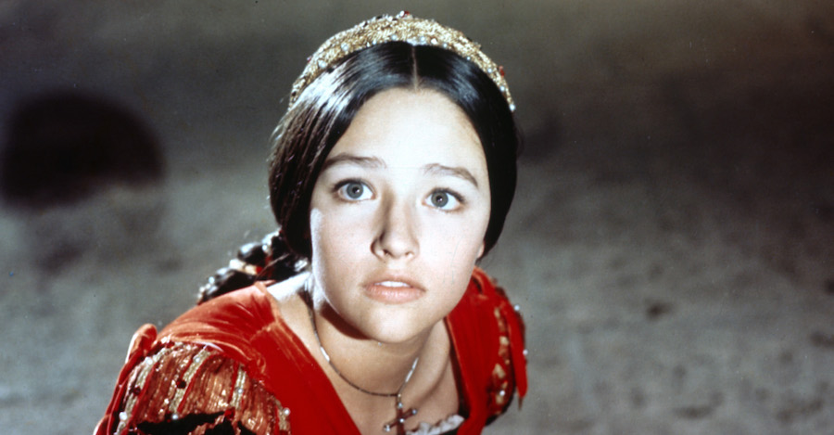
So what’s going on?
BIG QUESTION: Explore how Shakespeare presents the characters of Romeo and Juliet throughout the play.
This scene starts with Juliet waiting for night to come so that Romeo can come to her room.
The Nurse bursts in, crying, and tells her that “he” is dead.
Juliet thinks she means Romeo, and gets very upset.
The Nurse tells her that Tybalt is dead, and Romeo killed him.
Juliet is very upset and angry.

Slide 102
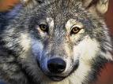
BIG QUESTION: Explore how Shakespeare presents the characters of Romeo and Juliet throughout the play.
Imagery is a collection of images that are built up in the
reader’s mind by the writer. They are usually linked and
work on the suggested meanings that particular images
may create in our heads.
Imagery can be easily categorised into positive and negative.
Look at the pictures above. Which of the pictures suggest something positive, and which suggest something negative?

Slide 103
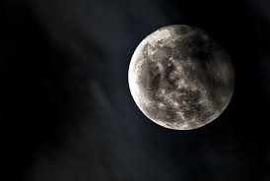
BIG QUESTION: Explore how Shakespeare presents the characters of Romeo and Juliet throughout the play.
What do you associate with night?
evil
Romeo and Juliet have just got married in secret – why might Juliet be waiting for night time?

Slide 104
BIG QUESTION: Explore how Shakespeare presents the characters of Romeo and Juliet throughout the play.
Together, read the extract from act 3 scene 2 and glue it into your book.
TASK: Use two colours of crayon or highlighter to pick out the negative imagery and the positive imagery.
What do you notice?
JULIET O God! did Romeo's hand shed Tybalt's blood?
Nurse It did, it did; alas the day, it did!
JULIET O serpent heart, hid with a flowering face! Did ever dragon keep so fair a cave? Beautiful tyrant! fiend angelical! Dove-feather'd raven! wolvish-ravening lamb! Despised substance of divinest show! Just opposite to what thou justly seem'st, A damned saint, an honourable villain! O nature, what hadst thou to do in hell, When thou didst bower the spirit of a fiend In moral paradise of such sweet flesh? Was ever book containing such vile matter So fairly bound? O that deceit should dwell In such a gorgeous palace!

Slide 105
JULIET O God! did Romeo's hand shed Tybalt's blood?
Nurse It did, it did; alas the day, it did!
JULIET O serpent heart, hid with a flowering face! Did ever dragon keep so fair a cave? Beautiful tyrant! fiend angelical! Dove-feather'd raven! wolvish-ravening lamb! Despised substance of divinest show! Just opposite to what thou justly seem'st, A damned saint, an honourable villain! O nature, what hadst thou to do in hell, When thou didst bower the spirit of a fiend In moral paradise of such sweet flesh? Was ever book containing such vile matter So fairly bound? O that deceit should dwell In such a gorgeous palace!
JULIET O God! did Romeo's hand shed Tybalt's blood?
Nurse It did, it did; alas the day, it did!
JULIET O serpent heart, hid with a flowering face! Did ever dragon keep so fair a cave? Beautiful tyrant! fiend angelical! Dove-feather'd raven! wolvish-ravening lamb! Despised substance of divinest show! Just opposite to what thou justly seem'st, A damned saint, an honourable villain! O nature, what hadst thou to do in hell, When thou didst bower the spirit of a fiend In moral paradise of such sweet flesh? Was ever book containing such vile matter So fairly bound? O that deceit should dwell In such a gorgeous palace!

Slide 106
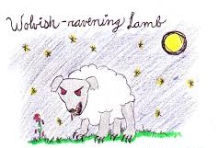
“Fiend Angelical”
BIG QUESTION: Explore how Shakespeare presents the characters of Romeo and Juliet throughout the play.
“Wolvish-ravening lamb”
In this scene, Shakespeare pairs opposites together to show that Juliet doesn’t know what to think about Romeo after hearing that he has killed Tybalt, her cousin. This language technique is called an oxymoron.
CHALLENGE: When did Shakespeare use this technique to show Romeo’s confusion?

Slide 107
BIG QUESTION: Explore how Shakespeare presents the characters of Romeo and Juliet throughout the play.
Choose one of the images from the extract.
Draw it in your book with the relevant quote.
Write a few sentences in which you explain the significance of the oxymoron that you chose. Why has Shakespeare used those particular words to describe Romeo?
CHALLENGE: What else is Shakespeare implying through
Juliet’s use of oxymoron? What does she feel that
Romeo has done to her?
SUPPORT
In act 3 scene 2, the audience know that Juliet is confused and angry after hearing that Romeo killed Tybalt. This is clearly shown through her calling Romeo “ “, “ “, and “ “. This shows her anger and confusion because…
The reader feels sorry for Juliet because...

Slide 108
Exit Ticket
BIG QUESTION: Explore how Shakespeare presents the characters of Romeo and Juliet throughout the play.
Why does the Nurse struggle to tell Juliet what has happened?
Who does Juliet think has died at first?
Why does Juliet have trouble believing that Romeo has killed Tybalt?
What does the Nurse say to Juliet about men?
Do you feel sorry for Juliet at this point and why?

