Slide 1
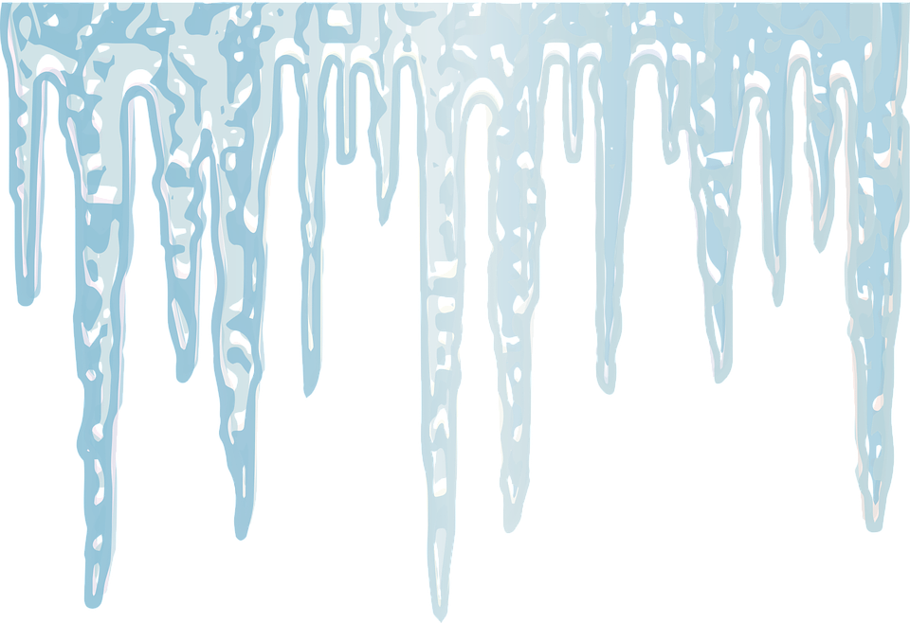
Specific Latent Heat
Do now activity:
Define the term ‘internal energy’.
Explain the differences in the forces of attraction found between particles of a gas compared to particles of a solid.
Explain what is meant by ‘latent heat’

Slide 2
Progress indicators
GOOD PROGRESS:
- Describe what is happening to the particles when a solid turns to liquid
- Explain what is meant by specific latent heat of fusion
OUTSTANDING PROGRESS:
- To be able to use and rearrange the calculation for specific latent heat of fusion

Slide 3
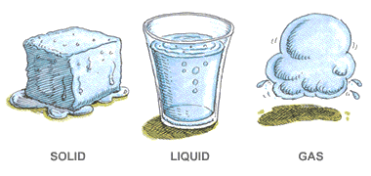
‘Latent heat’ is the energy transferred to a substance when it changes state.
It is the energy needed by the particles to break free from one another

Slide 4
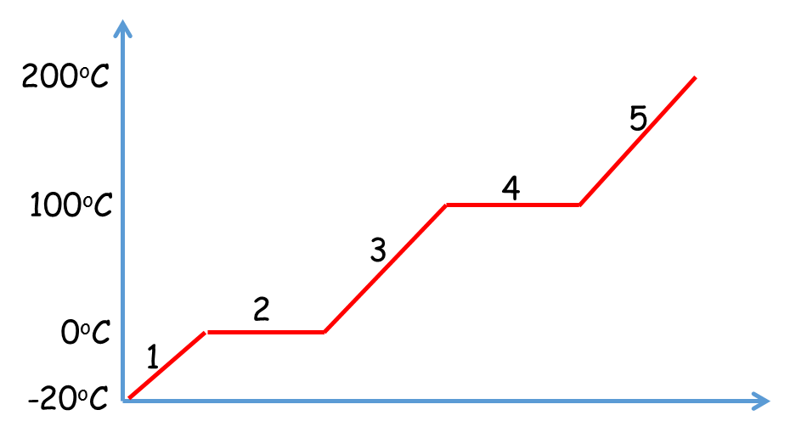
Ice at -20ºC is taken from a freezer and heated at a constant rate. The graph shows what will happen to its temperature. Describe the changes that the particles go through at each stage of the graph [6].

Slide 5
Self-assessment:
All particles are in a solid state (1).
Some particles are in a solid state, and some particles are in a liquid state (1).
All particles are in a liquid state (1).
Some particles are in a liquid state, and some particles are in a gaseous state (1).
All particles are in a gaseous state (1).
Final mark – at stages 2 and 4, the energy is being used to break the intermolecular bonds between the particles. (1)
200ºC
5
100ºC
4
3
2
0ºC
1
-20ºC

Slide 6
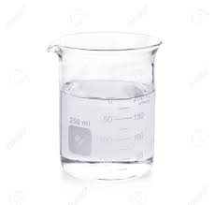
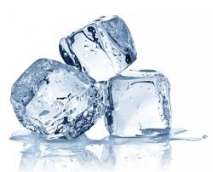
The specific latent heat of fusion L_{F} of a substance is the energy needed to change the state of 1kg of the substance from a solid to a liquid, at its melting point (without changing the temperature).
Units?
1 kg
1 kg
Specific latent heat of fusion, L_{F} = energy, E
mass, m

Slide 7
Rearranging the equation:
Energy (joules, J) =
Mass (kilograms, kg) =
Think > Pair > Share: How would you rearrange the formula for specific latent heat of fusion L_{F}, in order to find out the:
Specific latent heat of fusion x mass
Energy
Specific latent heat of fusion

Slide 8
Quick Check
Calculate the energy required to convert 1.5kg of ice to water. The specific latent heat of fusion of water is 334,000 J/kg.
The energy required to covert an unknown mass of ice into water was 145,000J, the specific latent heat of fusion of water is 334,000 J/kg. Calculate the mass of ice.
(3 marks)
(3 marks)

Slide 9
Self-assessment:
1. E = m x L
E = 1.5kg x 334,000
E = 501,000 J
M = E / L
M = 145,000J / 334,000J/kg
M = 0.43 kg

Slide 10
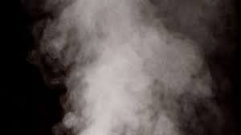
The specific latent heat of vaporisation L_{v} of a substance is the energy needed to change the state of 1kg of a substance from liquid to vapour, at it’s boiling point (i.e. without changing its temperature)
1 kg
1 kg
energy, E
mass, m
Specific latent heat of vaporisation , L_{v} =

Slide 11
Rearranging the equation:
Energy (joules, J) =
Mass (kilograms, kg) =
Think > Pair > Share: How would you rearrange the formula for specific latent heat of fusion L_{V}, in order to find out the:
Specific latent heat of vaporisation x mass
Energy
Specific latent heat of vaporisation

Slide 12
Quick Check
A mass of water was weighed and found to be 0.152kg, the heater was turned on and the mass dropped to 0.144kg in the time taken to supply 18,400 J of energy to the boiling water. Use the data to calculate the specific latent heat of vaporisation of the water.
A mass of water was weighed and found to be 0.6kg prior to a heater being turned on. The heater was turned on for exactly 10 minutes and after the 10 minutes the mass of water was found to be 0.465kg. Use the specific latent heat of vaporisation of water from the previous question to calculate how much energy was transferred to the water?
(3 marks)
(3 marks)

Slide 13
Self-assessment:
0.152kg - 0.144kg = 0.008kg
L_{v} = E / m
L_{v} = 18,000J/0.008kg = 2,300,000J/kg
b) 0.6kg – 0.465kg = 0.135kg
E = Lv x m
E = 2,300,000J/Kg x 0.135kg = 310,500J

Slide 14
Task: Watch this video and answer the following questions:
Calculate the energy required to 0.5kg of ice to water. The specific latent heat of fusion of water is 334,000 J/kg.
Calculate the energy required to convert 0.15kg of ethanol from a liquid to a vapour. The specific heat of vaporisation of ethanol is 846,000 J/kg.
https://www.youtube.com/watch?v=x7GZ2DXef84

Slide 15
Self-assessment:
E = m x L,
E = 0.5kg x 334,000 J/kg
E = 167,000 J
E = m x L
E = 0.15kg x 846,000 J/kg
E = 126,900 J

Slide 16
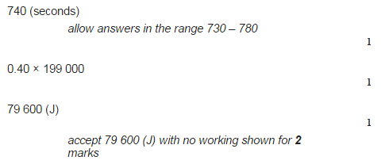
Task: Complete the past-paper question

Slide 17
Plenary – WhatsApp message
Write a WhatsApp message to your friend telling them what you have learnt this lesson!!

Slide 18
Resources

Slide 19
Calculate the energy required to 0.5kg of ice to water. The specific latent heat of fusion of water is 334,000 J/kg.
Calculate the energy required to convert 0.15kg of ethanol from a liquid to a vapour. The specific heat of vaporisation of ethanol is 846,000 J/kg
Calculate the energy required to 0.5kg of ice to water. The specific latent heat of fusion of water is 334,000 J/kg.
Calculate the energy required to convert 0.15kg of ethanol from a liquid to a vapour. The specific heat of vaporisation of ethanol is 846,000 J/kg
Calculate the energy required to 0.5kg of ice to water. The specific latent heat of fusion of water is 334,000 J/kg.
Calculate the energy required to convert 0.15kg of ethanol from a liquid to a vapour. The specific heat of vaporisation of ethanol is 846,000 J/kg

Slide 20
