Slide 1
ENTRANCE DOOR
GCSE PE – YEAR 9

Slide 2
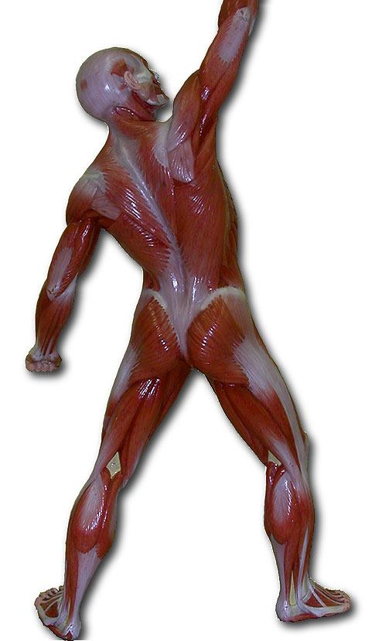
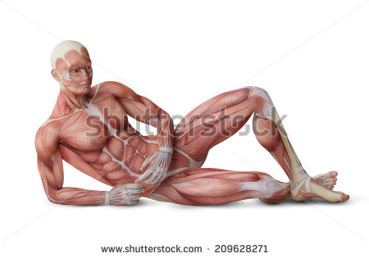
Do it Now:
3-4 = Locations of key muscles
5-6 = Location & job of key muscles
7-9 = Location and Job
B__________
–
T_______ –
Q____________ –
T_______ ________-
H____________ –
G____________–

Slide 3
Do it Now:
3-4 = Locations of key muscles
5-6 = Location & job of key muscles
7-9 = Location and Job
B__________
–
TASK:
3 min to complete on your own
30 seconds to view and recap answers on the screen
1min to add to your work
2min to to check and help your shoulder partner – GREEN PEN
T_______ –
Q____________ –
T_______ ________-
H____________ –
G____________–

Slide 4
Do it Now:
3-4 = Locations of key muscles
5-6 = Location
7-9 = Location and Job
Deltoid – flexion, extension, abduction or circumduction at the shoulder
Trapezius – Extension at the neck (tilting head back)
Biceps – Flexion at the elbow
Triceps – extend at the elbow
Latissimus dorsi – Extension, adduction or rotation at the shoulder
Pectoral – Adduction and flexion at the shoulder
Hip Flexors - Flexion of the leg at the hip
Quadriceps – Extension at the knee
Gluteus maximus – extend of the leg at the hip
Abdominals- Flexion at the waist
Tibialis Anterior- Dorsi-flexion at the ankle
Hamstrings – flex at the knee
External Oblique’ - Rotation or flexion at the waist
Gastrocnemius – Plantar-flexion at the ankle

Slide 5
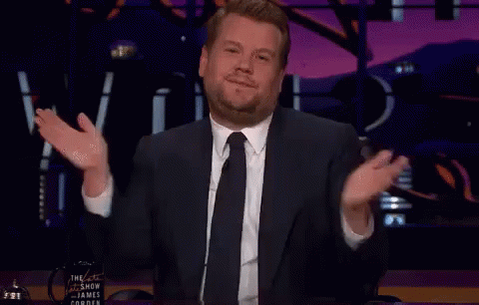
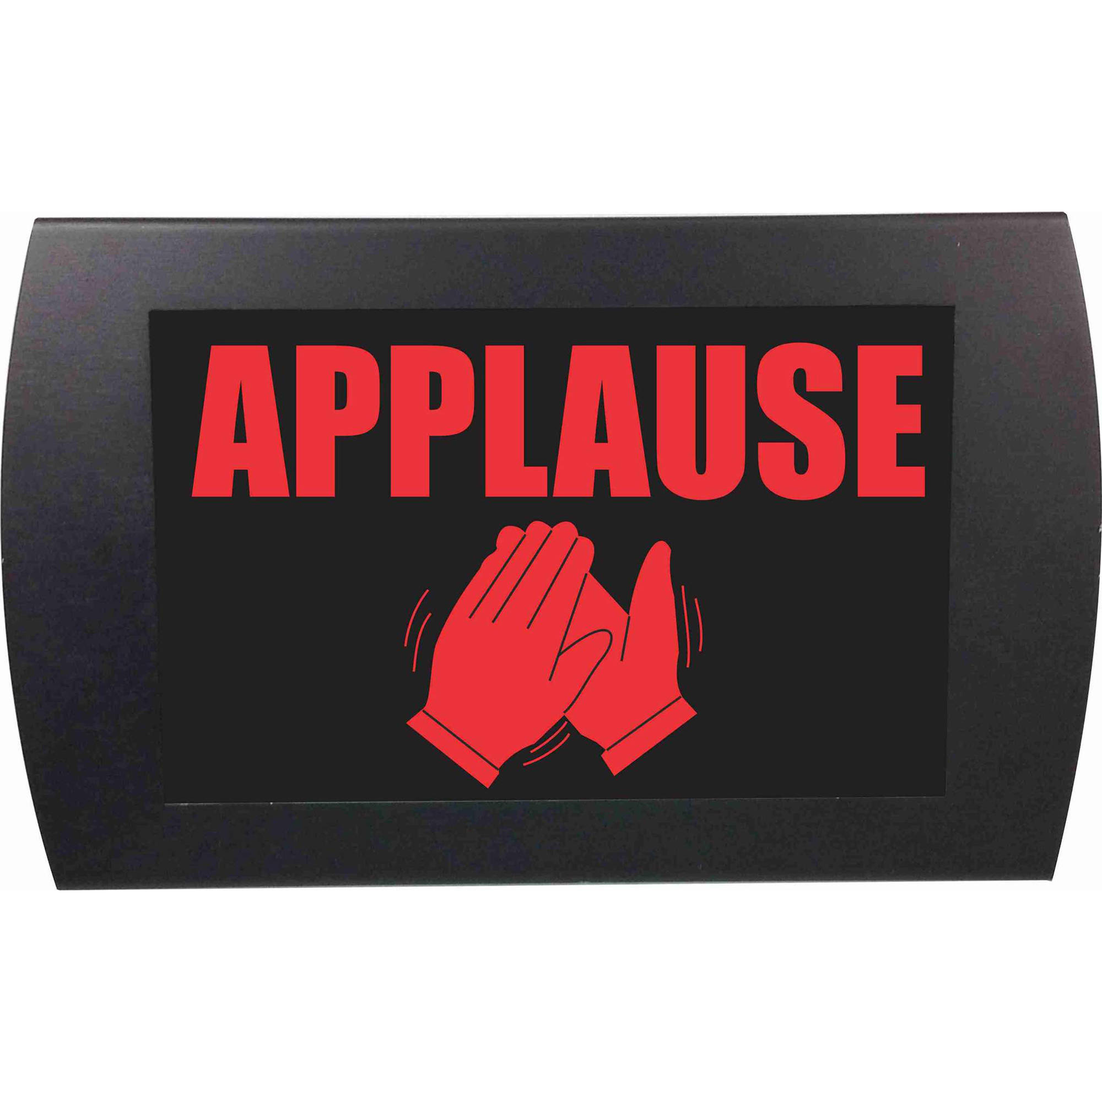
Jasmin Celaj – Fab Effort & Good book work!

Slide 6
Progress Indicators:
Green for Growth
Target | Good | Outstanding
ALL | With some support complete connect and GfG work. To identify some areas you have made progress in | To independently complete connect and GfG work and use knowledge to help others (if needed) To identify areas you and others have made progress in

Slide 7
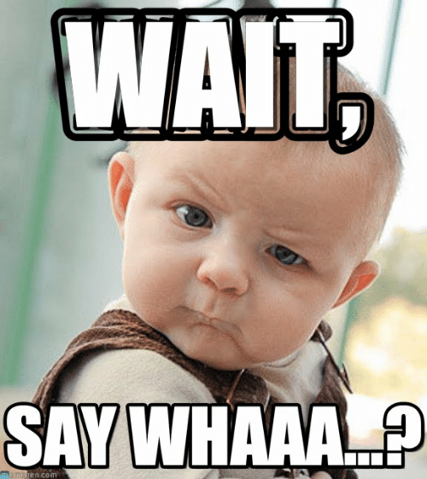
Target | Good | Outstanding
ALL | With some support complete connect and GfG work. | To independently complete connect and GfG work and use knowledge to help others (if needed)
Green for Growth
DO I NEED HELP?!
Complete your connect activity (Layla / James - do your demonstrate 1st!)
Complete your WWW/EBI on your exam
Look through your books and answer at my marking, CORRECT what you need to
EXTENSION STICKERS.
Pick a sticker
Stick it in your book
Answer it
Repeat
Use your BOOK
Use the revision mat
Ask your shoulder partner
Ask your face partner
FINALLY
5) ASK ME

Slide 8
Target | Good | Outstanding
ALL | With some support complete connect and GfG work. | To independently complete connect and GfG work and use knowledge to help others (if needed)
Green for Growth
TASK: (5min)
You have 13 minutes before we stop
You will then swap your books with your shoulder partner who will mark in Red pen your corrections (and sign next to it). Star the corrections not done
Extension: Underline the key words used in their connect (green pen)
3. Continue correcting work
DO I NEED HELP?!
Complete your connect activity (Layla / James - do your demonstrate 1st!)
Complete your WWW/EBI on your exam
Look through your books and answer at my marking, CORRECT what you need to
EXTENSION STICKERS.
Pick a sticker
Stick it in your book
Answer it
Repeat
Use your BOOK
Use the revision mat
Ask your shoulder partner
Ask your face partner
FINALLY
5) ASK ME

Slide 9
DO NOW ACTIVITY
Identify one sport and explain how each classification (flat, long, short and irregular) of bone aids (helps) performance.
___ /8
Question 1: (start of the lesson)
………………………………………………………………………………………………………………………………………………………………………
Points =
Question 2: (END of the lesson)
………………………………………………………………………………………………………………………………………………………………………
Points =
NAME_____________________

Slide 10
Identifies all types of bone and briefly describes their jobs
1 mark awarded for the correct type of bone
1 mark connected to the correct function
1-2
A01
Describes the role within sport
1-3 mark – all types of bones and describes their importance in a sporting activity.
Short bones like the tarsals in the foot are needed to support the weight of a gymnast when balancing on one leg. (done for each = 3 marks)
3-5
AO2
Explain and Justify their roles within sport
1-3 marks awarded if the sporting examples are relevant to the functions of each type of bone stated and justified. Why are they important and if they wasn’t there what might happen.
6-8
AO3

Slide 11
Identify all types of bone and describes their job role within the body
Describes the importance in a sporting activity for at least 2 of the types of bones.
Describes the importance in a sporting activity for ALL types of bones
Explain and Justify their roles within sport
Analyse a specific sporting movement and explain how each type of bone aids performance
Challenge
Discuss how the muscles learned so far will also help the specific movement (include the correct names of movement).

Slide 12
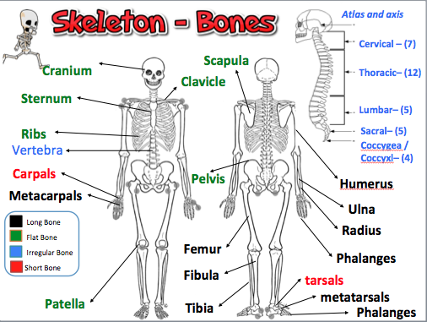
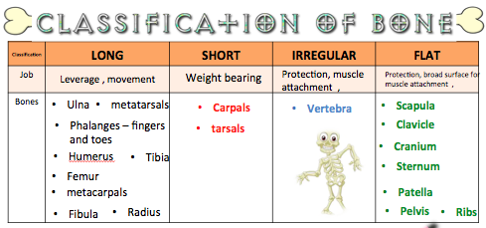
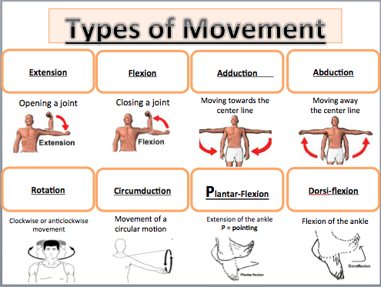

Slide 13
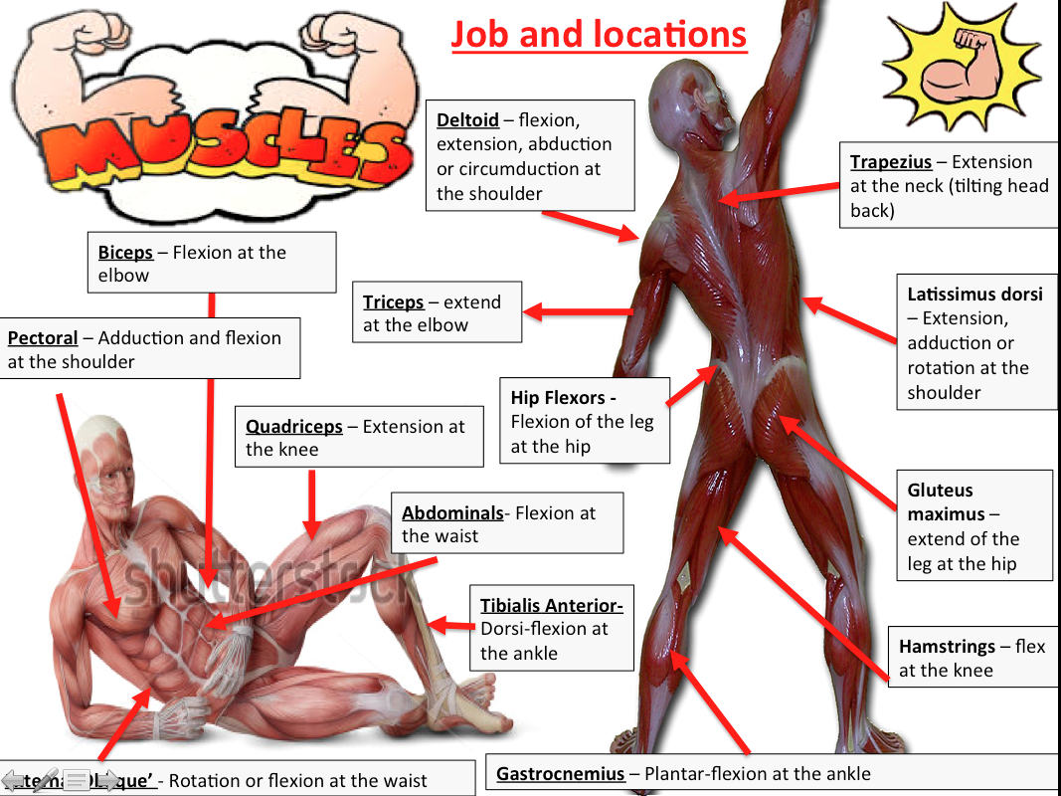

Slide 14
Progress Indicators:
Classification of Muscles
Target | Good | Outstanding
3-4 | To know there are 3 classifications of muscles (AO1) | To state the 3 classifications of muscles with some functions (AO1)
5+ | To begin to explain the 3 classifications, structure and functions (AO2) | To explain and describe the 3 classifications, structure and functions and how they help performance (AO3)

Slide 15
Classification and characteristics of muscle types:
Forming the heart
Of the skeletal system
In blood vessels
this is involuntary
striated muscles due to their appearance
we can't make them contract when we think about it.
this is voluntary
It is under the control of the autonomic nervous system
highly resistant to fatigue due to the presence of a large number of mitochondria
not under our conscious control
found in the internal organs
are under our conscious control
found in the walls of hollow organs such as the Stomach
we can move these muscles when we want to
Sometimes known as smooth muscle

Slide 16
Classification and characteristics of muscle types:
Problem:
There are 3 types of muscles make a list of the characteristics of each type using the
1) Voluntary muscles
2) Cardiac muscle
3) Involuntary muscles

Slide 17
Classification and characteristics of muscle types:
Problem: There are 3 types of muscles make a list of the characteristics of each type using the
1) Voluntary muscles
2) Cardiac muscle
3) Involuntary muscles
In blood vessels
Of the skeletal system
Forming the heart
found in the internal organs
this is voluntary
This is involuntary
It is under the control of the autonomic nervous system
not under our conscious control
are under our conscious control
we can't make them contract when we think about it.
we can move these muscles when we want to
highly resistant to fatigue due to the presence of a large number of mitochondria
Sometimes known as smooth muscle
striated muscles due to their appearance
found in the walls of hollow organs such as the Stomach
FIX IT WITH GREEN PEN!!!

Slide 18
SHOULDER PARTNER QUESTION:
Becky is swimming the English channel. Explain how each classification of muscle will help her complete her swim:
Copy the question
Plan and complete the question in your book together.
Leave space to stick the work sheet done today in
I will photocopy to put in the other persons book
Target | Good | Outstanding
3-4 | To know there are 3 classifications of muscles (AO1) | To state the 3 classifications of muscles with some functions (AO1)
5+ | To begin to explain the 3 classifications, structure and functions (AO2) | To explain and describe the 3 classifications, structure and functions and how they help performance (AO3)

