Slide 1
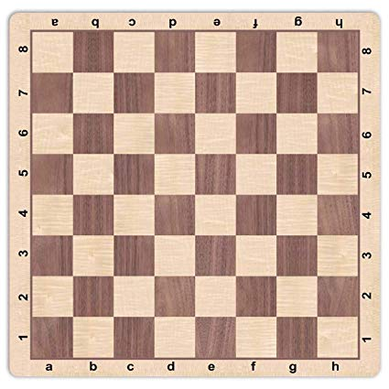
DNA
Ask a question or make a statement
What Fractions can you find?
Notes:
Option 1

Slide 2
Equivalent Fractions and Simplest form
Unit 4B

Slide 3
Prior learning:
Place value.
Percentage as an amount out of 100.
Multiplication and division.
Ordering integers on a number line.
Unit 5 - Fractions, Decimals
and Percentages
Shading fractions of diagrams, equivalence and simplification of fractions.
57-59,61
Convert between improper fractions and mixed numbers.
63-64
65-66,
67-70
Four operations with mixed and improper fractions.
60
Order fractions.
Find fractions of an amount.
77
Calculate a percentage of an amount and percentage change.
84-90
73-76,
82-83
Convert between fractions, decimals and percentages and compare them.
Calculate simple and compound interest.
93-94
Next steps:
Calculating proportions of pie charts.
Using multipliers.
Reverse percentages.
Reverse fractions.

Slide 4
Progress Indicators:

Slide 5
RECAP What does “Equivalent” mean? Give me an example

Slide 6
Look at the shapes below, they all have ½ shaded but the half could be written in different ways.
1
2
2
4
3
6
4
8

Slide 7
Problem Pair
$$\frac{3}{5}= \frac{ }{15}$$
$$\frac{4}{7}= \frac{12 }{ }$$
$$\frac{ }{5}= \frac{8 }{20}$$
$$\frac{ }{6}= \frac{12 }{18}$$

Slide 8
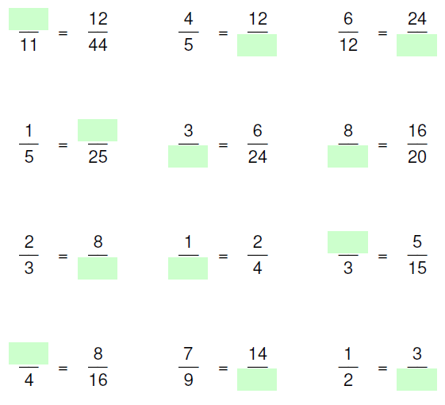
Your Turn

Slide 9
Answers
3
15
48
5
12
10
1
12
2
2
18
6

Slide 11
What is the highest common factor (HCF) of 6 and 8?
12
2
10
4

Slide 12
What is the highest common factor (HCF) of 6 and 8?
12
2
10
4

Slide 13
What is the highest common factor (HCF) of 12 and 16?
48
12
4
24

Slide 14
What is the highest common factor (HCF) of 12 and 16?
48
12
4
24

Slide 15
What is the highest common factor (HCF) of 10 and 25?
5
10
50
2.5

Slide 16
What is the highest common factor (HCF) of 10 and 25?
5
10
50
2.5

Slide 17
What is the highest common factor (HCF) of 24 and 36?
6
12
8
24

Slide 18
What is the highest common factor (HCF) of 24 and 36?
6
12
8
24

Slide 19
How does this help us with fractions?
We are going to simplify fractions.
To do this, we need to divide both the numerator and the denominator by their highest common factor (HCF).

Slide 20
Problem Pair
$$\frac{6}{8}= \frac{ }{ }$$
$$\frac{12}{14}= \frac{ }{ }$$
$$\frac{10}{30}= \frac{ }{ }$$
$$\frac{8}{20}= \frac{ }{ }$$

Slide 21
1. $\frac{2}{12} =$
2. $\frac{3}{12} =$
3. $\frac{4}{12} =$
4. $\frac{5}{12} =$
5. $\frac{10}{12} =$
6. $\frac{20}{24} =$
7. $\frac{15}{18} =$
8. $\frac{35}{42} =$
9. $\frac{35}{49} =$
10. $\frac{35}{56} =$
11. $\frac{56}{35} =$
12. $\frac{35}{35} =$
13. $\frac{5}{5} =$
14. $\frac{0}{5} =$
15. $\frac{15}{5} =$
16. $\frac{14}{4} =$
17. $\frac{13}{3} =$
18. $\frac{12}{2} =$
19. $\frac{12}{1}=$
20. $\frac{12}{18}=$
21. $3\frac{12}{18}=$
22. $6\frac{12}{18}=$
23. $\frac{612}{18} =$
24. $\frac{603}{18} =$

Slide 22
1. $\frac{2}{12} = \frac{1}{6}$
2. $\frac{3}{12} = \frac{1}{4}$
3. $\frac{4}{12} = \frac{1}{3}$
4. $\frac{5}{12} =\frac{5}{12}$
5. $\frac{10}{12} =\frac{5}{6}$
6. $\frac{20}{24} =\frac{5}{6}$
7. $\frac{15}{18} =\frac{5}{6}$
8. $\frac{35}{42} =\frac{5}{6}$
9. $\frac{35}{49} =\frac{5}{7}$
10. $\frac{35}{56} =\frac{5}{8}$
11. $\frac{56}{35} =\frac{8}{5}$
12. $\frac{35}{35} =1$
13. $\frac{5}{5} =1$
14. $\frac{0}{5} =0$
15. $\frac{15}{5} =3$
16. $\frac{14}{4} =\frac{7}{2}$
17. $\frac{13}{3} =\frac{13}{3}$
18. $\frac{12}{2} =6$
19. $\frac{12}{1}=12$
20. $\frac{12}{18}=\frac{2}{3}$
21. $3\frac{12}{18}=3\frac{2}{3}$
22. $6\frac{12}{18}=6\frac{2}{3}$
23. $\frac{612}{18} =34$
24. $\frac{603}{18} =33\frac{1}{2}$

Slide 23
Timed Challenge
Simplify the following fractions and group them into the categories below
9
15
4
12
3
9
15
25
10
30
20
32
10
16
18
30
6
10
2
6
15
24
12
20
5
15
25
40
6
18
50
80
1
3
3
5
5
8

Slide 24
Demonstrate
Fill in the blank
$\frac{3}{5}$ = $\frac{ }{45}$
Write $\frac{12}{40}$ in it’s simplest form
Simplify
Which fraction is bigger, $\frac{1}{2}$ or $\frac{5}{10}$ ?

Slide 25
Connect
Fill in the blank $\frac{3}{5}$ = $\frac{ }{20}$ $\frac{4}{5}$ = $\frac{ }{30}$ | Write the following in it’s simplest form: $$\frac{20}{32}$$ $$\frac{70}{120}$$ $$\frac{200}{3200}$$ | Which fraction is larger, $\frac{5}{7}$ or $\frac{7}{11}$ $\frac{4}{9}$ or $\frac{6}{10}$

