Slide 1
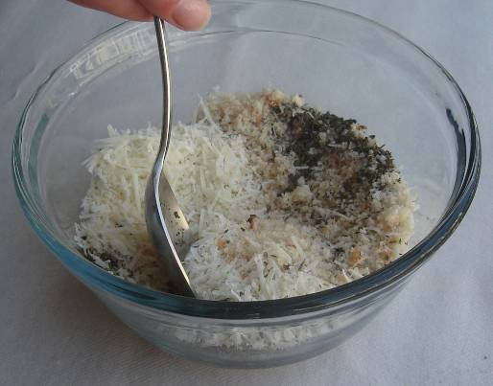
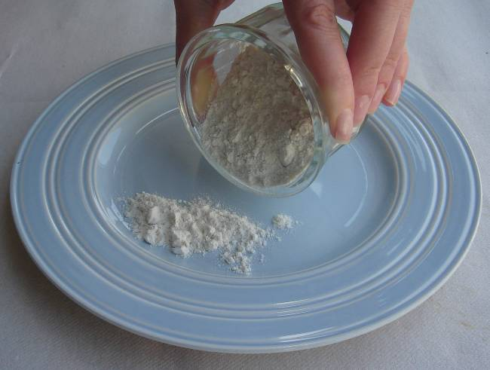
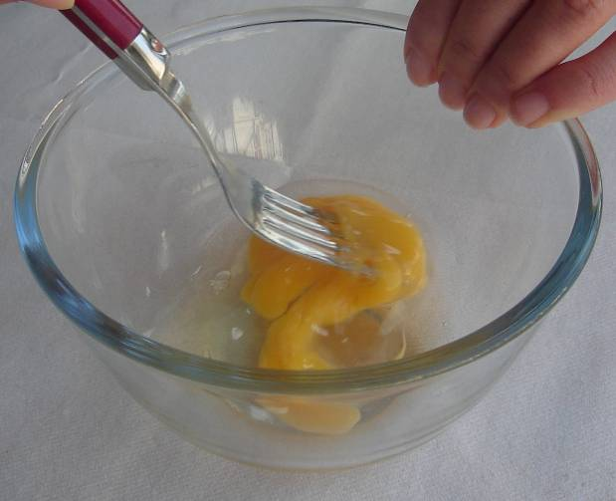
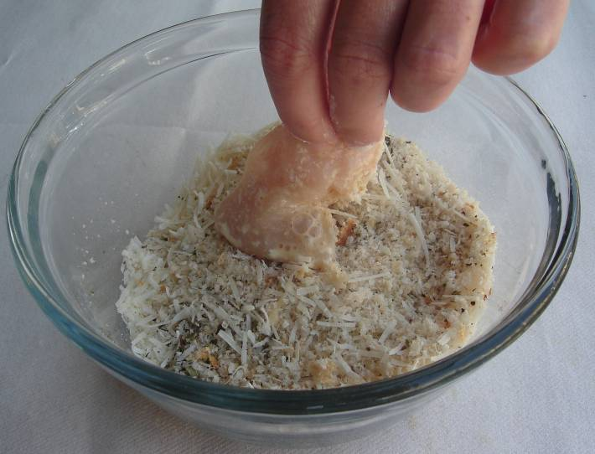
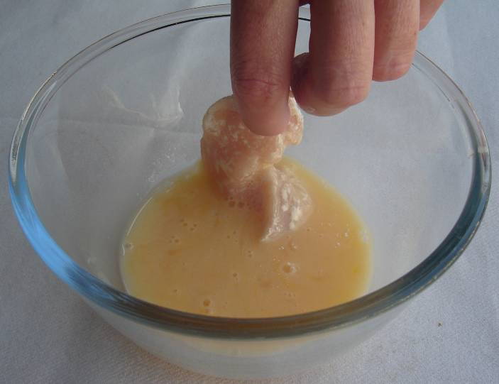
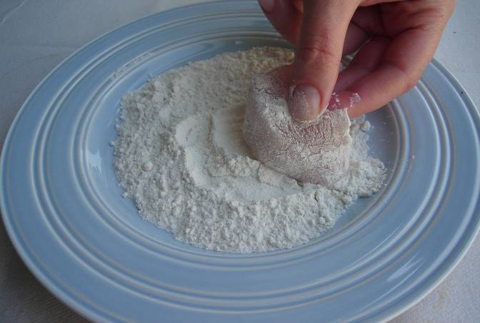
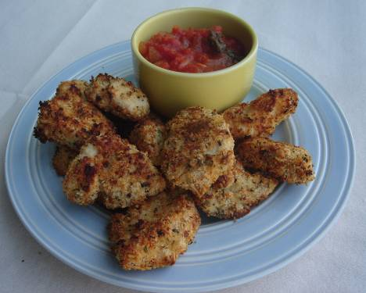
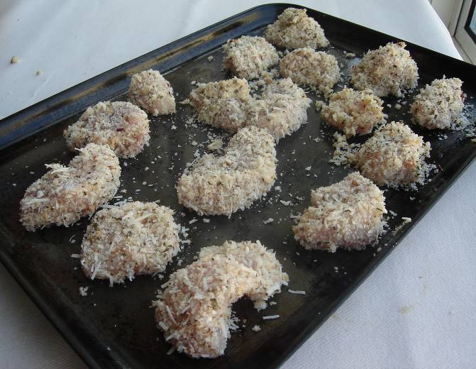
step BY STEP: fish/chicken goujons
Ingredients-
50g breadcrumbs 1 chicken breasts/fish fillet 1x15ml spoon plain flour 1 egg, beaten or milk for vegetarians
Equipment-
Baking tray
Chopping board
Knife
Plate
Bowl x2
Fork
Step 1-Mix the breadcrumbs, herbs and parmesan together in a small bowl.
.
Step 2- Pour the flour on a small plate.
Step 3- Beat the egg in a small bowl
Step 6-Roll in the breadcrumb mixture.
.
Step 5- Dip in the beaten egg
Step 4-Cut the fish into ‘nuggets’ then dust the fish in the flour.
Step 7-repeat stage 4-6 then place on the baking tray.
Step 8- Bake in the oven to 20minutes, until golden brown.

