Slide 1
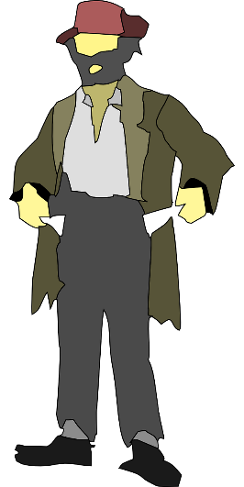
Student name: ____________________________
Date work completed: ________________________
Title: Analysing a non-fiction text
Today we’re going to read a description of homeless people in Victorian London by W. Booth.
Task 1:
Four of these eight statements are TRUE. Shade in the boxes for the ones which are true.
Task 2:
Highlight all the facts about the lives of the homeless in this extract.
Bonus Challenge: Write out a summary of the lives of the homeless using quotes from the article.
Statement |  | Statement
There are lots of homeless people in London. |  | The homeless are all men.
They have places to sleep at night. |  | They huddle together for warmth.
They sit on all the seats at the Embankment |  | Some put paper on the floor to try and stop it being so cold.
The police have moved them off some of the seats. |  | They never take off their hats.
Finished? You are Mr. W. Booth. Write a letter to the UK government asking them to help the homeless people on the Embankment in London. Use persuasive techniques (AFORREST) to convince them that this is the right thing to do.
Task 3:
Circle all the quotes which show the writer feels pity or sorry for the homeless people that he describes.
Bonus Challenge: Which language techniques does he use to make us feel pity for them? Make notes on these and explain how they make us feel sorry for them.

Slide 2
Victorian London - Houses and Housing - Homelessness - Sleeping rough 'There are still a large number of Londoners and a considerable percentage of wanderers from the country in search of work, who find themselves at nightfall destitute. These now betake themselves to the seats under the plane trees on the Embankment. Formerly they endeavoured to occupy all the seats, but the lynx-eyed Metropolitan Police declined to allow any such proceedings, and the dossers, knowing the invariable kindness of the City Police, made tracks for that portion of the Embankment which, lying east of the Temple, comes under the control of the Civic Fathers. Here between the Temple and Blackfriars, I found the poor wretches by the score; almost every seat contained its full complement of six - some men, some women - all reclining in various postures and nearly all fast asleep ... Here on the stone abutments, which afford a slight protection from the biting wind, are scores of men lying side by side, huddled together for warmth, and of course, without any other covering than their ordinary clothing ... Some have laid down a few pieces of waste paper, by way of taking the chill off the stones, but the majority are too tired, even for that, and the nightly toilet of most consists of first removing the hat, swathing the head in whatever old rag may be doing duty as a handkerchief, and then replacing the hat.
W.Booth, In Darkest England 1890
Victorian London - Houses and Housing - Homelessness - Sleeping rough 'There are still a large number of Londoners and a considerable percentage of wanderers from the country in search of work, who find themselves at nightfall destitute. These now betake themselves to the seats under the plane trees on the Embankment. Formerly they endeavoured to occupy all the seats, but the lynx-eyed Metropolitan Police declined to allow any such proceedings, and the dossers, knowing the invariable kindness of the City Police, made tracks for that portion of the Embankment which, lying east of the Temple, comes under the control of the Civic Fathers. Here between the Temple and Blackfriars, I found the poor wretches by the score; almost every seat contained its full complement of six - some men, some women - all reclining in various postures and nearly all fast asleep ... Here on the stone abutments, which afford a slight protection from the biting wind, are scores of men lying side by side, huddled together for warmth, and of course, without any other covering than their ordinary clothing ... Some have laid down a few pieces of waste paper, by way of taking the chill off the stones, but the majority are too tired, even for that, and the nightly toilet of most consists of first removing the hat, swathing the head in whatever old rag may be doing duty as a handkerchief, and then replacing the hat.
W.Booth, In Darkest England 1890

