Slide 1
LO1 – Nutrition
Good Progress | Outstanding Progress
Be able to explain how your work meets the MB1-2 criteria with an example of how it can improve | Identify your work as being at a MB2 + level and explain how it can improve to MB3

Slide 2
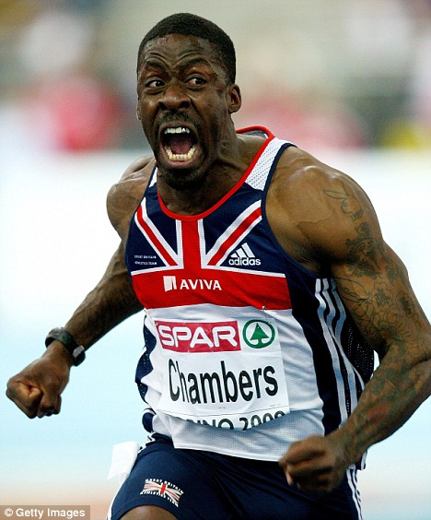
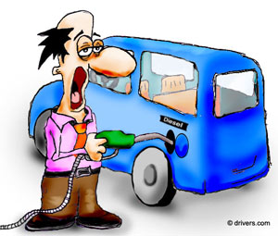
Diet
Diet produces energy
What you eat is the fuel that allows your
muscles to move

Slide 3
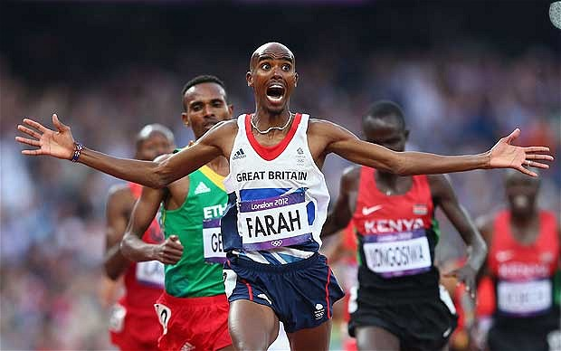
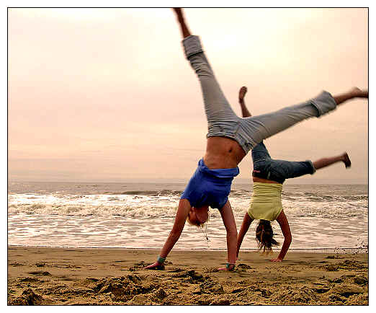
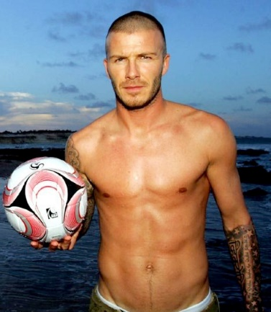
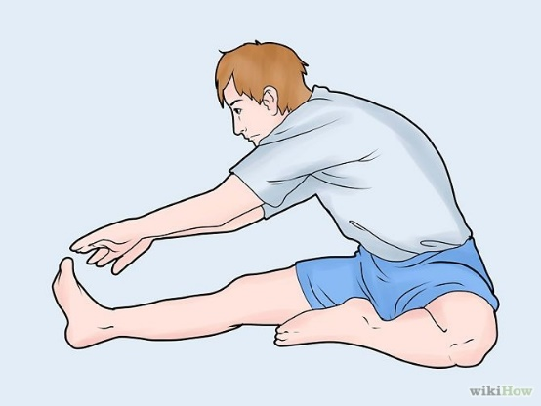
What does food do for me?
Provides energy
Repairs injured tissue
Helps our bodies grow
Contributes to good general health
A balanced diet produces enough energy for the working muscles and recovery after exercise

Slide 4
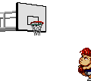
Types of foods
The 7 types of food:-
Carbohydrates
Protein
Fats
Vitamins
Minerals
Fibre
Water

Slide 5
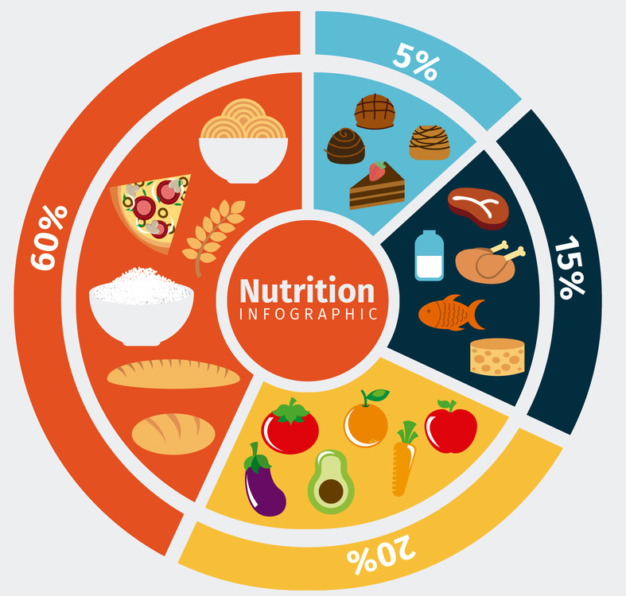
Balanced diet
Eat Variety of food types
A balanced diet means not eating too much of one thing. You spread your daily food intake across different food sources to allow a good a balance of different nutrients
This gives your body all the nutrients it
needs to perform different tasks
Meats, vegetables, fibre, fruit, fats and sugars
https://stock.adobe.com/uk/templates/nutrition-wheel-infographic-and-food-icon-set/124175507

Slide 6
Balanced diet
Suits the needs of the individual
Some people have allergies for example lactose intolerance or allergy to nuts.
The need to make their diet suitable for them and their lifestyle.
Some religious beliefs restrict specific food types for example the Jewish & Islamic society do not eat pork so they would get this protein source from other food types.
Allergies, intolerance to some foods, religious restrictions on some foods

Slide 7
Balanced diet
Nutritional requirements of the individual
You need to identify how many calories you burn on an average day and eat at least this much.
Otherwise you could loose energy and weight. People with active lifestyles burn more calories and then need to eat more to compensate.
Consumer enough the amount of calories that are burnt each day

Slide 8
What is a nutrient
What nutrients are chemicals a living organism needs in order to live and grow

Slide 9
Types of nutrients
Macronutrients
Carbohydrates
Fats
Protein
Micronutrients
Vitamins
Minerals
Water – keeps temperature
Fibre - digestion

Slide 10
Role of nutrients
For example a marathon runner would need carbohydrates to maintain performance and energy during a race.
A footballer would need a high level of protein to recover after a football match and make sure he does not have sore muscles.
A triathlete would need to eat vitamins and minerals so they could train consistently over time and not get sick and ruin their training.
Carbohydrates – Energy
Fats – Energy (fast use)
Proteins – Recovery
Fibre – Healthy digestive system
Water - Hydration
Vitamins & minerals – Healthy immune system & cell replenish
Link each one to at least two sporting examples

Slide 11
Sources of nutrients
Give at least 3 examples of each food group
Carbohydrates – pasta, potatoes, toast
Protein – buts, chicken, eggs
Fats – red meat,
Vitamins & minerals – broccoli, fruit,
Etc etc

Slide 12
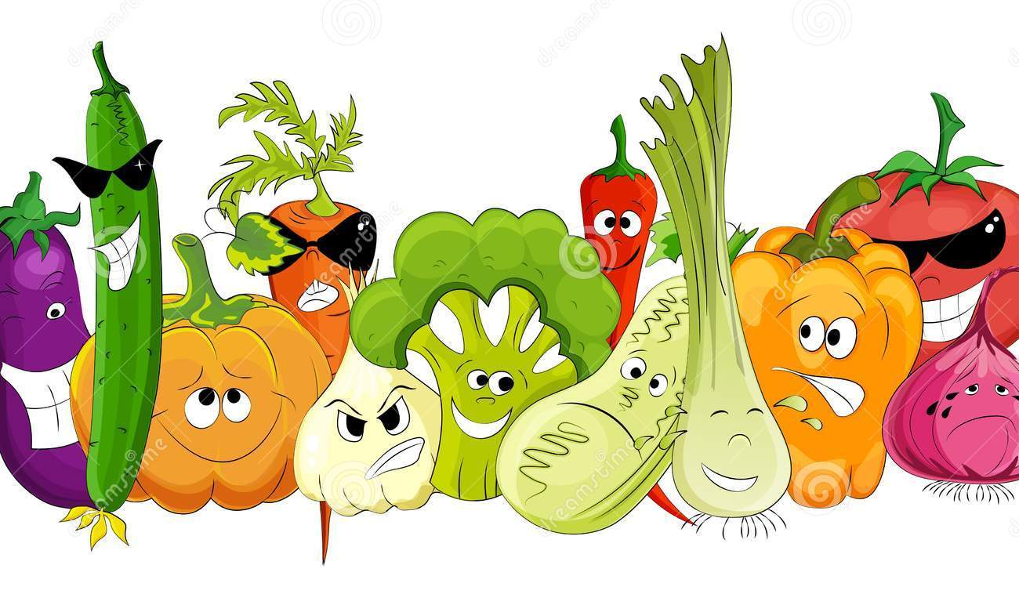
LO1 CAU
Work through LO1 Independently make sure you explain the following
Balanced diet
Nutritional requirements of individual
Why we need a variety of food types
What nutrients are
Role of the nutrients (what they do for the body)
Types of food groups
Needs & tastes of the individual
For guidance use your spec check sheet!

Slide 13
Quality of Work
MB1 1-3 Marks Identifies some of the characteristics of a balanced diet. Provides a limited description of what nutrients are and their role within a healthy balanced diet, giving a limited range of examples of food sources of nutrients. | MB2 4-6 Marks Briefly describes most of the characteristics of a balanced diet. Describes in detail what nutrients are and their role within a healthy balanced diet, giving a range of examples of food sources of nutrients. | MB3 7-9 Marks Describes in detail all of the characteristics of a balanced diet. Comprehensively describes what nutrients are and their role within a healthy balanced diet, giving a wide range of examples of food sources of nutrients.

Slide 14
Use this for guidance!!

