Slide 1
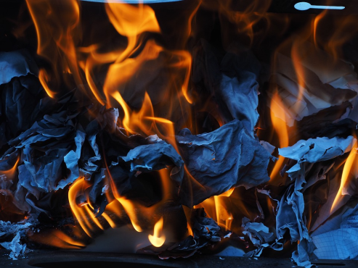
Exothermic & Endothermic Reactions
Do now activity: State what ‘conservation of mass’ means

Slide 2
Progress indicators
GOOD PROGRESS:
Define the terms endothermic and exothermic
Give some examples of endothermic and exothermic reactions
OUTSTANDING PROGRESS:
Describe the characteristics of exothermic and endothermic changes

Slide 3
There are plenty of examples of exothermic reactions, this is a reaction where energy is transferred from the reacting chemicals to the environment.
The thermite reaction
The screaming jelly baby
Combustion
https://www.youtube.com/watch?v=CWMATrOatRw
https://www.youtube.com/watch?v=410b79CPqP0
Rusting
Neutralisation

Slide 4
So what do you think might happen during an ‘endothermic’ reaction?
Think > Pair > Share: Discuss your ideas for a definition of an ‘endothermic’ reaction and come up with any examples if you can!
An endothermic reaction is one where energy is transferred from the environment to the reacting chemicals.
Thermal decomposition of calcium carbonate
Sherbet dissolving in water

Slide 5
https://www.youtube.com/watch?v=eJXL0IrbtqE
Task: Watch the video and answer the following questions:
What is an endothermic reaction?
What is an exothermic reaction?
Name three examples of exothermic reactions.
How could you detect an exothermic reaction?
What are three examples of an endothermic reaction?

Slide 6
Self-assessment:
An endothermic reaction is a reaction which takes energy in from the surroundings
An exothermic reaction is a reaction which transfers energy to the surroundings.
Neutralisation reaction between an acid and an alkali, reaction between water and calcium oxide and respiration.
You can detect an exothermic reaction by using a thermometer, if the temperature increases during a reaction it is exothermic.
Electrolysis, the reaction between sodium carbonate and ethanoic acid and photosynthesis.

Slide 7
Investigate: Endothermic or exothermic reaction?
Important: Wear eye protection at all times!!
Task: In pairs you will carry out an investigation to identify whether a reaction is endothermic or exothermic.
Copy the following table into your books in order to record your results:
Experiment | Temperature at the start (⁰C) | Temperature at the end (⁰C) | Change in temperature (⁰C) | Other observations | Endothermic or exothermic reaction?
1
2
3

Slide 8
Quick Check
Q. The table shows the temperature changes that occur when some substances dissolve in water. Which of these substances dissolves exothermically? Explain your choices.
Name of substance | Temperature before (°C) | Temperature after (°C)
Potassium chloride | 20 | 12
Calcium chloride | 20 | 42
Sodium hydrogen carbonate | 20 | 18
Sodium carbonate | 20 | 23

Slide 9
Self-assessment:
A: Calcium chloride and sodium carbonate both dissolve in water exothermically. We can tell this from the results as once these two substances are placed in water the temperature increases, this causes energy to be transferred to the surroundings indicating an exothermic reaction.

Slide 10
Plenary: Anagram challenge:
Task: Unscramble the following words to reveal 6 key words from the lesson today:
mroetiednhc
tacneivroson
smsa
reoetmxihc
itrcoean
lcacmehi
Endothermic
Conservation
Mass
Exothermic
Reaction
Chemical
Extra Challenge: Come up with a definition for each of the words once you have unscrambled them!
Notes:
Endothermic, conservation, mass, exothermic, reaction, chemical

Slide 11
Resources

Slide 12
Endothermic or exothermic?
Equipment needed:
anhydrous copper(II) sulfate • citric acid • sodium hydrogencarbonate • copper(II) sulfate solution • zinc powder • test tubes • spatula • dropping pipette • measuring cylinder • glass stirring rod
Method
Experiment 1: A test for water
Put a spatula measure of white, anhydrous copper(II) sulfate powder into a test tube.
Use a dropping pipette to add a few drops of water to the powder.
Watch what happens and cautiously feel the bottom of the tube.
Experiment 2: A sherbet mixture
In a dry test tube, mix one spatula measure of citric acid with one spatula measure of sodium hydrogen carbonate.
Add about 2 cm³ water to the mixture.
Watch what happens and cautiously feel the bottom of the tube.
Experiment 3: A competition reaction
Put about 5 cm³ copper(II) sulfate solution in a test tube.
Using a spatula, add a small measure of powdered zinc. Stir with a glass rod.
Watch what happens and cautiously feel the bottom of the tube.
Endothermic or exothermic?
Equipment needed:
anhydrous copper(II) sulfate • citric acid • sodium hydrogencarbonate • copper(II) sulfate solution • zinc powder • test tubes • spatula • dropping pipette • measuring cylinder • glass stirring rod
Method
Experiment 1: A test for water
Put a spatula measure of white, anhydrous copper(II) sulfate powder into a test tube.
Use a dropping pipette to add a few drops of water to the powder.
Watch what happens and cautiously feel the bottom of the tube.
Experiment 2: A sherbet mixture
In a dry test tube, mix one spatula measure of citric acid with one spatula measure of sodium hydrogen carbonate.
Add about 2 cm³ water to the mixture.
Watch what happens and cautiously feel the bottom of the tube.
Experiment 3: A competition reaction
Put about 5 cm³ copper(II) sulfate solution in a test tube.
Using a spatula, add a small measure of powdered zinc. Stir with a glass rod.
Watch what happens and cautiously feel the bottom of the tube.
Important: Wear eye protection at all times!!
Important: Wear eye protection at all times!!

