Slide 1
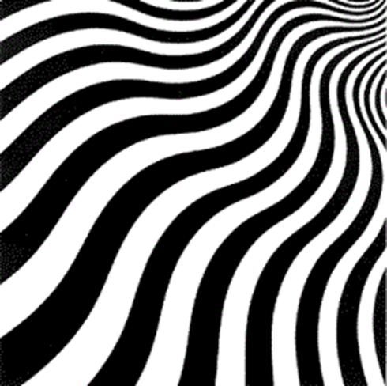
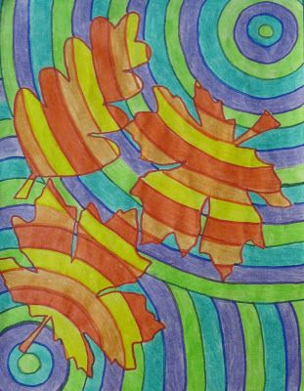
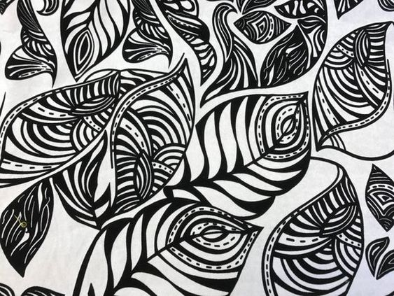
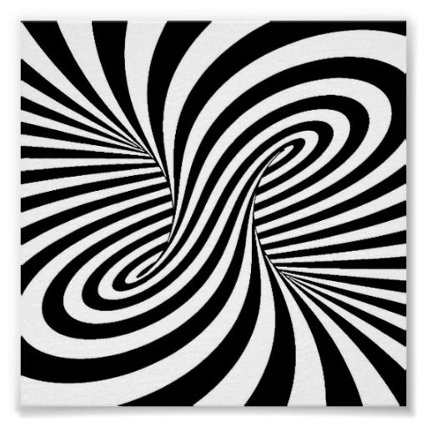
Optical Art
Task 1: You need to research and find out
What is Optical Art?
Name some artists:
D.o.b
Where they where born / live / work
Information about their artistic style
Media / materials they use
Images of their work – with titles / date / media/materials used
Write a detailed and descriptive personal response upon individual pieces of their work / style.
Task 2: Create your own work using the artists influence of style / media/materials / techniques ….(put optical effects inside a tracing of one of your natural form drawings you have done)
Optical artists
Bridget Riley
Victor Vasarely
Joseph Albers
Frank Stella

