Slide 1
Retrieval Practise – context.
- Front of Books
- Write the title – retrieval practise context
- Write the poem name and add two bullet points after it to respond to the task below.
- In silence
- 8 minutes.
For each of the poems identify two ‘contextual factors’ relevant to it:
Exposure
Charge of the Light Brigade
My Last Duchess
Bayonet Charge
Remains

Slide 2
LO: To understand the context of the poem and its structure.

Slide 3
DNA Read the words form the opening stanza. 1: What do you think the poem is about? Why? 2: Select three words from the list and write down the connotations of them.
armistice blazer blockade crimped
disrupting graves individual left paper petals pinned poppies red spasms Sunday war yellow

Slide 4
Connotations
Connotations?
an idea or feeling which a word invokes for a person in addition to its literal or primary meaning
Innocence
Fun
Enjoyment

Slide 5
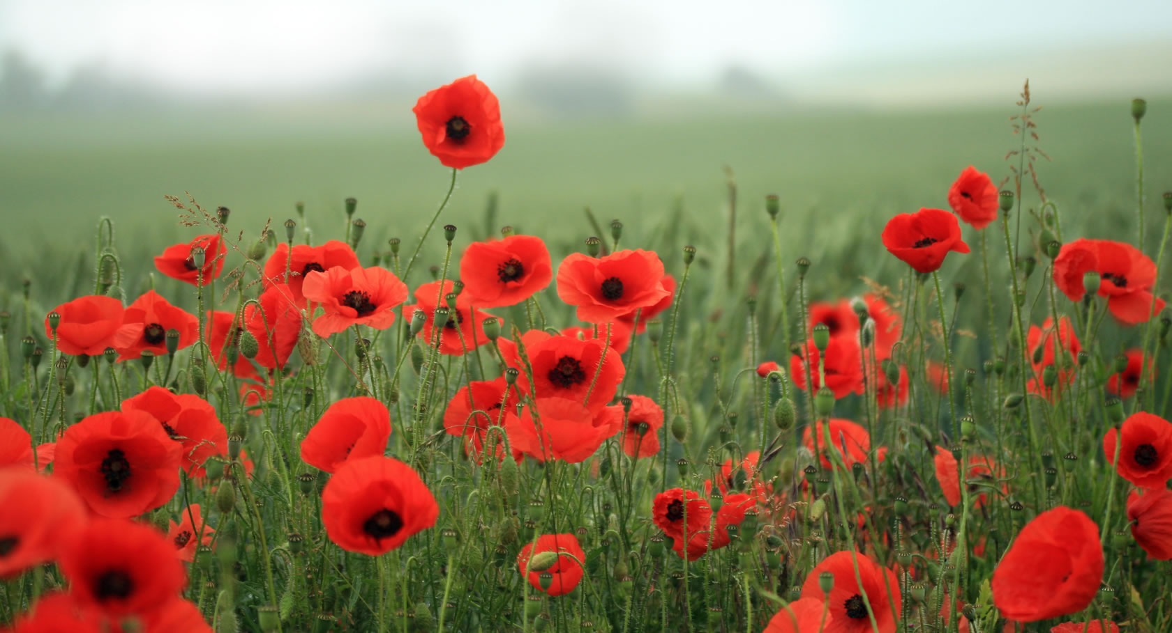
Connotations of image? Positive or negative?

Slide 6
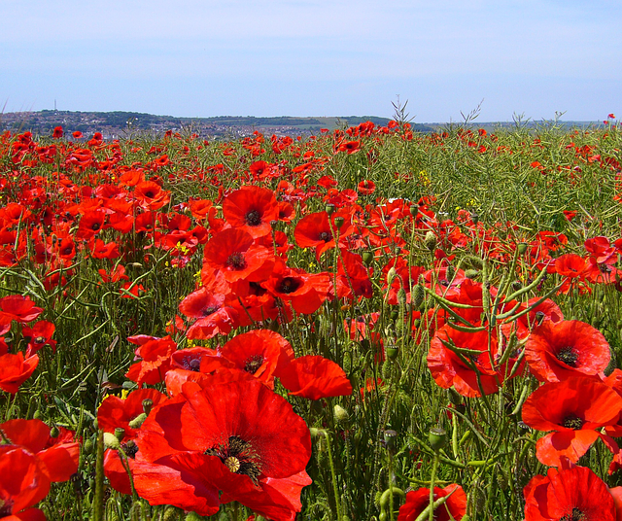
Why do people wear poppies at memorial?
What might a poppy symbolise?
Annotate the poem’s title with connotations and ideas

Slide 7
The poppy has a long association with Remembrance Day. But how did the distinctive red flower become such a potent symbol of our remembrance of the sacrifices made in past wars?
Scarlet corn poppies grow naturally in conditions of disturbed earth throughout Western Europe. The destruction brought by the Napoleonic wars of the early 19th Century transformed bare land into fields of blood red poppies, growing around the bodies of the fallen soldiers.
In late 1914, the fields of Northern France and Flanders were once again ripped open as World War One raged through Europe's heart. Once the conflict was over the poppy was one of the only plants to grow on the otherwise barren battlefields.

Slide 8
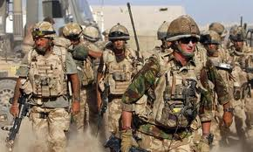
What would a son say about War?
What a mother say about War?

Slide 9
Read the poem on page 38 What happens?
 | What happens in the stanza?
Stanza 1
Stanza 2
Stanza 3
Stanza 4
Challenge - How does the mood or tone of the poem change throughout?

Slide 10
 | What happens in the stanza?
Stanza 1 | the mother looks back at remembrance day and the idea of the poppy which has helped trigger the memory.
Stanza 2 | the mother talks about helping her son get ready and seeing him off.
Stanza 3 | explores the emptiness that is left in his absence
Stanza 4 | the mother feels drawn to a war memorial bringing the story back to where it started, yet now with no son around. The suggestion of the dove being that he has died.
How does the mood or tone of the poem change throughout?

Slide 11
Retrieval Practise – AIC
Copy down the following quotation.
‘That’s what you’ve got to keep your eye on, facts like that, progress like that – and not a few German officers talking nonsense and a few scaremongers here making a fuss about nothing.’
Identify
who said it
Key themes it links to
Key contextual links
Key learning (what do we learn about the play/ writer’s viewpoint from this)

Slide 12
Poppies
Listen to the poem being read aloud
https://www.youtube.com/watch?feature=player_detailpage&v=r8QIcYdJPG0
Apply SMILE by yourself for 5 mins. Start with MEANING- what is this poem about?
S – Structure
M – Meaning
I – Imagery – stylistic techniques
L – Language
E – effect on reader

Slide 13
Retrieval DNA
Who is Jane Weir?
Why did she write the poem?
What are the issues in the poem?

Slide 14
Retrieval DNA
Who is Jane Weir?
Why did she write the poem?
What are the issues in the poem?
Language challenge
Pick one line from the poem and analyse the language uses in it.
Copy the line into your book and then explode the quotation.
Challenge - Bullet point 5 things that stand out about the poem Poppies

Slide 15
Meaning
Poppies explores conflict from the point of view of women affected by war.
The poem is written in the first person persona of a grieving mother that has lost her son in conflict.
Poppies is set in the modern day but it makes references to conflicts as far back as World War One and reflects on how mothers, sisters, wives and girlfriends coped with losing their loved ones.

Slide 16
Notes on structure
Written as a monologue - real thoughts and feelings
No rhyme scheme – would feel inappropriate given the subject matter
Long sentences and enjambment – lost in her own thoughts
The poem contains four stanzas. On first inspection, the poem seems quite uniformed and strictly organised.
However when you look closer you can see that the structure is much more irregular than it first appears. More than half of the lines have breaks in the middle (called caesuras) and are punctuated by commas or full-stops.
This reflects the mother herself. On the outside she is strong - keeping it together for her son. Yet beneath this façade she is frightened, anxious and emotionally fragile.
Notes:
Real thoughts and feelings – rhyme scheme would be inapproiate

Slide 17
Notes on structure: Time
What do you notice about the use of time in this poem? Scan the poem and underline all of the indications of time. Now what do you notice?
Events aren’t told in a chronological order but instead they jump from one time to another. Just as the mother’s emotions change the time sequence changes too.
The poem begins "Three days before" (line 1) then moves to "Before you left" (line 3) and then to "After you'd gone" (line 23) before it ends with "later" (line 25).
Poppies ends in the present - "this is where it has led me" (line 26). Here the mother exists in a kind of limbo, on the hill, half way between the present and the past.

Slide 18
"I wrote the piece from a woman's perspective, which is quite rare, as most poets who write about war have been men. As the mother of two teenage boys, I tried to put across how I might feel if they were fighting in a war zone.”

Slide 19
Poppies Jane Weir
She is a textile designer, writer and poet who has lived ‘all over the place’, including in Belfast, Northern Ireland during the Troubles (in the 1980s). Weir currently lives in Derbyshire and Manchester, where she writes and runs her own textile and design business.
Jane Weir describes herself as Anglo-Italian, and grew up in on the outskirts of Manchester on a council estate.
Weir’s poem ‘Poppies’ was commissioned by Duffy as part of a collection of ten contemporary war poems which were published in the Guardian in 2009, as part of a response to the escalating conflict in Afghanistan and the Iraq inquiry.
Weir describes being surprised by the ‘overwhelming response’ she had from readers across Europe to ‘Poppies’. Many of the readers who contacted her were mothers of soldiers killed in action in recent conflicts.

Slide 20
Plenary - Your thoughts
Which statement do you think best explains the poem. Choose one and explain your choice.
The poem is about bravery
The poem is about the loss of a woman’s son and her emotions about him leaving
The poem is conveying a sense of sadness that we are still losing sons due to war
The poem is a memorial

Slide 21
Poppies Lesson 2
To be able to annotate a poem with key ideas
To analyse language in the poem

Slide 22
Poppies recap – answer the questions in full sentences. FRONT of books. Title = Poppies.
Why was the poem written?
Why is it called Poppies?
How is the structure of the poem important?

Slide 23
The poem is about a mother who describes her son leaving home to fight in the army and her emotional reaction to her son leaving. She feels sad, lonely and scared for his safety. She describes helping him smarten his uniform ready to leave. After he leaves, she goes to places that remind her of him, desperately trying to find any trace of him.

Slide 24
Zooming in on language 1
We are now going to zoom in and analyse language in more detail.
Complete the table on the next slide.

Slide 25
Identify and comment on the poetic techniques employed by the poet
Technique | Evidence | Effect on reader | Which word is most effective? | Why?
metaphor | ‘All my words flattened, rolled, turned into felt, slowly melting’
simile
alliteration
Sympathy for the mother because she is clearly struggling to cope -INNER CONFLICT

Slide 26
Technique | Evidence | Effect on reader | Which word is most effective? | Why?
metaphor | ‘All my words flattened, rolled, turned into felt, slowly melting’ |  | “FLATTENED” “MELTING” | Suggest that she is broken, emotionally torn apart, lost a part of herself – being a mother
simile | “world overflowing like a treasure chest” | Sadness/sorrow – poignant moment because the son is excited about the prospect of going to war but we know that he venture is going to end in tragedy. | “overflowing” “treasure” | Shows she can’t contain her emotions. The world is too much for the boy to handle - dangerous Shows how valuable he is to his mother
alliteration | “steeled the softening” “bias binding” | Soft gentle sound to show a tender/intimate moment Harsh B sound – reflects what is about to face in battle | “steeled” “binding” | Shows she is trying to stay strong – contrast Suggests a connection between mother and son and that he is trapped
Sympathy for the mother because she is clearly struggling to cope -INNER CONFLICT

Slide 27
Zooming in on language 2
Annotate your stanza
Compare notes with a person doing the same stanza
Feedback your notes to others. Make notes on their stanzas

Slide 28
Why individual war graves? What is the effect?
Blockade Military reference to blocking, perhaps of emotion.
Three days before Armistice Sunday and poppies had already been placed on individual war graves. Before you left, I pinned one onto your lapel, crimped petals, spasms of paper red, disrupting a blockade of yellow bias binding around your blazer.
Alliteration also used with bias, binding, blunder emphasise bustle, mothering over her son
What is the effect of using ‘I’ ?
Where else might you see a blazer? What does this link to? What is the effect?

Slide 29
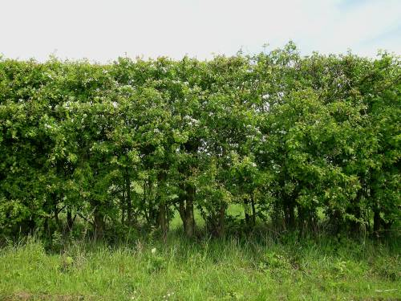
Where would you normally see a bandage? What does this link to? How might it link to her emotions?
What is the effect of repeating the ‘s’ sound with the sibilance?
Sellotape bandaged around my hand, I rounded up as many white cat hairs as I could, smoothed down your shirt's upturned collar, steeled the softening of my face. I wanted to graze my nose across the tip of your nose, play at being Eskimos like we did when you were little. I resisted the impulse to run my fingers through the gelled blackthorns of your hair. All my words flattened, rolled, turned into felt,
How did she treat him?
What is the effect of this anecdote?
What is the effect of this list of three?
Developing original ideas:
Is there anything else you would select that shows her feelings about her son?
What is the effect of this metaphor? What does it make the son sound like?

Slide 30
What does this simile suggest that her son felt about the world?
How did she act?
Is there anything to suggest how she was feeling deep down?
What is the effect of the mention of time in this way?
slowly melting. I was brave, as I walked with you, to the front door, threw it open, the world overflowing like a treasure chest. A split second and you were away, intoxicated. After you'd gone I went into your bedroom, released a song bird from its cage. Later a single dove flew from the pear tree, and this is where it has led me, skirting the church yard walls, my stomach busy making tucks, darts, pleats, hat-less, without a winter coat or reinforcements of scarf, gloves.
Why might the son be like this song bird? What might this symbolise?
What is the effect of the list of verbs?
Stretch yourself:
How is the use of symbolism effective in this stanza?
What is the effect of this personification? What does it show us about how she is feeling?

Slide 31
What does a dove represent?
What does this line remind us of?
What is this a reminder
of?
On reaching the top of the hill I traced the inscriptions on the war memorial, leaned against it like a wishbone. The dove pulled freely against the sky, an ornamental stitch. I listened, hoping to hear your playground voice catching on the wind.
What does this simile suggest about her state at this point?
What is the effect of the caesura? (pauses in the middle of a line)
Something small and delicate yet beautiful. What might this link to?
What is the tone (mood) at this point in the poem? How is this created?

Slide 32
Language tasks
How are references to peace/normality and references to conflict woven throughout the poem? What effect do they have? 2 PEEZ minimum.
To what extent do physical location and time affect the narrator? How do they help us to understand her position? 2 PEEZ minimum

Slide 33
Find evidence that the poem makes us think about…
The pain and difficulty of loss
The personal price a family can pay
The value of Remembrance

Slide 34
Poppies Lesson 3
To consolidate knowledge and understanding of the poet’s meaning and purpose

Slide 35
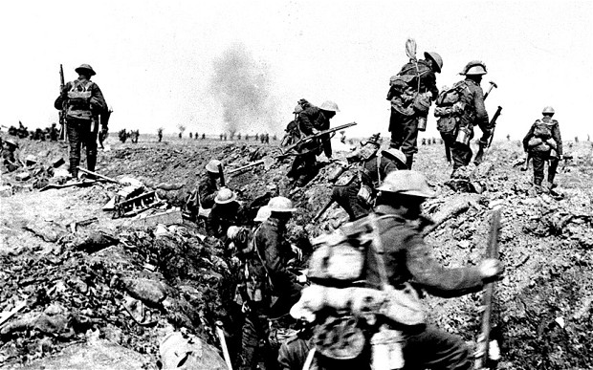
What is your view on this statement: On a post-it note add your views
War is a necessary evil.

Slide 36
What are their connotations?

Slide 37
Find phrases that show…
War -
The pain and difficulty of loss -
Memory -
Childhood -
Innocence -
Adulthood –
The value of Remembrance-
Conflict…
Power…
Then…
What is the poet saying about these themes?
What images/language does she use to express them?

Slide 38
We are going to produce a revision mind map for every poem
You will have 30 mins of the lesson to produce this mind map using the notes from the last few lessons.
The aim is not to copy ALL of your notes from one place to another. The aim is to skim and scan your notes and SELECT the KEY aspects for your revision and key quotes. Key words only.
‘conflict’ and ‘power ‘ are key terms as this is the name of the anthology; it stands a chance it will be used in the exam question. So bullet point HOW conflict and power is presented in the poem.

Slide 39
Context
Effect on reader
Poppies by Jane Weir
Poet’s intentions
Structure
Key
Quotes
On conflict

Slide 40
Bringing it all together: How does this poem show a mother’s feelings of conflict?
Structure-look at the start and end of the poem
Language- what devices/ symbolism/ vocabulary are used?
Images- what image is created of both mother, and the way she sees her son?
Themes-what are the ideas and messages of this poem?

Slide 41
Summing up
Tweet the key ideas of the poem in less than 140 characters

Slide 42
How is the mother’s inner conflict shown in the poem Poppies?
The mother’s inner conflict is shown through her memories of her son. Jane Weir uses references to time to show that she is in limbo between past and present. The poet refers to, “three days before,” “after you had gone” and “later” to demonstrate that she is dwelling on memories of her son who she is grieving over. The quote, “all my words flattened, rolled and turned into felt” uses a metaphor to reveal that she feels crushed because she has lost her son. The reader would feel sympathy for the mother because she is clearly struggling to cope. This is a modern poem that was influenced by the conflict in Iraq and Afghanistan.

