Slide 1
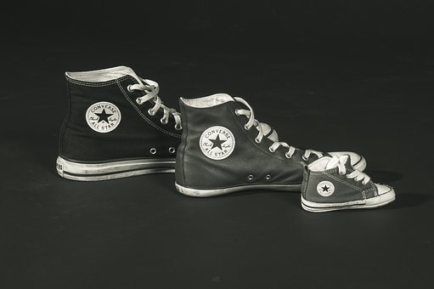
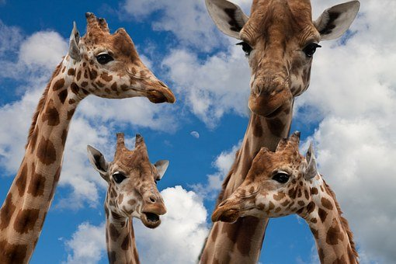
Continuous & Discontinuous Variation
Learning objectives:
Describe the difference between discontinuous and continuous variation
Represent variation within a species using graphs.
Starter: What is the difference between inherited and environmental variation? Use examples in your answer.

Slide 2
Continuous & Discontinuous Variation
Everyone out of their seats, you are going to organize yourselves based on the following factors:
Organise yourselves according to your eye colour.
Organise yourselves according to your gender.
Organise yourselves according to your height.
Think > Pair > Share: What do you notice about the way your organized yourselves for each of these different factors?

Slide 3
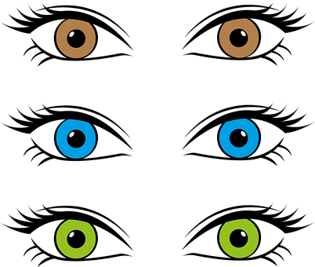
Discontinuous variation
When you organized yourselves into groups according to gender or eye colour, you divided yourselves into distinct groups. E.g. male or female, green/brown/blue eyes. This is known as discontinuous variation.

Slide 4
Continuous variation
When you organized yourselves into groups according to height, you arranged yourselves into one big group standing in height order – shortest to tallest. A characteristics that can take any value within a range is known as continuous variation.

Slide 5
The Great Big Class Survey
Task: You are going to be organised into groups, each group will be assigned a characteristic. You will need to collect data on this characteristic from at least 20 people in your class, for example shoe size or eye colour.
Group 1 – Eye colour
Group 4 – Arm length
Group 3 - Height
Group 2 – Lobed/Lobeless Ears
Group 5 – Hand span
Group 5 – Handedness (R/L)

Slide 6
Discontinuous or continuous variation
You were each assigned a characteristic to collect class data on.
Think > Pair > Share: Which of these categories are examples of continuous variation? Which are examples of discontinuous variation?
Eye Colour
Handedness
Shoe size
Hand span
Lobed/Lobeless Ears
Height

Slide 7
Self-assessment:
Discontinuous: Eye colour, handedness & lobed/lobeless ears.
Continuous: Hand span, arm length & height.

Slide 8
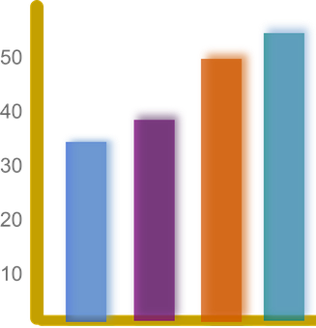
Plotting discontinuous & continuous data
Number of people
Number of people
146 - 150
Up to 120
126-130
141 - 145
121-125
131 - 135
136 - 140
A B AB O
Blood Group
Height (cm)
Discontinuous data can be plotted on a bar chart. For example, a person can only have one of four blood groups – A, B, AB or O.
Continuous data is plotted on a histogram, this shows a range of measurements from one extreme to another. The curve that the graph produces is know as normal distribution.

Slide 9
Task: Now, go back to sitting in your groups and use the data that you collected to plot a graph of your results. (One graph per person, not per group ☺!!)
Group 1 – Eye colour
Group 4 – Arm length
Group 3 - Height
Group 2 – Lobed/Lobeless Ears
Group 5 – Hand span
Group 5 – Handedness (R/L)

Slide 10
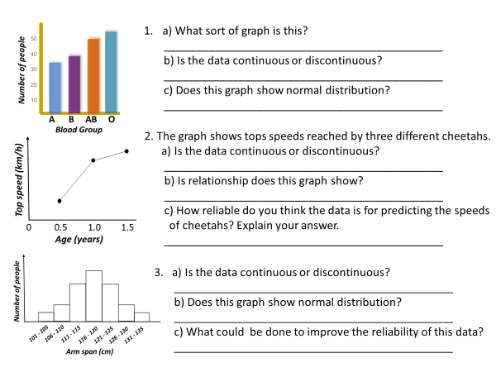
Task: Answer the questions on the worksheet, using the data provided.

Slide 11
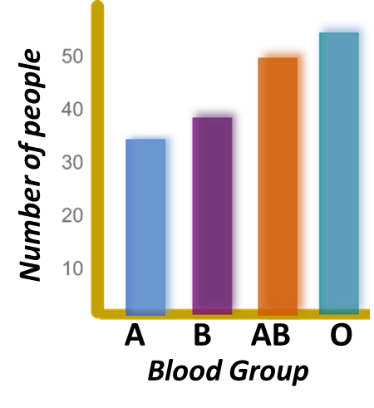
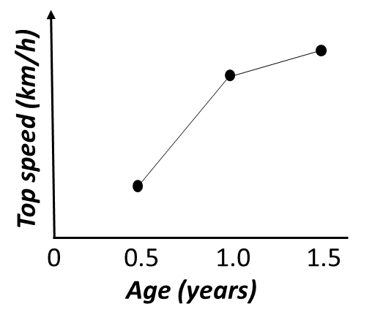
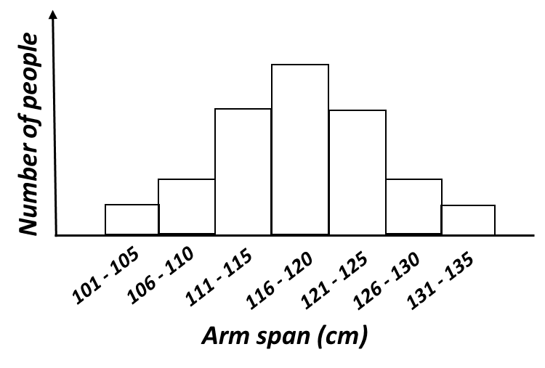
Self-assessment:
1.
Bar chart
Discontinuous
No normal distribution
2.
Continuous
The older the cheetah the faster they are able to run
Not very reliable as the top speeds of only three cheetahs were measured
3.
Continuous
Yes it shows normal distribution
Ask a larger number of women

Slide 12
Plenary – WhatsApp message
Write a WhatsApp message to your friend telling them what you have learnt this lesson!!

Slide 13
Resources

Slide 14
a) What sort of graph is this?
_____________________________________________
b) Is the data continuous or discontinuous?
_____________________________________________
c) Does this graph show normal distribution?
_____________________________________________
2. The graph shows tops speeds reached by three different cheetahs.
a) Is the data continuous or discontinuous?
_____________________________________________
b) Is relationship does this graph show?
_____________________________________________
c) How reliable do you think the data is for predicting the speeds of cheetahs? Explain your answer.
_____________________________________________
3. a) Is the data continuous or discontinuous?
_____________________________________________
b) Does this graph show normal distribution?
_____________________________________________
c) What could be done to improve the reliability of this data?
_____________________________________________

Slide 15
Number of people
106 - 110
101 - 105
111 - 115
121 - 125
116 - 120
131 - 135
126 - 130
Arm span (cm)
Top speed (km/h)
0 0.5 1.0 1.5
Age (years)

