Slide 1
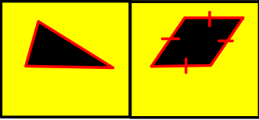
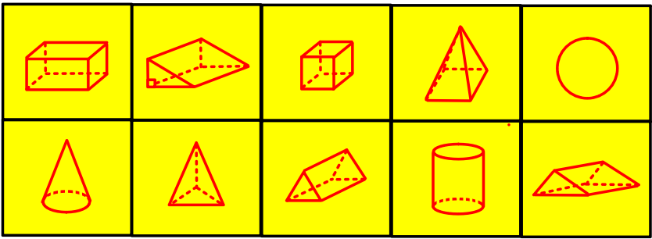
Connect
Name the shapes | Name the 3d Shapes | List the number of faces, edges and vertices for each shape

Slide 2
DNA
Ask a question or make a statement
Would you rather run 34 kilometres or 29543 metres?

Slide 3
Names and Properties of Shapes
Unit 9 – Objective 9a

Slide 4
Number Bonds
Where are you now? | Emerging | Developing | Proficient | Advanced

Slide 5
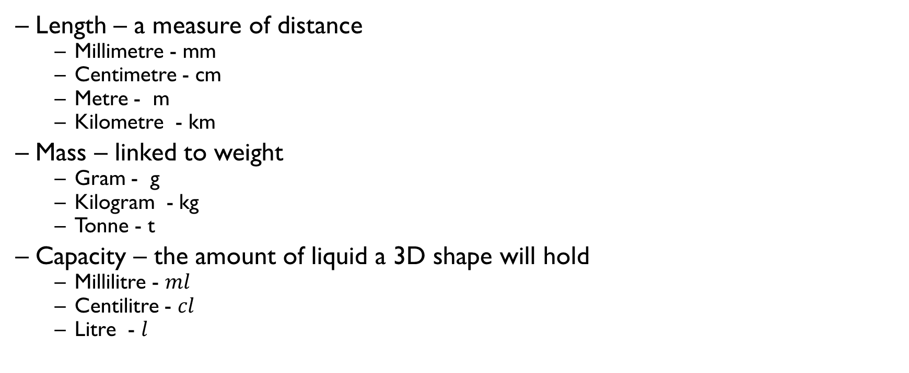
Metric units of measurement
Length – a measure of distance
  Millimetre - mm
  Centimetre - cm
  Metre - m
  Kilometre - km
Mass – linked to weight
  Gram - g
  Kilogram - kg
  Tonne - t
Capacity – the amount of liquid a 3D shape will hold
  Millilitre - $ml$
  Centilitre - $cl$
  Litre - $l$

Slide 6
Write down which metric unit of length you would use to measure each of these items:
1.
mm
Km
km
M
Km
Mm
Width pen nib
Height of a mountain
Distance from Leeds to York
Length of a bedroom
Length of a river
Length of a needle
2.
Which metric unit would you use to weigh each item listed below?
kg
g
t
g
Man
Letter
Delivery van
Tin of tuna
3.
Which metric unit would you use to measure the capacity of each container listed below?
cl
ml
ml
l
Large bottle of pop
Carton of cream
Bottle of shampoo
Paddling pool

Slide 7
Metric units of measurements
Complete the worksheet in your exercise books

Slide 8
Metric conversions
10mm = 1cm
100cm = 1m
1000m = 1km
1000g = 1kg
1000kg = 1 tonne
1000ml = 1 litre
100cl = 1 litre

Slide 9
Converting between units
X 10
X 100
X 1000
cm
mm
m
cm
km
m
÷ 10
÷ 100
÷ 1000
X 1000
X 1000
kg
g
l
ml
÷ 1000
÷ 1000

Slide 10
Converting metric units
On white boards……
20mm = ……..cm

Slide 11
Converting metric units
On white boards……
450mm = ……..m

Slide 12
Converting metric units
On white boards……
0.5cm = ……..mm

Slide 13
Converting metric units
On white boards……
6000g = ……..kg

Slide 14
Converting metric units
On white boards……
2500kg = ……..t

Slide 15
Converting metric units
On white boards……
400cm = ……..m

Slide 16
Converting metric units
On white boards……
4000m = ……..km

Slide 17
Converting metric units
On white boards……
4.5kg = …….g

Slide 18
Converting metric units
On white boards……
6500g = …….kg

Slide 19
Converting metric units
On white boards……
3 litres = …….ml

Slide 20
Converting units
In your exercise books:
5.9m = ….cm
43mm = ….cm
2.4kg = ….g
7.4 litres = ….ml
9.5kg = ….g
70cm = ….m
300mm = ….m
600ml = ….l
3g = ….kg
700g = ….kg
590cm
4.3cm
2400g
7400ml
9500g
0.7m
0.3m
0.6l
0.003kg
0.7kg
4 litres = ….ml
509g = ….kg
63 litres = ….ml
1400ml = …. Litres
3.5km = ….m
2500kg = ….t
0.3m = ….cm
3.7m = ….mm
5.02kg = ….g
10.3cm = ….mm
4000ml
0.509kg
63000ml
1.4l
3500m
2.5t
30cm
3700mm
5020g
103cm
Show any calculations that you do to work out the answer

Slide 21
Demonstrate
What would you use to measure
a) The weight of a book? b) The amount of liquid in a glass
Convert 4m to cm
Convert 340cm to m
Convert 450g to kg
Convert 450l to ml

