Slide 1
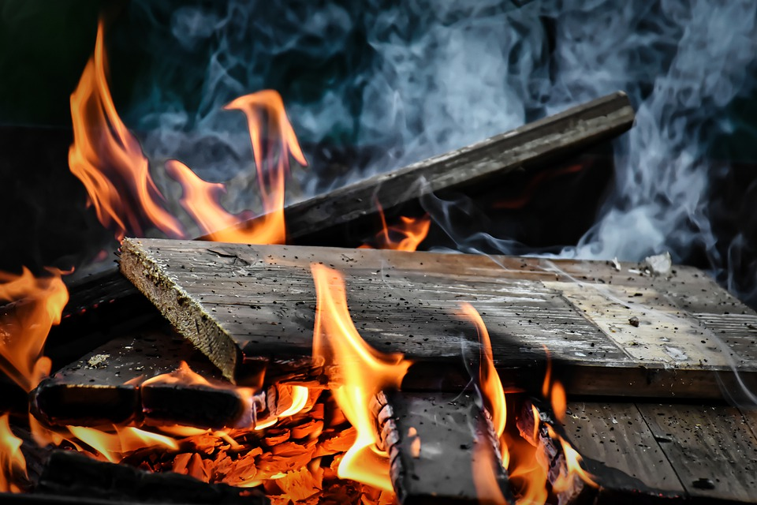
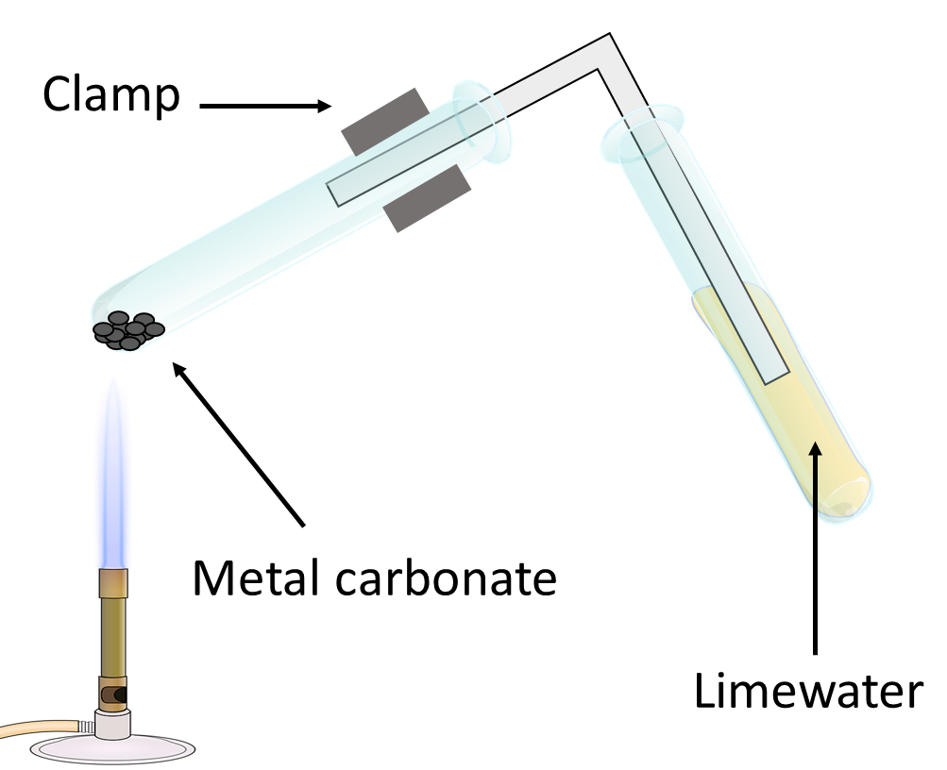
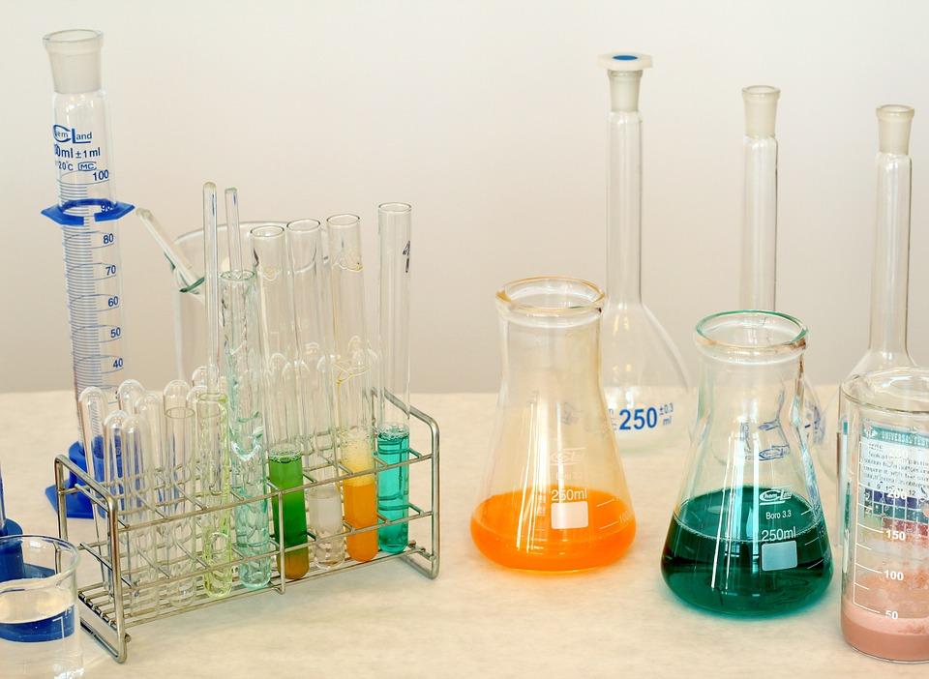
Conservation of Mass
Do now activity: What is a thermal decomposition reaction? Can you given an example?

Slide 2
Progress indicators
GOOD PROGRESS:
Recall the definition of ‘conservation of mass’
Explain conservation of mass in chemical reactions
OUTSTANDING PROGRESS:
Calculate the masses of reactants and products.

Slide 3
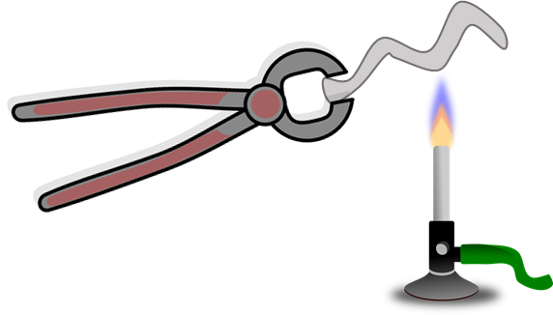
Demo: Conservation of Mass
Task: I am going to burn some magnesium in oxygen. Write down whether you think the mass will:
Stay the same
Increase
Decrease
Explain your prediction!!

Slide 4
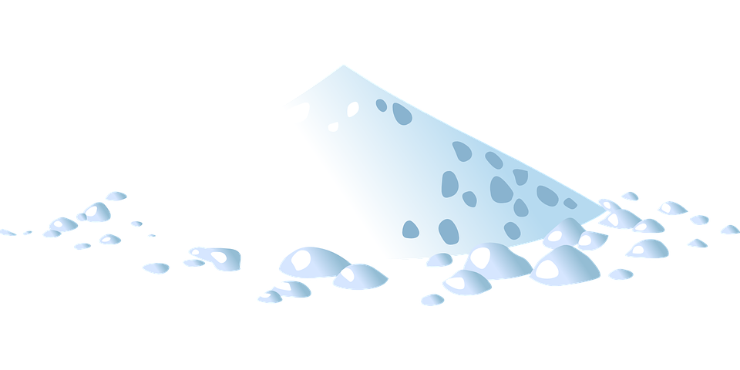
Mass of magnesium at the start is ___ g
Mass of magnesium oxide is ____g
Therefore, the mass of oxygen reacting with the magnesium must be ____g.
In chemical reactions the total mass of the product is equal to the total mass of the reactants. This is called the conservation of mass.
In chemical reactions the total mass of the products ………………………. the total mass of the reactants. This is called ……………………………………. of mass.

Slide 5
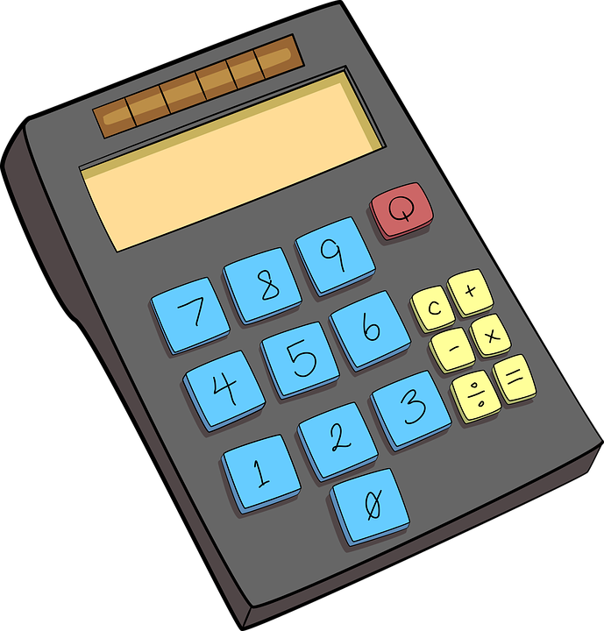
Quick Check
Reiss heats 12.5g of zinc carbonate. It decomposes to make 8.1g of zinc oxide. Calculate the mass of carbon dioxide made.
24g of copper carbonate was heated, this decomposed to make copper oxide and carbon dioxide. Melia measured 18.5g of copper oxide, how much carbon dioxide was made?
12.5g – 8.1g = 4.4g of carbon dioxide
24g – 18.5 = 5.5g of carbon dioxide

Slide 6
Task: Match the sentences correctly:
When two liquids react
If a gas combines with a solid or liquid
Conservation of mass states the mass of reactants and products
If a substance melts
Reactions that release gas
The mass will appear to increase
Should be the same
The mass will stay the same
The mass of each liquid will add together
Appear to decrease in mass

Slide 7
Self-assessment:
When two liquids react
If a gas combines with a solid or liquid
Conservation of mass states the mass of reactants and products
If a substance melts
Reactions that release gas
The mass will appear to increase
Should be the same
The mass will stay the same
The mass of each liquid will add together
Appear to decrease in mass

Slide 8
Balancing Equations
Step 1: Lets look at the number of atoms each side of this equation
Step 2: Balance the equation
Magnesium + Oxygen Magnesium Oxide
2
Mg
O₂
2
MgO
+
2 magnesium atoms
2 oxygen atoms
1 magnesium atom
2 oxygen atoms
1 magnesium atom
1 oxygen atom
2 magnesium atoms

Slide 9
Why do we need to balance chemical equations?
Key Words: mass, products, equation, balanced, atoms
equation
The chemical __________ needs to be ___________ so that it follows the law of conservation of ______.
A balanced chemical equation occurs when the number of the different ________ of elements in the reactants side is equal to that of the _________ side.
balanced
mass
atoms
products
Self-assessment

Slide 10
+
Chlorine
Sodium Chloride
Sodium
2
2
Na
+
Cl₂
NaCl
Na
Cl
Cl
Na
Cl
Na
Na
Cl

Slide 11
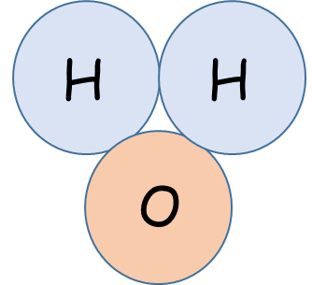
Sodium
+
Water
Sodium Hydroxide
+
Hydrogen
2
+
2
2
+
H₂
Na
H₂0
NaOH
Na
H
H
Na
O
H
H
H
O
Na
Na
O
H

Slide 12
Step 1: Look at each equation on your sheet, add up the total number of atoms on each side of the equation
Step 2: Decide whether the equation is balanced
1
1
1
1
3
3
Extra Challenge: If the equation is not balanced, have a go at balancing the equation!

Slide 13
Self-assessment
2
2
2
2
No
2
3
2
2
Na
1
1
No
Cl
2
1

Slide 14
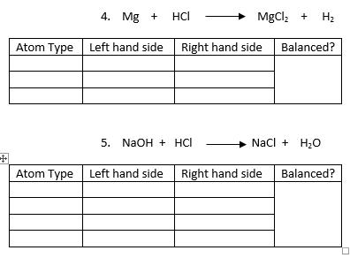
2
Mg
1
1
H
1
2
No
Cl
1
2
Na
1
1
O
1
1
Yes
H
2
2
Cl
1
1

Slide 15
Plenary – What did you learn this lesson?
3 facts
3 key words
1 question to test your peers

Slide 16
Resources

Slide 17
